Slide 1
The International Telecommunication Union in a fast evolving ICT world
June 2014
www.itu.int

Slide 2


Welcome to
welcome to the

Slide 3
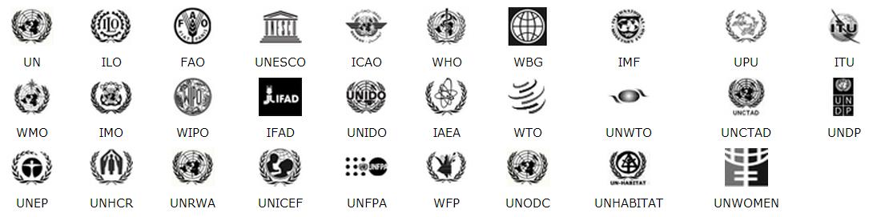
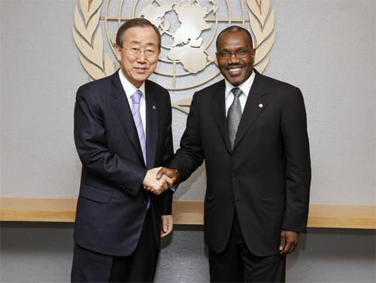
What we share
What make us different
The Charter of the UN
Created to address a certain global issue
The rationale of operation
A set of coordination mechanisms
Grouped under the chairmanship of UN SG
Membership
Mandate
Governing bodies
Set of resolutions
Secretariats
Executive heads

Slide 4
So, what do we do exactly?

Slide 5

To communicate with each other we need to have a number of elements …
Medium
Channel
Message
Receiver
Emitter

Slide 6
… and define a few rules …
What code will we use?
Who has the right to use the channel?
When can I reply?
Who speaks first?

Slide 7

(especially when we want to connect over a long distance and using limited resources)
How do we manage these resources to get everybody connected?
Only one channel available

Slide 8
(when we are using different technologies)
How can we ensure that they get to communicate?

Slide 9


(or when we are trying to connect people without access to technologies)
How can we help them to communicate?

Slide 10
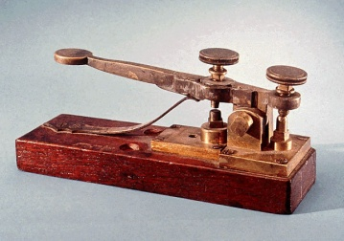
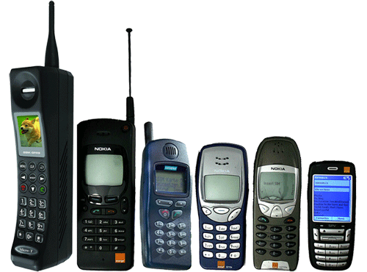
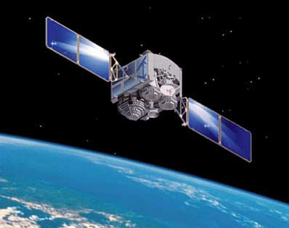
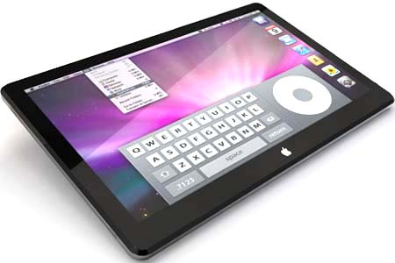
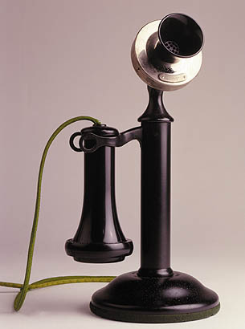
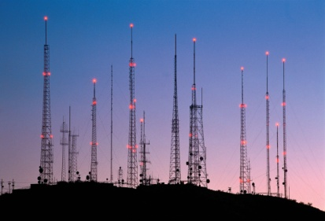

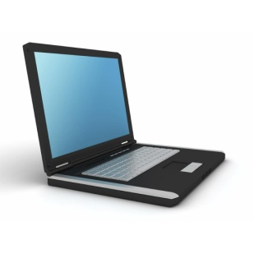

This is what ITU has been doing since 1865…
1865 2015
… throughout the constant (and fast) evolution of Information and Communication Technologies (ICTs)

Slide 11
ITU is the UN specialized agency that promotes global collaboration for a connected world

Slide 12
A little bit more about us

Slide 13
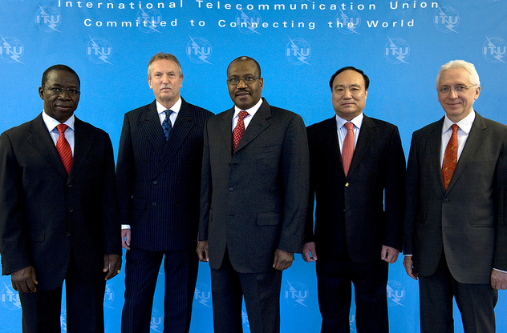
ITU is the oldest UN specialized agency
149 years young
Central role in Connecting the World
ITU is based in Geneva, Switzerland
193 Member States and 700 Sector Members and Associates.
760 staff, from 80 nationalities.
Budget USD 160 M (est)
Organized in three Sectors:
      Radiocommunication (ITU-R)
      Standardization (ITU-T)
      Development (ITU-D)

Slide 14
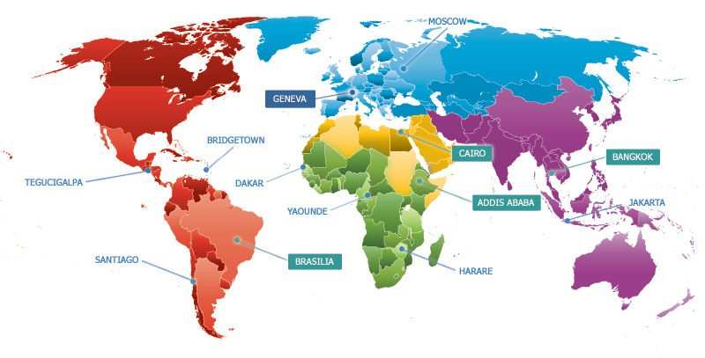
ITU has a global presence
5 regional offices, 8 area offices

Slide 15
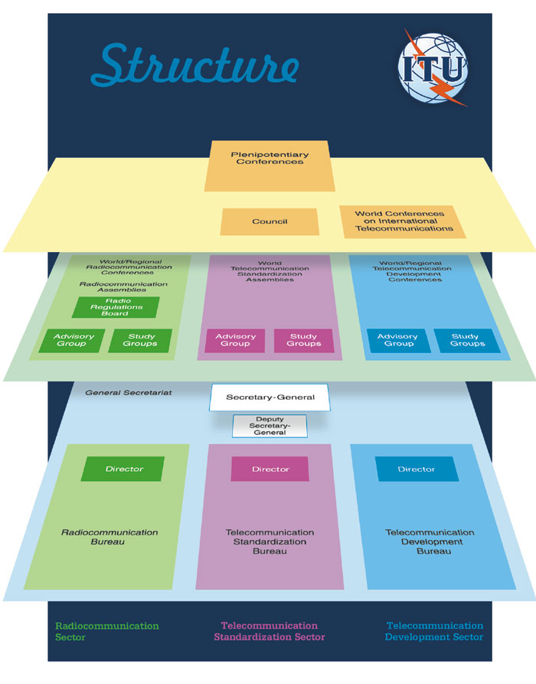
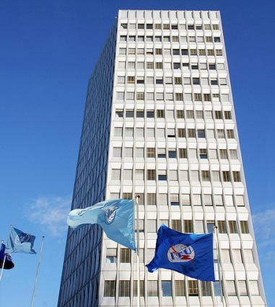
ITU’s decision making process…
The PP is the main body of decision making
(meets every 4 years)
Council is made of 25% of Member States (elected every 4 years)
(meets annually)
Each Sector is overseen by
Advisory groups
and world conferences
(This is us, the ITU Secretariat)

Slide 16
A few examples on how we are doing this

Slide 17

ITU has three core areas of activity
Radiocommunication
Standardization
Development

Slide 18




Roles of ITU-R
global standards
& guidelines
international regulations
assistance to administrations
Rights of access to the spectrum
Efficient use of spectrum
Operation free from interference
Economies of scale
Interoperability and roaming
Global harmonization
Guidelines for national
& regional regulations
Good quality
and less costly equipment
More favorable investment environment (clear & stable )
18

Slide 19
ITU-R mission
To ensure interference-free operations of radiocommunication systems by implementing the
Radio Regulations and regional agreements, as well as updating these instruments in an efficient and timely manner through the processes of world and regional radiocommunication conferences.
To establish Recommendations intended to assure the necessary performance and quality in operating radiocommunication systems.
To seek ways and means to ensure the rational, equitable, efficient and economical use of the radio-frequency spectrum and satellite-orbit resources and to promote flexibility for future expansion and new technological developments.
Role conducted through
(inter alia):
World and Regional Radio-
communication Conferences
Radiocommunication
Study Groups
Radio Regulations Board
Radiocommunication Bureau
In implementing this mission, the actions in ITU-R aim at creating the conditions for harmonized development and efficient operation of existing and new radiocommunication systems, taking due account of all parties concerned.

Slide 20


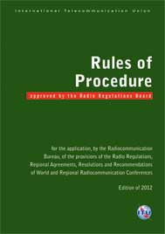
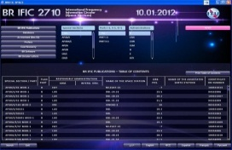
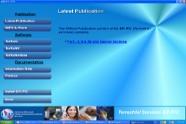
ITU-R structure & activities
Notices
RA
WRC
Rec
RAG
CPM
RRB
Director
Radiocommunication Bureau
SPACE & TERRESTRIAL services
SGD
SSD
TSD
IAP
SG & SC
Reg. & Tech.
examinations
Draft RoP
Harm. Interf.
RoP: Rule of Procedure
RR: Radio Regulations (treaty status)
RRB: Radio Regulations Board
SG: Study Group
WRC: World Radiocommunication Conference
RoP
Findings
MIFR
CPM: Conference Preparatory Meeting
MIFR: Master International Frequency Register
RA: Radiocommunication Assembly
RAG: Radiocommunication Advisory Group
Rec: Recommendations (international voluntary standards)
IFIC: International Frequency Information Circular
BR IFIC

Slide 21
Radio Regulations (RR)
The Radio Regulations (international treaty)
incorporates the decisions of the World Radiocommunication Conferences, including all Appendices, Resolutions, Recommendations and
ITU-R Recommendations incorporated by reference.
Frequency block allocations to defined radio services (Article 5)
Mandatory or voluntary regulatory procedures (coordination, plan modification, notification, recording) that are adapted to the allocation structure

Slide 22
ITU has three core areas of activity
Radiocommunication
Standardization
Development

Slide 23
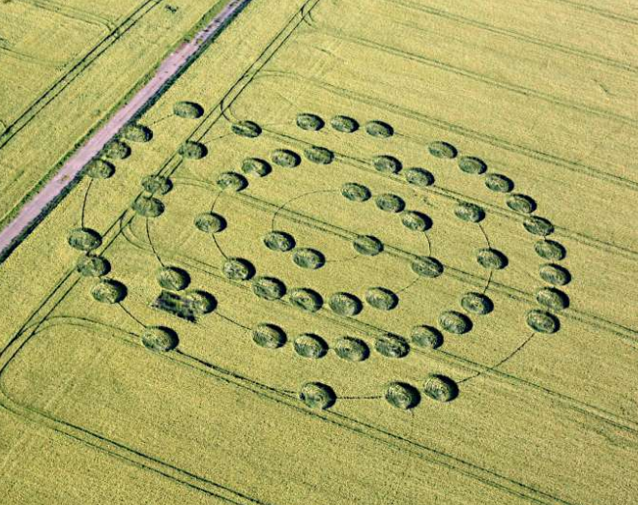
Proprietary technologies may lead to silos and islands of users
(A prominent example: the early telephone franchises system in the US)

Slide 24

Defining interoperable standards promotes a connected world for the global benefit

Slide 25




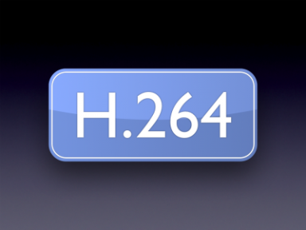

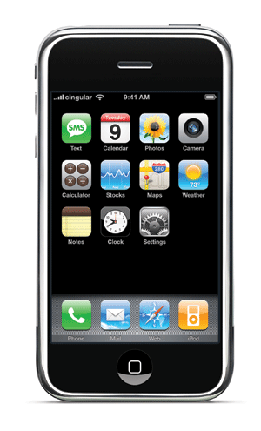
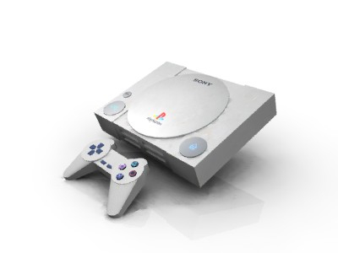


A few examples of open standards
A few examples of proprietary technologies

Slide 26
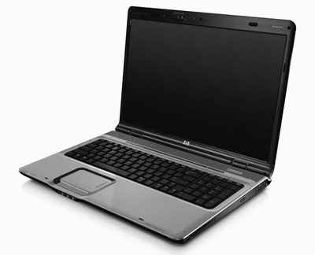
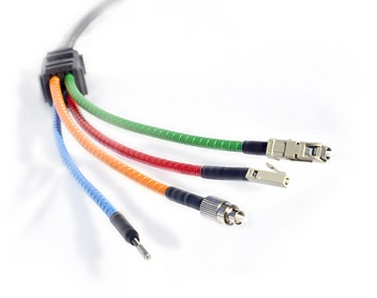
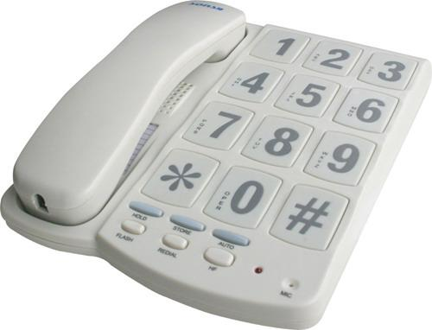
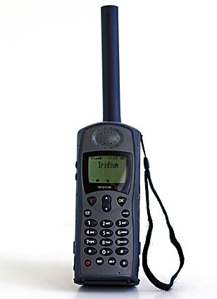
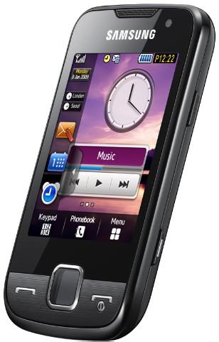
ITU-T promotes global ICT standards for innovation:
Global
Standards

Slide 27
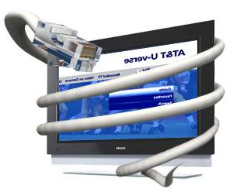
ITU-T standards in action
ITU standards work conducted in Study Groups
Long and distinguished history of work by engineers on fixed telephony, mobile communications & Internet.
Producing recommendations or standards on globally used technologies e.g. G992.1 on ADSL, G993.1 on VDSL., universal phone charger
Private sector & government work together in partnership
ITU coordination with other standards bodies
ITU presence at the inception of technologies:
  Addressing new ICT infrastructure paradigms e.g. NGNs, smart grids.

Slide 28
ITU has three core areas of activity
Radiocommunication
Standardization
Development

Slide 29
The world is experiencing a fast development of ICTs
http://www.itu.int/ITU-D/ICTEYE
29

Slide 30
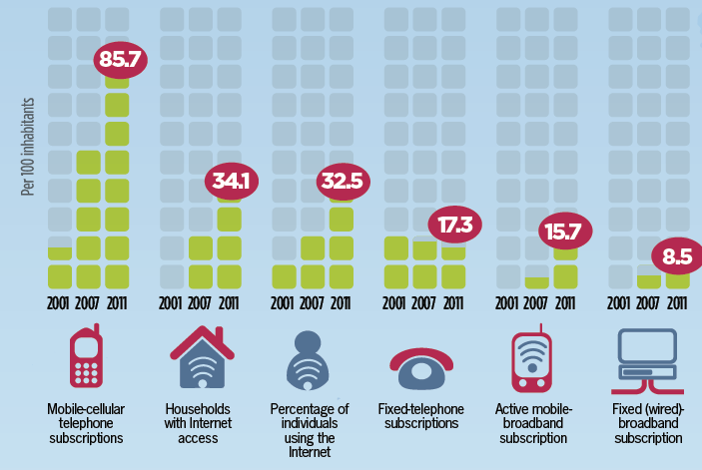
The world is experiencing a fast development of ICTs
http://www.itu.int/ITU-D/ICTEYE
30

Slide 31
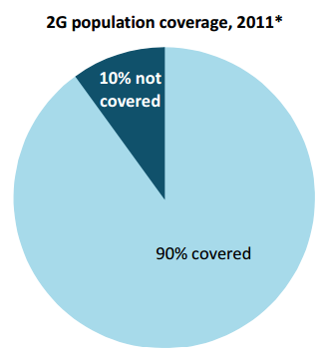
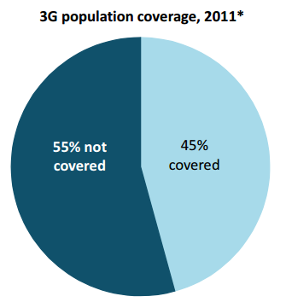
Although at different speeds, creating the “digital divide”
Access to Mobile phones

Slide 32
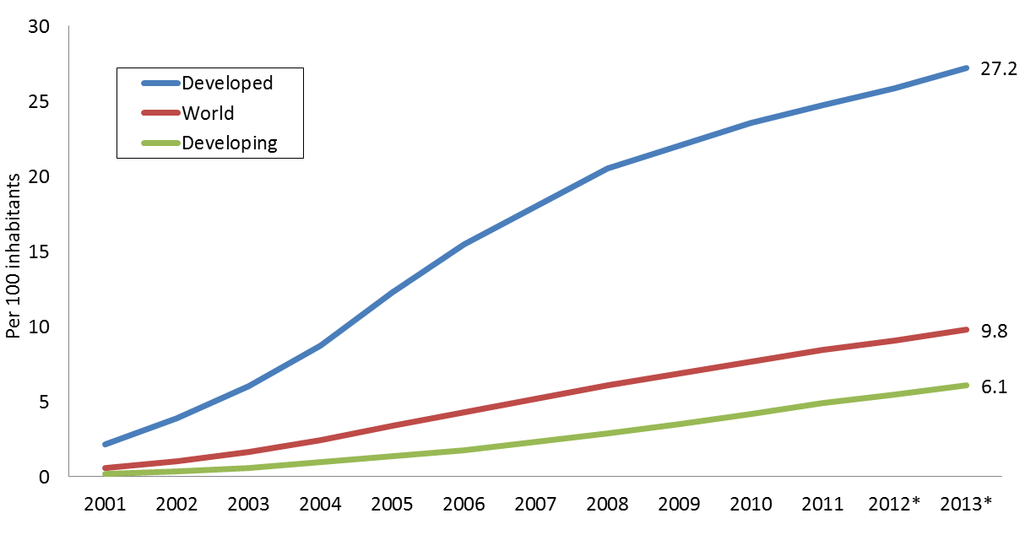
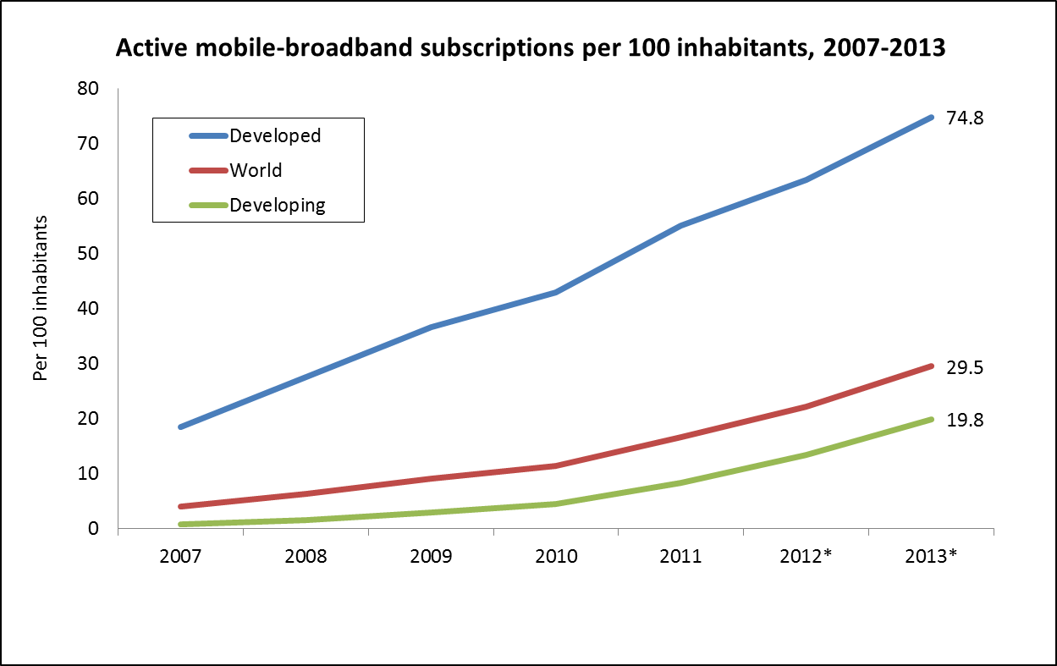
Also in broadband development
Access to wired broadband
(per 100 inhabitants)
Access to mobile broadband
(per 100 inhabitants)

Slide 33
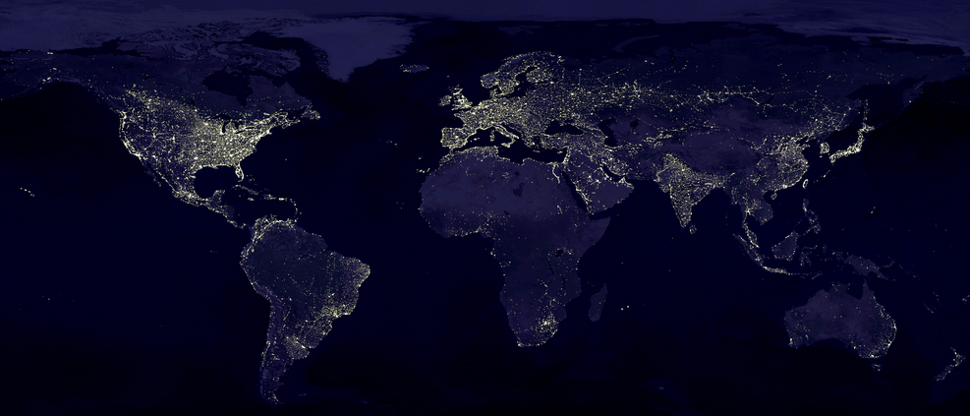
The digital divide is a result of the global development divide

Slide 34

ITU-D works to promote development of ICTs
(bridge the digital divide) and promote development through ICTs
(and achieve the MDGs)

Slide 35
ITU-D works to bridge the digital divide and connect the unconnected
Measuring the advance of the Information Society (ICT Development Index)
Assisting developing countries in putting into practice competitive ICT markets
Building capacity in developing and least developed countries
Executing agency of UN for ICT projects, working with governments and industry partners
Mobilizing resources and partners for project implementation

Slide 36
ITU has three core areas of activity
Radiocommunication
Inter-sectoral
activities
Standardization
Development

Slide 37

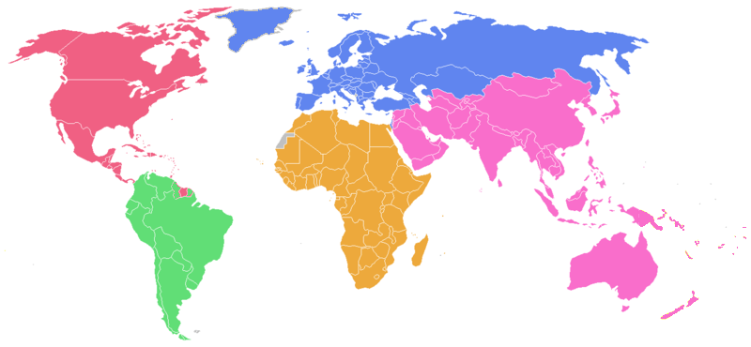

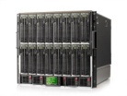

Cybersecurity is a global challenge

Slide 38
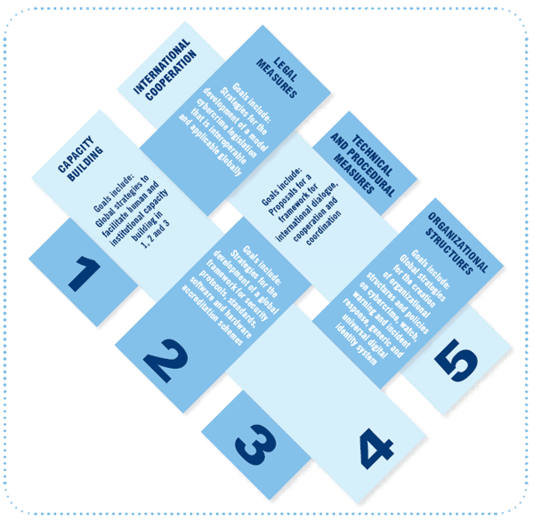
Cybersecurity
ITU’s goal is to build trust, confidence and security in the use of ICTs
ITU works under the five pillars of the Global Cybersecurity Agenda:
  Legal Measures
  Technical and Procedural Measures
  Organizational Structures
  Capacity Building
  International Cooperation

Slide 39

ITU’s Child Online Protection
Under the GCA umbrella, ITU initiated the Child Online Protection initiative (COP) in November 2008.
COP has been established as an international collaborative network for promoting the online protection of children and young people worldwide by providing guidance on safe online behavior.
Key Objectives of COP
  Identify risks and vulnerabilities to children in cyberspace
  Create awareness
  Develop practical tools to help minimize risk
  Share knowledge and experience

Slide 40


ICTs & Climate Change
Climate change is a looming crisis
  The global challenge of our times
ICTs not identified as part of the problem but provides solutions:
  ICTs contribute 2-2.5 % of greenhouse
  gas (GHG) emissions
  Energy-efficient devices, applications & networks
  Encourage environment-friendly design
  Reduce carbon footprint of the ICT industry
ITU & Climate Change
  Reduce impact by promoting Next-generation networks (NGN)
  Promoting online documentation
  Developing standards for smart technologies, allocating spectrum for satellite remote sensing, intelligent transport systems, conferencing…

Slide 41
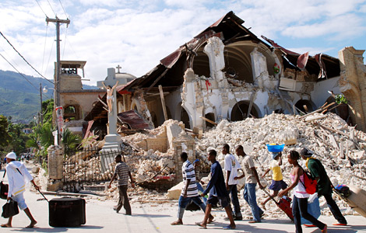
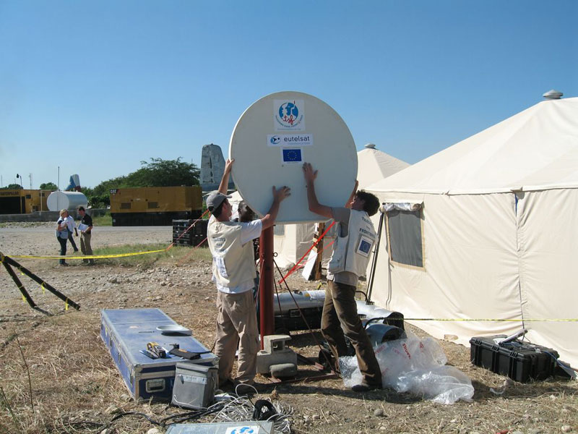
Emergency Telecommunications

Slide 42

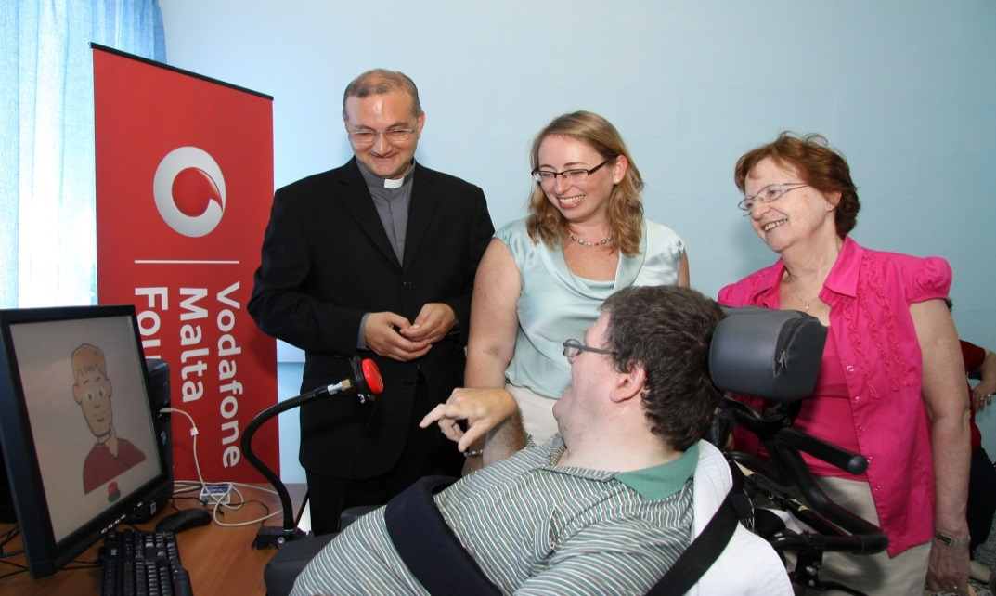
Digital inclusion for persons living with disabilities

Slide 43

WSIS
World Summit on the Information Society
  True Multi-Stakeholder Process
Outcomes
  Geneva Declaration of Principles
  Geneva Plan of Action
  Tunis Commitment
  Tunis Agenda for the Information Society
Current Stage: Implementation and Follow up
  Next event: WSIS+10 High-Level Event 2014 (10-13 June 2014)
Please visit our interactive forum at: http://groups.itu.int/Default.aspx?tabid=740

Slide 44

Summarizing …
In ITU-R we coordinate global wireless communication
(which uses limited resources)
In ITU-D we provide assistance to the un-connected
In ITU-T we produce interoperable technical ICT standards
In the GS we provide intersectoral coordination for the whole organization and represent ITU externally

Slide 45
What challenges are we facing in our sector?
(a final message)

Slide 46
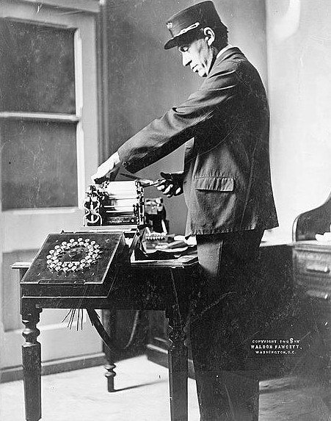
Telecommunications have evolved notably since the invention of the telegraph …

Slide 47

Today, the use of Information and Communication Technologies (ICTs) is the key to access to the information society
Real-time Information
Libraries
On-line public services
Personal communication
Entertainment
Media
Databases
Social and professional networks
Social media

Slide 48
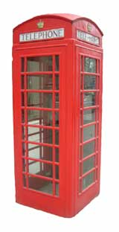
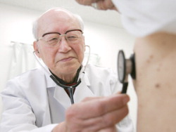
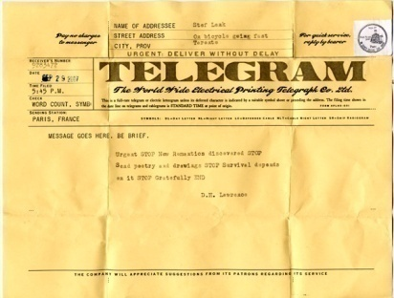

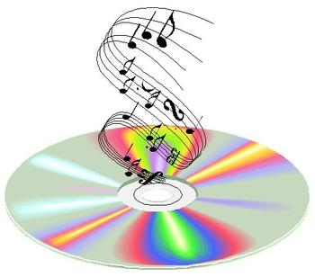




In their evolution, ICTs have become a transformational tool that is deeply changing several products, industries and sectors

Slide 49


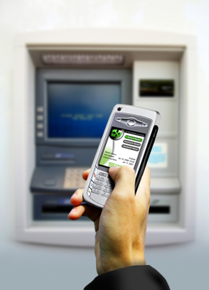

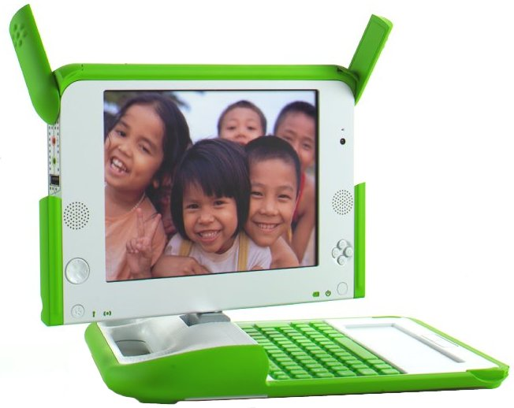
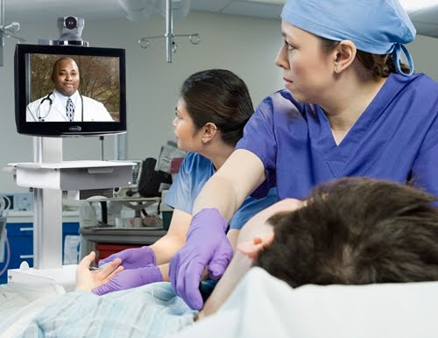

This is our challenge: to convey all these new actors and technologies to work for a connected global society

Slide 50
Q & A

Slide 51
Thank you!

