Slide 1
Overview of Threat Landscape
Siân John
Chief Strategist EMEA, Symantec
Notes:
Tip: simple SEO adjustments can make your presentation more discoverable. Read this PDF for best practices: http://seo.ges.symantec.com/seo-best-practices-for-file-optimization.pdf

Slide 2

Attacker motivations
CYBERCRIME
ESPIONAGE
Financial Trojans
Nation states
Ransomware
Corporate
SUBVERSION
SABOTAGE
DDoS
Physical damage
Social media hacking
Data destruction

Slide 3





Subversion through hacktivism
WEBSITE DEFACEMENT
DDOS ATTACK
SOCIAL MEDIA HACKING
Y
U
I
http://
H
J
K
L
WWW
?
START
DDoS
PREFERENCE FOR HACKING SOCIAL MEDIA
SOCIAL MEDIA ACCOUNTS VULNERABLE
Powerful communications medium
Social engineering attacks
Easy to propagate false market moving news
Password guessing/brute force
Fast, and news can spread virally
Guessing security questions

Slide 4



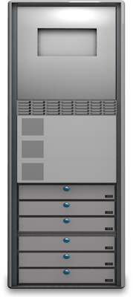

Distributed denial of service (DDoS) attacks
DDOS ON THE RISE
Attack size +216%
Q1-Q2 2014
Attacks are shorter but stronger
Max of 400 GBPS
Record level in 2014
TYPES OF ATTACKS
BOTNETS
AMPLIFICATION/
REFLECTION
WEB APPLICATIONS
Attacker controlled
botnets. Increasingly
using hacked Linux servers
Abusing DNS, NTP,
SNMP services to
multiply attack size
Attacks against specific
service based features.
Accounts for 69% of DDoS
using HTTP*
Notes:
*Prolexic:
- NTP attacks are down in Q2 /2014 by 56% compared to Q1 as many people upgraded to non vulnerable versions of the server
- SNMP amplification where up in Q2

Slide 5


Targeted Attacks on the Rise
2013
2012
+91%
NUMBER OF TARGETED ATTACK CAMPAIGNS CONTINUES TO RISE…
Notes:
Targeted attacks were up 91 percent and lasted an average of three times longer compared to 2012.

Slide 6



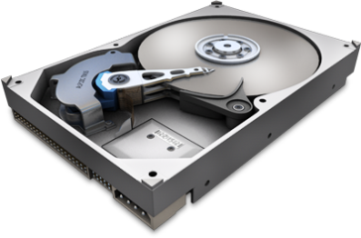
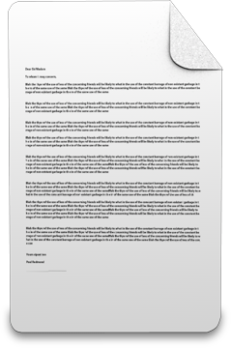

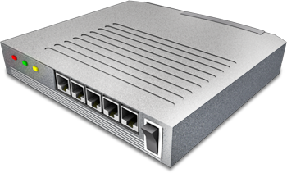




Stages of an attack
INCURSION
DISCOVERY
CAPTURE
EXFILTRATION
TOP
SECRET
Attacker breaks into
the network by
delivering targeted
malware to
vulnerable systems
and employees
Attacker then maps
organization’s
defenses from the
inside
Create a battle plan
Accesses data on
unprotected systems
Installs malware
to secretly acquire
data or disrupt
operations
Data sent to attacker
for analysis
Information may be
used for various
purposes including
fraud and planning
further attacks
RECONNAISSANCE
INCURSION
DISCOVERY
CAPTURE
EXFILTRATION

Slide 7
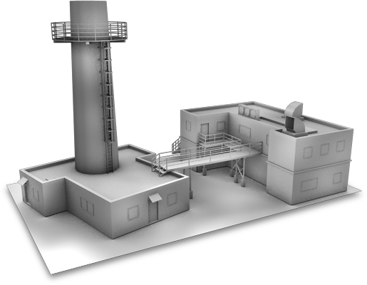

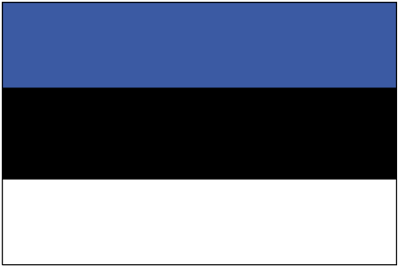




A brief history of sabotage attacks…
W32.STUXNET
W32.FLAMER
W32.GAUSS
GAUSS
W32 FLAMER
JUL 2010
MAY 2012
AUG 2012
JAN
APR
JUL
OCT
JAN
APR
JUL
OCT
JAN
APR
JUL
OCT
JAN
APR
JUL
OCT
JAN
APR
JUL
OCT
…
2007
2010
2011
2012
2013
ESTONIA DDOS
W32.DUQU
W32.DISTTRACK
TROJAN.JOKRA
DQ
[dyü-kyü]
APR 2007
SEP 2011
SEP 2012
MAR 2013
Notes:
Overall we’ve seen an increase in attacks against critical infrastructure.
The first of this kind of attack to gain public attention were the attacks against Estonia which saw attacks performed against websites belonging to the Estonian parliament and ministries as well as those belonging to banks and media. The attacks were performed in retaliation against the relocation of war graves.
The king of this type of attack is Stuxnet whose payload was the disruption of centrifuges used by the Iranian nuclear programme. Since then a number of associated malware has been identified, such as Flamer, Duque and Gauss.
More recently we saw attacks against energy companies in the middle where a threat called W32.Disttrack was used to destroy 1000s of client machines.

Slide 8
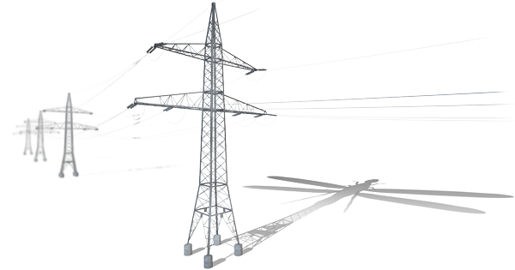
Dragonfly: Attacks against the energy sector
Dragonfly attack group has been active since 2011,
but shifted focus to the energy sector in early 2013…
ACTIVITIES
TARGETS
Information theft
Electricity infrastructure
Sabotage capable
Electricity generation
Industrial equipment suppliers
Pipeline operators
OTHER INDUSTRIES
ENERGY SECTOR
2011
2012
2013
2014
Notes:
Series of campaigns taking place since 2011
Shifted focus to Energy sector in early 2013
Targets are:
Electricity infrastructure
Electricity generation
Industrial equipment providers
Petroleum pipeline operators
Primary focus is information theft
Capable of sabotage

Slide 9


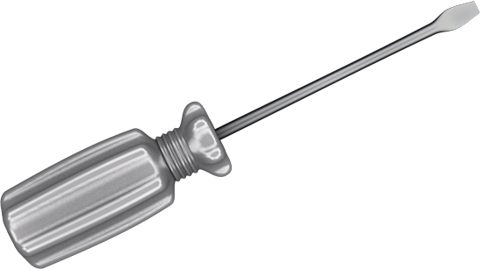
Dragonfly: The tools of the trade
TROJAN.KARAGNY
Available in underground markets
Adapted for use by Dragonfly group
Download/upload/execute files
Additional plugins available
BACKDOOR.OLDREA
Custom made malware
RAT – full back door access
Used in 90% of cases
Notes:
Backdoor.Oldrea
Custom malware; may have been created by the Dragonfly group or especially for it
Remote Access Tool (RAT) which provides full backdoor access for attackers
Preferred tool; used in over 90% of infections
Trojan.Karagny
Was available on the underground market.
Dragonfly appear to have modified it for its own use
Capable of uploading stolen data, downloading new files and running executable files
Can run plugins, for collecting passwords, taking screenshots, and cataloging documents on infected computers.

Slide 10



Dragonfly: Is sabotage ready
3 x ICS software vendors specifically targeted
DRIVER SOFTWARE
VPN SOFTWARE
MGMNT. SYSTEMS
Driver software for
specialist PLC devices
Provides remote
access to PLC devices
that control industrial
processes
Management systems
for wind turbines,
biogas & other energy
infrastructure
Establish beachhead in
target orgs
Access to critical infra-
structure can be used for
sabotage
Notes:
Attackers specifically targeted at least 3 ICS software manufacturers
VPN software providing access to PLC devices
Driver software for specialist PLC devices
Management systems for wind turbines, biogas plants, and other energy infrastructure
Provides “beachhead” within corporate network
Also provides access to critical infrastructure and the potential for sabotage

Slide 11



How to get more information
Blog
http://www.symantec.com/connect/symantec-blogs/sr
Twitter @threatintel
http://twitter.com/threatintel
Whitepapers
http://www.symantec.com/security_response/whitepapers.jsp

Slide 12
Siân John
sian_john@symantec.com
Phone: +447894600068 twitteR:@sbj24

