Slide 1
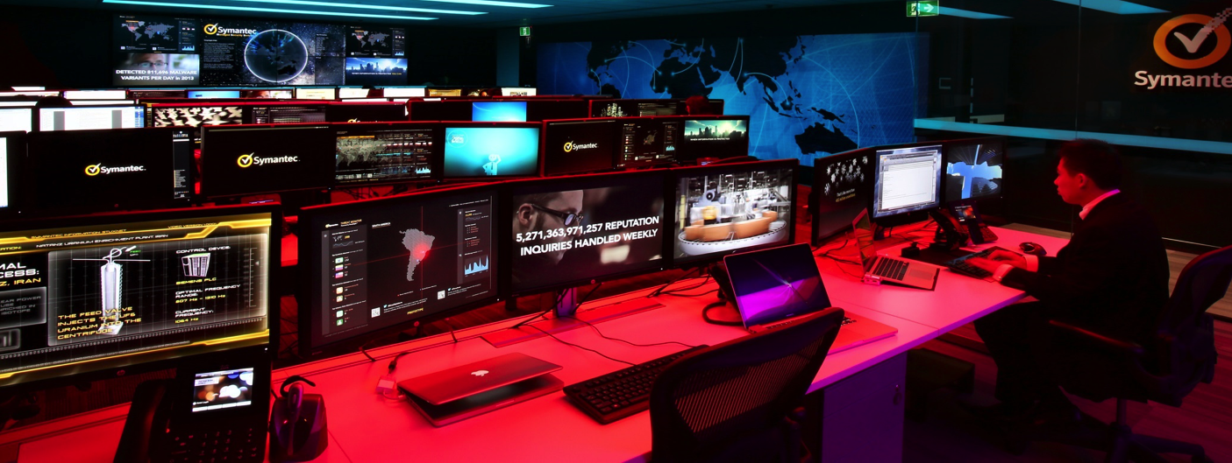
Symantec Managed Security Services The Power To Protect
Duncan Evans
Director, Cyber Security Services

Slide 2
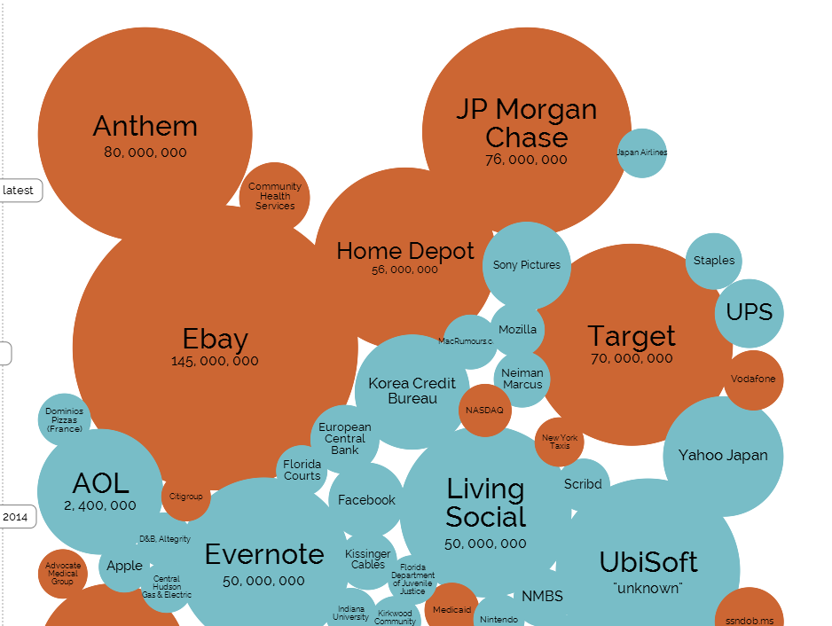
Data Breaches and Hacks
Source: Information is beautiful – World’s biggest data breaches and hacks

Slide 3
Organizations Are Not Stopping
Targeted Attacks
66% Breaches went
undetected for 30 days
or more
243 days before detection
4 months to remediate
Notes:
Unfortunately, most businesses are not very good at detecting and responding to these breaches when they happen:
66% of all breaches went undetected for more than 30 days (Source: Verizon Breach Report)
On average, data breaches were detected 243 days after they happened (Source: Ponemon)
And the average data breach takes 4 months to remediate (Source: Mandiant ATP 1 Report)

Slide 4
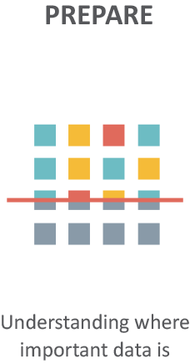
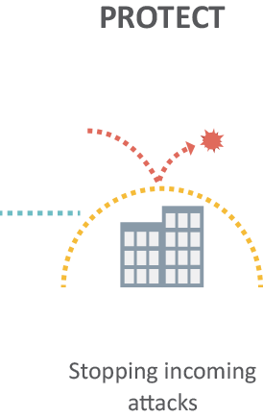
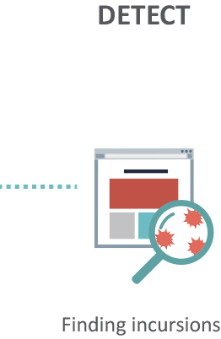
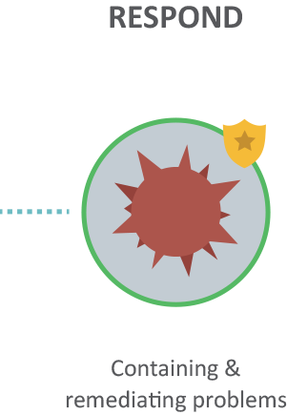
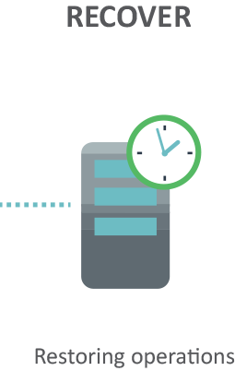
The Shift in Mindset

Slide 5
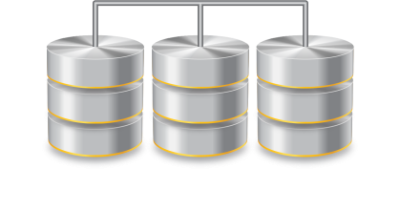
Managed Security Service Expert Security on a Global Scale
Big Data Security Analytics
Security Intelligence
World-class Expertise
660 Billion Log Lines (per month)
Over 4.7M new events identified (per day)
64.6M attack sensors
5M decoy accounts
8B+ email messages (Per day)
1.4B+ web requests (per day)
5 SOCs globally
Over 500 security experts on a global scale
100% GIAC certified SOC analysts

Slide 6
Symantec IS Security Intelligence
7 Billion
File, URL & IP Classifications
Capturing previously unseen threats & attack methods
1 Billion+
Devices Protected
More visibility across devices creates better context and deeper insight
2.5 Trillion
Rows of Security Telemetry
Putting “big data” analytics to work for every end user
2B+ events logged daily
Over 100,000 security alerts generated annually
200,000 daily code submissions
Monitors Threats in 157+ countries
14 Data Centers World Wide
550 Threat
Researchers
Notes:
6
A key element of that is our global intelligence network, it’s our threat intelligence, our visibility and that not only enables our technology to find the elusive threats for our customers, it also enables our experts to be better experts. It enables us to identify potential trends and new tactics that require us to make changes in our technology and additional investments that we have to do to make sure we’re continuing to provide world-class detection capability for our customers.
The secret to Symantec’s Security is providing intelligent security by leveraging the largest global intelligence network available. With 100’s of millions of contributing users creating over 2.5 trillion rows of security telemetry across over 7 billion file, URL and IP classifications, Symantec is able to but big data security analytics on the side of even the smallest business. By combining big-data with over 550 worldwide researchers, trends are derived through analyzing extensive amounts of data. And that data in-turn is collected through what we like to call the Symantec Global Intelligence Network or what we sometimes like to call the GIN. The GIN is comprises a number of loosely coupled data collection systems.
Ultimately, the data in the GIN is the fuel behind all of our product lines. We see tremendous synergy in the different offerings. For example, a piece of spam email that is blocked by Symantec’s Brightmail Anti-Spam service might contain the first instance of a new virus or piece of malicious software. We can in-turn ensure that all Symantec endpoints contain protection against this virus.
So, to me the real intelligence we provide is not so much in a piece of client software that runs on a customer machine, but rather in the billions of dollars of research that provides the underlying intelligence and fuels these products

Slide 7
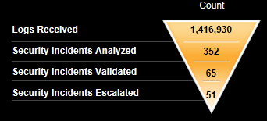
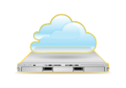
How can Symantec respond to threats?
DeepSight Global Threat Intelligence
Security Analysts
On-Premise
Correlation
Symantec SOC
Log Collection Agent
Data Warehouse
Customer Portal
Notes:
Increase ability to respond
Its about people
Breach is inevitable

Slide 9
Duncan Evans
Duncan_evans@symantec.com

