Slide 1
Smart Cities: project sustainability and viability
Dr. Leonidas Anthopoulos, Associate Professor
Business School, TEI of Thessaly, Greece

Slide 2
Smart city context
urban space description from various perspectives:
  Urban intelligence characteristics
  seven core systems’ model measuring sustainable prosperity
  challenging market area
  ICT as a means to contribute on social challenges
  Living Labs
  information flow that overrides space of places
  cities from scratch with pervasive technology
  smart solutions for energy efficient and ecological living

Slide 3
Smart city context
ITU accepted definition:
  SSC is an innovative city that uses information and communication technologies (ICTs) and other means to improve quality of life, efficiency of urban operation and services, and competitiveness, while ensuring that it meets the needs of present and future generations with respect to economic, social and environmental aspects.

Slide 4
How about viable smart city projects?
ITU definition focuses on city sustainability with the application of intelligence and innovation = smart city
Question: how can these innovative and intelligent solutions can “sustain” in terms of social adoption and market success (viability)?
Methodology:
  Explore forms and corresponding architectures (understand + develop)
  Define business models (finance)
  Realize organization and strategic management systems (strategy)
Tools: literature + interviews + case study analysis

Slide 5
How about viable smart city projects?
Innovation Life-Cycle
City Branding?
Organization
+
Business Modeling
Strategic Control
Viability
Develop
Understand
Notes:
City services: public services, local administration
Citizens: health, education, safety, Government services
Business: environment, burdens
Transport: cars, road, transportation, airports, harbors
Communication: broadband, wireless, phones, computers
Water: sanitation, freshwater supplies, seawater
Energy: oil, gas, renewable, nuclear

Slide 6
Explore forms and corresponding architectures (understand + develop)
various adjectives to “city” :
  web or online, knowledge-based, digital, smart, wireless or mobile, broadband, ubiquitous, green or eco
  >150 worldwide cases
according to the smart infrastructure type:
  Hard infrastructure based: innovations addressing city’s hard infrastructure systems (i.e. transport, water, waste, energy).
  Soft infrastructure based: innovations addressing soft infrastructure and the people of the city (i.e. social and human capital; knowledge, inclusion, participation, social equity, etc.).
According to corresponding development stage:
  New cities
  Existing cities
  Smart plants

Slide 7
Explore forms and corresponding architectures (understand + develop)
Various e-services and provision chain: technologies-suppliers-customers:
  Government, Education, Healthcare, Public safety, Real estate Transportation, Utilities etc.
Architecture types:
  N-tier
    Dubai City (UAE) (3 layers: infrastructure, data, application)
    Trikala (Greece) (6 layers: data, infrastructure, interconnection, business, service and user)
    Barcelona (Spain)(4 layers: code, nodes, infrastructure and environment)
    Blacksburg Electronic Village (3 layers: infrastructure, content, community)
    Amsterdam (Netherlands)
    Singapore (4 layers: ICT infrastructure, Cognitive infrastructure, Services, Customers) etc.
Notes:
City services: public services, local administration
Citizens: health, education, safety, Government services
Business: environment, burdens
Transport: cars, road, transportation, airports, harbors
Communication: broadband, wireless, phones, computers
Water: sanitation, freshwater supplies, seawater
Energy: oil, gas, renewable, nuclear

Slide 8
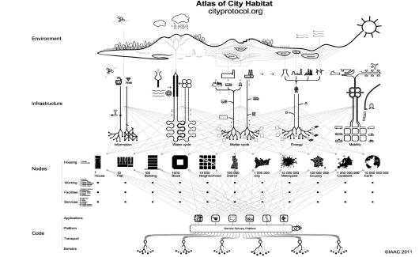
Explore forms and corresponding architectures (understand + develop)

Slide 9
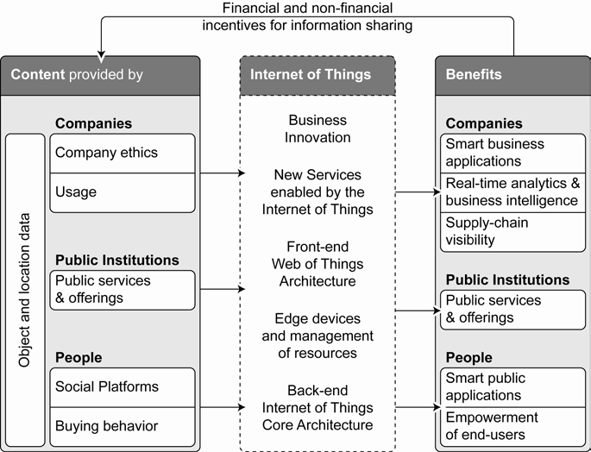
Explore forms and corresponding architectures (understand + develop)
Internet-of-Things approach:
  n-tier is the most appropriate architecture to be followed:
    content (provided by city users and stakeholders)
    is transformed by the IoT infrastructure and services to
    benefits (to the same consumers)
Notes:
City services: public services, local administration
Citizens: health, education, safety, Government services
Business: environment, burdens
Transport: cars, road, transportation, airports, harbors
Communication: broadband, wireless, phones, computers
Water: sanitation, freshwater supplies, seawater
Energy: oil, gas, renewable, nuclear

Slide 10
Realize organization and strategic management systems (strategy)
Case | Literature findings
 | Architecture | Organization
Two cities in Netherlands | SOA | SOE run by the municipality
52 cases (study by Alcatel-Lucent) | n-tier architecture Network, Content, Intelligence, e-services | Public Organization (i.e., Gdansk (Poland), Masdar (UAE)) Public Private Partnership (PPP) (i.e., Amsterdam (Netherlands)) Private Companies (Malaga (Spain), New Songdo (Korea))
Helsinki, Kyoto | n-tier architecture information, interface, interraction | State-Owned-Enterprise (SOE) run by the Municipality
Dubai | n-tier architecture Infrastructure, data, application | Public Organization (Government)
Trikala | n-tier architecture: data, infrastructure, interconnection, business, service and user | State-Owned-Enterprise (SOE) run by the Municipality
Barcelona | n-tier architecture: code, nodes, infrastructure and environment | SOE run by the Municipality in cooperation with the local university
Blacksburg Electronic Village | n-tier architecture: infrastructure, content, community | PPP between Bell Atlantic Telecoms, Virginia Tech, Municipality
Amsterdam | n-tier architecture | PPP between Municipality and Liander grid Operator
Singapore | n-tier architecture: ICT infrastructure, Cognitive infrastructure, Services, Customers | Public Organization

Slide 11
Realize organization and strategic management systems (strategy)
Case | Findings
 | Architecture | Organization
Tampere | SOA (various partners offer different types of services) | Public organization (Municipal agency)
Geneva | n-tier (fibre-optic network lies under the smart city and concerns the key-component) | SOE (Municipality, SIG State energy company, SWISS Telecoms)
Zurich | n-tier (fibre-optic network lies under the smart city and concerns the key-component) | SOE (Municipality, EWZ State energy company, SWISS Telecoms)
Australian cases (Brisbane, Queensland, Melbourne) | n-tier (virtual communities) | Public projects (the State with the collaboration of the University)

Slide 12
Define business models (finance)
Case | Findings
 | Business Description | Business Model
Tampere | Create business opportunities | Open network with expert free-lancers
Trikala | Smart city know how to other cities | Direct sale
Geneva | Develop high speed networks and smart grids for energy management | Open access network (rent to operator)
Zurich | Develop high speed networks and smart grids for energy management | Open access network (rent to operator)
Australian cases (Brisbane, Queensland, Melbourne) | Develop new ideas for the urban space | Full service provider
New Songdo, Seoul | City as a product | Full service provider
London | Climate change management | Full service provider
Smart Vienna | Develop standards for smart city solutions | Value-net-integrators
New York City | Develop cloud services and open data | Information service provider
World Bank | Develop cloud services and open data in developing countries’ cities | Information service provider
UN ITU | Standardize smart sustainable city infrastructure | Open access network (rent to operator)
UN Habitat | Engage mayors internationally to preserve climate change and establish urban resilience. | N/A

Slide 13
Domain study
a survey is being conducted with experts in smart city domain, with the use of a structured questionnaire with:
  Architecture relative questions
  Data relative questions (sources and structure)
  Questions regarding project and organization management
  Details regarding the components’ selection
The questionnaire was followed with the experts from the following smart cities:
  Tampere (Finland); Trikala (Greece); Geneva and Zurich (Switzerland); Brisbane, Melbourne, Queensland and Roland Victoria (Australia), NYC, Hong Kong, World Bank.
Layer determination is affected by
  network infrastructure and utilities
  e-services and
  service stakeholders
Notes:
City services: public services, local administration
Citizens: health, education, safety, Government services
Business: environment, burdens
Transport: cars, road, transportation, airports, harbors
Communication: broadband, wireless, phones, computers
Water: sanitation, freshwater supplies, seawater
Energy: oil, gas, renewable, nuclear

Slide 14
Conclusions #1
Literature review results:
  Architecture selection is independent to the technological approach (It is not clear how the approach affects layer definition)
  Five types of smart city organization:
    public organization
    public-private-partnerships,
    State-owned-enterprises
    private companies
    Project coalitions
  smart city organization does not affect architecture selection, since all organization forms are observed in n-tier architecture (the role of organization in layer definition is not clear)
Notes:
City services: public services, local administration
Citizens: health, education, safety, Government services
Business: environment, burdens
Transport: cars, road, transportation, airports, harbors
Communication: broadband, wireless, phones, computers
Water: sanitation, freshwater supplies, seawater
Energy: oil, gas, renewable, nuclear

Slide 15
Conclusions #2
Literature review results:
  architecture selection is not influenced by the underlying business (n-tier architecture is observed with different business models)
    it is unclear whether layer selection is affected by the business model
Conclusion: smart city architecture’s selection is independent to the technological approach, organization and business models.
Notes:
City services: public services, local administration
Citizens: health, education, safety, Government services
Business: environment, burdens
Transport: cars, road, transportation, airports, harbors
Communication: broadband, wireless, phones, computers
Water: sanitation, freshwater supplies, seawater
Energy: oil, gas, renewable, nuclear

Slide 16
Conclusions #3
Understanding & Developing:
  More preferred architecture: n-tier
  Technological approach, organization and business models do not affect architecture selection
  Network, e-services, stakeholders are factors in layer definition
Organization + Business Modeling:
  Most preferred organization: SOE
  Organization and business models do not affect architecture selection
Strategic control:
  Vienna and Hong Kong: clear strategies with specific vision and mission.
  Melbourne, NYC: action plans
Future thoughts: more secure findings
Notes:
City services: public services, local administration
Citizens: health, education, safety, Government services
Business: environment, burdens
Transport: cars, road, transportation, airports, harbors
Communication: broadband, wireless, phones, computers
Water: sanitation, freshwater supplies, seawater
Energy: oil, gas, renewable, nuclear

Slide 17
Thank you
Enterprise Architecture for Digital Cities (EADIC)
ARCHIMEDES III project
TEI of Thessaly & Aristotle University of Thessaloniki
Greece
Notes:
City services: public services, local administration
Citizens: health, education, safety, Government services
Business: environment, burdens
Transport: cars, road, transportation, airports, harbors
Communication: broadband, wireless, phones, computers
Water: sanitation, freshwater supplies, seawater
Energy: oil, gas, renewable, nuclear

