Slide 1

ISO/TMB
Smart Cities
Strategic Advisory Group
Chairman: Graham Colclough
Secretary: Francesco Dadaglio
ITU “Smart Sustainable Cities: a rising priority for decision-makers”
3rd March 2015

Slide 2
Agenda
ISO Smart Cities Strategic Advisory Group Mandate
Approach & Progress
Q&A

Slide 3
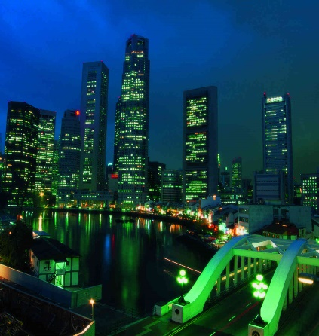
Smart Cities Strategic Advisory Group Mandate
Clear working definition of ‘smart cities’
Describe smart cities landscape & identify aspects most relevant to ISO
Review existing initiatives and activities in ISO
Gap analysis – areas for ISO work, and collaboration across standards bodies
Coordinate ISO input and nomination of experts to IEC/SEG 1
14 experts
4 liaison reps
8 observers
Launch June 2014
Report September 2015
26-Feb-15

Slide 4
Advisory Group Scope & Approach
Supply Driven
Demand Driven
#1 Definitions
‘Common-usage’ & ‘precise’
Meaningful and useful at leadership & operational levels
Put context to various key words (e.g. smart/sustainable/resilient & city/community)
#4 Needs Assessment
Survey of Cities; City Networks; International Associations
Develop and test hypotheses; access opinions; determine priorities
Analysis
#2 Landscape
Market features & characteristics, & relevance to ISO activities
Perspectives: city, industry, investor
#5 Gap (& Overlap) Analysis
3-layer model: Strategic Guide; Mgmt Framework; Technical Specification
Inter-dependencies; overlaps & gaps; priorities
#3 Standards Inventory
Vision: easy role/needs-based navigator to SDO & other guidance
Inventory
  Existing / In Process
Framework, synthesis of existing for mapping purposes
Conclusions
#6 Action Plan
Roadmap
Recommendations
Plan & action parties
#7 Engagement
Stakeholder engagement
Recommendations for dissemination
Priority - cooperate & avoid duplication of efforts

Slide 5
A city-needs-led approach
Demand Focus
3-layer cascade
Recognising who cities listen most to…
Be relevant at all levels (in cities)…

Slide 6
Definition cascade
Sustainability
Resilience
Smart(er)
City
Community
PURPOSE: e.g. accelerate improvement in sustainability and resilience.
COMMON MEANING: e.g. sustainability is the destination, smart is the accelerator.
CHARACTERISTICS of a smart city might include being:
People-centric (citizens, businesses, workers, residents, visitors, etc.);
well led and governed;
inclusive and open (to all people and to new ideas);
transparent in communications and operations;
secure in respect of personal information;
supported by integrated services and infrastructure; and
pro-active in learning and developing.
DEFINITION

Slide 7
Smart Cities “Working Definition”
A Smart City…
dramatically increases the pace at which it improves its sustainability and resilience,
…by fundamentally improving how it engages society, how it applies collaborative leadership methods, how it works across disciplines and city systems, and how it uses data and integrated technologies,
…in order to provide better services and quality of life to those in and involved with the city (residents, businesses, visitors)

Slide 8
Demand-Side Survey
Purpose
Content
To understand
  how cities perceive standards & SDOs, and
  cities needs in relation to guidance
Engage the unengaged:
  city leadership / senior officials
  small & mid-sized cities
Inform ISO plans, and how it operates with SDOs / influential bodies
Current Experience with standards
Relevance at senior levels
Leadership content
City domain content
Legitimacy of SDOs
Any other matters
Targets
5-10 Cities of different size / maturity – selected via national bodies
In 15 TMB countries, plus: Singapore, Republic of Korea, Kenya, Russian Federation, Canada, Nigeria, Mexico, Morocco, Israel, United Arab Emirates, Indonesia, Spain
Associations: Bloomberg, C40 Climate Leadership Group, City Protocol Society, International Council for Local Environmental Initiatives (ICLEI), Smart Cities Council, UNEP, World Bank; Eurocities, OECD
Inform: ITU-T, IEC, CEN-CENELEC-ETSI & IEEE
Process
Launch March
Close end April
First insights May/June
01-Mar-15

Slide 9
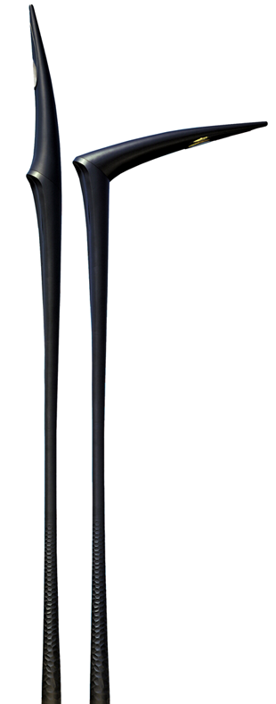
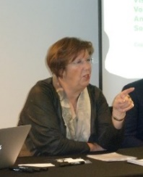
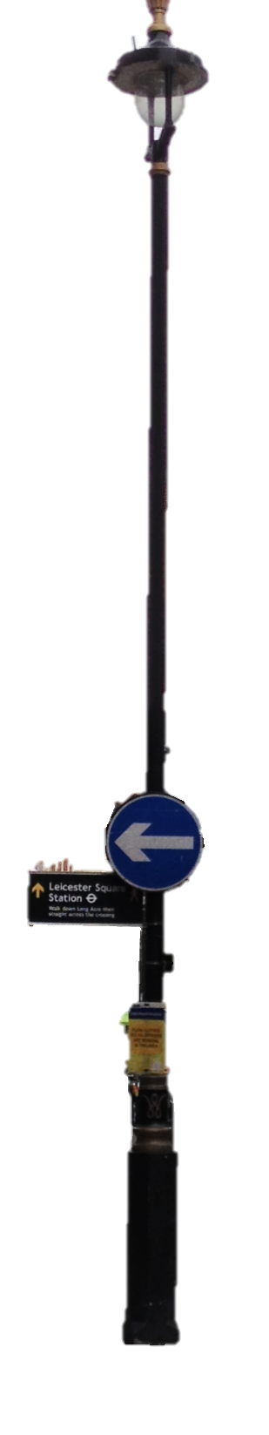
A very practical example…the ‘Humble Lamppost’
“If we can’t implement something as simple as the humble lamppost along the lines of the EIP ambitions, then what will happen when we tackle something difficult?!”
(EU data)
60-90m
Estimated nos. streetlights across Europe
Mayor Annemarie Jorritsma, President CEMR
EIP “Humble Lamppost” Initiative Champion
75%
Percentage of streetlights over 25yrs old
The EIP¹ Humble Lamppost Vision
20-50%
Proportion of city’s energy bill from streetlights
An open affordable component-based city lighting solution
…that enables other smart city initiatives;
delivered collaboratively between cities & Industry
to speed integrated delivery, and value
€3 bln
Approx. annual street lighting energy cost
SAG Approach
#2 Landscape
#3 Standards Inventory
#4 Needs Assessment
#5 Gap Analysis
#6 Action Plan
#7 Engagement
50-75%
Energy saving potential thru SLL/LED
360 technical standards; from 37 SDOs
Little performance focus; no ‘smart’ approaches
Need for Mgmt F’works; & Leadership Guide
€1.9 bln
Annual energy saving from SSL/LED
2.6 mln
GHG equivalent in removing #cars from EU roads
01-Mar-15
1. EIP European Innovation Partnership for Smart Cities & Communities

Slide 10

THANK
YOU!
Notes:
Mention that, since there are many committees that contribute to smart cities, ISO TMB created an Advisory Group that coordinates ISO work and liaise with the IEC’s recently created SEG as well as monitoring activities in ITU and other bodies.

