Slide 1
ITU-T Study Group 5 Activities on Smart Sustainable Cities
Dr Ahmed Zeddam,
Chairman, ITU-T Study Group 5
Orange, France

Slide 2
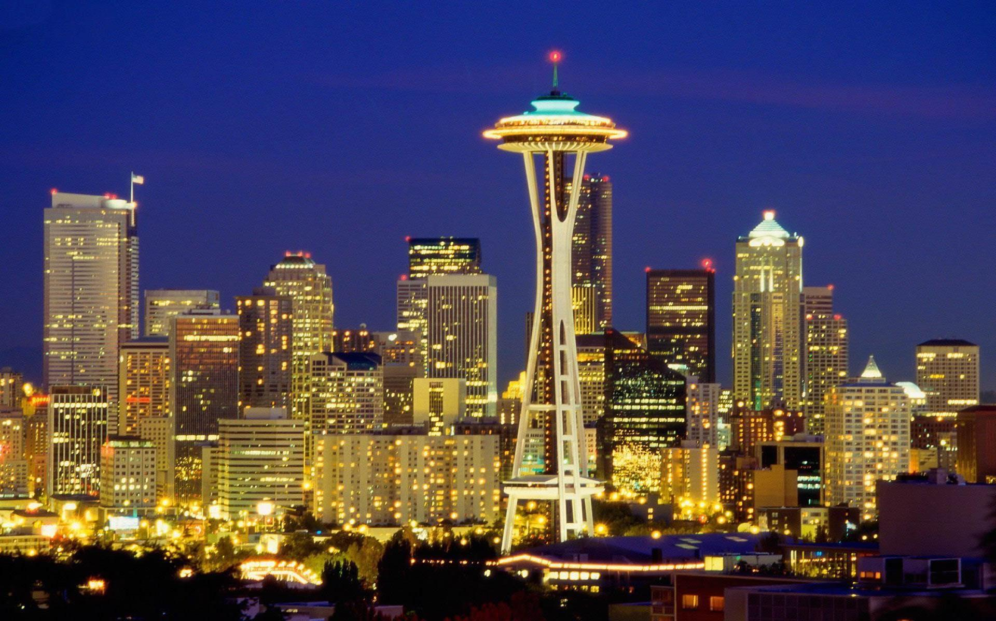
Standards are vital to shape smart sustainable cities
Cities are responsible for more than 70% of global greenhouse gas emissions and they are accountable for 60-80% of global energy consumption.

Slide 3
ITU-T Study Group 5
Mandate
Lead study group for:
environment and climate change;
electromagnetic compatibility and electromagnetic effects.
Structure
7 Questions
WP1/5
Damage prevention and safety
WP3/5
ICT and climate change
4 Questions
WP2/5
Electromagnetic fields: emission, immunity and human exposure
Question 12 Terminology
New Question 20 Smart sustainable cities and communities
6 Questions

Slide 4
New Question 20
Motivation:
The integration of ICT into all aspects of city planning and operations allows for better informed decision-making thereby facilitating the integration of city services and cooperation across different sectors.
Tasks - developing Recommendations (inter alia):
for terms and definitions, characteristics and requirements, architecture framework of SSC&C;
on key performance indicators, metrics, measurement methodologies;
for guidelines and best practices related to SSC&C strategic planning and implementation.
Question 20 Smart sustainable cities and communities (SSC&C)

Slide 5
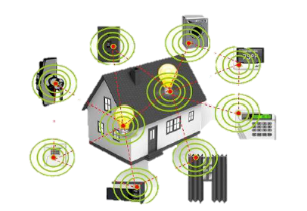
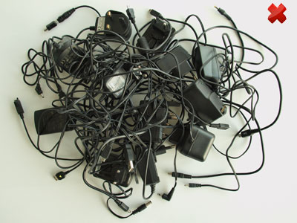
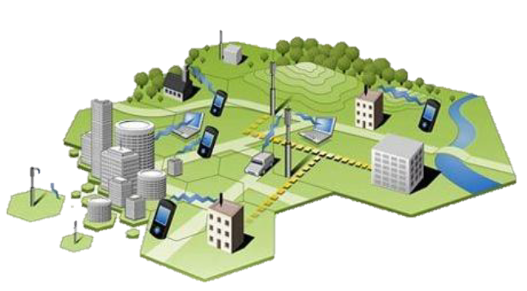
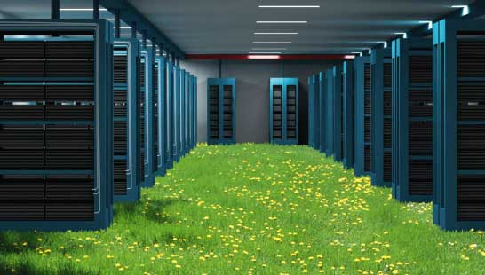
Green ICT standards
Tackling e-waste
EMF considerations
Q13/5 – Environmental impact reduction including e-waste
Q7/5 – Human exposure to electromagnetic fields (EMFs) due to radio systems and mobile equipment
Methodologies on cities
Green data centers
Q18/5 - Methodologies for the assessment of environmental impact of ICT
Q17/5 - Energy efficiency for the ICT sector and harmonization of environmental standards

Slide 6
Focus Groups
Smart Water Management
Smart Sustainable Cities
Established by the ITU-T TSAG meeting in Geneva (June 2013)
A multi-stakeholder approach to the development of smart water-management systems.
Established at the Study Group 5 meeting in Geneva (February 2013)
As an open platform for smart-city stakeholders to identify the standardized frameworks needed to support the integration of ICT services in smart cities.
Next FG-SSC Meeting in May 2015
Addressing the world water crisis
Shaping the city we want

Slide 7
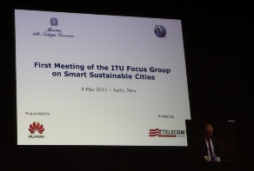
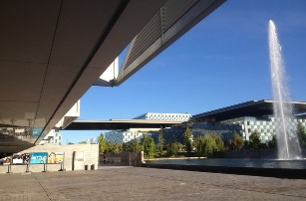
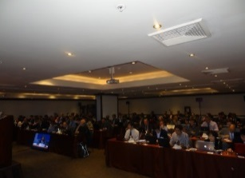
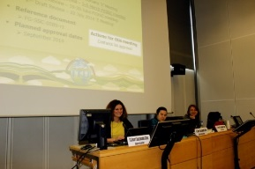
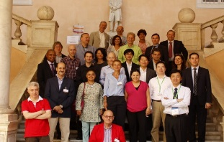
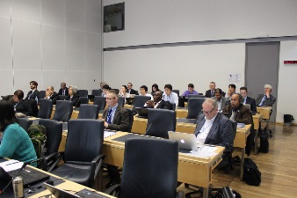
FG-SSC main achievements
7 meetings held
1
ICT role and roadmap for smart sustainable cities
Smart sustainable cities infrastructure
2
Policy and positioning
KIPs and metrics for smart sustainable cities
4
3
4 Working Groups created

Slide 8
FG-SSC main achievements (continued)
“A smart sustainable city is an innovative city that uses information and communication technologies (ICTs) and other means to improve quality of life, efficiency of urban operation and services, and competitiveness, while ensuring that it meets the needs of present and future generations with respect to economic, social and environmental aspects”
The FG SSC has agreed upon the following definition for a smart sustainable city:
Considerable liaison activities are underway with a host of other SDOs including ISO, IEC, IEEE, ETSI, EC DG Connect, UNECE, UNU, StEP, CEDARE, UNESCO, UN-Habitat, WMO, UNEP and UNFCCC.

Slide 9
FG-SSC main achievements (continued)
The following technical reports and specifications were approved by SG5 in December 2014:
Technical Report on overview of smart sustainable cities and the role of information and communication technology
Technical Report on smart sustainable cities: an analysis of definitions
Technical Report on smart water management in cities
Technical Report on electromagnetic field (EMF) considerations in smart sustainable cities
Technical Specifications on overview of key performance indicators in smart sustainable cities

Slide 10
FG-SSC main achievements (continued)
Other 20 deliverables are under development:
SSC Architecture & Framework
Smart Infrastructure
Engaging Stakeholders
Smart Buildings
Cybersecurity and Resilience
Climate Change Adaptation & Resilience
Key Performance Indicators
Integrated Management
Open Data

Slide 11
It is a journey, it is not a final destination
5. Ensuring accountability and responsibility
4. Defining KPIs, standards and monitoring
3. Identifying and developing smart city services
2. Developing smart infrastructure and integrated platform
1. Setting the basis

Slide 12
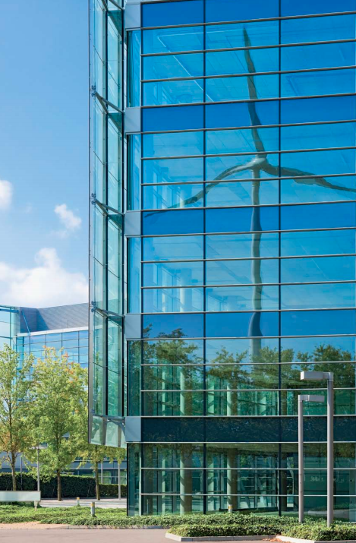
Conclusions
Need for SDOs to collaborate and work together
Need for ITU to work with municipalities, ICT sector, policy makers, international and regional organizations
Development of joint and comprehensive strategies
ITU as global platform for the empowerment of smart sustainable cities.

Slide 13
Thank you
Contact: greenstandard@itu.int Website: itu.int/go/ITU-T/climate

