Slide 1
The City Protocol Society
Building a community of cities that agree to develop and use common approaches to city transformation

Slide 2
Smart/future cities
Cities are made up of a complex set of organisations trying to manage a complex set of issues
Digital Technology can make this management process much easier
This requires not simply technology solutions, but new ways of handling data and new organisational ways of working

Slide 3
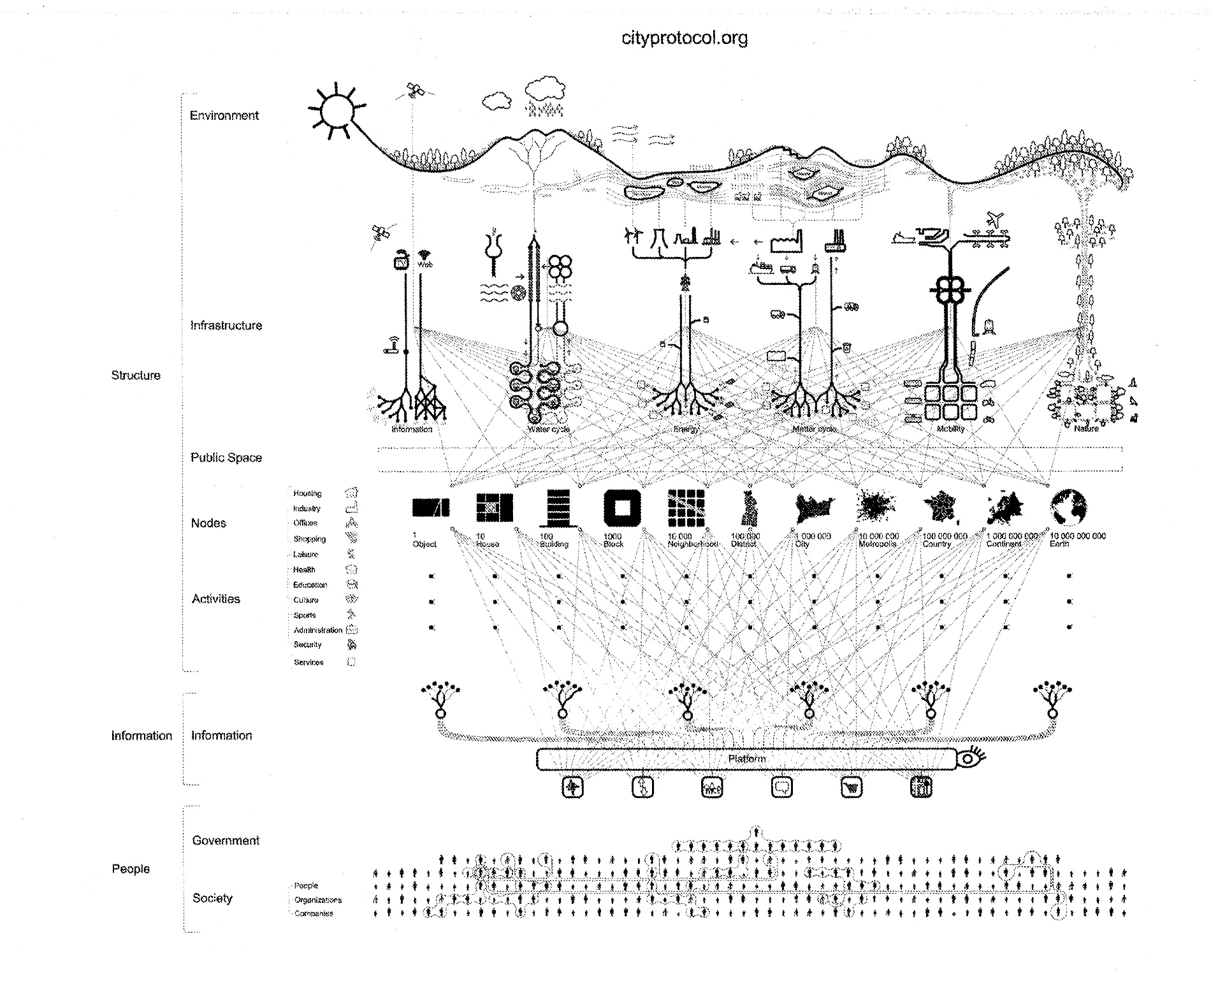

Slide 4
The problem
A lot of resources are going into tackling these issues, but they are extremely fragmented:
Cities are trying to find solutions on their own
Global companies are trying to sell proprietary solutions based on the strengths of their offerings
Research and trials are taking place on an ad-hoc basis with no consistent approach that would allow different approaches to be compared
Standards work in this area is only just beginning and is missing a strong, city-led focus

Slide 5
Barriers to progress
a focus on innovation in specific city subsystems, such as water and energy, rather than integration. These silos are seen in the work of businesses, the research base, and in city government organisational structures
no individual company has all the skills necessary to deliver the requirements of cities in the future. This is a particular problem for smaller innovative companies, but even the largest find it difficult to build broad enough collaborations to meet the challenge
no neutral space for city governments, business and the knowledge base to collaborate on new integrated solutions
solutions need to be demonstrated and validated at scale and in use to convince the market. Little data is available on performance in use of integrated systems
limited involvement of the social and behavioural sciences in developing solutions that recognise cities as places where people live and work; placing citizens at the heart of the city.
Future cities catapult brochure

Slide 6
This is a new market
To gain the investment needed:
There needs to be certainty
There needs to be scale
There needs to be the right incentives for all the key players to play their role
This market needs to be designed by all key players together and on a global scale

Slide 7
What is the City Protocol
City Protocol provides a global framework for cities, industry, research institutes, organisations and citizens to collaborate in developing common approaches and solutions to help cities work better.
This will accelerate the worldwide market for products and services that will enable sustainable city transformation worldwide.

Slide 8
The beginnings
Launch conference held in Barcelona July 2012
Organised by:
Barcelona city council
Cisco
GDF Suez – The world’s largest utility company

Slide 9
Who was there
Cities |  | Companies | Organizations | Universities
Amsterdam Barcelona Boston Buenos Aires Busan Copenhagen Derby Dublin Genova Helsinki Hyderabad Istanbul Lima Livorno Lyon Maputo Medellín | Milan Moscow Nairobi New York City Nice Paris Quito Rome San Francisco Seoul Taipei Torino Uppsala Venice Vienna Yokohama | Abertis Accenture Agbar Capgemini Citigroup Fujitsu Grupo Etra Hp IBM Indra Microsoft Oracle Ros Roca Schneider Electric – Telvent Siemens Telefonica Philips Opentext Sap Italtel | Aenor Barcelona Urban Ecology Agency Citilab Citizen Housing And Planning Council New York Ecocity Builders Eurocities European Commission European Network Of Living Labs Fundació Mobile World Capital Green Building Council Iclei Jnnurm Living Labs Global Localret Major Cities Of Europe Metropolis Red Española De Ciudades Inteligentes Smart City World Congress Think Innovation United Cities And Local Governments | Argonne National Laboratory - University Of Chicago Center For Technology In Government - University At Albany Esade Institute For Advanced Architecture Of Catalonia (Iaac) Iese Imperial College Business School London School Of Economics (LSE) Mit (Architecture & ICT) Rutgers University School Of Public Affairs & Administration - Public Technology Institute, Universidad De Cantabria University Of Girona University Of Sydney University Of Virginia Universitat Politècnica De Catalunya (Upc) Yonsei University

Slide 10
The City Protocol
What is a Protocol?
A set of conventions governing the treatment and formatting of data in a communication system
The records that show the agreements arrived at by a group of negotiators

Slide 11
Designing the Internet
The inspiration is the way the protocols of the Internet are produced and managed
There are 2 main organizations that are responsible for the Development and Governance of the Internet:
The Internet Engineering Task Force (www.ietf.org)
The Internet Society (www.isoc.org)

Slide 12
The Internet Engineering Task Force
Is a key body in developing the standards that allow the Internet to function
It has no formal constitution and no formal membership. It is a “large open international community of network designers, operators, vendors and researchers concerned with the evolution of the Internet architecture and its operation”. It is open to any individual.
It operates through self appointed, deliverable oriented and limited-time scope Working Groups that produce draft documents (RFCs: Request For Comments) that eventually obtain a de facto standard category, under one or several Chair(wo)men.
It stands to the principle of “rough consensus and running code”
It acts under the formal umbrella of the Internet Society

Slide 13
The Internet Society
Is the parent corporation of the IETF (though it grew out of the latter!)
It is an organization with bylaws and formal membership (individuals and organizations). It is “a global cause-driven organization governed by a diverse Board of Trustees that is dedicated to ensuring that the Internet stays open, transparent and defined by you”.
It formally owns the output (RFCs) of the IETF, making them freely available to everyone, including non-members, free of charge.
It has Local Chapters (some 90 currently) that address issues of local interest

Slide 14
Learning from the success of the Internet
Though this is a different field, much can be learned from the open processes of standardization and governance of the Internet.
The working methodology of the City Protocol Society is like that of the IETF: Open, Collaborative, Rough Consensus and written documents
The governance of the City Protocol is like that of ISOC: Formal Membership of Organizations, Supervision and Ownership of the CP, Board elected by Constituencies

Slide 15
The City Protocol
Provides a framework that can incorporate existing work to develop models and standards, along with new work needed to fill in any gaps, and make all of it visible and able to be commented on, to allow rough consensus to develop
Will build agreement among cities and all other key players around that rough consensus, in order to bring about a common approach and thus enable the scale and certainty needed to allow the smart city market to develop quickly and effectively

Slide 16
Where things are now
The right governance structure have been carefully developed in order to manage Intellectual Property issues
Board set up in October last year
City Protocol Task Force Chair appointed
City Protocol Task Force to be launched November 2nd – 4th in Amsterdam
www.cityprotocol.org

