Slide 1
Focus Group on Smart Sustainable Cities
Paolo Gemma
WG2 Coordinator of ITU-T FG SSC

Slide 2
Focus Group on Smart Sustainable Cities (FG SSC)
Established at ITU-T Study Group 5 meeting in Geneva in February 2013.
Lifetime: one year from the first meeting held on 8 May 2013. Extented to May 2015.
As an open platform for smart-city stakeholders to exchange knowledge in the interests of identifying the standardized frameworks needed to support the integration of ICT services in smart cities.
Participation is open to all.
Notes:
2

Slide 3
Management team
Chairman:
Silvia Guzman
Vice-chairmen:
Flavio Cucchietti, Telecom Italia
Pablo Bilbao, Federation Argentina de Municipios, Argentina
Franz Zichy, USA ​
Nasser Saleh Al Marzouqi, UAE​
Ziqin Sang, Fiberhome Technologies Group
Sekhar Kondepudi, National University of Singapore
Secretariat:
Cristina Bueti, Adviser, ITU

Slide 4
Terms of reference
Main tasks and deliverables:
Defining the role of ICTs in environmentally sustainable smart cities;
Identifying or developing a set of Key Performance Indicators (KPIs);
Identifying future smart-city standardization projects;
Developing a roadmap for the ICT sector’s contribution to smart sustainable cities.
Establishing relationships with:
Within SG5: Q7, Q13, Q14, Q15, Q16, Q17, Q18, and Q19, etc.;
All ITU-T Study Groups, especially SG11, SG13, SG15, SG16 and SG17;
Other international, regional and national SDOs, such as ISO, IEC, IEEE, CEN/CENELEC, ETSI, etc.;
Relevant entities including: municipalities, federation of municipalities, NGOs, policy makers, industry forums and consortia, companies, academic institutions, research institutions, etc.
Notes:
Main tasks and deliverables:
Defining the role of ICTs in environmentally sustainable smart cities, and identifying the ICT systems necessary to their development;
Identifying or developing a set of Key Performance Indicators (KPIs) to gauge the success of smart-city ICT deployments;
Establishing relationships and liaison mechanisms with other bodies engaged in smart-city studies and development;
Identifying future smart-city standardization projects to be undertaken by its parent group, ITU-T Study Group 5;
Developing a roadmap for the ICT sector’s contribution to Smart Sustainable Cities, providing cohesion to the development and application of technologies and standards.
Collaboration with:
Within SG5: Q7, Q13, Q14, Q15, Q16, Q17, Q18, and Q19, etc.;
All ITU-T Study Groups, especially SG11, SG13, SG15, SG16 and SG17;
Other international, regional and national SDOs, such as ISO, IEC, IEEE, CEN/CENELEC, ETSI, etc.;
Relevant entities including: municipalities, federation of municipalities, non-governmental organizations (NGOs), policy makers, industry forums and consortia, companies, academic institutions, research institutions, etc.
4

Slide 5
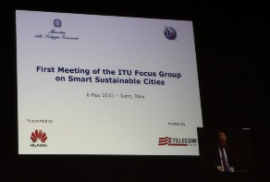
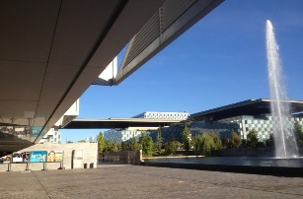
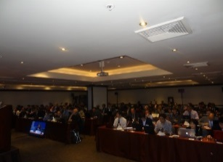
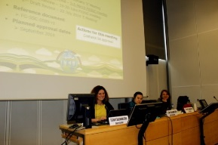
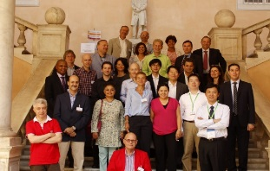
Past meetings
1st meeting: Turin, 8 May 2013 (Telecom Italia) >50 participants
2nd meeting: Madrid, 17 Sept 2013 (Telefónica) >50 participants
3rd meeting: Lima, 6 Dec 2013 (Gov. of Peru) >60 participants
4th meeting: Geneva, 5-6 March 2014 (ITU) >30 participants
5th meeting: Genoa, 19-20 June 2014 (Genoa Municipality) >45 participants

Slide 6
Main achievements
Establishment of FG SSC structure and working methods,
Creation of 4 working groups, and appointment of the respective coordinators;
Creation of technical groups within WG2, WG3 and WG4, and appointment of the respective leaders;
Extension of the FG SSC mandate until May 2015;
Agreement on definition of SSC:
Development of a Roadmap for SSC (including technical specifications) to be submitted for approval in December 2014;
16 technical reports under development;
Liaison statements sent to other bodies engaged in smart-city studies and development, such as ISO, IEC, IEEE, ETSI, EC DG Connect, UNECE, UNU, StEP, CEDARE, UNESCO, UN-Habitat, WMO, UNEP and UNFCCC.
Notes:
6

Slide 7
Working groups
1. ICT role & roadmap for Smart Sustainable Cities
2. Smart Sustainable Cities Infrastructure
3. Standardization gaps, KPIs and metrics
4. Policy & positioning (communications, liaisons and members)
Notes:
7

Slide 8
Working group 1
1. ICT role & roadmap for Smart Sustainable Cities
WG1 coordinator: Sekhar Kondepudi (National University of Singapore)
Plan and deliverables:
Technical report on overview of SSC and the role of ICT;
Technical report on definitions and attributes of a SSC;
Roadmap for SSC implementation.
Notes:
8

Slide 9
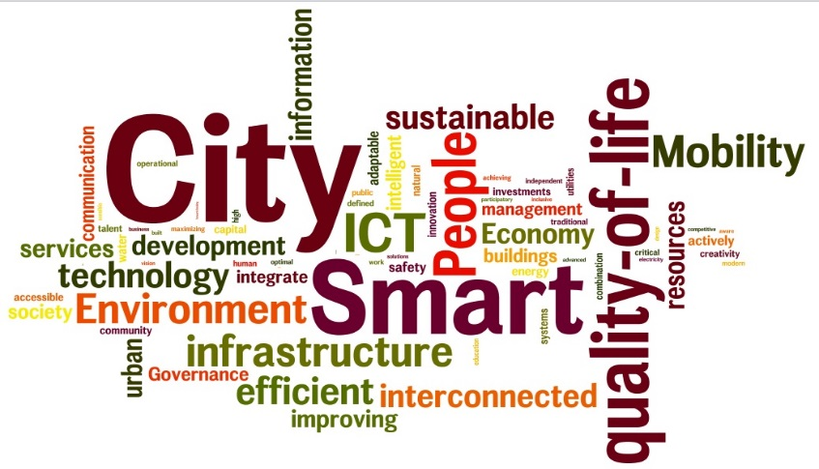
FG-SSC agreed definition of a Smart Sustainable City
120 basic definition analyzed
Agreed definition of SSC:
“A smart sustainable city is an innovative city that uses information and communication technologies (ICTs) and other means to improve quality of life, efficiency of urban operation and services, and competitiveness, while ensuring that it meets the needs of present and future generations with respect to economic, social and environmental aspects.”
Notes:
9

Slide 10
Working group 2
2. Smart Sustainable Cities infrastructure
WG2 coordinator: Paolo Gemma (Huawei)
Plan and deliverables:
Providing an overview of the use of ICT in cities;
Looking at future trends;
Identifying standardization’s need;
8 technical reports under development.
Notes:
10

Slide 11
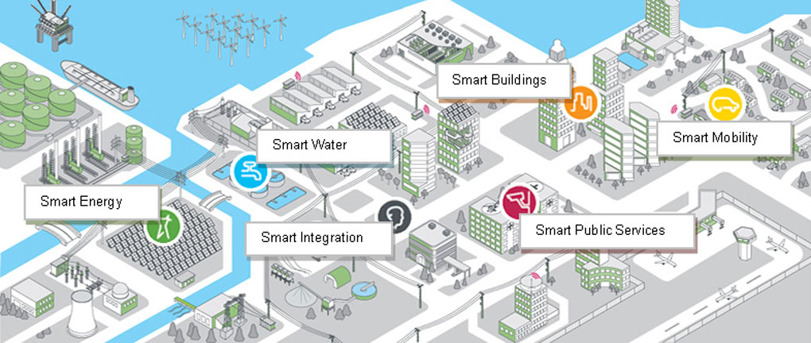
Areas of technical reports
Open Data
Integrated Management
Smart Buildings
Smart Water Management
Smart Infrastructure
Climate Change Adaptation
Cyber-Security and Resilience
EMF considerations
Notes:
11

Slide 12
Working group 3
3. Standardization gaps, KPIs and metrics
WG3 coordinator: Sang Ziqin (Fiberhome Technologies Group)
Plan and deliverables:
Technical report on standardization activities and gaps for SSC and suggestions to SG5
Technical report on KPIs definitions for smart sustainable cities
Technical report on KPIs metrics evaluation

Slide 13
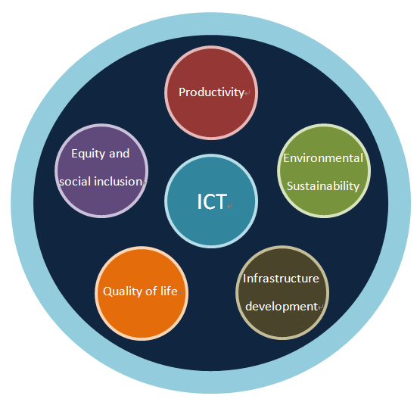
TR2/WG3 on Key Performance Indicators (KPIs) Definitions for smart sustainable cities
dimension | indicators
ICT | 14, covering Network facilities, Information facilities
Environmental sustainability | 14, covering Environment, Energy and natural resources
Productivity | 12, covering Innovation, Economy sustainability
Quality of life | 22, covering Convenience and comfort, Security and safety, Healthcare, Education and training
Equity and social inclusion | 11, covering Openness and public participation, Social sustainability, Governance sustainability
Non-ICT infrastructure development | 15, covering Building, Transport, Sanitation, Municipal pipe network

Slide 14
Working group 4
4. Policy & positioning (communications, liaisons and members)
WG4 coordinator: Daniela Torres
(Telefónica)
Plan and deliverables:
Technical report on Smart Sustainable Cities stakeholders
Technical report on assessment of energy & GHG emissions from ICT in cities (NEW)
Notes:
14

Slide 15
TR1/WG4 Technical report on smart sustainable cities stakeholders
Steps for stakeholders analysis
IDENTIFICATION
First list derived from the definition.
CATEGORIZATION
Categorization of listed stakeholders in a graph (list)
DETAILED ANALYSIS
Identifying individual characteristics and expected implications for SSC development
Ensuring with the stakeholders visual map developed in this report.
Studing relationships between stakeholders: map of relations.
Validation with a general classification by World Bank, other reports from the FG-SSC, literature used for this report.
Notes:
15

Slide 16
Next steps
A lot has been done …
… but lots more needs to be done
Smart Sustainable Cities are a complex ecosystem
They need many different technologies and expertises
Are a new and huge challenge to SDOs
No SDO can answer them all and alone
Cooperation among SDOs is a need (and an opportunity)
ITU-T, ISO, IEC, IEEE and CEN-CENELEC-ETSI should join forces and involve other Regional/national bodies too

Slide 17
Way forward
Sharing documents and activities
Possible next steps
Sharing results
To disseminate the outcomes
Sharing drafts
To collect views from other experts
Working together
To develop a real integrated analysis
E-meetings
Several e-meetings held and planned to help advance progress on deliverables
Join the online discussions!
Ideal = joint deliverables
It is possible!

Slide 18
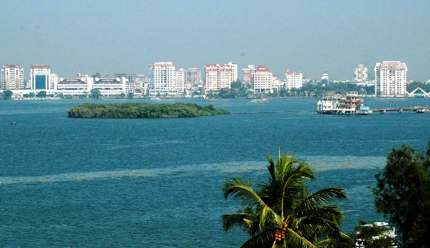
Conclusions
Need to engage new cities & other key stakeholders (such as academic and research institutes, civil society, NGOs, SDOs, and ICT organizations, industry forums and consortia) to participate and contribute.
JOIN US: 7th FG SSC meeting (Kochi, India, 10-12 December 2014)
Collaboration and contributions are welcomed.
Notes:
18

Slide 19
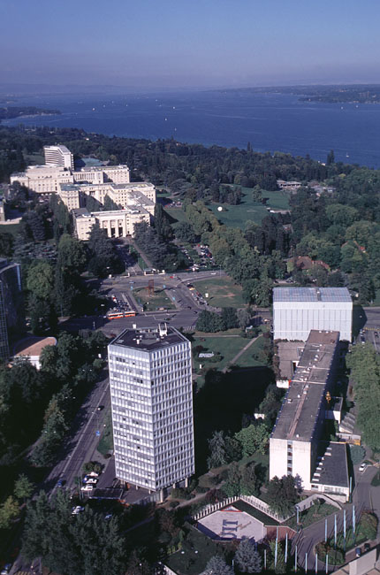
ITU-T and Climate Change itu.int/ITU-T/climatechange
Focus Group on Smart Sustainable Cities itu.int/en/ITU-T/focusgroups/ssc/
Symposia & Events on ICTs and Climate Change itu.int/ITU-T/worksem/climatechange
Thank you
tsbfgssc@itu.int

