Slide 1
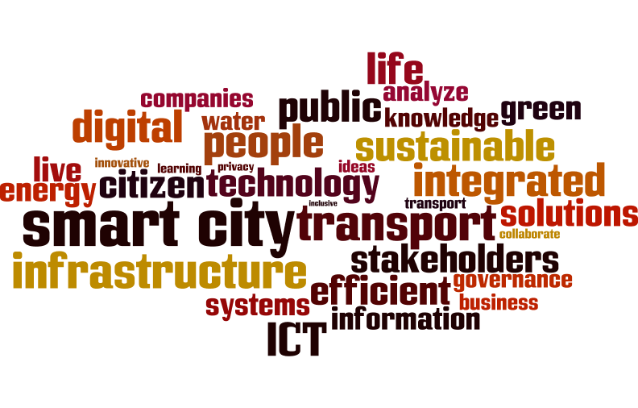
Smartness is a means, Sustainability is the goal.
Roman Serdar Mendle, Smart Cities Program Manager,
ICLEI – Local Governments for Sustainability
Notes:
For a short intro, you could talk briefly what ICLEI is.
Who we are: ICLEI is the world’s leading network of over 1,000 cities, towns and metropolises committed to building a sustainable future. By helping our Members to make their cities sustainable, low-carbon, resilient, biodiverse, resource-efficient, healthy and happy, with a green economy and smart infrastructure, we impact over 20% of the global urban population.
What we do: We promote local action for global sustainability and supports cities to become sustainable, resilient, resource-efficient, biodiverse, low-carbon; to build a smart infrastructure; and to develop an inclusive, green urban economy with the ultimate aim to achieve healthy and happy communities.

Slide 2
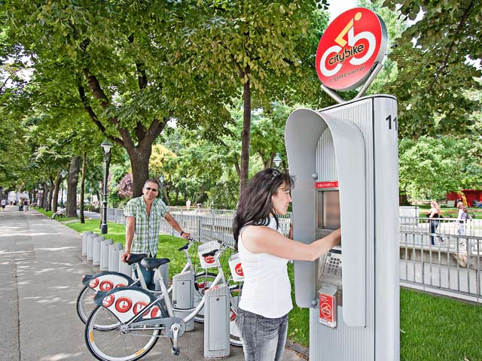
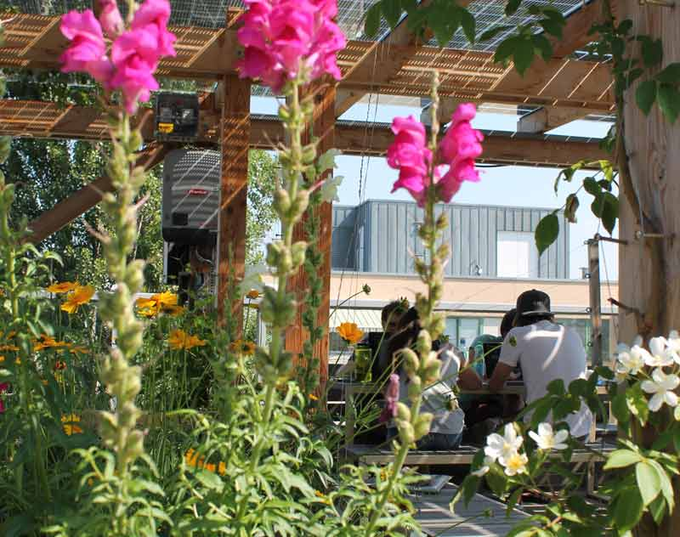
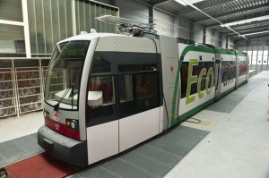
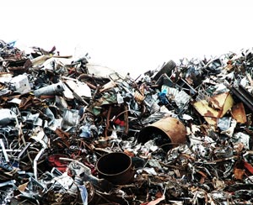
One Example: Vienna

Slide 3
One example: Vienna
„The key objective of Smart City Wien for 2050 is: best quality of living for all people in the city – combined with maximum resource preservation, which is brought about by comprehensive innovations."
„A city of codetermination and social justice“
„A city of green spaces and renewable energy“
„A city of equal opportunities for all generations"

Slide 4
Technological progress?
Efficiency?
Better Services for citizens?
Purpose of a smart city?
Economic development?
Sustainability?
Citizen empowerment?
‘because we want it’?

Slide 6
‘City makers’ or consumers?
End users?
Empowered agents?
The role of people?
Groups or individuals?
Subjects of analysis?
Participants in governance?
Data points?

Slide 7
What’s worth the trade?
Integrated systems
Resilience
Monitoring & data mining
Privacy & data security
Efficiency increase
Absolute resource use

Slide 8
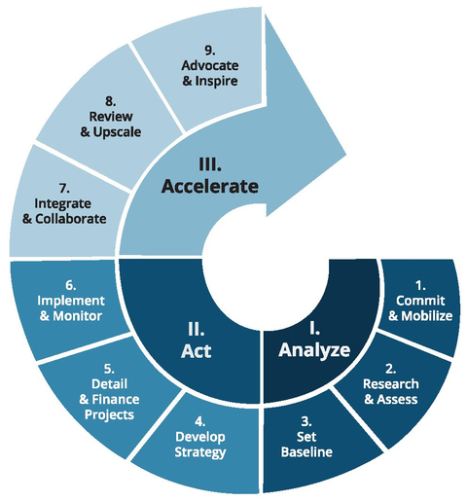
Analyze, Act, Accellerate -> Repeat!
Involve stakeholders & citizens.

Slide 9
Technologies change. People change. Cities change.
Smart cities learn continuously and share knowledge.
Smart cities follow sustainability principles.
Smart Cities bridge silos and work with all stakeholders.
Smartness is a means. Sustainability is the goal.

Slide 10
Visit our website: www.metropolitansolutions.iclei.org

Slide 11
Connect with us!
@ICLEI
ICLEI World Secretariat
www.talkofthecities.iclei.org
ICLEI
email directly:
smart.cities@iclei.org
ICLEI Global
ICLEI-Local Governments for Sustainability
www.iclei.org

