Slide 1
Sustainable Cities:
Hubs of Innovation, Jobs, Industrialization and Climate Action
Ms. Tonilyn Lim
Industrial Development Officer
Renewable and Rural Energy Division
Department of Energy, UNIDO

Slide 2
UNIDO's Mandate: Inclusive and Sustainable Industrial Development
Trade Capacity Building
Poverty Reduction through Productive Activities
Energy & Environment
Inclusive
Industry
Competitive
Industry
Green
Industry
Notes:
Toni (0.5m)

Slide 3
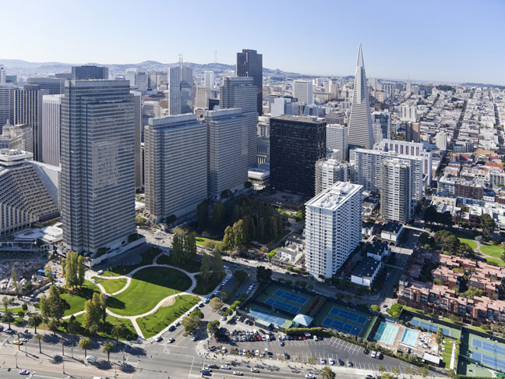
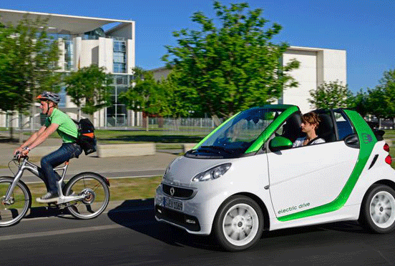
Sustainable Cities: UNIDO perspective
Sustainable cities are hubs of innovation, jobs, industrialization and climate action
Photo Source: Inhabitant
Photo Source: Chronicle Herald
Notes:
How does UNIDO view sustainable cities?
Source: http://inhabitat.com/8-overarching-urban-systems-that-make-a-sustainable-city/
http://thechronicleherald.ca/wheelsnews/120758-urban-mobility-gets-smart-er

Slide 5
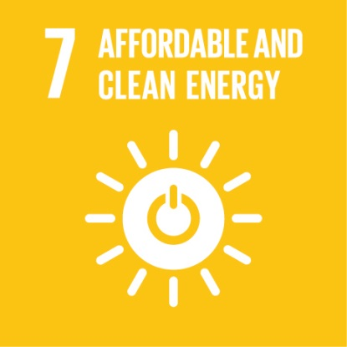
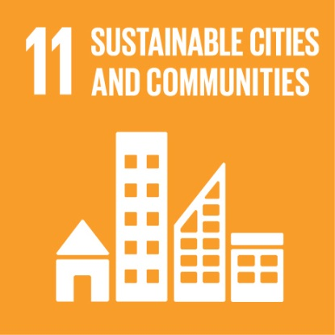
Actions inspired by the SDGs
Notes:
How does it link with SDG?

Slide 6
Key Development Interventions
UNIDO’s key strategies for sustainable cities
1) Driving green technology innovation at city scale
Focusing on urban transport, energy and resource efficient system
Creating innovation by pilot demonstration and scaling up
Fostering green value chains and supporting SMEs
2) Promoting climate resilience in urban planning and development
Integrating climate risks and sustainability strategies in urban planning and management
Improving urban institutional framework
3) Increasing partnerships with diverse stakeholders
Drawing private sector, financing institutions, government, civil society, research institutes and international organizations to secure solid funding mechanism and promote knowledge management
Notes:
How does UNIDO approach for sustainable cities?

Slide 7
Thematic Areas
Climate Resilient Industries hosted by Cities
Climate Smart City Service Delivery
- Energy Management System (ISO 50001) application in cities
- EE/RE in waterworks, transport, buildings
- Smart waste-to-energy refineries
- Smart grids
- IEE and RE for Industrial applications
- Green supply chains / Green Freight influenced by Industrial Parks / Clusters
- Disaster Risk Reduction through resilient energy supply
Value Chain Development of Products for Sustainable Cities
- Electric Vehicles and Charging Infrastructure
- Sustainable building materials production
- Clean Fuels
- Climate-Smart Peri-Urban Agriculture (Greening the Food Value Chain)
Enabling Environment; Innovation; Technology Demonstration; Partnerships

Slide 8
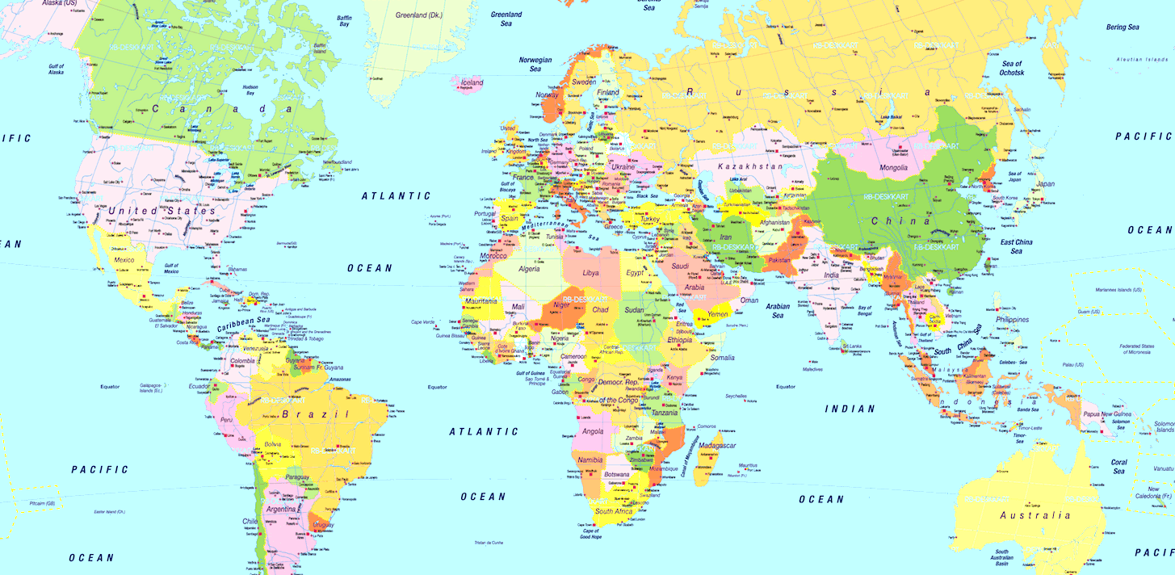
Sustainable Cities Integrated Approach Pilot
Dakar
Melaka
Jaipur, Bhopal, Mysore, Vijayawada, Guntur
Abidjan
- Integrated approach to mega-trends driving global environmental degradation
- UNIDO in climate change & chemicals and waste focal areas

Slide 9
Participation in Global Forums
UNIDO Green Industry Conference in Ulsan (28-30 June 2016)
Green Industry in Sustainable Cities
4th Eco-Cities Forum in Barcelona (October 2016)
Event co-organization with Jordan Ministry of Environment
Habitat III in Quito (October 2016)
Side Event (under application)
UNFCCC Conference of the Parties (COP 22) in Marrakesh (7-18 November 2016)
Greening of COP 22
Preparing for the 5th Vienna Energy Forum 2017 (June)
Main event on Sustainable Cities planned

Slide 10
Thank you for your attention
Ms. Tonilyn Lim
Project Manager
T.Lim@unido.org
+431 26026 3847

