Slide 1
Cultural and Creative City Monitor
A tool to measure cultural and creative activities in Europe
Paweł Stano, Dorota Węziak-Białowolska, Michaela Saisana
European Commission, Joint Research Centre (JRC) Composite Indicators Research Group (JRC-COIN)
https://ec.europa.eu/jrc/en/coin

Slide 2
WHY
Request by the JRC Directorate General in agreement with Commissioner Navracsics
To stress the importance of culture and creativity as a way out of recession and for increased youth employment
To place culture at the heart of discussions and in the EU policy agenda
To urge to collect reliable and comparable data at city level on cultural and creative aspects
To identify specialisation strategies for European cities

Slide 3
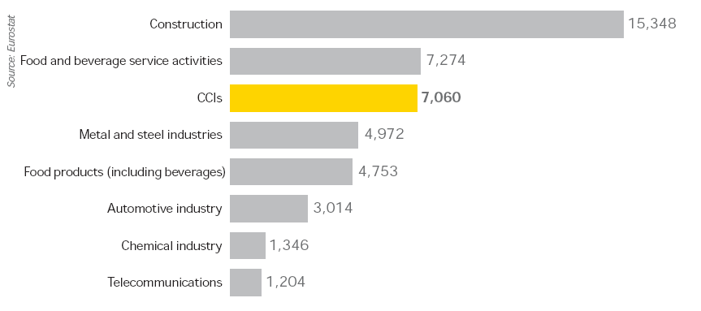
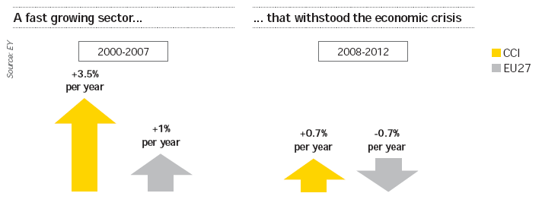
Employment (in thousands) 2012
Job creation

Slide 4
WHO
Partners
Joint Research Centre,
DG on Urban and Regional Policy,
DG Education and Culture,
DG Communications Networks, Content and Technology,
European Centre for Creative Economy,
European Cultural Foundation,
European Network of Cultural Administration Training Centers,
World Intellectual Property Organization,
Université Libre de Bruxelles
United Nations (UNECE)
European Environment Agency
Scientific Committee
Pier Luigi Sacco
Enzo Grossi
Luca Dal Pozzolo

Slide 5
The monitor includes 158 cities in 29 European countries, where almost 87,000,000 million live. These were selected among 1,000 cities included in the Eurostat Urban Audit database using the following criteria that were established for this tool:
the cities were or will be European Capitals of Culture (up to 2019), or
the cities applied for a nomination to become a European Capital of Culture and have been shortlisted, or
the cities held international cultural festivals acknowledged by EFFE (Europe for Festivals, Festivals for Europe).

Slide 6
What information is featured in the Monitor?
The Cultural and Creative Monitor 2016 presents city profiles along key dimensions and over 50 individual indicators. The dimensions considered include:
Creative Employment
Cultural Venues
Human Capital
Academic Appeal
Technology
Cultural Engagement
Innovation Output
Social Cohesion
Connectivity
Living Conditions
Governance

Slide 7
Cultural and Creative City Monitor
C³ Index
Inputs
Outputs
Socio-economic outcomes of culture and creativity
Enabling environment

Slide 8
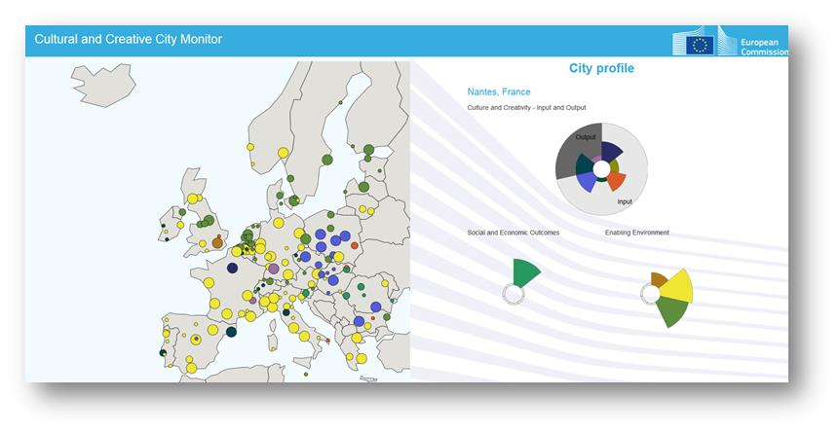
Online tool:

Slide 9
Thank you
Paweł M. Stano
pawel.stano@jrc.ec.europa.eu
Composite Indicators Research Group (JRC-COIN)
https://ec.europa.eu/jrc/en/coin

