Slide 1
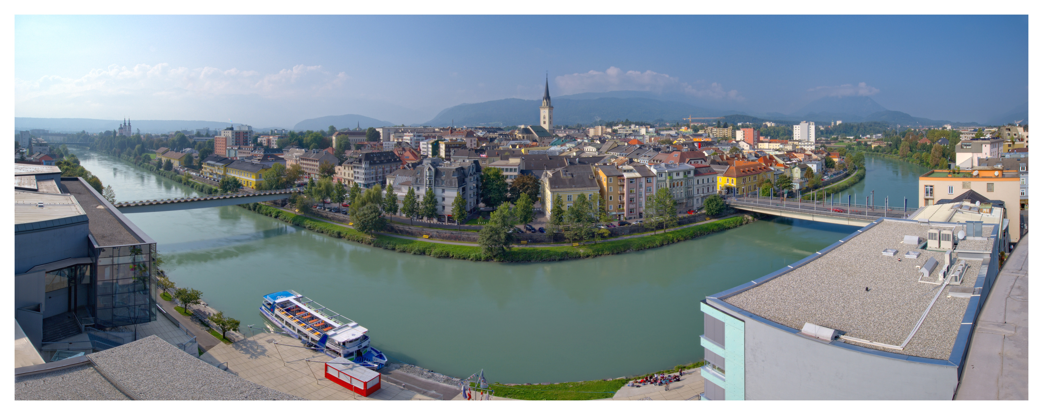
Villach
Sustainability and longterm energy strategy
18th May 2016, Rome

Slide 2
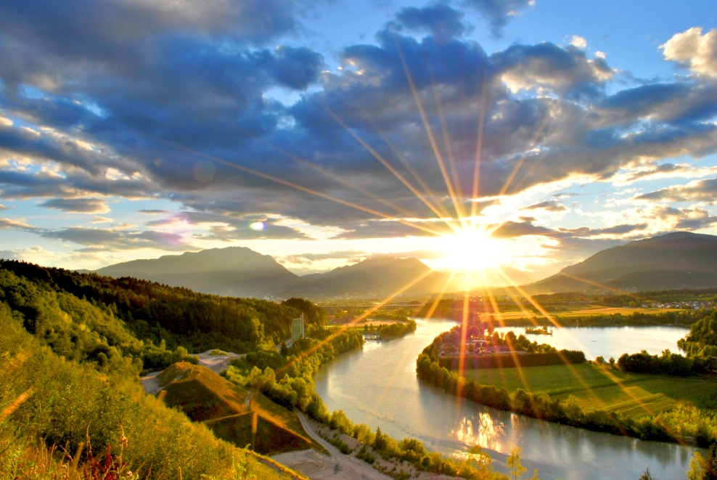
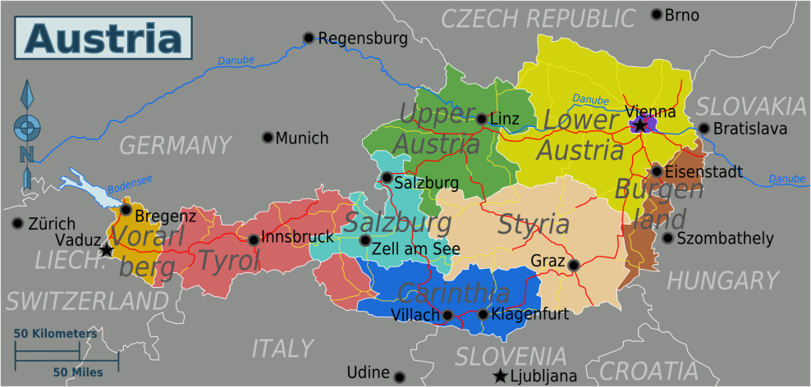
Villach - Perfect conditions for Renewable Energy Sources
Located in the southern part of Austria
About 60.000 inhabitants
134 km² municipal area
Close to two rivers – Drau and Gail
56 % woodland area
2.182 hours of sunlight per year
About 17.000 m² solar thermal collectors
About 4.000 kWp PV
Hydro power plants (39.000 kW)

Slide 3
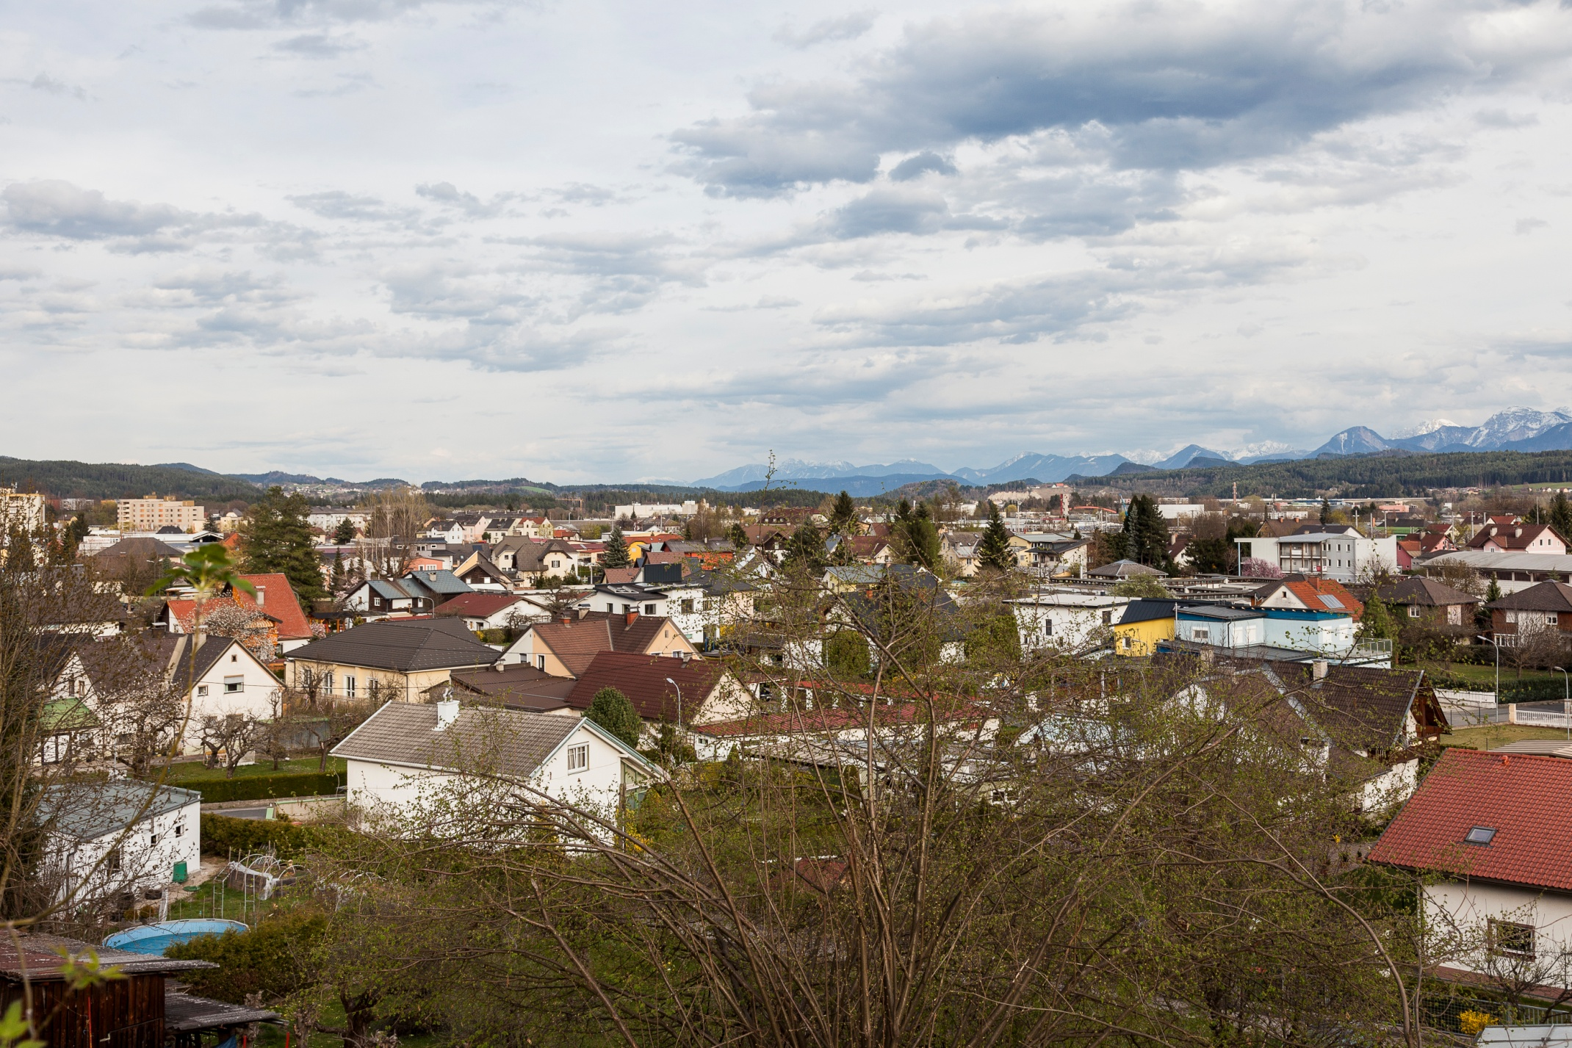
Kelag Wärme
Share of RES and waste heat utilization is up to 80%
2013 a solar thermal injection into the district heating network was realised
Serveral small local heat supplier
Mainly based on biomass and biogas
Heating

Slide 4
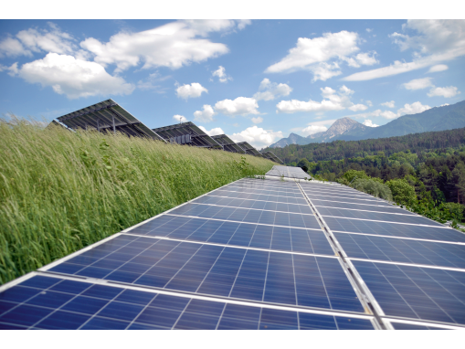
Negotiated agreements
Member of the Climate Alliance since 1992
2009 member of the „e5-Program“
European Energy Award
2009 starting the „Smart City Project“
Fairtrade-initative in 2015

Slide 5
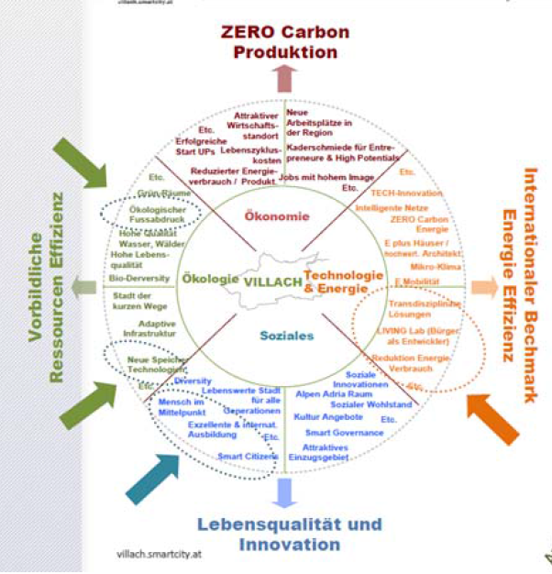
Ambitious Goals – Smart City
Villach has an energy strategy since 1994
Ongoing review of energy goals and benchmarks
In 2009 Villach started the „Smart City Project“
Short-, medium- and longterm goals (2050) were set
Goals for 2020 (base year 2010):
30 % Greenhousgas reduction
50 % Renewable Energy Sources in gross energy consumption
Increase energyefficiency by 20 %
Plus 10 % public transport, minus 10% motorized private transport

Slide 6
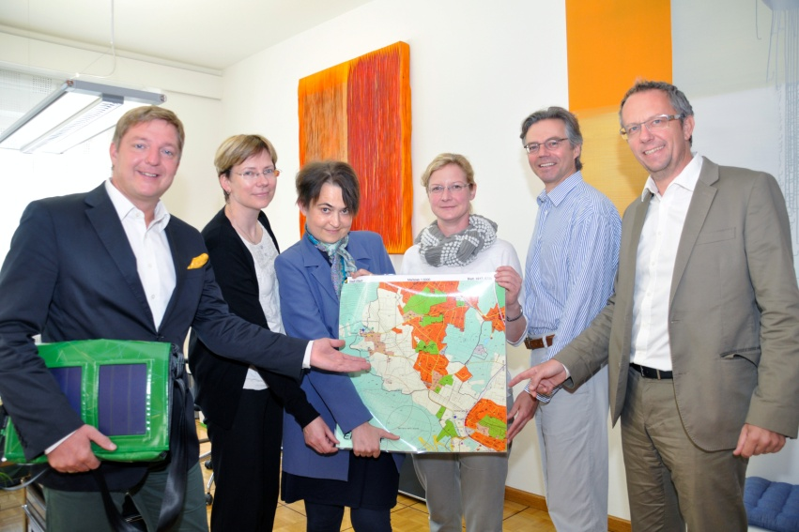
Close to the citizens: Strategy and participation
Urban planning strategy
Town of short distances
Utilisation and integration of potential RES
Installation of a 550 kWp PV-plant with public participation
Participation in the strategy process (energy strategy, smart city, urban planning,..)

Slide 7
Contact
Petra Oberrauner
Rathausplatz 1
9500 Villach
T:+43 4242 205 5201
W: www.villach.at

