Slide 1
Ministry of Regional Development, Construction and Housing and Communal Services of Ukraine
CREATION OF SMART CITIES– ENABLING SUSTAINABLE DEVELOPMENT OF PUBLIC SPACES IN UKRAINE
First Deputy Minister of Regional Development, Construction and Housing and Communal Services of Ukraine
Viacheslav Negoda

Slide 2
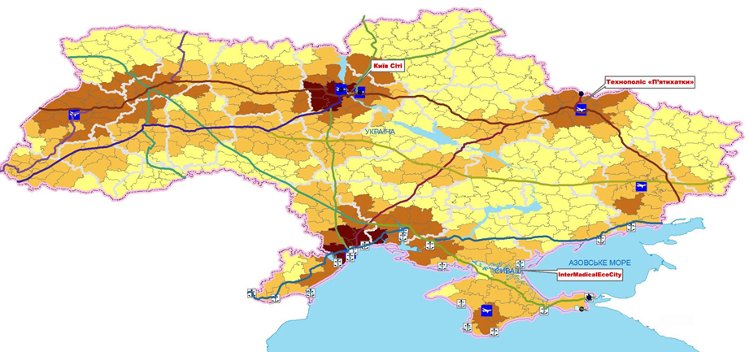
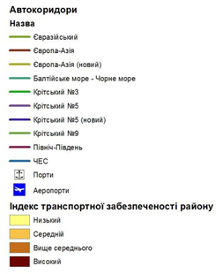
Transportation network at rayons’ level

Slide 3
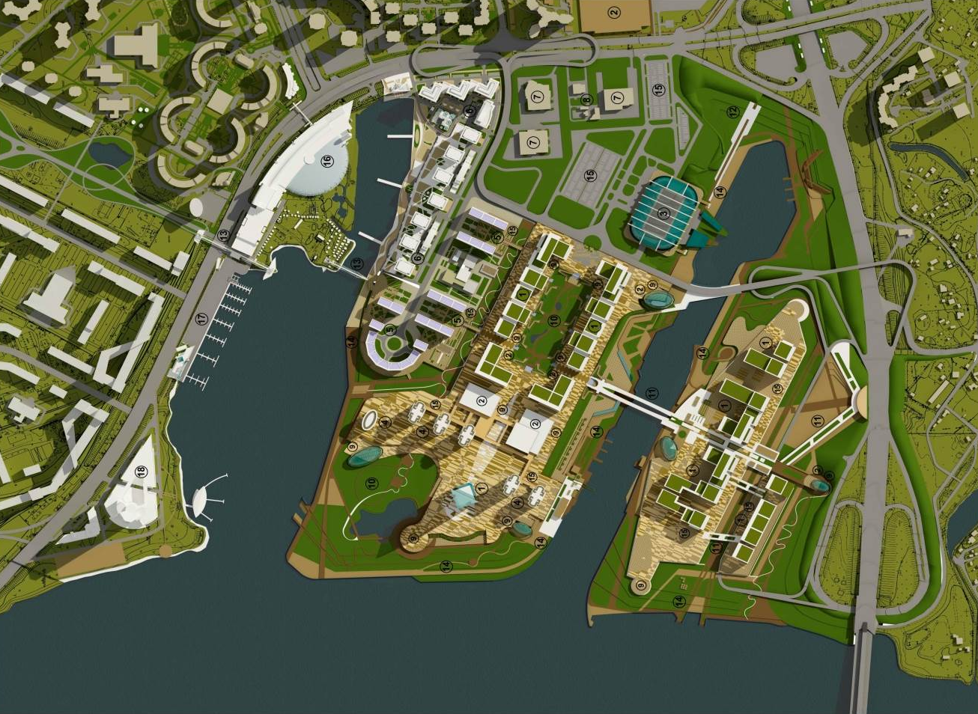
Kyiv city

Slide 4
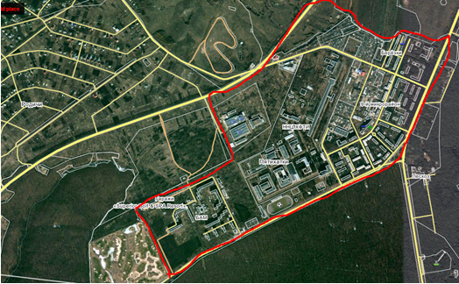
Technology town “Pjyatukhatki”

Slide 5
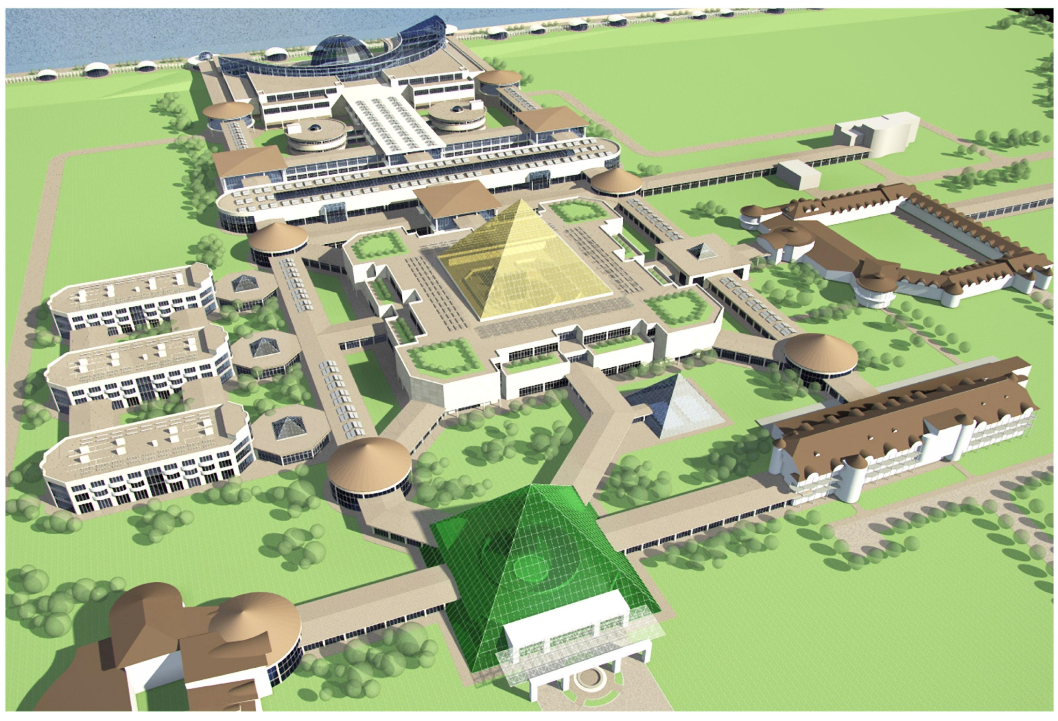
InterMedical Eco City

Slide 6
THANK YOU!

