Slide 1

Making Our Cities Smarter and More Sustainable
Cristina Bueti
18 May 2016, Rome

Slide 2
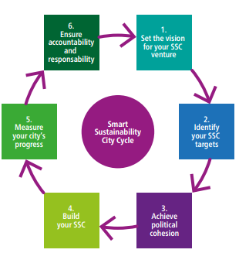
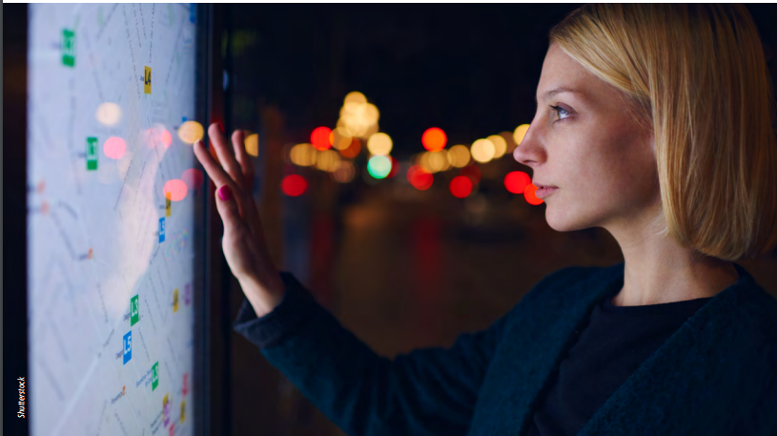
Pathway for Smart Sustainable Cities
Guide for City Leaders

Slide 3
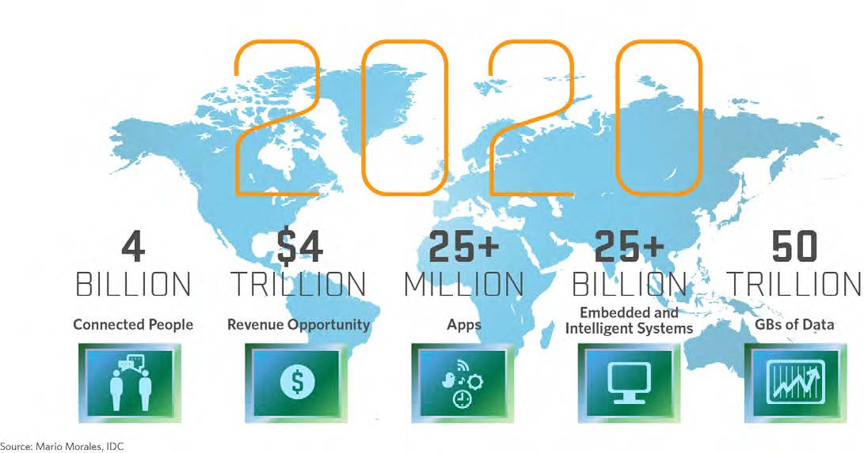
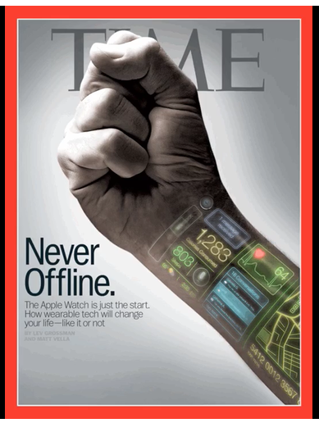
TODAY
55% of today’s 7 billion people on Earth live in cities
75% of energy is consumed in cities
Notes:
The rapid increase in population coupled with financial constraints, the convergence of technologies and a desire to reduce environmental impact is creating new challenges and opportunities for cities in areas such as energy use, mobility, security, infrastructure, healthcare and governance.

Slide 4
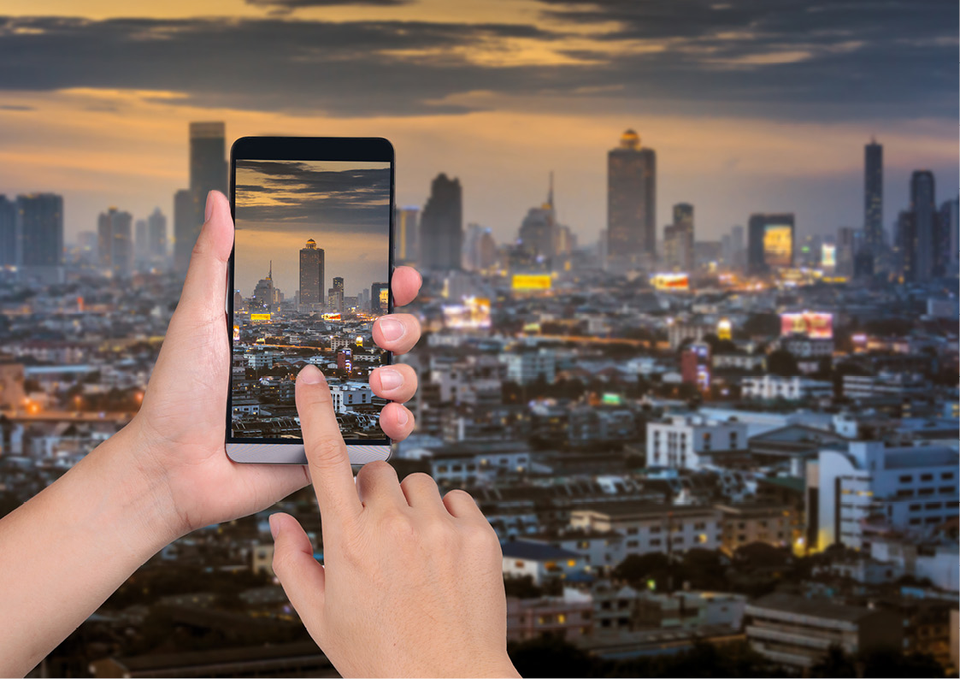
Smart sustainable cities
By reimagining the role of technology and connectivity in today’s cities, we’re not only addressing current challenges, but we’re creating countless smart and sustainable solutions built for the future.

Slide 5

“To support future city strategies, we need to understand the benefits of the embedded ubiquitous technologies and smart city developments in our everyday lives”

Slide 6

Towards IoT-enabled smart communities
WHAT TO DO?
FROM
TO
Nurture ‘Open Data’ platforms that utilize ‘Smart Data’ as an asset in its own right
to create citizen-centric innovations
driven & managed in collaboration by smart city stakeholders
Closed & un-connected vertical silos of functionally-oriented service providers
Innovative and collaborative new models that connect these vertical silos
ENERGY
TELECOM
WATER
TRANSPORT
HEALTH
HOUSING
ECONOMY
POLICING
EDUCATION
WASTE
ENVIRO SVCS
SOCIAL SVCS
ENERGY
TELECOM
WATER
TRANSPORT
HEALTH
HOUSING
ECONOMY
POLICING
EDUCATION
WASTE
ENVIRO SVCS
SOCIAL SVCS
INFORMATION SHARING
GUIDING PRINCIPLES
INTEGRATION & CROSS-SECTOR COLLABORATION FOR USERS SERVICES
Visionary
Citizen-centric
Digital
Open
Collaborative
INTERCONNECTION OF SYSTEMS

Slide 7

ITU-T Study Group 20 (SG20) on
“Internet of Things and its applications, including smart cities and communities”
ITU-T SG20 develops international standards to enable the coordinated development of IoT technologies, including machine-to-machine communications and ubiquitous sensor networks to address urban development challenges .
Q1/20 - Research and emerging technologies including terminology and definitions
Working Party 1/20 Internet of Things (IoT)
Working Party 2/20 Smart cities and Communities (SC&C)
Notes:
ITU-T SG20 will be responsible for international standards to enable the coordinated development of IoT technologies, including machine-to-machine communications and
ubiquitous sensor networks.
Established by the Telecommunication
Standardization Advisory Group (TSAG) in June 2015.

Slide 8
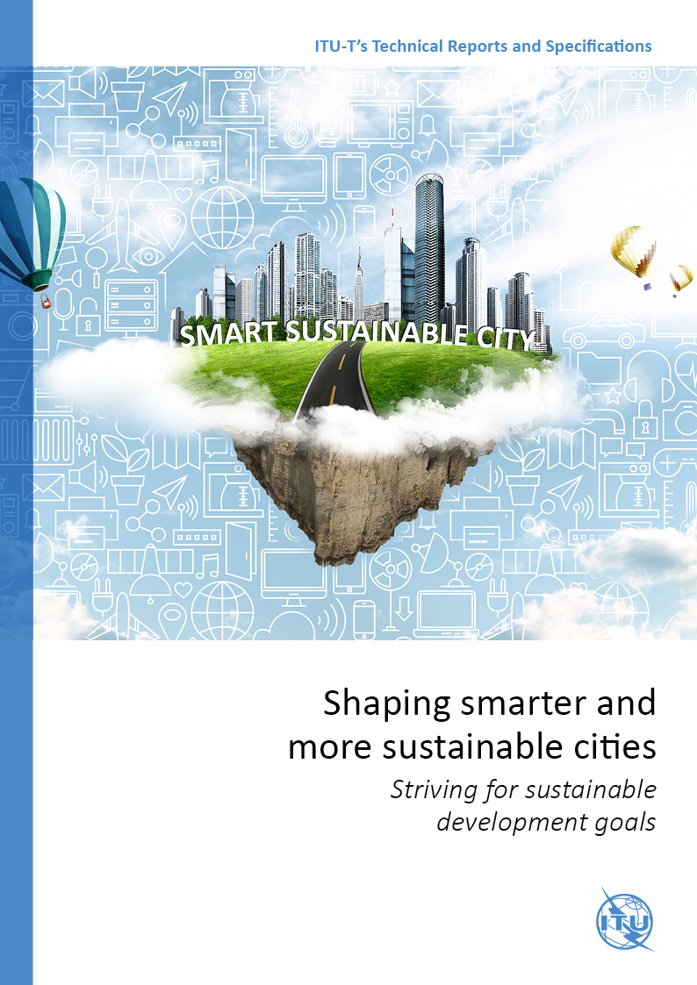
Flipbook: Shaping smarter and more sustainable cities: Striving for sustainable development goals
This compendium of 21 Technical Reports and Specifications details policy and technical considerations relevant to the development of SSC, providing policymakers and engineers with valuable reference material to guide their pursuit of happier, safer life in our cities.
Content
Empowering SSC Transitions
Exploring the SSC Infrastructure
Metrics for Measuring SSC Transitions
Paving the way for SSC
Click here: http://wftp3.itu.int/pub/epub_shared/TSB/ITUT-Tech-Report-Specs/2016/en/flipviewerxpress.html

Slide 9





KPIs Project for Smart Sustainable Cities to Reach SDGs
ITU- UNECE KPIs
You cannot manage what you cannot measure!
Assess the smartness and sustainability of the city
Advisory Board and Technical Advisory Group
Dubai
Singapore
Launched on
18 May 2016
Montevideo
International
Standards
Buenos Aires
and many others…
Measure success
Guidelines and policies

Slide 10


United 4 Smart Sustainable Cities
ITU and UNECE launched "United for Smart Sustainable Cities" (U4SSC) in response to the Sustainable Development Goal 11: "Make cities and human settlements inclusive, safe, resilient and sustainable".
U4SSC will primarily advocate for public policy to encourage the use of ICTs to facilitate and ease the transition to smart sustainable cities.
Click here: http://itu.int/go/U4SSC

Slide 11



Towards HABITAT III &
beyond
How can we improve participation and political commitment in cities through the use of ICTs?
How can we promote the use of ICTs to set a new urban agenda and contribute to Habitat III?
How can we help cities to develop their cities strategies?
Are ICTs key enablers to help cities become smarter and more sustainable?
What are the challenges? What are the opportunities?

Slide 12

Thank you
U4SSC
http://itu.int/go/U4SSC

