Slide 1
Shaping Smart Sustainable Cities
ITU-UNECE-Habitat III Cross-Cutting Expert Group Meeting on Driving Smart Sustainable Cities Worldwide
Cristina Bueti Advisor, ITU
21 July 2016

Slide 2
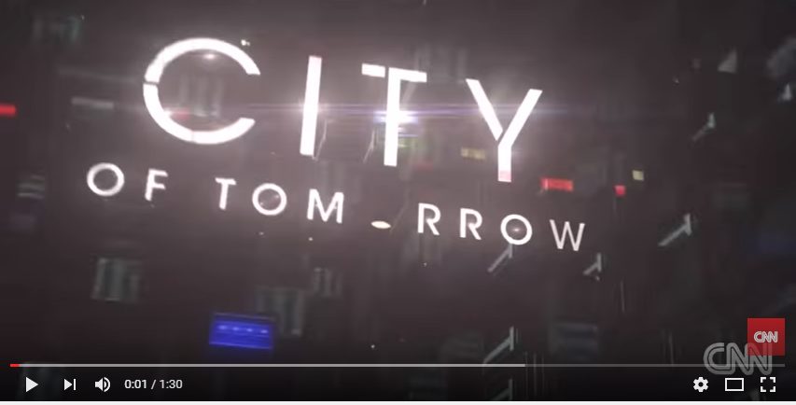
Notes:
http://edition.cnn.com/videos/tech/2014/05/27/cot-overview-animation.cnn/video/playlists/city-of-tomorrow/
Option you tube: https://www.youtube.com/watch?v=Zb6VOKiher0

Slide 3
Top urban challenges facing cities around the world
Europe
Social - Migration
Climate change
Economic development
Demographic change
Environment resource management
North America
Climate change
Environment resource management
Social inclusion
Mobility
Water
Asia
Urban Planning
Environment resource management
Climate change
Water
Mobility
Middle East & North Africa
Water
Safety & Security
Innovation & Entrepreneurship
Migration
Environment resource management
South America
Economic development
Climate change
Mobility
Environment resource management
Urban planning
Sub Sahara Africa
Water
Economic development
Innovation & Entrepreneurship
Safety & Security
Environment resource management
Oceania
Climate change
Environment resource management
Economic development
Investment climate
Power/ Energy
Source: World Economic Forum, Shaping the Future of Urban Development & Services Initiative & PwC Research

Slide 4
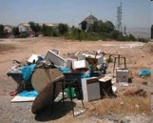
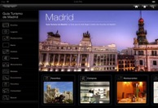
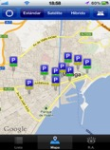
Cities challenges vs citizens’ interests
Waste & Water
Management
Tourism & cultural
engagement
i.e. Sao Paulo, New Delhi, Panama
i.e. Paris, Buenos Aires, Florence
Traffic & mobility
Management)
Business &
commerce
Cities interests
i.e. Beijing, Barcelona, Cairo
i.e. Berlin, New York, Tokyo.
Electricity Supply
Safety
i.e. Caracas, Germany
i.e México City, Rio de Janeiro
Sources: (1) McKinsey Global Institute - Big Data Report, May 2011. (2) 2012E, Strategy Analytics , Global Social Network Market Forecast, Oct 2011. (3) United Nations, April 2010, (4) Youtube 2011
Notes:
Cities face quite similar challenges, most of them related to sustainability

Slide 5
Notes:
The International Telecommunication Union and the United Nations Economic Commission for Europe have adopted an internationally approved definition for smart sustainable cities (SSC) to harness the potential of information and communication technologies (ICTs) to develop a competitive and sustainable edge in urban areas and improving the living situation of urban residents.

Slide 6
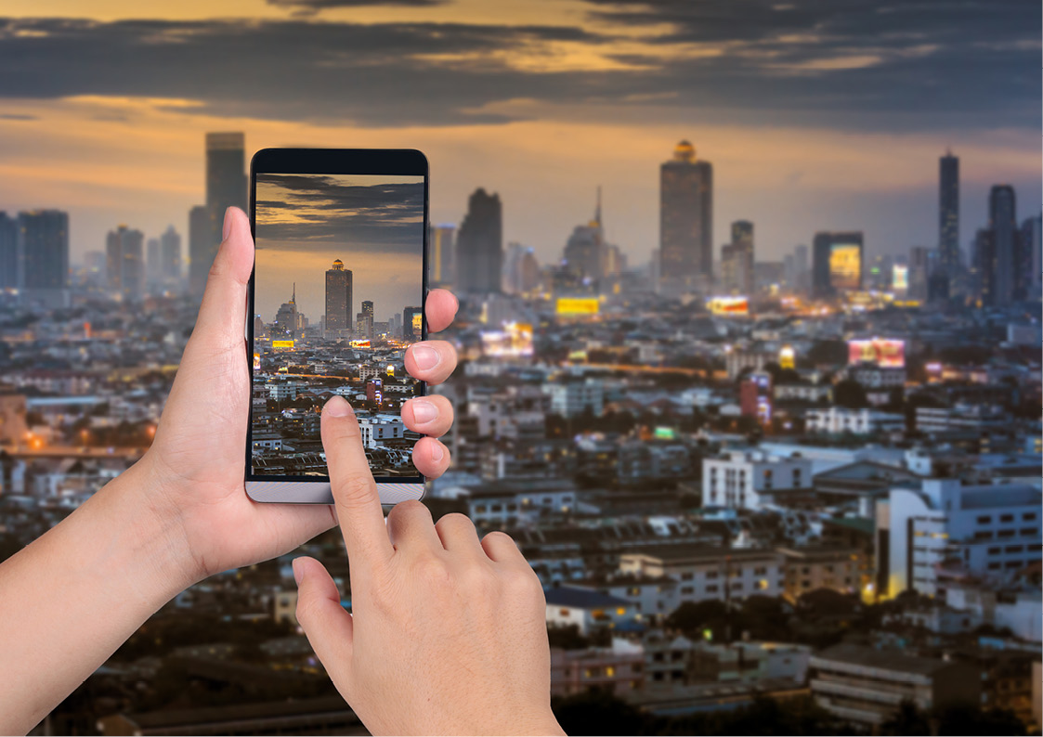
Smart sustainable cities
By reimagining the role of technology and connectivity in today’s cities, we’re not only addressing current challenges, but we’re creating countless smart and sustainable solutions built for the future.

Slide 7
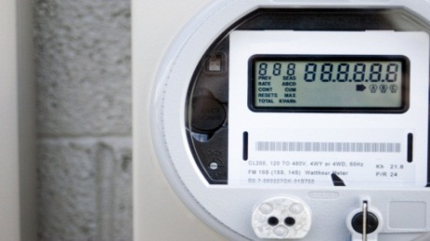
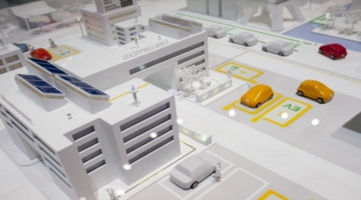
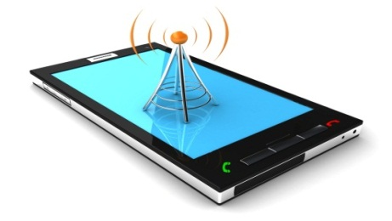
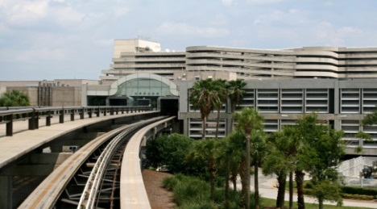
ICT as a Key Enabler for SSC
Smart Energy: Digital Management of Energy
Smart Buildings: Automated Intelligent Buildings
Smart Mobility: Intelligent Mobility
Smart Grids
Smart Meters
Intelligent Energy Storage
Building Automation
Intelligent Buildings: Advance d HVAC, Lighting Equipment
Low-emission Mobility
Integrated Mobility Solutions
Multimodal Transport
Smart Technology: Seamless Connectivity
Smart Infrastructure: Digital Management of Infrastructure*
Smart Healthcare: Intelligent Healthcare Technology
Broadband penetration rate of over 80%
Location Based Services, Augmented Reality, GPS enabled devices/ phones
Sensor Networks
Digital Water and Waste Management
Use of ehealth and mhealth systems
Intelligent and connected medical devices
Smart Security: Safe Cities
Smart Governance: Government-on-the-Go
Smart Citizen: Civic Digital Natives
Surveillance
Biometrics
Simulation modelling and crime prediction
C2 and response
e-Government
e-Education
Disaster Management Solutions
Use of Green Mobility Options
Smart Lifestyle Choices
Energy conscious
Note: *Infrastructure not included in other segments
Source: Frost & Sullivan analysis.
Notes:
Building Smart Sustainable Cities
Key Parameters that will define a Smart Sustainable City in 2020

Slide 8
Making Our Cities Smarter and More Sustainable

Slide 9
ICTs as a key enabler of SSC
ICTs allow for cooperation between urban leaders and make them better equipped to deploy smart sustainable city activities, introduce intuitive policies and prioritize technology-driven infrastructure upgrades in keeping with the SDGs.
The use of ICTs help to transform urban areas into safe, resilient, climate change resistant, ecologically resilient, inclusive and sustainable cities by upgrading existing urban infrastructures.
ICTs to facilitate knowledge transfer among national, sub-national, and local governments and other stakeholders to enhance effective urban planning and management using effective e-governance techniques.

Slide 10
Towards IoT-enabled smart sustainable cities
WHAT TO DO?
FROM
TO
Nurture ‘Open Data’ platforms that utilize ‘Smart Data’ as an asset in its own right
to create citizen-centric innovations
driven & managed in collaboration by smart city stakeholders
Closed & un-connected vertical silos of functionally-oriented service providers
Innovative and collaborative new models that connect these vertical silos
ENERGY
TELECOM
WATER
TRANSPORT
HEALTH
HOUSING
ECONOMY
POLICING
EDUCATION
WASTE
ENVIRO SVCS
SOCIAL SVCS
ENERGY
TELECOM
WATER
TRANSPORT
HEALTH
HOUSING
ECONOMY
POLICING
EDUCATION
WASTE
ENVIRO SVCS
SOCIAL SVCS
INFORMATION SHARING
GUIDING PRINCIPLES
INTEGRATION & CROSS-SECTOR COLLABORATION FOR USERS SERVICES
Visionary
Citizen-centric
Digital
Open
Collaborative
INTERCONNECTION OF SYSTEMS

Slide 11
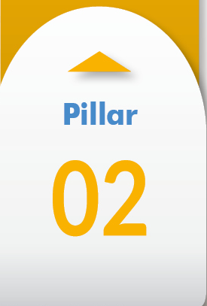
United for Smart Sustainable Cities (U4SSC)
Setting the Framework
WG
Urban planning
Policy, standards & regulation
Key performance indicators
U4SSC is a global platform for smart city stakeholders which advocates for public policy to encourage the use of ICTs to facilitate the transition to smart sustainable cities.
Connecting Cities and Communities
WG
Smart living
Smart mobility
Smart environment
JOIN us now!
Enhancing Innovation & Participation
WG
Smart governance
Smart people
Smart economy
1st meeting of U4SSC on 21-22 July 2016 Geneva, Switzerland

Slide 12
“Smart sustainable cities is a journey.
Not a final destination”.
Nasser Al Marzouqi,
Co-Chairman, of the U4SSC
Notes:
Cities will have to make a CHOICE today

Slide 13
Thank you!
More information http://itu.int/go/tsg20
http://www.itu.int/en/ITU-T/ssc
cristina.bueti@itu.int

