Slide 1
Joint Report on E-waste Management in Latin America Geneva, March 2015
The World Health Organization
Initiative on E-waste and Child Health
Latin America
Marie-Noël Bruné Drisse
Department of Public Health, Environmental and Social Determinants of Health
World Health Organization
Notes:
Note:
The agenda is at the end but may also be positioned in the beginning.
Slide 5 and 10 can be left out in order to shorten the presentation.

Slide 2
E-waste and child health
A systematic review led by WHO and WHO collaborating centres looking at health outcomes related to e-waste exposure, showed that increases in spontaneous abortions, stillbirths, and premature births, and reduced birth weights and birth lengths are associated with exposure to e-waste

Slide 3
E-waste and child health – Latin America
… contains various hazardous substances
Unsafe recycling techniques and landfilling are common in many countries.
Informal e-recycling is a frequent source of income.
Occupational and ecological exposures may pose significant health risks
Notes:
References:
Frazzoli C, Orisakwe OE, Dragone R & Mantovani A. 2010. Diagnostic health risk assessment of electronic waste on the general population in developing countries scenarios. Environmental Impact Assessment Review, 30: 388-399.
ILO. 2012. Working towards sustainable development: opportunities for decent work and social inclusion in a green economy / Green Jobs initiative. Geneva, International Labour Office (ILO).
Lundgren K. 2012. The global impact of e-waste: addressing the challenge . Geneva : Programme on Safety and Health at Work and the Environment (SafeWork), Sectoral Activities Department (SECTOR), Geneva, International Labour Office (ILO).
Photos: WHO

Slide 4
Child Health and E-Waste – Exposures Latin America
Child workers engaged in e-recycling
Secondary exposures
Home-based family workshops
Parental take-home exposures
Schools, homes, play areas near dump sites (that include e-waste)
Breastfeeding and transplacental exposures
Contaminated water and foods
In Uruguay: 24 % of children with blood lead levels higher to 5 mcg/dl – burning of cables in neighboring area
Notes:
References:
Lundgren K. 2012. The global impact of e-waste: addressing the challenge . Geneva : Programme on Safety and Health at Work and the Environment (SafeWork), Sectoral Activities Department (SECTOR), Geneva, International Labour Office (ILO).
Song Y, Wu N, Han J, Shen H, Tan Y, Ding G, Xiang J, Tao H & Jin S. 2011. Levels of PCDD/Fs and DL-PCBs in selected foods and estimated dietary intake for the local residents of Luqiao and Yuhang in Zhejiang, China. Chemosphere, 85:329–34.
World Health Organization (WHO). 2006. Environmental Health Criteria 237: Principles for evaluating health risks in children associated with exposure to chemicals. Geneva, World Health Organization (WHO).
Manhart A. 2007. Key social impacts of electronics production and WEEE-recycling in China. Freiburg, Germany, Öko-Institut e.V., Institut für angewandte Ökologie, Institute for Applied Ecology.
Photos: WHO

Slide 5
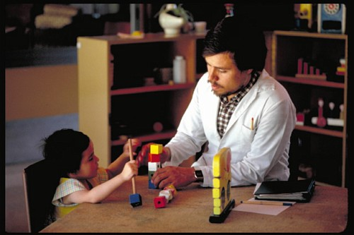
WHO & partners e-waste and child health initiative
WHO and partners have identified through an initial consultation (2013) urgent gaps
communicating the problem to health actors
developing training methods and tools for health professionals
identifying needs at local level
encouraging specific research about e-waste
gathering interested stakeholders to move this issue forward around interventions that can improve the health of those affected
Upcoming WHO/NIEHS e-waste and health workshop on next steps (August, Depok, Indonesia) Prevention Strategies to Reduce E-waste Exposure in Children

