Slide 1
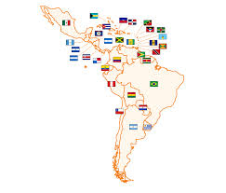


E-waste – Reverse Chain Consolidation
Latin America and Caribbean Integration
Sebastian Rovira
Vanda Scartezini

Slide 2
Agenda
Concepts
Goals
Diagnostic and Countries Strategy
Proposed Model
Public Impact
Expected Results
Indicators
Tentative Schedule

Slide 3
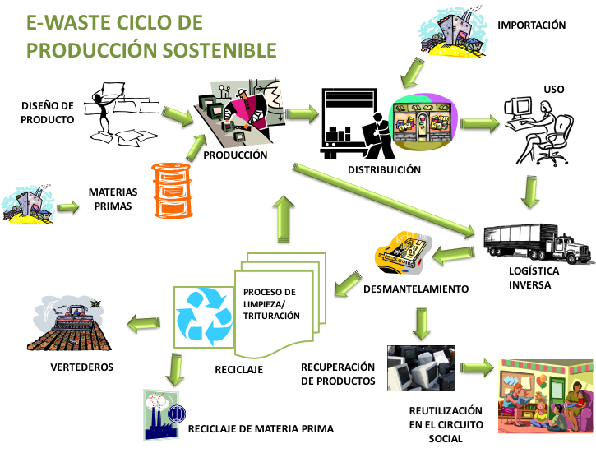
Reversed Chain

Slide 4
Concepts: New Development Reality
Collaborative work
Network model
Shared knowledge
Technology as a tool for social empowerment
Development with practical and sustainable results
Jobs and work opportunities

Slide 5
Projects Goals
E-waste
GENERAL: Technological Consolidation for E-waste in Latin America and Caribbean
SPECIFICS
Technologies development focused on recovering E-waste chemical elements
Process development focused on reducing human risks and promoting social inclusion with job and work (new opportunities).

Slide 6
Quick Diagnostic
LEGAL FRAMEWORK - Some countries have specific laws but few coordinate or collaborative actions. General need of capacitation in all levels.
HEALTH – lack of knowledge - High contamination - with mercury ; lead; arsenic; copper; chrome; nickel; Trichloroethylene – plastic burn.
ECONOMICS - waste of money – from 1 million mobile phones it is possible to get:
  16 tons of copper ~ US$ 47,720/ 350 kg of silver ~ US$ 191,245 / 34 kg of gold ~ US$ 1,340,755 / 15 kg of palladium ~ US$ 1,820,505
ENVIRONMENT - soil and water contamination
WORK - there are new opportunities for work at all levels in the E-waste chain .

Slide 7
Countries Strategies
Countries involved: Ar + Br+ Cl+ Co + Cr +Ec+ Dr+ Mx + Ni+ Pe+ Sv+ Uy+ Ve.
Although countries have laws on solid waste, few of them have laws related to E-waste.
Need to reinforce capabilities in every country.
Promote the interchange at academy and research level.
Interest in understanding the economy of E-waste reverse chain to identify how to promote new jobs and entrepreneurship.
focusing in recovering materials

Slide 8
Proposed Model
General
Coordination
Sub Projects
GENERAL PROJECTS
Legislation and Harmonization
Training and capacity building
Standards and Best Practices
Extern Consultant
Countries to join in the future

Slide 9














4. Model Proposed
CO
EC
Network extended
BR
DR
ES
AR
Results data base
E-learning courses
Coaching to companies
Pilot Plants …
MX
UY
NU
PE
CL
VE
Experts as Contractors
Main Coordination with Experts
New countries joining

Slide 10
…General Project
Hire Expert in the region (if possible) or elsewhere by calling for Expression of Interest. (EoI)
General Projects shall be just one for the whole region:
  Training and Capacity Building ( instruction Manuals to help SME to set up small productive plants ,e-learning courses, capacity building for multipliers etc.)
  Legislation & Harmonization (analysis and proposals for each country working with the local responsible. Regional harmonization proposal)
  Standards & Best Practices (compile, analysis, minimum basic group of standards proposal to each step in the e-waste reverse chain) + (detailed models for operation and management as a reference for countries and SMEs

Slide 11
…Sub-Projects
Projects by product - each sub Project shall be coordinated by one country with more technical knowledge related to the product. Other interested countries shall participate - web work and face to face meetings of short time will be the basis for Sub Projects development. List of products already agreed:
  CRT
  Mobile Phones
  Computers
  Tablets e Flat Screens
  Batteries
  Telecommunication’s equipment
  Sub Projects – Technology – focus on recovery strategic and valuable chemical elements.

Slide 12
….Sub-Projects Items
Each Sub-project shall have as deliverables the following:
Related to the product:
  Raw Materials, components y parties
  Production and Distribution
  Reverse Logistic
Related to process
  Identification of Technological Gaps
  Reverse manufacturing E-waste process
  Work with General Project to propose capacity building items to small and micro enterprises
Set up a Pilot Plant – Infrastructure and tools.
Commercialization .

Slide 13
5 – Public to be addressed
SME ( small and micro enterprises) allowing them to enter to the market and/or add value to their own business or even add another more profit activity.
Professionals interested in E-waste.
Lower social level people collecting waste in the streets, allowing them to enter into a formal market with better capacitation, also helping them to protect their own health.
NGOs both with technical or social focus that can join the projects.
Academy, offering new higher level courses creating a new turn of knowledge.
Governments getting benefits from the sector organization.
Private sector
The whole region when the Harmonization allows interchange of business in this sector..

Slide 14
...Impacts expected
E-waste
Technologic
Technology development, innovation and cooperation to solve common problems
Enviromental
Reducing environmental pollution and Human health risks
Social
Generation of new SMEs and new jobs, savings of energy, improving trade, reduce health expenditure.....
Economics
Improving job offer and work opportunities with focus on social inclusion – Reducing related diseases.

Slide 15
6 – Expected Results
E-waste reverse chain characterized for participating countries and basis for regional agreements established.
Technological gaps identified and solved – more balance knowledge among countries in this region . New knowledge improving economy.
Relevant technologies developed for companies, society and governments.
E-waste collection organized, classification and transportation under E-waste principles with promotion of private initiative and social inclusion.
New Technological and Economic opportunities for all actors under E-waste chain.
Management systems, models developed considering regional, environmental and traceability of e-waste.

Slide 17
Thank you!
sebastian.rovira@cepal.org

