Slide 1
1st global e-waste monitor and the specific situation in the Latin American Region
​​18:15 – 18:20 Opening Remarks - Chaesub Lee and Kees Baldé
18:20 – 18:35 E-waste Statistics – guidelines on classification, reporting and indicator - Kees Baldé, United Nations University​​
18:35 – 18:45 The 1st Global E-waste Monitor – Feng Wang, UNU
18:45 - 18:55 Questions & Answers
18:55 – 19:30 Joint Report on E-waste Management in Latin America Moderator Matthias Kern
Panelists: Cristina Bueti, Leila Devia, Sebastien Rovira, Irene Kitsara, Alfredo Cuevas
19:30 – 19:40 Question and answers
19:40 – 19:45 Closing remarks

Slide 2
E-waste Statistics – guidelines on classification, reporting and indicators co-authored by representatives of UNU, SBC, UNCTAD, ITU, Eurostat
Kees Baldé – balde [at] unu.edu
United Nations University

Slide 3
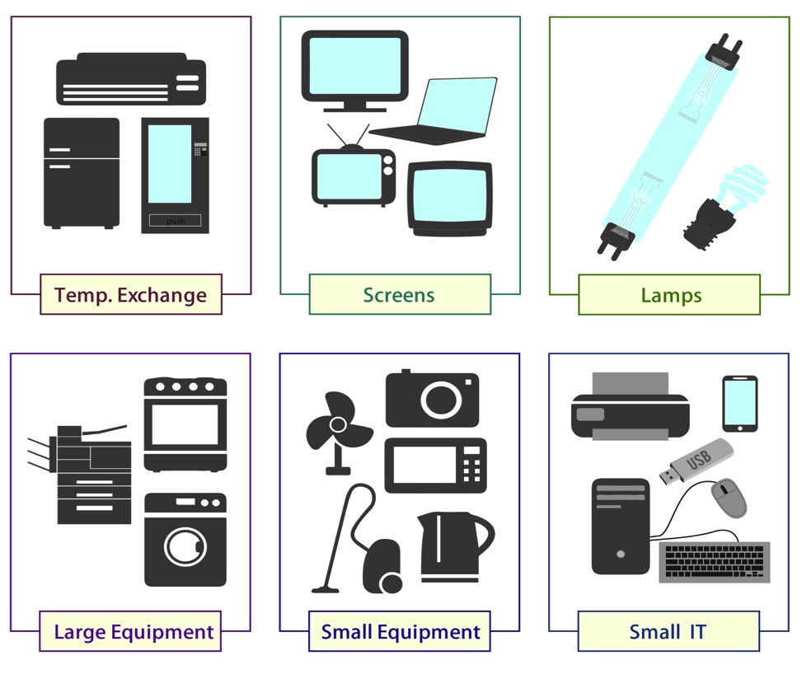
What is e-waste?
Conference of Parties - 2015 Geneva
11/05/2015

Slide 4
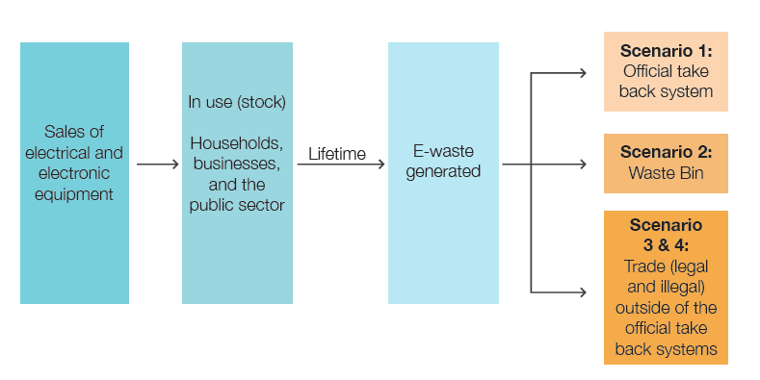
What happens with e-waste?
Conference of Parties - 2015 Geneva
11/05/2015

Slide 5
First harmonise scope with UNU KEYS
HS Trade codes
Uniform Average Weight
Official Statistics
Uniform Lifetimes
Harmonized Approach
Uniform Environmental Relevancy
UNU Keys (54)
WEEE Directive 2003 (10)
WEEE Dir. Recast 2012 (6)
Conference of Parties - 2015 Geneva
11/05/2015

Slide 6
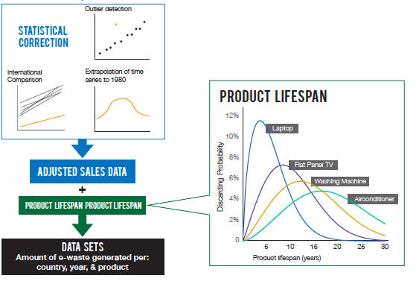
Calculate E-waste generated
Sales = apparent consumption approach
Trade data downloaded from UN Comtrade database
HS codes linked to UNU-KEYS
Conference of Parties - 2015 Geneva
11/05/2015

Slide 7
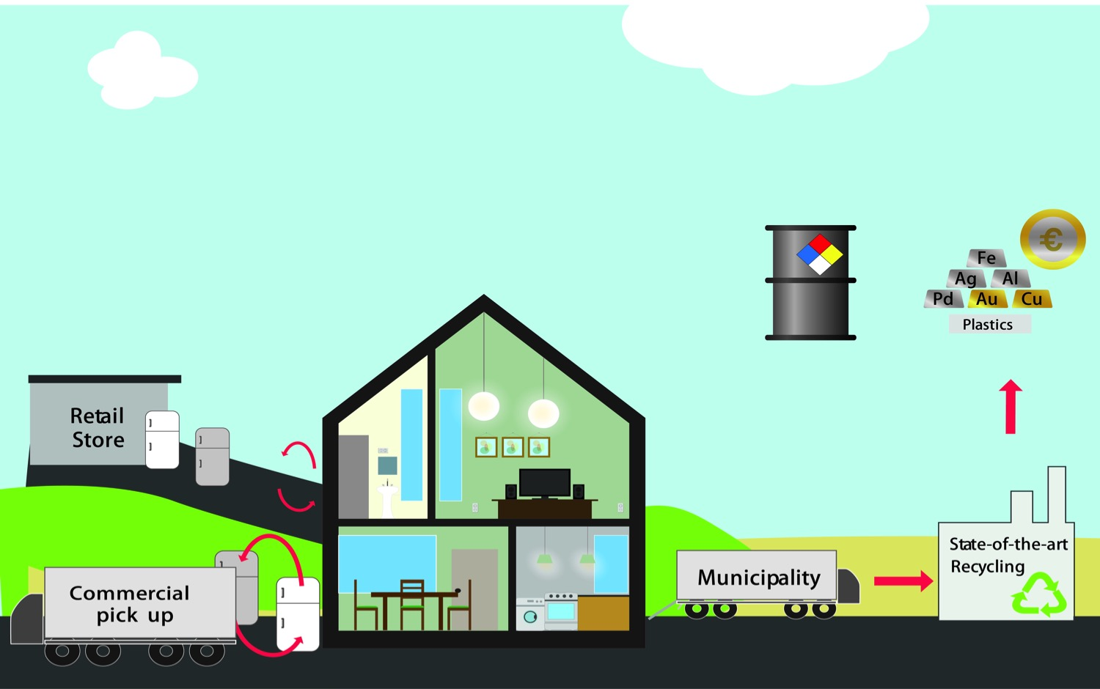
Scenario 1: Official collection

Slide 8
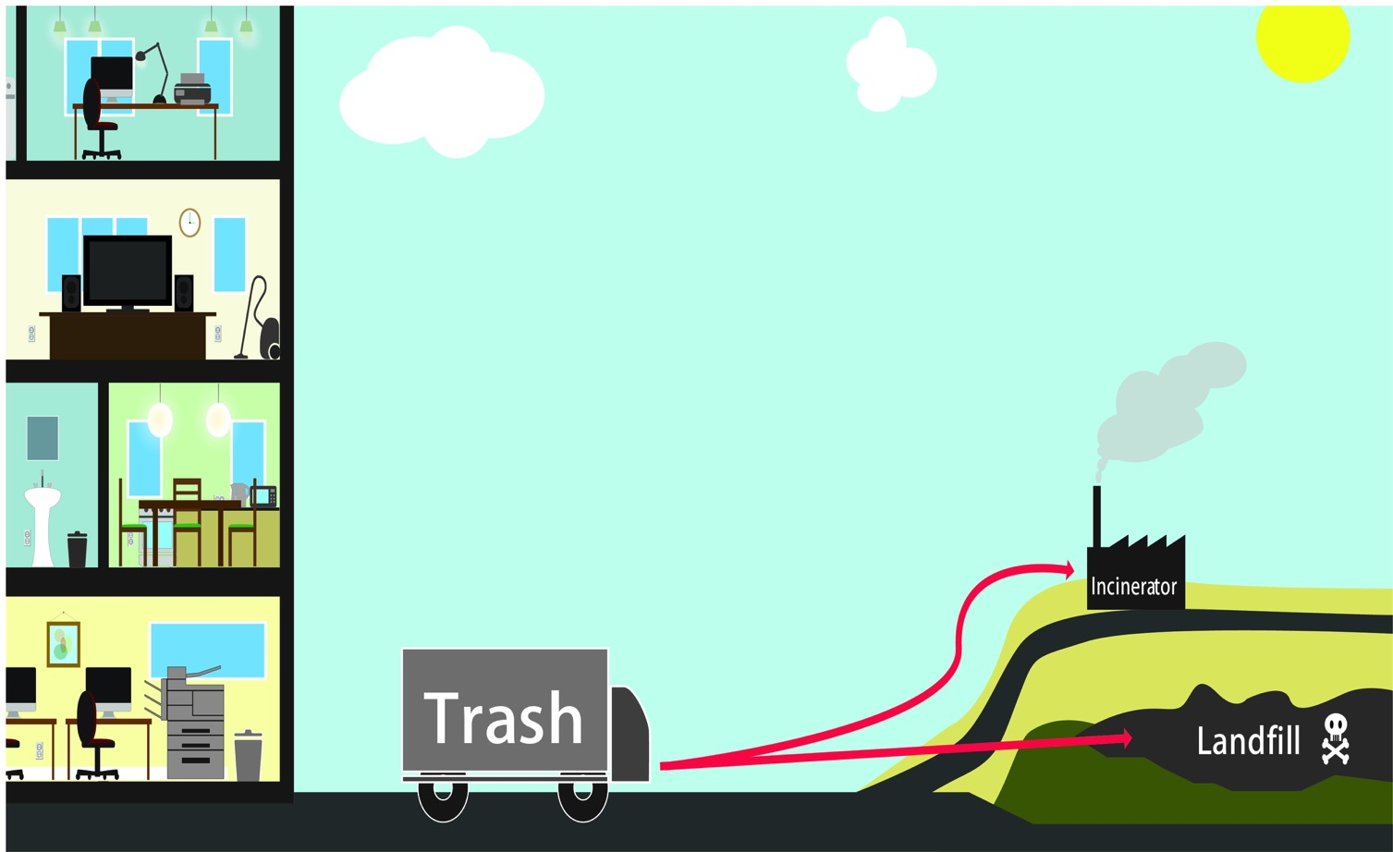
Scenario 2: E-waste in waste bin

Slide 9
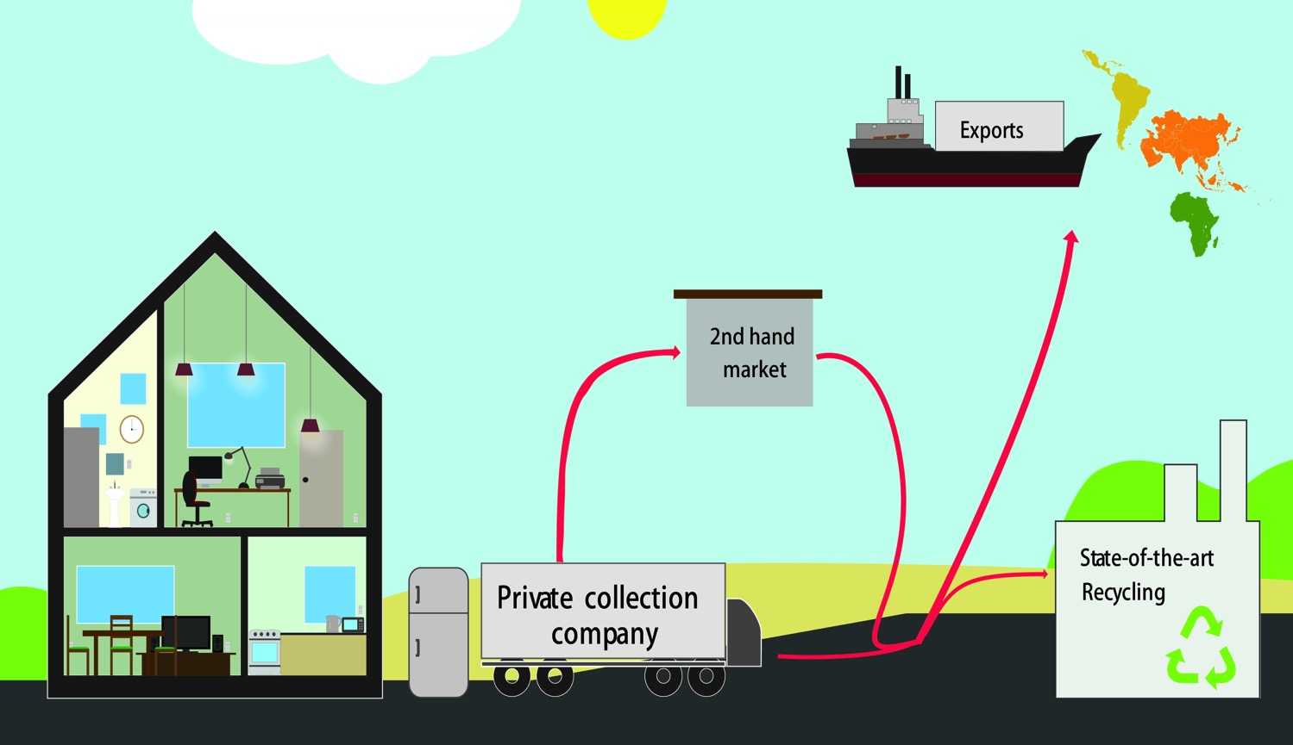
Scenario 3: collection outside official schemes in developed countries

Slide 10
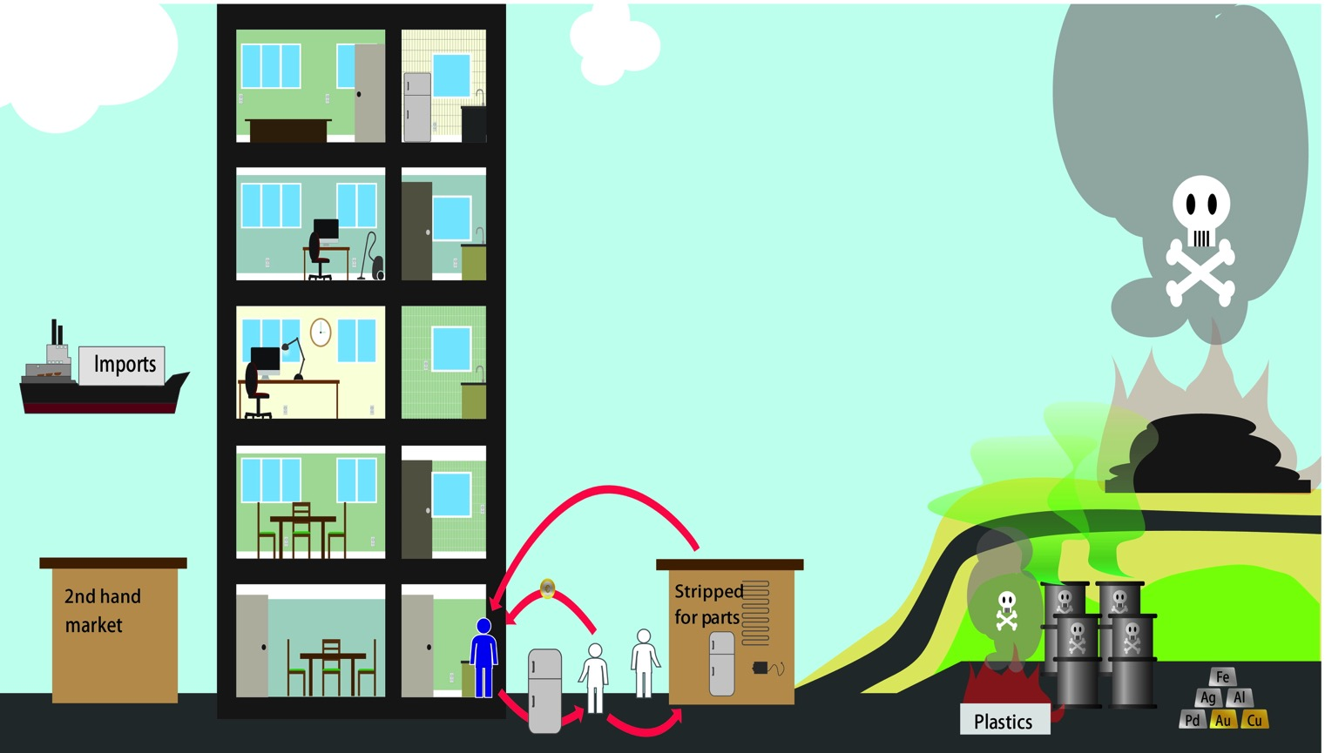
Scenario 4: Informal collection and recycling in developing countries

Slide 11
Indicators
Collection rate =
E-waste collection official take back / E-waste generated
Total Put on Market
(kg/inh)
Total E-waste generated
(kg/inh)
Conference of Parties - 2015 Geneva
11/05/2015

Slide 12
Methodology
Internationally recognized (by UN) statistical concepts
Co authored by representatives of UNU, SBC, UNCTAD, ITU, Eurostat
Guide countries to measure relevant parameters for e-waste
http://ias.unu.edu/en/research/e-waste-quantification.html#outputs
Conference of Parties - 2015 Geneva
11/05/2015

Slide 13
Outlook
2014-2015: EC and Eurostat
2015: Questionnaire with UNECE via statistical working parties
2015: Questionnaire with OECD via statistical working parties
2016: World wide data gathering with UNSD (Statistical Division)
Data gathering of e-waste via integration in their existing questionnaires (6 languages)
Title Presentation - Location
06/06/11

Slide 14
E-waste and Sustainable development goals
E-waste is mentioned twice in the SDG indicators
Quote:
“Target 11.6: By 2030, reduce the adverse per capita environmental impact of cities, including by paying special attention to air quality and municipal and other waste management
Proposed Indicator 1: Percentage of urban solid waste regularly collected and recycled (disaggregated by E-waste and non-E-waste)
Proposed Indicator 2: Level of ambient particulate matter (PM 10 and PM 2.5)
Target 12.5 By 2030, substantially reduce waste generation through prevention, reduction, recycling and reuse
Proposed Indicator 1: National waste generation (solid waste to landfill and incineration and disaggregated data for e-waste) in kg per capita/year
Proposed Indicator 2: National recycling rate, tonnes of material recycled “

Slide 15
Bad funding
Bad data
Bad information
Bad or no policies

Slide 16
Good funding
Good data
Good information
Better policies
Conference of Parties - 2015 Geneva
11/05/2015

Slide 17
The 1st Global E-waste Monitor

Slide 18
First global e-waste monitor
Feng Wang – fwang [at] unu.edu
Kees Baldé – balde [at] unu.edu
United Nations University

Slide 19
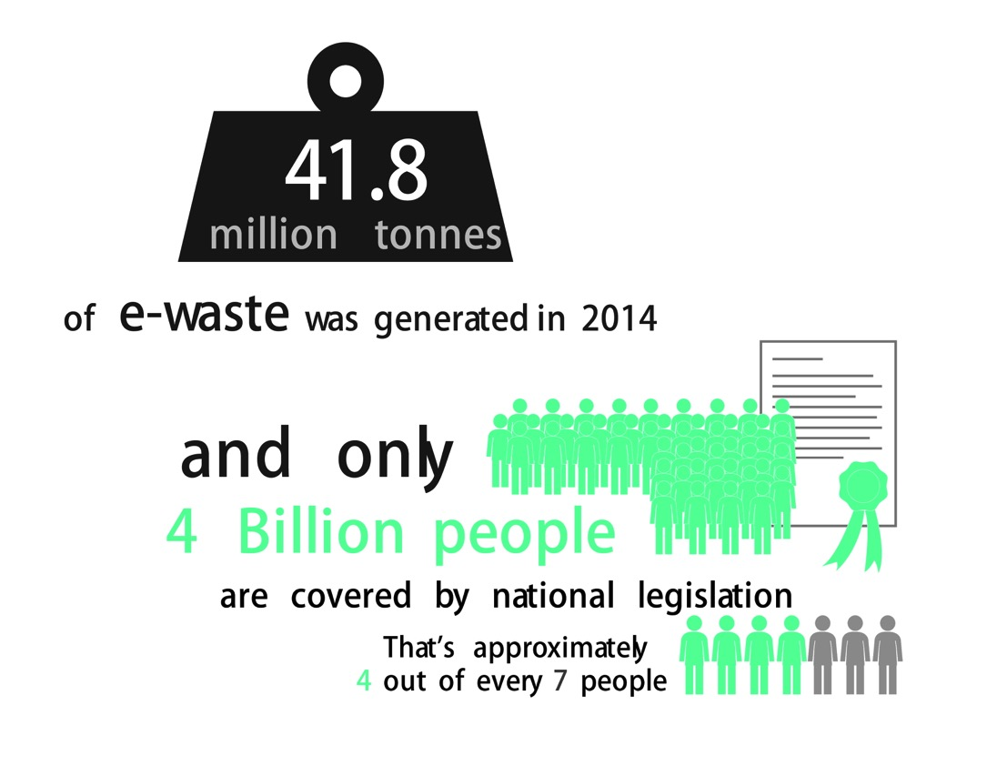
Whole world
Conference of Parties - 2015 Geneva
11/05/2015

Slide 20
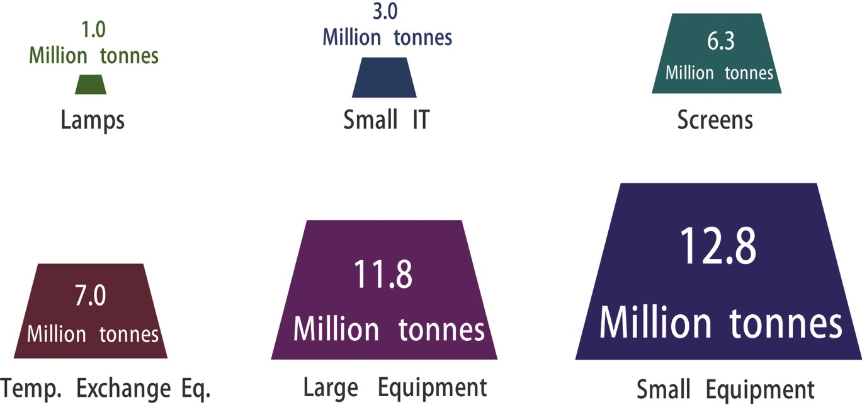
E-waste types
Conference of Parties - 2015 Geneva
11/05/2015

Slide 21
E-waste generation in 2014
Europe: 15.6 kg/inh
Asia: 3.7 kg/inh
Americas: 12.2 kg/inh
Africa: 1.7 kg/inh
Oceania: 15.2 kg/inh
< 5 kg/inh
5 to 10 kg/inh
10 to 15 kg/inh
>15 kg/inh
Conference of Parties - 2015 Geneva
11/05/2015

Slide 22
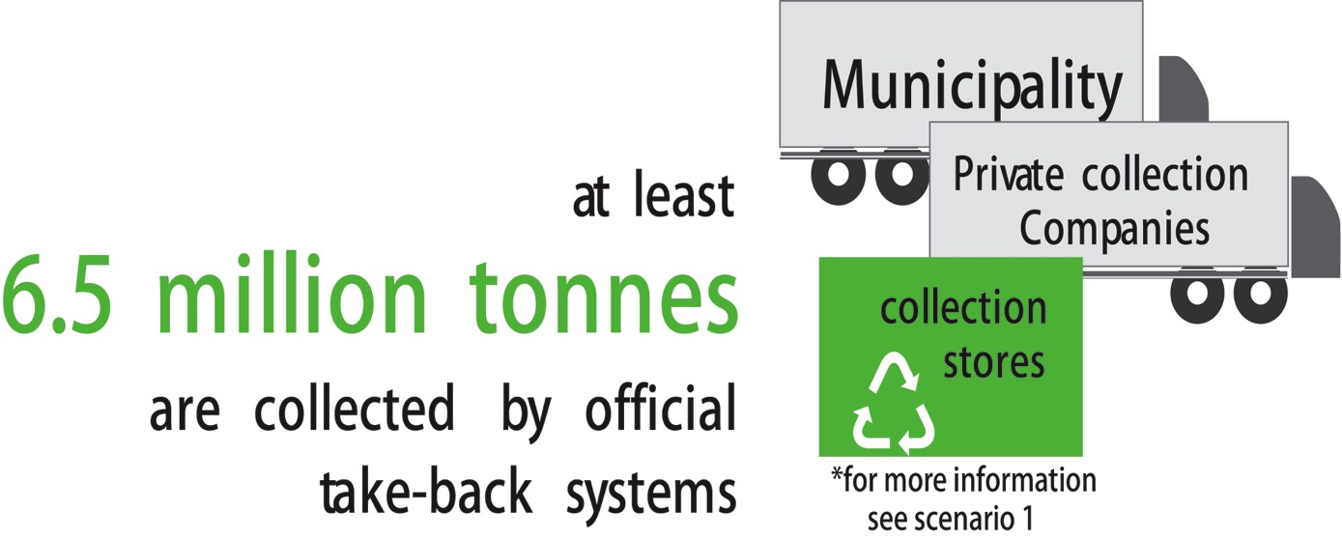
Official collection
Conference of Parties - 2015 Geneva
11/05/2015

Slide 23
Reported collection percentage of e-waste generated.
± 40%
± 12%
± 24%
± 28%
± 30%
± 1%
< 20 %
20-40 %
>40 %
Based on literature and gov. sources. EU is harmonized, but other countries are not yet (scope might differ)

Slide 24
Urban mine

Slide 25
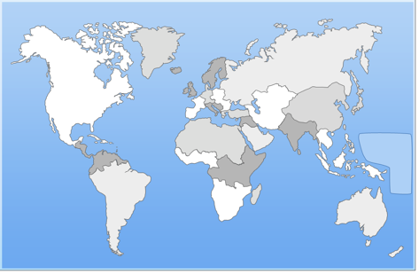
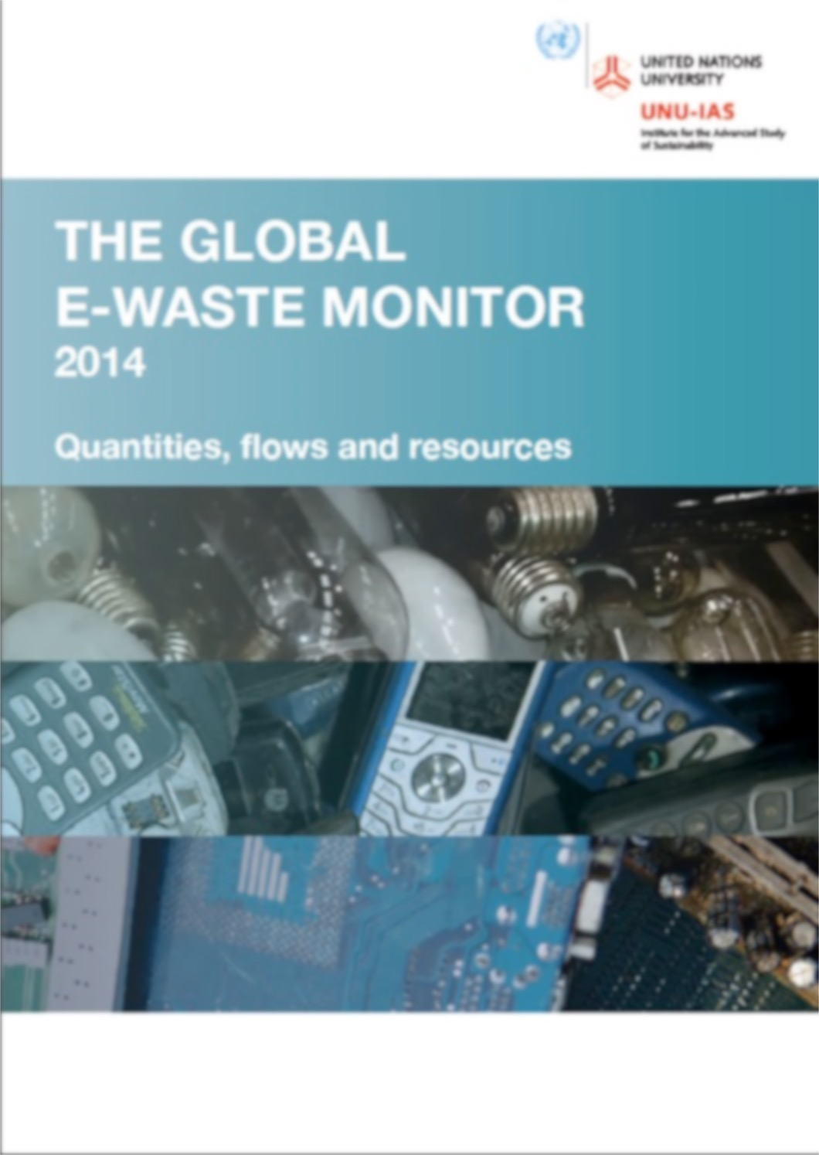
Output
http://www.step-initiative.org/index.php/WorldMap.html
Baldé, C.P., Wang, F. Kuehr, R., Huisman, J. (2015), The Global e-waste monitor – 2014, United Nations University, IAS-SCYCLE, Bonn, Germany
Conference of Parties - 2015 Geneva
11/05/2015

Slide 26
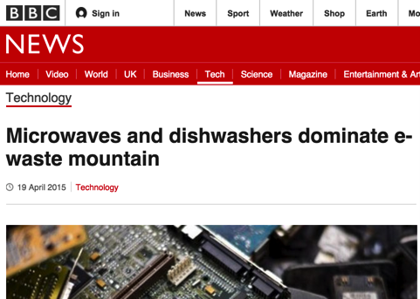
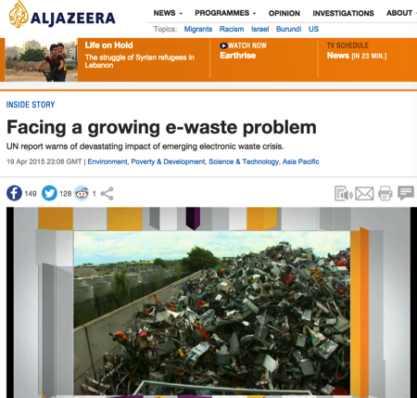
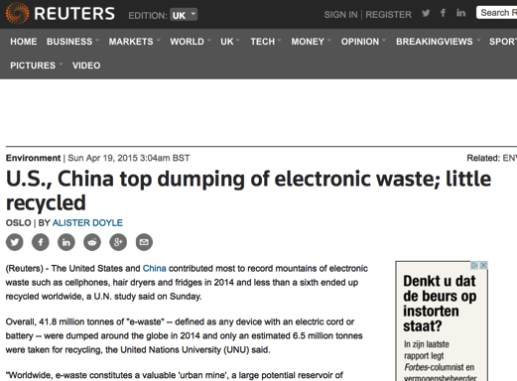
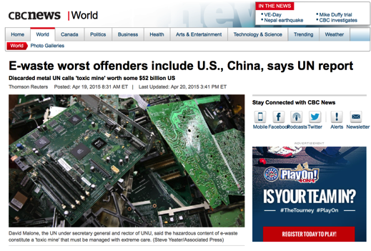
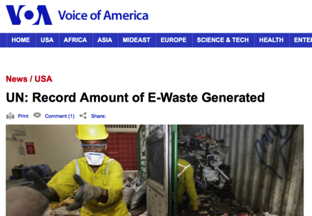
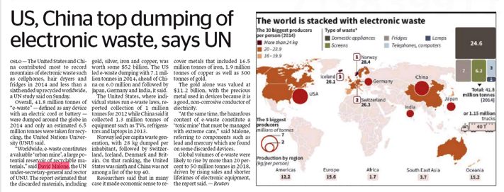
Press coverage
At least 84 countries, over 1000 news items, at least 34 languages
Including influential news sites: NDTV in India, TV – Al Jazeera, Nature, Daily Mail, Forbes, BBC, Deutsche Welle etc.

Slide 27
Conclusion
Unprecedented level of detailed knowledge of the world e-waste market
Breakdown into 54 types of e-waste types is available per country, but not published. Contact UNU if this data is needed
41.8 Mt of e-waste
48 billion euro of raw materials
At least 6.5 Mt is collected by official take back systems
At least 0.7 Mt of e-waste is discarded in the EU (5 to 10%)
Rest is unknown …
Conference of Parties - 2015 Geneva
11/05/2015

