Slide 1
Forum on Energy Efficiency and Future Network Infrastructure
Overview of ITU-T Study Group 5”- Environment and climate change
Paolo Gemma
Chairman of Working Party 3/5 of ITU-T Study Group 5

Slide 2
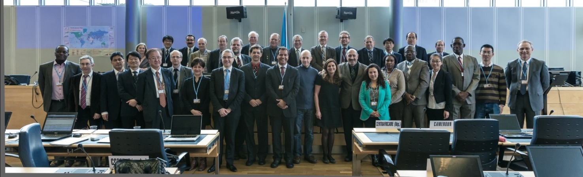
Forum on Energy Efficiency and Future Network Infrastructure
ITU-T Study Group 5
Mandate
Lead study group for:
environment and climate change;
electromagnetic compatibility and electromagnetic effects;
resistibility and grounding.

Slide 3
Forum on Energy Efficiency and Future Network Infrastructure
ITU-T Study Group 5
Structure
Question 12 Terminology
7 Questions
WP1/5
Damage prevention and safety
WP3/5
ICT and climate change
5 Questions
WP2/5
Electromagnetic fields: emission, immunity and human exposure
6 Questions
Notes:
3

Slide 4
Forum on Energy Efficiency and Future Network Infrastructure
Working Party 3/5: ICT and climate change
Work areas:
Q13/5 - Environmental impact reduction including e-waste
Q14/5 - Setting up a low cost sustainable telecommunication infrastructure for rural communications in developing countries
Q15/5 - ICTs and adaptation to the effects of climate change
Q16/5 - Leveraging and enhancing the ICT Environmental sustainability
Q17/5 - Energy efficiency for the ICT sector and harmonization of environmental standards
Q18/5 - Methodologies for the assessment of environmental impact of ICT
Q19/5 - Power feeding systems

Slide 5
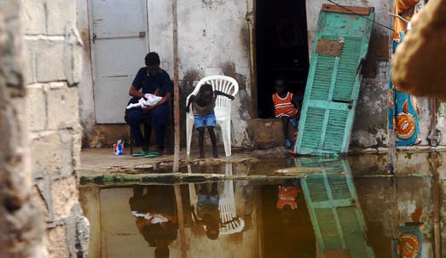
Forum on Energy Efficiency and Future Network Infrastructure
Highlights on deliverables
Climate change adaptation
New Recommendation ITU-T L.1500 - Framework for information and communication technologies (ICTs) and adaptation to the effects of climate change (consented)
Recommendation ITU-T L.1501 - on how countries can utilize ICTs to adapt to the effects of climate change (consented)
Recommendation ITU-T L.Infrastructure_Adaptation - on adapting the ICT infrastructure to the effects of climate change (under development)
Recommendation ITU-T L.Cities_Adaptation - on how ICTs can help cities to adapt to the effects of climate change (under development)
Notes:
Recommendation ITU-T L.1500 describes a framework for information and communication technologies (ICTs) and adaptation to the effects of climate change. This framework identifies and defines the basis for development of the following Recommendations:
Recommendation ITU-T L.1501 on how countries can utilize ICTs to adapt to the effects of climate change. It will also provide a framework and a checklist for countries to integrate ICTs into their national strategies for adaptation to climate change. Examples of checklists, use- cases, best practices, guidelines, consideration points, etc will be added when appropriate.
Recommendation ITU-T L.Infrastructure_Adaptation on adapting the ICT infrastructure to the effects of climate change. It will provide a set of guidelines, requirements and best practices to be referred to during operation, maintenance, upgrade and improvement of existing ICT infrastructure and when planning, designing and constructing ICT projects, goods, networks and services to adapt to the effects of climate change. Examples of checklists, use- cases, best practices, guidelines, consideration points, etc will be added when appropriate.
Recommendation ITU-T L. Cities_Adaptation on how ICTs can help cities to adapt to the effects of climate change. It will also provide a framework and a checklist to assist municipal authorities in the implementation of ICT-based solutions in cities’ climate change adaptation strategies. Examples of checklists, use- cases, best practices, guidelines, consideration points, etc will be added when appropriate.

Slide 6
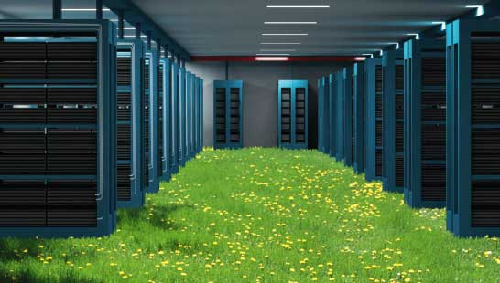
For example, applying best practices to cooling could reduce the energy consumption of a typical data centre by more than 50%.
Forum on Energy Efficiency and Future Network Infrastructure
Highlights on deliverables
Best practices for green data centres
Recommendation ITU-T L.1300rev
Best practices related to optimum design and construction;
Efficient use and management of data centres, taking into account both power and cooling equipment.
Notes:
Recommendation ITU-T L.1300rev - Best practices for green data centers
Recommendation ITU-T L.1310rev - Energy efficiency metrics and measurement for TLC equipment
Recommendation ITU-T L.1320 - Energy efficiency metrics and measurement for power and cooling equipment for telecommunications and data centres
Recommendation ITU-T L.1340 - Informative values on the energy efficiency of telecommunication equipment
Recommendation ITU-T L.1300 describes best practices aimed at reducing the negative impact of data centres on the climate. It is commonly recognized that data centres will have an ever-increasing impact on the environment in the future. The application of the best practices defined in this Recommendation can help owners and managers to build future data centres, or improve existing ones, to operate in an environmentally responsible manner. Such considerations will strongly contribute to a reduction in the impact of the information and communication technology (ICT) sector on climate change.
The application of the best practices defined in this Recommendation can therefore help owners and managers to build future data centres, or improve existing ones, to operate in an environmentally responsible manner.
For example, applying best practices to cooling could reduce the energy consumption of a typical data centre by more than 50 per cent.

Slide 7
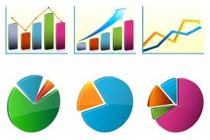
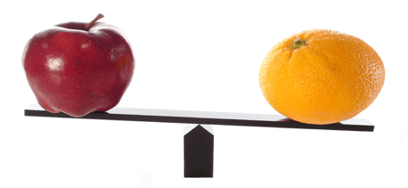
Forum on Energy Efficiency and Future Network Infrastructure
Highlights on deliverables
Energy efficiency measurement
Recommendation ITU-T L.1310rev
Metrics and measurement methods defined for broadband wireline/wireless equipment and small networking devices
These metrics allow for comparisons of equipment within the same class (e.g. equipment using the same technologies)
Notes:
Recommendation ITU-T L.1300rev - Best practices for green data centers
Recommendation ITU-T L.1310rev - Energy efficiency metrics and measurement for TLC equipment
Recommendation ITU-T L.1320 - Energy efficiency metrics and measurement for power and cooling equipment for telecommunications and data centres
Recommendation ITU-T L.1340 - Informative values on the energy efficiency of telecommunication equipment
Recommendation ITU-T L.1310 contains the definition of energy efficiency metrics test procedures, methodologies and measurement profiles required to assess the energy efficiency of telecommunication equipment.
Metrics and measurement methods are defined for telecommunication network equipment and small networking equipment.
These metrics allow for comparisons of equipment within the same class e.g. equipment using the same technologies.
Comparisons of equipment in different classes are out of the scope of this Recommendation.
Benefits:
Understand the evolution of network in term of efficiency
Compare different solution of the same technologies

Slide 8
Forum on Energy Efficiency and Future Network Infrastructure
Highlights on deliverables
Common set of methodologies for the environmental assessment of ICT
Without, it will be impossible to provide meaningful comparisons
Helps to establish the business case to go green
Developed in cooperation with UNFCCC, ETSI, EC and over 40 other organizations, etc..
Notes:
These methodologies aim at providing accurate and reliable tools for assessing the environmental impact, which will generate statistics that governments and regulators can rely on to gauge the benefits that green ICTs can achieve for social and economic welfare.

Slide 9
Forum on Energy Efficiency and Future Network Infrastructure
Highlights on deliverables
Power Feeding Systems
Recommendation ITU-T L.1200 specifies direct current power feeding with interface direct current 260V to 400V at the power input to ICT equipment which can offer many potential benefits:
simple power chain
low maintenance
modularity and power scalability
high reliability
high energy efficiency (gain of 5 to 20% energy consumption compared to different existing best in class powering solutions)
low cost at same performance level
Notes:
Recommendation ITU-T L.1200
This Recommendation specifies a LVDC current interface at the power input of ICT equipment obtained from a power source of up to 400 Volts (260-400VDC voltage range) , which allows higher energy efficiency and reliability than can be achieved using low voltage power feeding solutions. The recommendation defines a power feeding system applicable to ICT equipment compliant with L.1200 in locations equipped with these power sources such as: telecommunication centres; radio base stations; data centres; and customer premises.
Additionally, the LVDC interface will simplify the use of renewable energy sources producing LVDC output such as photovoltaic generators or some fuel cell systems.
A gain of 5 up to 20% of energy consumption has been assessed and measured in existing sites by several certified experiments compared to existing powering solutions.

Slide 10
Forum on Energy Efficiency and Future Network Infrastructure
ITU-T and Climate Change itu.int/ITU-T/climatechange
ITU-T Study Group 5 itu.int/en/ITU-T/studygroups/2013-2016/05/Pages/default.aspx
Symposia & Events on ICTs and Climate Change itu.int/ITU-T/worksem/climatechange
Thank you
tsbsg5@itu.int

