Slide 1
ITU-UNESCO:IOC-WMO Joint Task Force on SMART Submarine Cable Systems
Nigel Bayliff C.Eng, FIET
Chair, Publicity, Outreach & Marketing, JTF
Managing Director, SIN Medida Consultancy
nigel@sinmedida.com
http://www.itu.int/en/ITU-T/climatechange/task-force-sc/Pages/default.aspx
5th Workshop, Broad Industry Perspective

Slide 2
Reflection: Establishing the JTF
The International Telecommunication Union (ITU), World Meteorological Organization (WMO) and UNESCO Intergovernmental Oceanographic Commission (IOC) organized the 1st Workshop on Using Submarine Telecommunications Cables for Ocean and Climate Monitoring and Disaster Warning in September 2011, in Rome, Italy.
This workshop closed with the adoption of a Call to Action inviting ITU, UNESCO IOC and WMO to establish and coordinate a Joint Task Force (JTF):
Serious Charter “To develop trans-ocean mini observatories to measure seafloor temperatures and hazards over several decades”
Notes:
As part of the Green Standards Week (Rome, Italy, 5-9 September 2011), ITU together with the Intergovernmental Oceanographic Commission of UNESCO and the World Meteorological Organization (WMO) organized a workshop on “Submarine Cables for Ocean/Climate Monitoring and Disaster Warning: Science, Engineering, Business and Law” on 8-9 September.
The workshop successfully brought together major experts from different communities involved in this issue. Scientists, engineers, telecommunication companies and legal experts gathered in Rome to share views and further explore business and legal opportunities, foster research of new technologies and envisage standards for engineering feasibility towards the development of a submarine cables climate monitoring and disaster warning system.
The workshop closed with the adoption of a Call to Action inviting ITU, UNESCO/IOC and WMO to establish and coordinate a Joint Task Force composed of world renowned experts from science, engineering, business and law to further investigate the issue.

Slide 3
Why Submarine Cables: Future trends in the industry
Drivers: Global population growth ever increasing demand for connectivity
Technology: Ongoing surge in ICT developments, use of Internet and progression of subsea technology….
Geographic connectivity: Wider geographic cable coverage throughout the oceans is necessary and being expanded
Anticipate continued demand for additional connectivity and increasing capacity demand
Notes:
Many are still being built = ideal ‘carrier’ in the right place

Slide 4
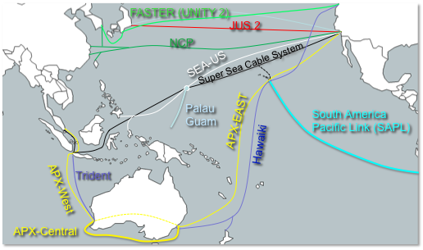
The Pacific – Example of increasing demand for connectivity and capacity
An array of new cable systems, both proposed and being implemented
Notes:
Cables have very variable development paths and several recently announced that had been moving very slowly or stalled. How do we become integrated with this process – offering potentially valuable capital and operational funding in return for inclusion of sensors/micro-observatories.

Slide 5
Challenges: Money, money & money?
Permitting: appears to be a universal fear – pre-application validation may be a worthwhile exercise – insulating cable developers from potentially disrupting their own applications
Money
Technology/Capability: Whilst internally integrated inclusion of sensors may require significant development effort, the majority/all vendors could provide branched connectivity with some innovative modification of their standard products
Money
Construction & Operation: Capital contribution expected, operating costs are also a concern.
Money
Notes:
Questions to representatives:
What would have to happen for your organisation to sponsor or allow sensors on your cables

Slide 6
Facilitators: encouraging signs
Corporate Social Responsibility: many carriers are climate-considerate and look for ways to give back
general committment
Global Organisation: Content providers, carriers and connectors are interacting with government and NGOs globally – subjects include Climate
potentially useful
Funding Study Output: Various monies may be available through global agencies for climate monitoring advancement
potentially useful

Slide 7
Submission of Liaison Statement to SG15
In seeking to achieve its objectives, JTF submitted a liaison to SG15:
Incorporate into the general framework of submarine cable system recommendations: allowing cable owners and suppliers to have access to a common reference document
Technical Specification: making freely available the typical requirements of potential data users from such equipped systems
Seek comment and suggestion from SG15: helping the industry players to formulate their plans behind a single definition and set of user requirements

