Slide 1
5th Workshop on "SMART Cable Systems: Latest Developments and Designing the Wet Demonstrator Project"
(Dubai, UAE, 17-18 April 2016)
EMSO,
a long term European commitment
for long term seafloor and water column monitoring:
programmatic progress as pertains to JTF
Jean-François Rolin
Ifremer , EMSO and ESONET Vi
jrolin@Ifremer.fr
on behalf of the EMSO Consortium and ESONET Vi network

Slide 2
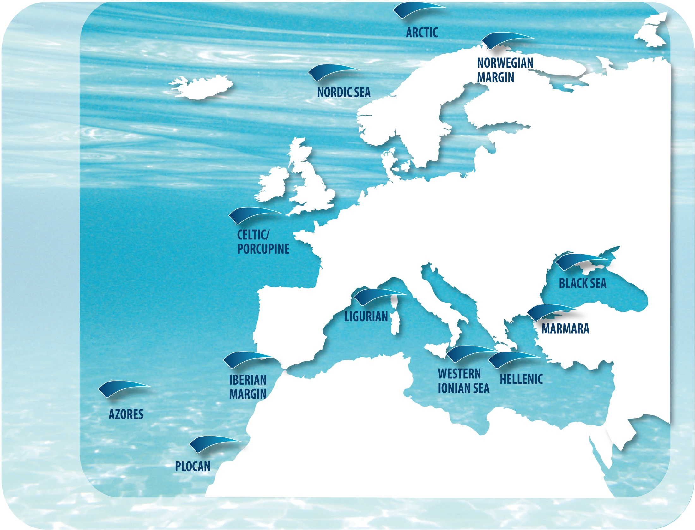




EMSO
European Multidisciplinary Seafloor and Water-Column Observatory
on behalf of the EMSO Consortium and ESONET Vi network
Notes:
Changes highlighted in red

Slide 3
EMSO European Research Infrastructure Consortium,
a company according to European law, established in 2016
EMSO is the European Research Infrastructure of
fixed seafloor and water column observatories constituting a distributed infrastructure for long-term monitoring of marine environmental processes

Slide 4

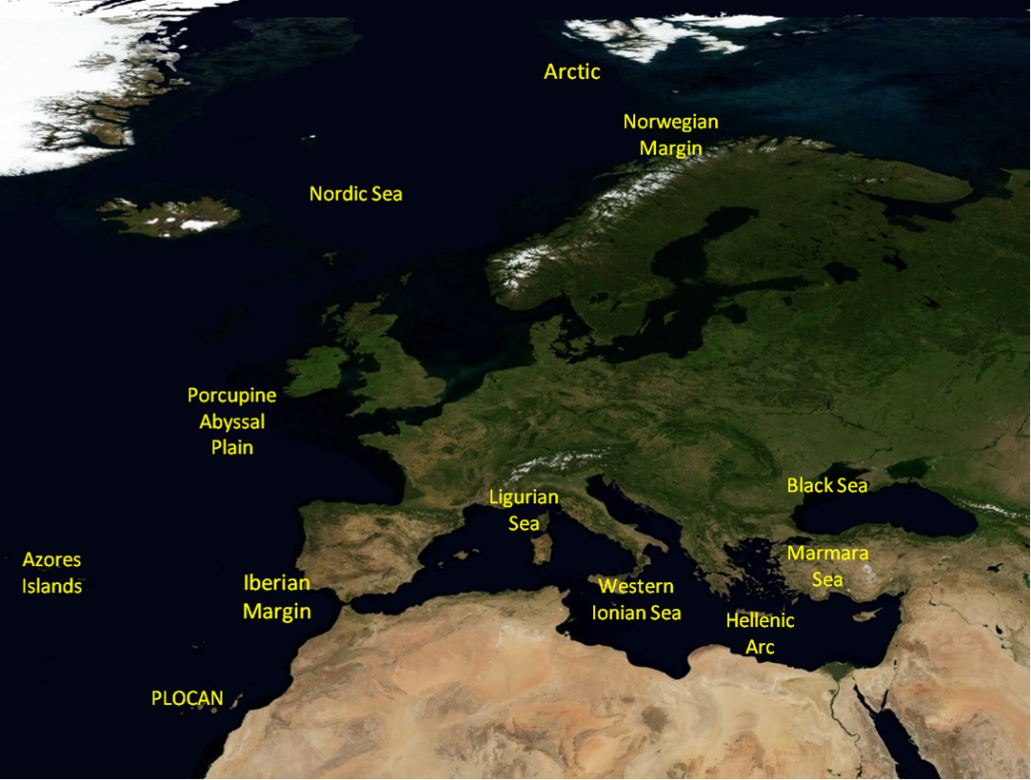
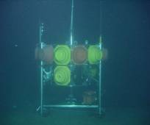
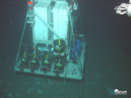
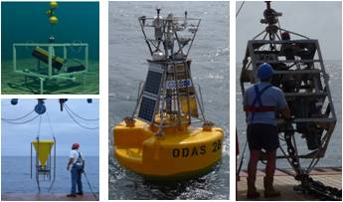

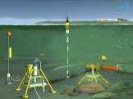
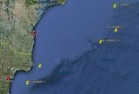
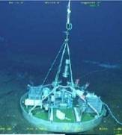
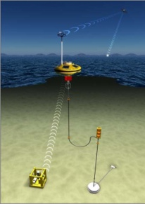
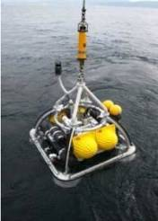

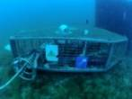
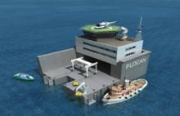
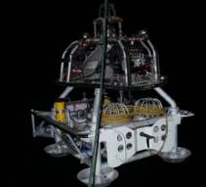
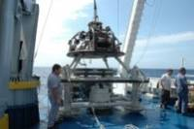
EMSO nodes
Koljö Fjord
SmartBay
Molène
OBSEA
test sites
nodes
Notes:
Add slide on data infrastructure ?

Slide 5


EMSO-ERIC and JTF
  EMSO and ESONET Vi supported the creation of the Joint Task Force (2011) and participated to some of the reference documents
  EMSO interim office sent a formal letter of support to JTF Smart subsea cable plan
  Common interest in a wide distribution of generic instruments on the seafloor : spatial complementarity
  Support of establishing common standards and participate to R&D
  Will to participate to the prototyping and testing phase
Notes:
Missing concepts: could not the international dimension and relation with counterpart RI (OOI, DONET, etc..) be seen as an added value ?

Slide 6
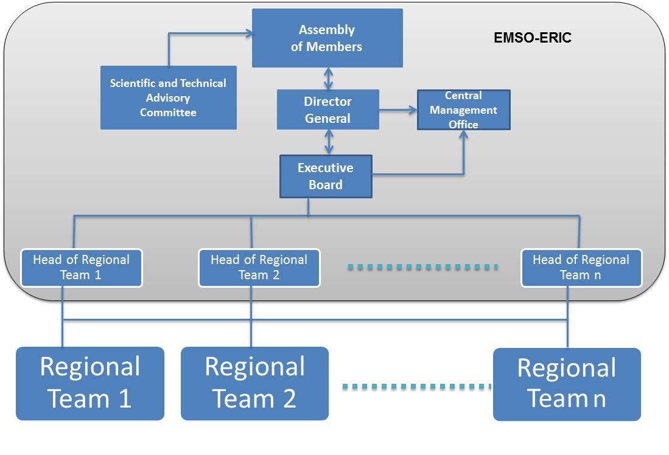













EMSO Governance
ESONET-Vi
EMSO-ERIC will:
  Establish agreements with equipment/facility owners such as JTF Smart cables partners
  Stimulate user group ESONET Vi
  (training, exchange, conferences on time series,…)
Executive Board
………………………………….
Head of Regional Team 1
Head of Regional Team 2
Head of Service
Engineering Service
Science Service
ERIC EMSO
in May 2016
ERIC EMSO
Later on in 2016
Esonet Vi institutes will join
through their countries in
the coming years.
Notes:
Note for Paolo: to mention the multidisciplinary and interdisciplinary nature of the STAC: Geosciences, Physicsal Oceanographys, Biogeochemistry, Marine Ecology, Data and Analysis tools

Slide 7
Also partly addressed by

Slide 8
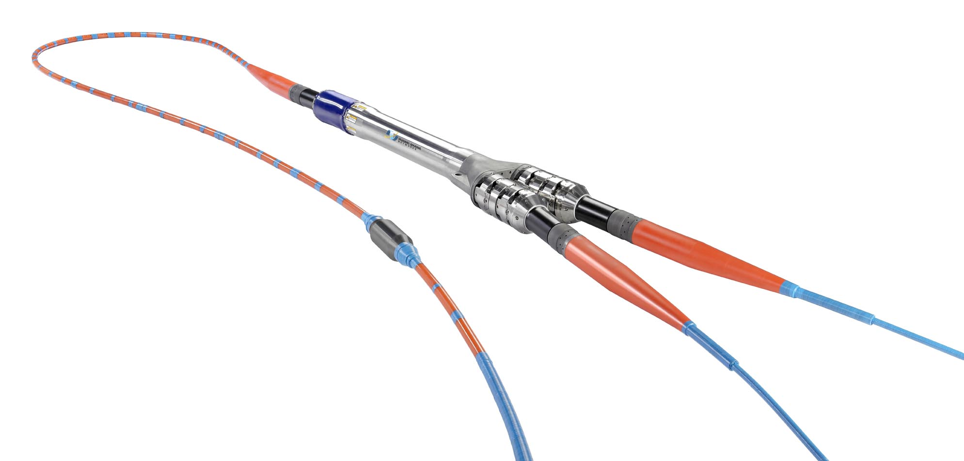
Common objectives/common technologies?
All EMSO nodes (cabled or not) will potentially have an
EMSO Generic Instrumentation Module (EGIM)s
Salinity
Dissolved oxygen
Turbidity
Ocean currents
Passive acoustics
Temperature
Precise pressure
options:
Seismics
Fluorescence
Camera
Temperature
Precise pressure
Seismics
All subsea repeaters will potentially
have a SMART cable device
Built by EMSODEV project in 2016

Slide 9
Common objectives/common technologies?
All EMSO nodes (cabled or not) will potentially have an
EMSO Generic Instrumentation Module (EGIM)
Salinity
Dissolved oxygen
Turbidity
Ocean currents
Passive acoustics
Temperature
Precise pressure
options:
Seismics
Fluorescence
Camera
Temperature
Precise pressure
Seismics
All subsea repeaters will potentially
have a SMART cable device
Built by EMSODEV project in 2016

Slide 10
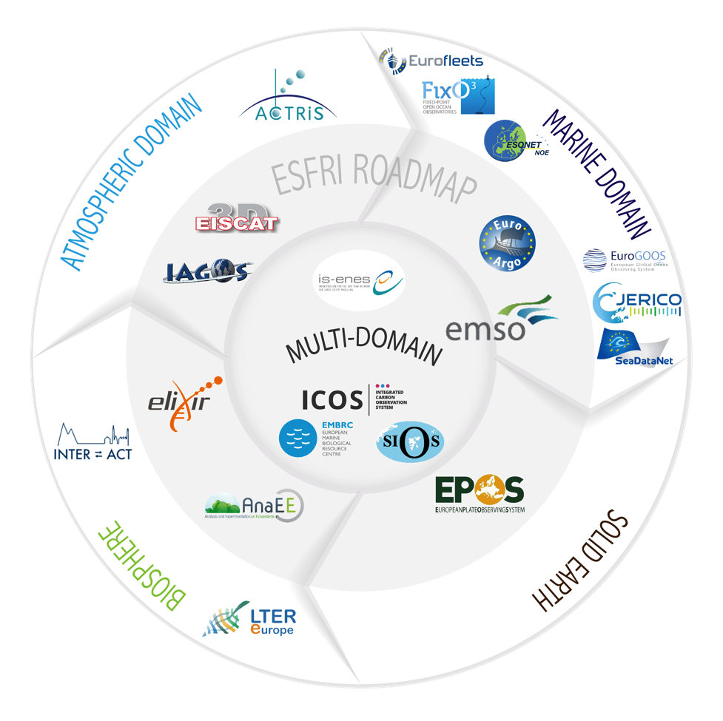

Environment Research Infrastructures in Europe

Slide 11
Environment Research Infrastructures in Europe
Coordinate and mobilize
for JTF

Slide 12
Choice and operation of seafloor seismometers according to the same requirements and data management
Improve spatial coverage of seismic recording thanks to the JTF SMART SuBsea Cable systems – For instance case study for southern Europe
Validate innovative instruments (MEMS, Fiber optics) , 10km extensions on FO with power over fiber,…

Slide 13
Can we coordinate data management choices?
Establishing data flow ...
In-situ Observation
Products from elaborated data
Data on follow up of instrumentation (sensor registry, sensor types qualification, calibration,…)
Log book of sea operations (deployment, repair,…) with precise positionning
Real time data received (decoding for sensor web enablement, decoding for cybersecurity, control, alerts,…)
Real time data dissemination (ftp, web) according to international recognized procedures
Quality control (automated or expert driven) and diffusion of qualified data (web)
Constitution of elaborated datasets either according to routine procedures or (operational oceanography, operational tsunami warning, operational seismic monitoring)
or specific : for scientific teams.
Archiving and publication of datasets, allocation of DOI according to a common policy of JTF
Visualisation, Maps, ...
Very long term archiving, security and interoperability of data throughout datacenters.
An R&D use case in ENVRIPLUS?
Ifremer Carval

Slide 14
Could we address the cyber-security concerns of the instrumentation system?
Confidentiality: Data is unreadable to unauthorized entities (even channel hosts).
Authenticity: Data should be generated by the correct/expected entities.
Integrity: Data should not be modified by unauthorized entities (even channel hosts).
Availability: Live data should be available, along with the archive.
Blocking: Should authorities be enabled to stop data transfer at any point of time?
ENVRIPLUS-ENSTABr

Slide 15

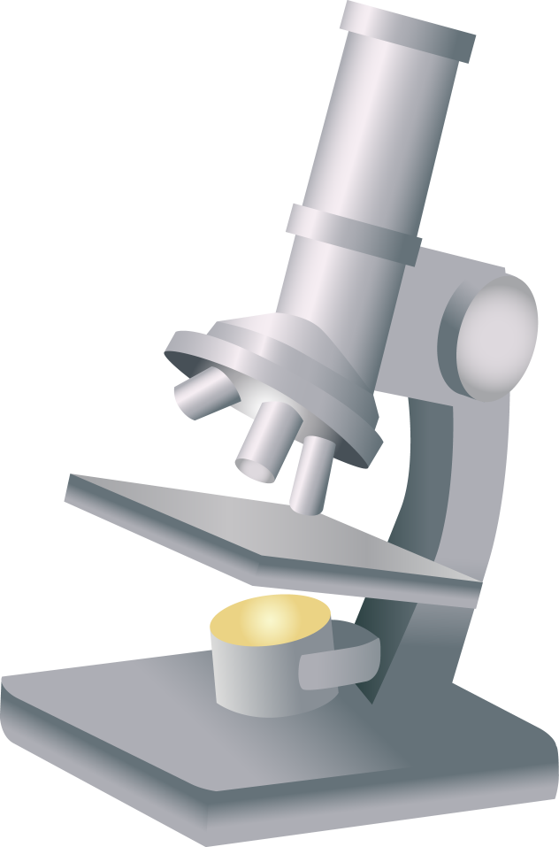
Security Concerns for the submarine cable systems
Sensors
S₁
S_{i}
S_{n}
Attacks
Attacks
Attacks
Cable End 1
Cable end 2
R₁
R_{i}
R_{n}
Subsea cable consortium
SDM
Scientific and operational environment data bases
SDM = Smart Cable
Data Management
ENVRIPLUS-ENSTABr

Slide 16
Security Concerns for the submarine cable systems
Sensors
S₁
S_{i}
S_{n}
Encoding/Decoding
functions f₁ … f_{n}
Security Boxes
(B₁ … B_{n}) added
B₁
B_{i}
B_{n}
Encoding/Decoding
function F
Port Boxes (P)
added
P
P
P
Cable End 1
Cable end 2
R₁
R_{i}
R_{n}
Subseacable consortium
SDM
Scientific and operational environment data bases
Encoding/Decoding
function F
Security Boxes
(B₁ … B_{n}) added
B₁
B_{i}
B_{n}
Encoding/Decoding
functions f₁ … f_{n}
SDM = Smart Cable
Data Management
ENVRIPLUS-ENSTABr

Slide 17
EMSO ERIC and connected EC funded projects may help JTF develop Smart SubSea Cable Systems.
EMSO ERIC infrastructures may be useful for the testing or the demonstration phase
(testing components, burial effect on sensors, thermal bias,…)
Paul Gaughan (EMSO/MI) will present a talk and open the discussion tomorrow in session 7

Slide 18

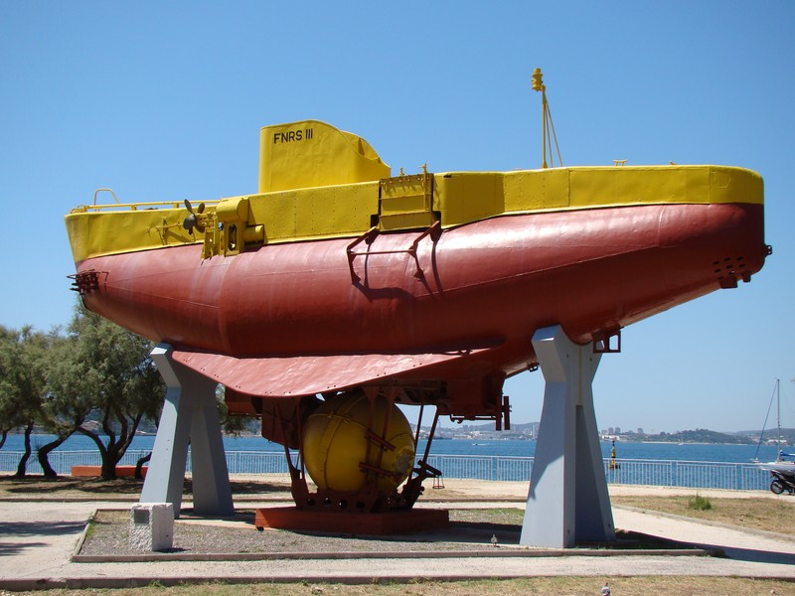
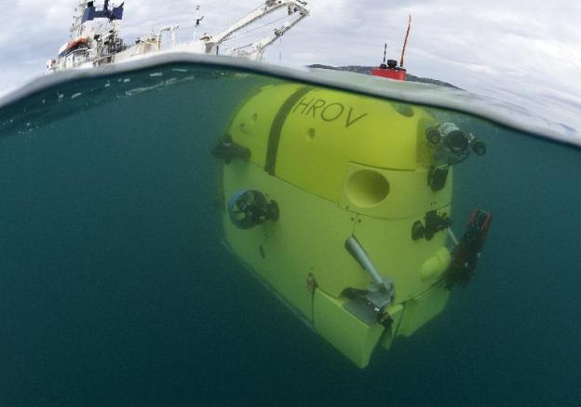
Thanks for your attention
Wishing a long term contribution to JTF Smart subsea cable systems
from the long lasting EMSO ERIC and associated institutions

