Slide 1
ITU Workshop on "Future Trust and Knowledge Infrastructure", Phase 1
Geneva, Switzerland, 24 April 2015
Session 4 – IoT data platform based on oneM2M
Dr. Omar Elloumi,
Technical Plenary Chair,
Alcatel-Lucent (oneM2M member)
oneM2M www.oneM2M.org

Slide 2












The Partnership Project
Over 200 member organizations in oneM2M

Slide 3
Purpose & Deliverables
Purpose
To specify and promote an
M2M Common Service Layer
Deliverables
Technical Reports and Technical Specifications

Slide 4
M2M Common Service Layer in a nutshell
It is a software layer
It sits between M2M applications and communication HW/SW that provides data transport
It normally rides on top of IP
It provides functions that M2M applications across different industry segments commonly need. Those functions are exposed to Applications via IT-friendly APIs.
It allows for distributed intelligence (device, gateway, cloud apps)

Slide 5
Standardization approach
Use cases
Requirements
Architecture
APIs and protocols
Test and Interop
Automotive
Security & privacy
IP communications
Reference points
Home
Device Management
Restful webservices APIs
Device certification
Energy
Data exchange
Reuse of existing protocols
Open source
E-Health
Interworking
Semantics framework (future)

Slide 6


oneM2M Architecture approach
Automotive
Application
Home
Application
Energy
Application
Automotive
Application
Home
Application
Energy
Application
Common Service Layer
Communication Technologies & Protocols
Communication Networks
Communication Devices & Hardware
Currently developed solutions are similar are vertically integrated, with limited integration of data models (Zigbee, DLMS for smart meters, etc.).
Horizontal framework, Restful API
Objects represented as resource
Access control policy to access resource
IoT will be based on ontologies (formal description of concepts and relationships, e.g. W3C Semantic Sensor Network) as well as big data frameworks
TOMORROW
IoT ready
IoT enabled

Slide 7
Common Service Functions
Registration
Discovery
Security
Group Management
Data Management & Repository
Subscription & Notification
Device Management
Application & Service Management
Communication Management
Network Service Exposure
Location
Service Charging & Accounting

Slide 8
Why does it matter
Combat fragmentation
Healthy eco-system with economies of scale
More partnering choices and opportunities for M2M/IOT industry stakeholders
Lower CAPEX
Standardized protocols / APIs -> simplifies application development/deployment
Cross-vertical standards -> same devices and back-ends in different industries
Lower OPEX
Standard features to use networks more efficiently -> get better tariffs
Flexibility for verticals -> utilize best transport network meeting business needs
Time to Market
Reduced development, test and deployment lifecycles through focusing on core business (application logic)
oneM2M is IoT ready

Slide 9
Technical Specifications
Requirements
TS-0002
(WI-0001)
Functional
Architecture
TS-0001
(WI-0002)
Definitions
& Acronyms
TS-0011
(WI-0003)
Service Layer
Core Protocols
TS-0004
(WI-0009)
HTTP Protocol
Binding
TS-0009
(WI-0013)
CoAP Protocol
Binding
TS-0008
(WI-0012)
Management
Enabl^{nt} - OMA
TS-0005
(WI-0010)
Management
Enabl^{nt} - BBF
TS-0006
(WI-0010)
MQTT Protocol
Binding
TS-0010
(WI-0014)
Security
Solutions
TS-0003
(WI-0007)
Service
Components
TS-0007
(WI-0011)
ftp://ftp.onem2m.org/Work Programme/

Slide 10







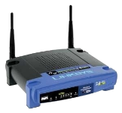



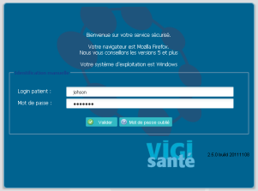







Example Scenario – E-Health
Doctor
Medicalized support
Patient
E-Health
Web-application
Blood Pressure
Meter
Bluetooth Smart
Network
Pill dispenser
with integrated
comm. gateway
Tech support
Application
Cellular
Network
M2M Platform
Scales

Slide 11
Design principles
IP-based, but interworks with specific IP and non IP technologies in the M2M Area networks
RESTful resource oriented APIs, resources are representations of devices, applications, things and related descriptions, etc.
Distributed intelligence (device, gateway, edge, cloud)
Reuse of existing device management frameworks
Reuse of existing data exchange protocols
Reuse of existing security
Reuse of underlying network capabilities such as location, triggering, etc.
Resource access control policies allows many to many communications framework
Future proof – ready to add semantics support
No mandated implementation (Database choice, intelligence location, etc.)

Slide 12
Architecture
Application Entity Provides application logic for the end-to-end M2M solutions
Network Services Entity Provides services to the CSEs besides the pure data transport
Node Logical equivalent of a physical (or possibly virtualized, especially on the server side) device
Application
Layer
AE
AE
AE
Underlying
Network
Underlying
Network
Network
Layer
NSE
NSE
NSE
NSE
Application Service Node
Middle Node
Infrastructure Node

Slide 13
Architecture
Reference Point One or more interfaces - Mca, Mcn, Mcc and Mcc’ (between 2 service providers)
Common Services Entity Provides the set of "service functions" that are common to the M2M environments
Application Entity Provides application logic for the end-to-end M2M solutions
Network Services Entity Provides services to the CSEs besides the pure data transport
Node Logical equivalent of a physical (or possibly virtualized, especially on the server side) device
Application
Layer
AE
AE
AE
Mca
Mca
Mca
Service
Layer
CSE
CSE
CSE
CSE
Mcn
Mcc
Mcn
Mcn
Mcc
Mcn
Mcc’
Underlying
Network
Underlying
Network
Network
Layer
NSE
NSE
NSE
NSE
Application Service Node
Middle Node
Infrastructure Node
Inf. Node

Slide 14

Concrete example
M2M Gateway
Resources
Aggregation & format conversion
IN-CSE
3G Network
M2M Device
B
Local
Connectivity
M2M customer’s application
MN-CSE
Measurement App.
A
New measurement value available
Write to //MN-CSE/A
MN-CSE notifies aggregation app about new data, MN-CSE keep a copy of the data
for subsequent use
New measurement value available
Write to //MN-CSE/A
MN-CSE notifies aggregation app about new data, MN-CSE keep a copy of the data
for subsequent use
… etc, etc …
Ask MN-CSE to write aggregated/transformed data to //IN-CSE/B….
and BTW, this is low priority and you got 12 h time for that!
MN-CSE checks with policies and when time is good gets connected…
..and writes aggregated data to //IN-CSE/B
IN-CSE notifies network app (DB, HRN) about new data.
Measurement app can simply keep on delivering its data to the MN-CSE
Aggregation app gets always notified about the new bits coming in
MN-CSE will store-and-forward aggregated/transformed data at a good time
IN-CSE will notify DB app when new data arrived
=> Very little effort to synch the different apps
Starting assumptions:
- Bootstrapping / DM is done (provisioning of credentials/apps)
- MN-CSE and IN-CSE have logically connected (authentication, binding, encryption)
- Apps have authenticated to xCSE and access right were established

Slide 15
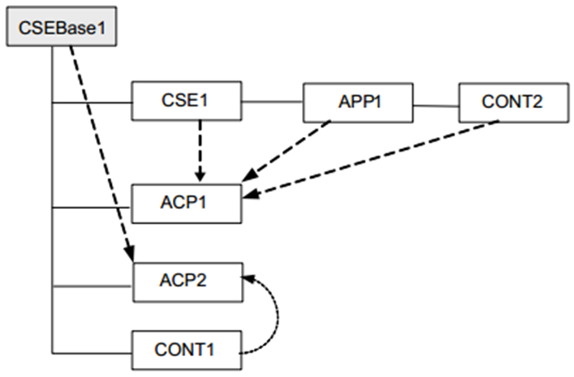
Information Modelling
Resource-based information model
Information is stored in the system as Resources
A given Resource can be identified with a Uniform Resource Identifier
  A given Resource is of one of the defined Resource Types
  The Resource Type determines the semantics of the information in the Resource
  Resources can be Created, Read, Updated or Deleted to manipulate the information
  Resources are organized in a tree-like structure and connected by links

Slide 16
Communication Protocols
  Reuse IP-based existing protocols
Service Layer
Core Protocols
TS-0004
CoAP Binding
TS-0008
HTTP Binding
TS-0009
MQTT Binding
TS-0010
  XML or JSON Content serialization
  HTTP Example
REQUEST
GET http://provider.net/home/temperature HTTP/1.1
Host: provider.net
From: //provider.net/CSE-1234/WeatherApp42
X-M2M-RI: 56398096
Accept: application/onem2m-resource+json
RESPONSE
HTTP/1.1 200 OK
X-M2M-RI: 56398096
Content-Type: application/onem2m-resource+json
Content-Length: 107
{"typeOfContent":"application/json",
"encoding":1,
"content": "{'timestamp':1413405177000,'value':25.32}"
}

Slide 17
Security
Challenges & Solutions
Large variety of scenarios
Any device in any deployment
A device cannot make “judgment calls” on privacy
Secure communication
    various authentication options
Remote provisioning
    various authentication options
Access Control Policy
    express wide variety of rules

Slide 18
Interworking – OMA & BBF
  Reuse existing Device Management technologies
Application Entity
Mca
OMA DM 1.3
OMA DM 2.0
OMA LWM2M
oneM2M
Domain
IN-CSE
DM
Domain
BBF TR-069
BBF Server
DM Server
BBF CPE
BBF Device
DM Client

Slide 19
Privacy principles
oneM2M technology answer examples
Use limitation
Each resource has an Access Control Policy (ACP) which specifies who (which entity) can access the resource, R/W permissions and under which context (time of the day, etc)
Applications link published data to ACP according to user consented purpose
Data quality
Collected data is assigned a time-stamp and linked to a producer entity
Expiration time ensures old data is removed – could be used to enforce data retention policy
Security safeguards
Authentication and authorization, secure communications
Participation
PI owner provides prior consent about the intended use of data – applications set Access Control Policy accordingly
Accountability
System allows tracing and history of all interactions

Slide 20

Thank You!
Q&A

