Slide 1
THE POLICIES FOR A BALANCED CYBER-SECURITY AND PRIVACY POSTURE. Giampiero Nanni Government Affairs - Europe, Middle East, Africa Symantec giampiero_nanni@symantec.com
ITU Workshop on "Future Trust and Knowledge Infrastructure", Phase 1 Geneva, Switzerland, 24 April 2015
Copyright © 2015 Symantec Corporation
Notes:
Session 3: Paradox between “Open and Secure” Objectives: This session will discuss the paradox between “Open and Security” taking into account recent trends of businesses and threats using data and information. Different views between public and private sectors are compared. The following issues at this session will be considered: Moderator: Tomas Lamanauskas, (ITU) [ Biography ] Speakers: Beyond Data Security: How to Build Trust Through Transparency: Mark Jeffrey, (Microsoft, USA) [ Biography | Presentation ]
Open and Secure, Paradox or Property: Olaf Kolkman, (Internet Society) [ Biography | Abstract | Presentation ]
The Policies for a Balanced Cyber-Security and Privacy Posture: Giampiero Nanni, (Symantec Corporation, UK) [ Abstract ]
ABSTRACT: A rigorous and comprehensive cyber-strategy is vital to ensure appropriate defence and response to today’s cyber-threats towards governments, private sector and citizens. And while governments tend to have a more open data approach for the public sector activities (freedom of information), profound concerns inevitably emerge about the way cyber-security and privacy are balanced.
The presentation will focus on the policies that can drive an effective, inclusive approach to the problem, also touching on different scenarios and disciplines, like cyber-intelligence, data protection, electronic identity, critical infrastructure protection, Internet of Things.

Slide 2
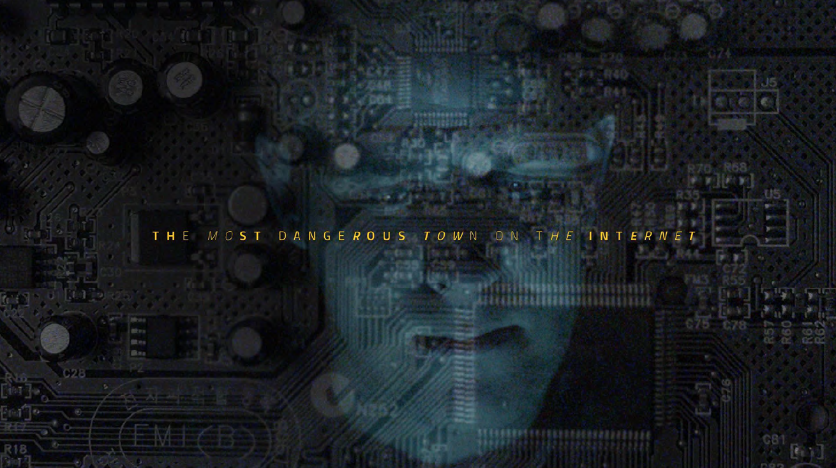
LJQWEIFO3WI6JWLKF5E5WQ6OEFIJWQOFEKWQF2E2O2I2QWJFLKDFNVLCXVNSFQPWOIRJTU94U07844976334EWRE09QU043Q39JFIJSODIFJ0Q9UQ
HKKRKKSKDNCURIPPSKXODODOSSSOPOIUIUREH34DDOSOSKSOSSPSPSPSPSPSSDJCJCMCMCFFPOIUERHGPWEORIJ92058T2HTPOINFDJHSUWHDDE
JAOFI943853490OIQREJFDSAKJNF9E8TU4309RJFODSJORIJW0ERTUWKSDF4K4HFDG3HDOIFU8G7H43OREIER08ODIGSDOIGEORI65J346EOROFIO53YDIO

Slide 3
Agenda
1 | Threat landscape
2 | Security
3 | Privacy
4 | Balance

Slide 4
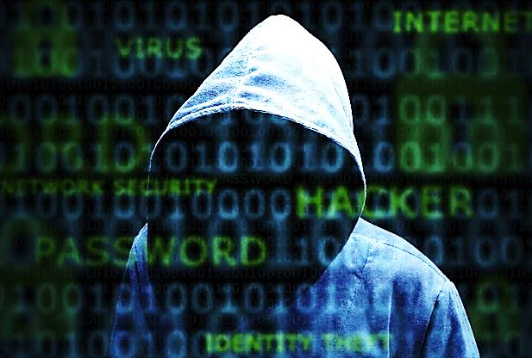
1 | Threat landscape
2 | Security
3 | Privacy
4 | Balance
Are you ready for the
next cyber-attack ?

Slide 5
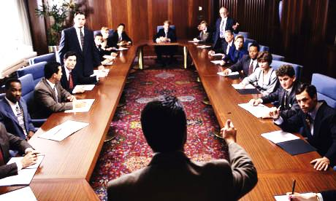
Imagine… you have to tell the Board of Directors, that your organization has been compromised by an attack…

Slide 6
It took the attackers only six minutes to circumvent the perimeter defenses. From there, they achieved domain administrator privileges in less than 12 hours.In less than a week they fully compromised all 30 of our global domains.
They harvested all our credentials, giving them the ability to log in to the network masquerading as any of us. There was no place on our global network they could not go and only a handful of computers they did not have easy access to.
The attackers were in a position to electronically transfer millions of dollars out of our bank accounts through our accounts payable system.
They had direct access to our manufacturing environment and could affect both the quality of our production processes and safety on our shop floors.
They had access to our most sensitive intellectual property, including our past, current and future plans for major acquisitions and divestitures as well as the results of the billions of dollars we have invested in a decade of research and development.
Their tools did not set off any alarms.
And, in the end, they were able to steal all the data.
We were not able to stop them, or even see them in our network.

Slide 7
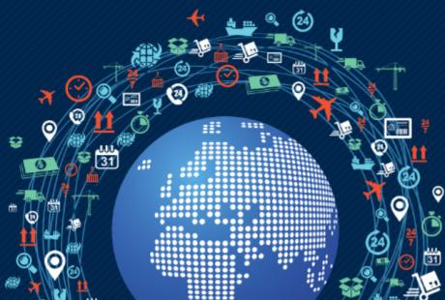
The information economy trends
IoT/ Hyper-connectivity
Mobility/
Platform proliferation
Socialisation
Smart Infrastructure
Big Data
Data flow globalisation
Cloud/
Virtualisation

Slide 8
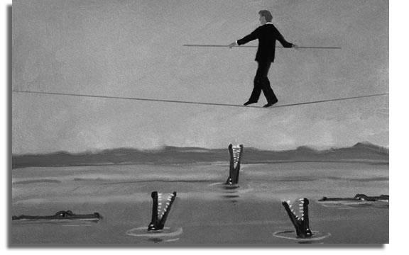
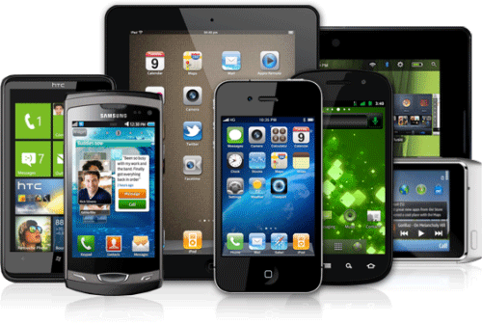
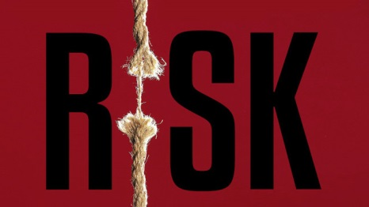
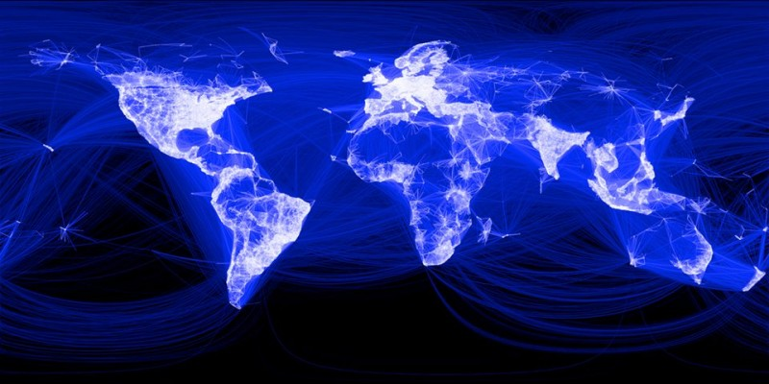
The information economy risk
IoT/ Hyper-connectivity
Cloud/
Virtualisation
Mobility/
Platform proliferation
Smart Infrastructure
Big Data/ Data flow globalisation
Socialisation

Slide 9
Risk level
Lloyd’s Risk Index 2013
26 Energy security | 39 Harmful effects of new technology
27 Demographic shift | 40 Pandemic
28 Industrial/workplace accident | 41= Abrupt regime change
29 Environmental liability | 41= Riots and civil commotion
30 Sovereign debt | 41= Flooding
31 Piracy | 44 terrorism
32 Climate change | 45 Windstorm
33 Water scarcity | 46 Drought
34 Strikes and industrial action | 47 Threats to biodiversity
35 Population growth | 48 Earthquake
36 Expropriation of assets | 49 Impact of space weather
37 Urbanisation | 50 Volcanic eruption
38 Food security
Notes:
Given the well-documented frequency of cyber breaches, the relatively low weighting given to cyber risk in both the 2009 and the 2011 Risk Indices suggested too many businesses were underestimating its impact. Not any more. Cyber risk has moved from position 12 (malicious) and 19 (non-malicious) in 2011 to the world’s number three risk overall. What has effected this change? One development may be that the perception of what motivates cyber attacks is evolving: from financial crime to political and ideological attacks. 2012 saw the takedown of the Interpol, CIA and Boeing websites, the suspension of alternative currency Bitcoin’s trading floor, the mass theft of passwords from professional networking site LinkedIn, the outage of the websites of six major US banks and many more.
The number of incidents attributed to state-sponsored hacking and revenge attacks by ‘hacktivist’ networks is growing. So, too, are the costs of cyber breaches. A 2012 study by the Ponemon Institute3 found that the average annualised cost for 56 benchmarked organisations was US$8.9 million a year, up from US$8.4 million in 2011, with a range from US$1.4 million to a staggering US$46 million per year, per company. The most costly cybercrimes involved malicious code, denial of service and web-based attacks. It appears that businesses across the world have encountered a partial reality check about the degree of cyber risk. Their sense of preparedness to deal with the level of risk, however, still appears remarkably complacent. Against all the evidence of the past two years, businesses believe they are slightly more able to deal with the risk, with an overall preparedness score of 5.9, against the priority given to the risk itself at 5.7. In 2011, the US was the only world region where the cyber threat made it into the top five; by 2013, this is now the region’s number two risk. And yet US businesses still score their preparedness (at 5.4) at a higher rate than the risk itself (at 5.1).
The EU’s Digital Agenda Commissioner, Neelie Kroes, has pointed out: “Cyber security is too important to leave to chance, to the goodwill of individual companies”, and
many governments have been progressing the issue over the past two years. In May 2013, Republican and Democrat senators came together in a rare agreement to
propose the Deter Cyber Theft Act4 to halt the theft of valuable commercial data from US companies by foreign firms and governments. The European Commission,
meanwhile, is considering proposals to ensure companies that store data on the internet report the loss or theft of personal information or face sanctions. And yet in terms of event frequency, most businesses would be wise to look closer to home for solutions. According to a report published in April 2013 by the Insurance Information institute,5 employee negligence is responsible for 39% of data breaches, system glitches for 24% and malicious or criminal attacks for only 37%. That leaves nearly two-thirds of incidents caused by issues which should reasonably be within a business’ control. As in 2011, we must ask again if, despite their escalating spend on cyber-security, businesses are actually spending money on the right things? Cyber insurance specialists are offering increasingly integrated cyber products, including those that provide cover for data breach costs, forensic analysis and crisis public relations services in one package. While these products are highly effective in an emergency, spending money upfront on risk management – and ensuring recommendations are implemented throughout a company – might go a long way to preventing a cyber disaster before it starts.

Slide 10
Risk level
Lloyd’s Risk Index 2013
1 High taxation | 14 Corporate liability
2 Loss of customers/cancelled orders | 15= Major asset price volatility
 | 15= Poor/incomplete regulation
4 Price of material inputs | 17 Fraud and corruption
5= Excessively strict regulation | 18 Government spending cuts
5= Changing legislation | 19 Theft of assets or IP
7 Inflation | 20 Failed investment
8 Cost and availability of credit | 21 Corporate governance failure
9 Rapid technological changes | 22 Critical infrastructure failure
10 Currency fluctuation | 23 Supply chain failure
11= Interest rate change | 24 Increased protectionism
11= Talent and skills shortage | 25 Insolvency risk
13 Reputational risk
3 Cyber risk

Slide 11
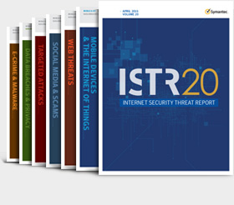
Symantec Internet Security Threat Report, Vol. 20
In 2014
Nearly ONE MILLION new threats released
Every day
More than 400 MILLION identities exposed
Targeted attacks to large enterprise up 40% (5 out of 6)
60% of targeted attacks were against SMEs
Crypto-ransomware up 4500%
17% Android mobile Apps are malware carriers
E-mails still the preferred vector but social media fastly rising
The « Internet of Things » is source of vulnerability (cars, medical equipment)
Software download websites a new vehicle for hackers

Slide 12
Cyber-attackers
are leap-frogging defences
in ways organisations
lack insight to anticipate

Slide 13
Facts, not predictions
Risk zero doesn’t exist
Attacks will happen, some successfull
Errors will occur, human or technical
Insiders will be negligent or malicious
Confidentiality, Integrity & Availability will be impacted
It’s impossible to protect everything at the highest level
All critical assets are not identified or even known
Mobility is pervasive, Internet of Things
There is no IT perimeter anymore
« Social » is the new normal
« Smart » is the new normal

Slide 14
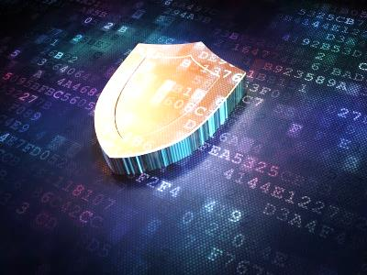
2 | Security
3 | Privacy
4 | Balance

Slide 15
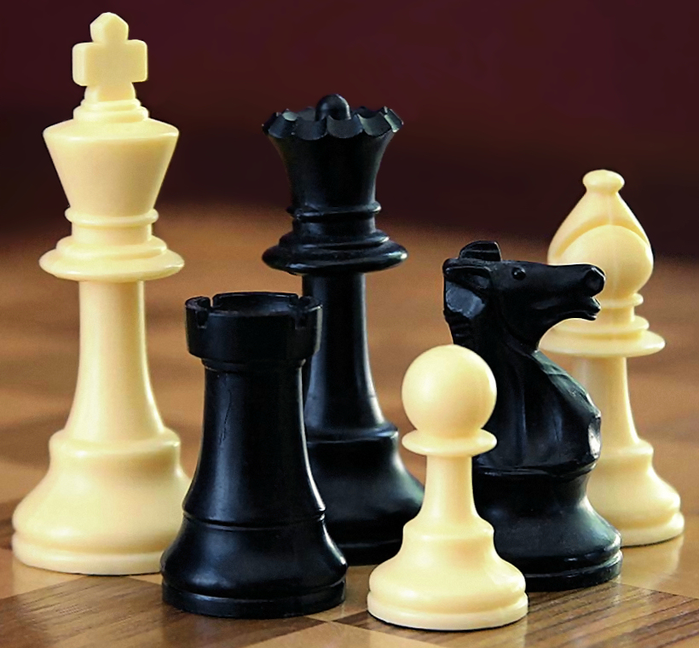
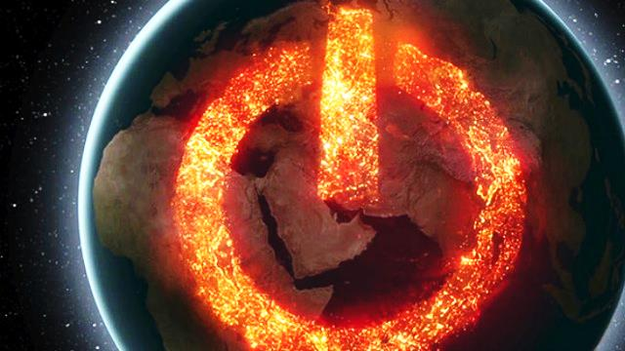
An asymmetric challenge
ATTACKERS
Can focus on one target
Only need to be right once
No need to expose themselves
Not location-dependent
Attribution not easy
Prosecution almost impossible (no clear jurisdiction)
DEFENDERS
Must balance defence with business impact
Must get it right every time
Can’t really “win”, can draw at most
Asymmetry to increase before it decreases

Slide 16
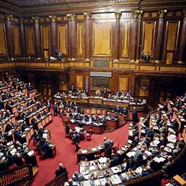
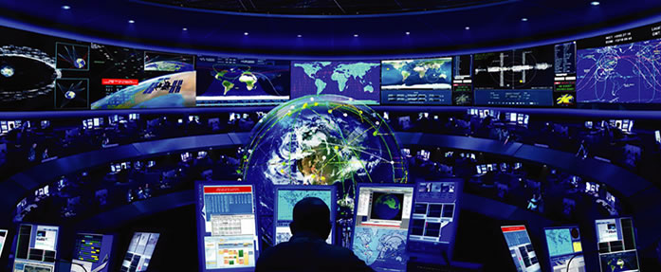
Security posture: PREPARE→PREVENT→DETECT→RESPOND
≠
Cyber-Security = Antivirus
Legislation/Regulation/Policy
Establish authorities & stakeholders
Acquire intelligence, monitor threats
Establish response teams (CERT)
Define procedures/processes
Define Critical Infrastructure
Coach people, build capacity
Cooperate, share information – PPP
Invest

Slide 17
3 | Privacy
2 | Security
3 | Privacy
4 | Balance

Slide 18
Cyber-security must address 3 dimensions
PEOPLE
PROCESSES
TECHNOLOGY

Slide 19
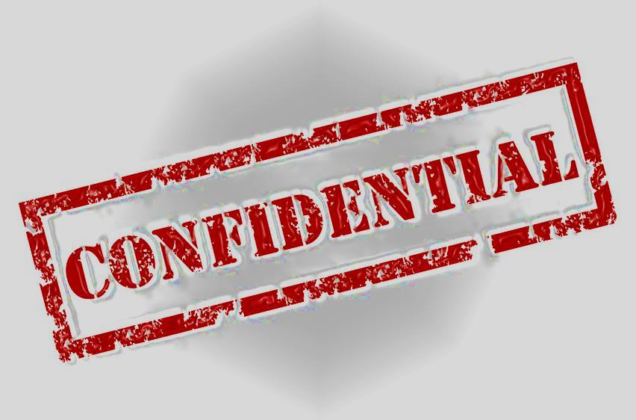
+1
Privacy
PEOPLE
PROCESS
TECHNOLOGY

Slide 20
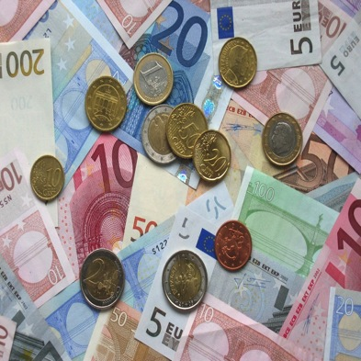
The State of Privacy study
In a digital economy data is the “new currency”
Information protection generates value, enables growth
Individual/Industry/Government/National Security interlinked.
Changing European legislation
Lack of ownership
Business apathy
Exponential growth of risk
81%
of consumers think that their data has value
How much is your data worth?
57% up to €1,000
43% €1,000+
(24% €10,000+)

Slide 21
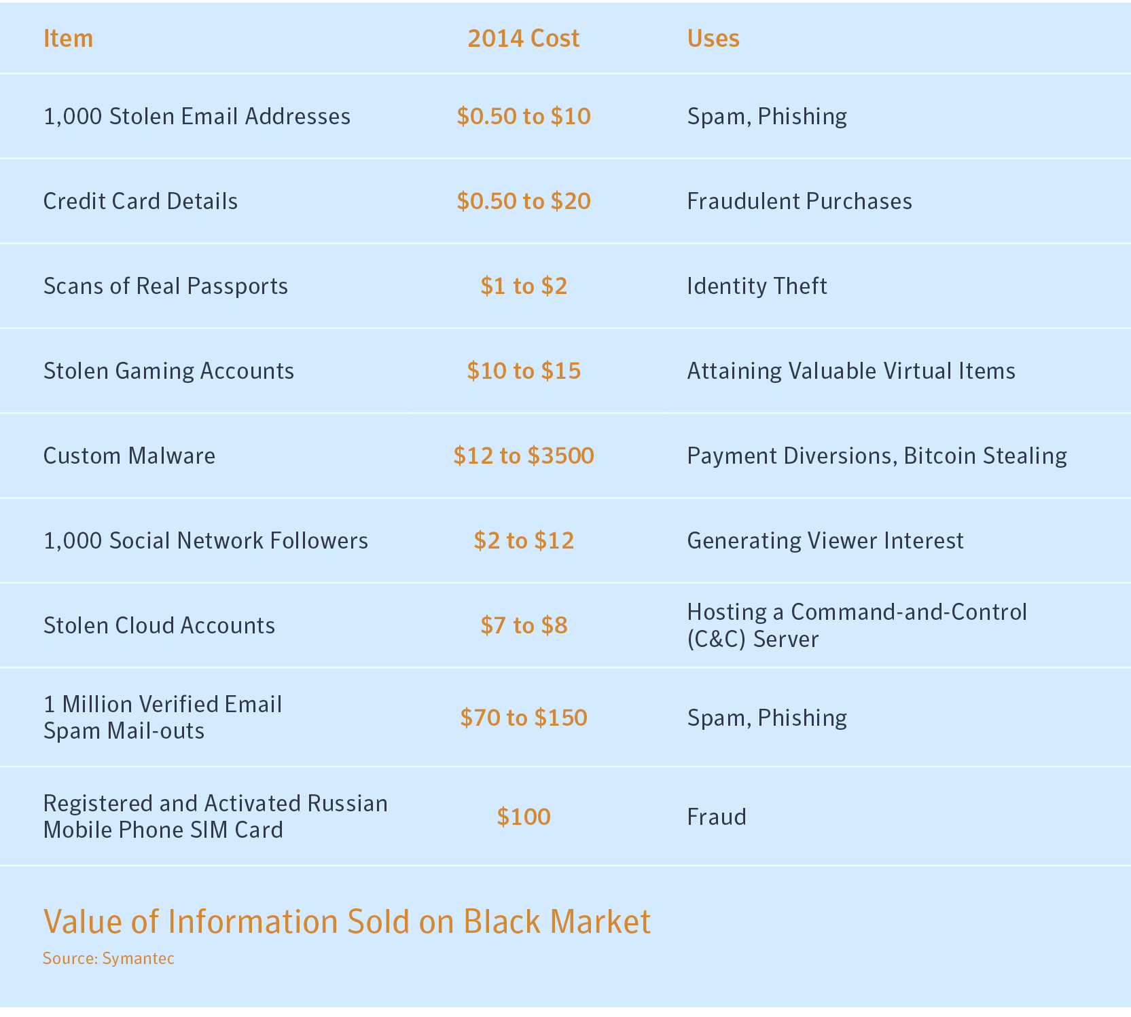
Value of Information Sold on Black Market

Slide 22
Almost half of people are not happy to share their personal data with third parties
The State of Privacy study: Personal data
% of responsibility in protecting personal information
HAPPY
DEPENDS ON QUANTITY OF INFORMATION SHARED
Government, Institutions
BUSINESS
GOVERNMENT
Private Sector
NOT HAPPY
individual
CONSUMER

Slide 23
The State of Privacy study: Level of trust in organisations
Organisations with business models based on data (tech companies and social media companies) appear less trusted to keep customer data completely secure
Technology
companies
On-line retailers
Social network
24/04/2015
23
The State of Privacy

Slide 24
Consumers will trade personal data in exchange for…
1 in 3
give
false information
in order to protect
their data
57%
avoid posting
their detail online
STORE DISCOUNT
33%
WIN A PRIZE
30%
FOR MONEY
30%
LOYALTY BENEFITS
29%
ACCESS to a FREE APP
17%

Slide 25
4 | Balance
2 | Security
3 | Privacy
4 | Balance

Slide 26
EU General Data Protection Regulation (GDPR)
“Personal data shall mean any information relating to an identified or identifiable natural person ("data subject"); an identifiable person is one who can be identified, directly or indirectly, in particular by reference to an identification number or to one or more factors specific to his physical, physiological, mental, economic, cultural or social identity“
Applicable to all industry of a certain size in all Countries
Possibly to public sector - by Country discretion
Regulates how personal data are collected, processed, retained and transferred
Severe sanctions
PRIVACY
DATA
Privacy is the new “Green”
Emotional and highly political
Snowden effect
Reputational risk
Legal risk
Moral issues
Customer expectations and rights
Collection is fair and lawful
Collection is for a specific purpose
Collection is proportionate, limited in time and for the minimum amount necessary
Data is accurate and is protected
Data transfer is regulated

Slide 27
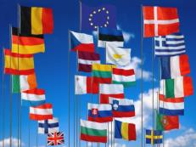
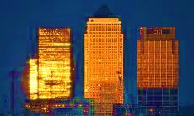
Network & Information Security (NIS)
Obligation for EU Member States:
Establish national cybersecurity strategies
Build incident response capabilities
Share information with each other
Obligation for industry:
In key sectors (energy, transport, finance, health, and possibly some large scale public clouds) to manage cyber risk and notify cybersecurity breaches;
Obligation for industry to share information with their governments
Change
in
Business model

Slide 28
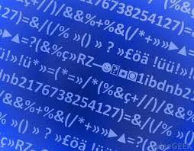
The security vs. privacy dilemma
Encryption
Comply with one government’s law or break another’s?
Break customer trust?
The broader issue of state surveillance is putting companies in the middle of national security debates between sovereign governments.
NO Hidden functionality (back doors)
NO malware whitelist in security solutions
As a Certificate Authority, NO copies of encryption keys that customers use.

Slide 30
Giampiero Nanni
Government Affairs - Europe, Middle East, Africa
giampiero_nanni@symantec.com

