Slide 1
ITU Workshop on "Future Trust and Knowledge Infrastructure", Phase 1 Geneva, Switzerland, 24 April 2015
Open and Secure
Paradox or Property?
Olaf M. Kolkman
Chief Internet Technology Officer,
kolkman@isoc.org

Slide 2
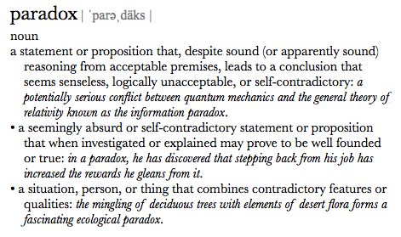
Paradox
Source: OSX Dictionary Application

Slide 3
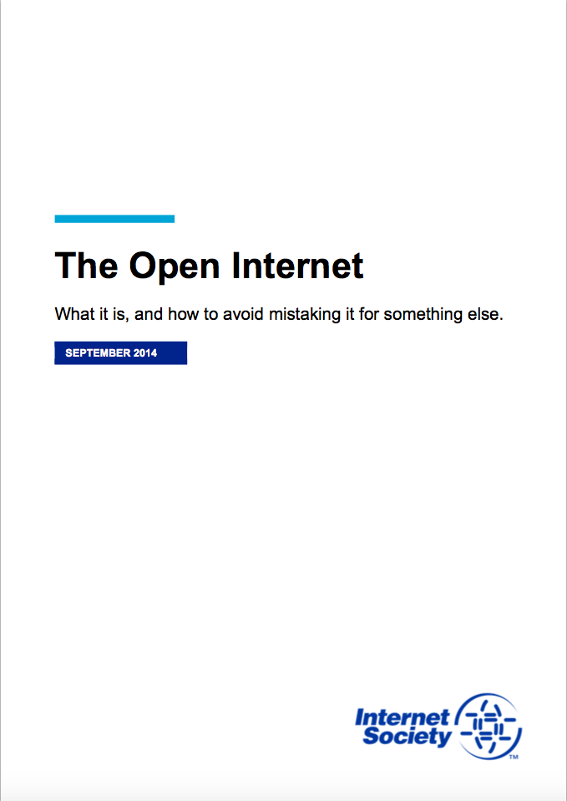
Open !?!
Transparency
Participation
Accessibility
Vulnerability
Source: http://www.internetsociety.org/doc/open-internet-what-it-and-how-avoid-mistaking-it-something-else

Slide 4
The theme that most clearly emerges from these meanings of “openness” is opportunity. The open Internet enables an environment of social and economic growth and empowerment because it creates a level playing field in which everyone enjoys the same opportunity to participate.
The first popular–press references to Internet openness focused heavily on the vulnerability dimension—and of course security issues still plague the Internet—but modern usage embraces transparency, participation, and access in balance with the risks associated with being in an open space. Different societies make different choices about the way in which individual and collective responsibility mitigate the vulnerability of openness.
[…] [miscast as] “anything goes” anarchy that would sweep aside the rule of law and other norms […] But that is far from the reality of an open Internet, in which permissionless innovation is about […] [having to ask ] permission from any established gatekeeper. It is freedom, not disorder.
“Innovation in the Open Internet arrives by consensus through open collaboration”

Slide 5
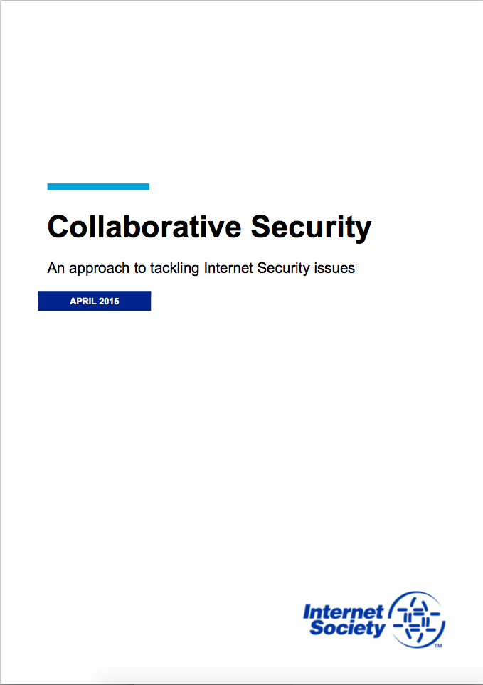
Consensus through Open Collaboration

Slide 6
Fostering Confidence and Protecting Opportunities
Collective Responsibility
Evolution and Consensus
Collaborative Security
Fundamental Properties and Values
Think Globally, Act Locally

Slide 7
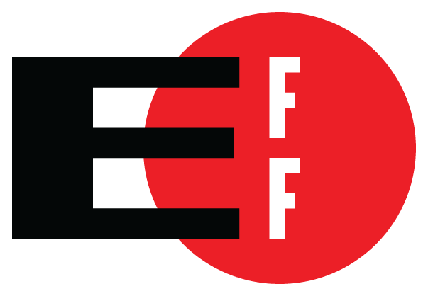
Examples of Collaborative Security
Cryptech.is
Don’t f0rget them
CSIRTs
DevOps
Routingmanifesto.org
A very incomplete set of
ITU-T
ITU-D

Slide 8
Open and Secure
Paradox or Property?

Slide 9
Open and Secure:
Necessity!

