Slide 1
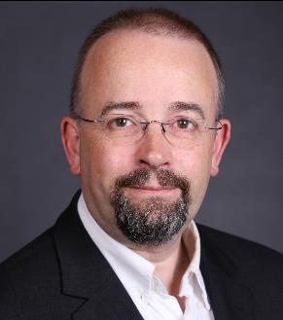
ITU Workshop on "Future Trust and Knowledge Infrastructure", Phase 1
Geneva, Switzerland, 24 April 2015
Beyond Data Security: how to build trust through transparency
Mark Jeffrey
Rapporteur ITU-T Q19/13
Assoc. Rapporteur ITU-T Q8/17
Mark.Jeffrey@Microsoft.com

Slide 2
Data Security Today
An example:
Power companies can use IoT motion sensors to intelligently adjust your building temperature and lighting when your staff have gone home
If they can get access to it, criminals could potentially use the exact same data to know when to break in
Data Security is more critical than ever before

Slide 3
But Security alone does not create Trust
Do you remember …
A company that told all their customer’s friends that they had just bought a surprise gift?
A phone that embedded the exact location and time a photo was taken, and posted this on social networks?

Slide 4
Trust through Transparency
Cloud Service Providers have many different (valid) business models such as
  Pay-for-service
  Free/Advertising funded
  Freemium
For all of these, the key to being trusted is Transparency
  Say what you do with the data
  Say why you do it
  Do what you say

Slide 5
Data Categories
(from Y.3500)
Cloud Service Customer Data | Data that the customer uploads to the cloud service, or creates using the cloud service
Cloud Service Provider Data | Data needed to run the service
Cloud Service Derived Data | Data arising from the customer’s use of the cloud service

Slide 6
Where does your data go?
All of this data moves between:
  Devices (PCs, phones, tablets, sensors, TVs, …)
  Device Platform Cloud Services
  Public Cloud Services
  Enterprises
  Private Cloud Services
  Legacy Systems

Slide 7
  (from ISO/IEC WD 19944 with permission)

Slide 8
What do cloud services do with your data?
Everyone wants you to have data security …
… but not from them
- Bruce Schnier

Slide 9
Standards to aid Trust
To be a trusted service provider, transparency comes first
  Say what you do, and Do what you say
Security
  Be clear on what security standards you meet, or why you don’t
Privacy
  Be clear on what privacy standards you meet (e.g. ISO/IEC 27018)
  Be clear on what you do about anonymising data
Good Business practices
  Be clear on what your SLAs mean, and how you will respond to problems
  Be clear on what you will do with customer and derived data, and to what purpose
  Be clear on how your company is run and how policy is decided
Accessibility

Slide 10
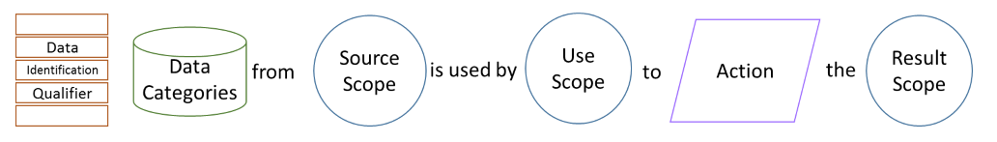
A possible uniform syntax
Aggregated
sensors at all of our customers’ premises
a third party trends analysis company
telemetry readings
predict
future needs of our customers
Purpose
  (from ISO/IEC WD 19944)

Slide 11
Conclusion
Data today moves around
  … a lot
Data has many uses
  some not intended or understood by the customer
Many valid business models need to use customer and derived data in new ways
Transparency in such use of data is essential
Emerging standards will aid in transparency

Slide 12
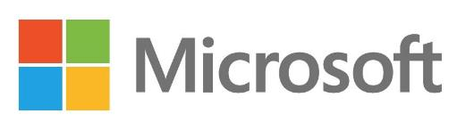
Thank You

