Slide 1
ITU Workshop on "Future Trust and Knowledge Infrastructure", Phase 1 Geneva, Switzerland, 24 April 2015
Trusted environment in future ICT infrastructure and the role of the context
Proff. Dr. Viliam Sarian,
Director of the Scientific and Education Center, FSUE NIIR Russia, sarian@niir.ru

Slide 2
Activities of the Communications Administration of Russia
Eurasian Economic Commission (EEC), 2014
United Nations ESCAP, 2013
Regional Commonwealth in the field of Communications (RCC), 2014
APEC TEL “Interoperable ICT: semantic, linguistic and other aspects”, 2013
Draft Recommendation Y.trusted-env “The basic principles of a trusted environment in ICT infrastructure”, 2014
Expert dialogue in BRICS, 2015
Rashid Ismailov
Deputy Minister of Telecom and Mass Communications of the Russian Federation

Slide 3
Importance of the problem
A large number of economies, peoples, languages
Active cooperation between the economies
High mobility of people
A large number of leading IT-companies

Slide 4
Interrelation of concepts (1)
Future ICT infrastructure
Trusted environment
Context

Slide 5
Interrelation of concepts (2)
Interoperability
Transboundary
Trust

Slide 6
A set of fundamental principles for trusted environment
Groups of principles
UNCITRAL
continuity
architecture

Slide 7
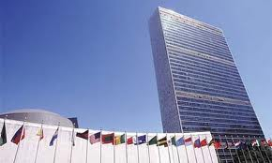
A set of fundamental principles UNCITRAL
UNCITRAL
technological neutrality
Non-discrimination
functional equivalence

Slide 8
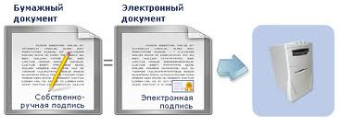
Moving from paper to electronic document
continuity
Unification
scalability
functional equivalence

Slide 9
Common infrastructure of trust
architecture
strength balance
CUSTOMER oriented
systematization

Slide 10
Limitation principle
User 1
User 2
User 3
Service 1
Service 2
As a number of services and users increases, amount of required context data growths non-linearly
At some point increasing the size of the trusted environment becomes impossible
To maintain the high level of trust it is mandatory to limit the scope of the trusted environment to the most critical services and to the group of users that need it most
Interaction 1
Interaction M
Context
data 1
Context
data N
+ One extra user
+ One extra service
+ X extra interactions
+ X^{α} extra context data

Slide 11
The role of context
Interactions environment S
D=f₁(S, n, f, ∆t) – the number of documents available in the environment of interactions;
D₀ =f₂(S, n, f, ∆t) – the number of documents, the minimum required to make the interaction.
D – D₀ = K = f₃(S, n, f, ∆t) – context - the formally non-binding information to help decide.
n, f, S – const, so
D=D(∆t), because available documents accumulated during the interaction
Context
Context Notary
The quantitative characteristics of the interaction environment S:
n – the number of participants;
f – the number of interactions;
∆t – time for one interaction;

Slide 12
Relation of Interactions environments and their contexts
Interactions environment S₁
Interactions environment S₂
Context 1
Context 2
Notary 1
Notary 2

Slide 13
Importance of context
With the rapid development of ICT and increase the number of users, protection against cyber threats requires more and more Investment
There may come a time when the cost of security within trusted environment will exceed profits
Development of means of context production may improve safety in a trusted environment at a lower cost

Slide 14
Thank you for your attention!

