Slide 1

CLOUD COMPUTING AND DATA HANDLING IN AFRICA: ACCELERATING INNOVATION AND DIGITAL TRANSFORMATION
Carole LEPREGNON
Autorité de Régulation des Télécommunications/TIC de Côte d’Ivoire

Slide 2
SOMMAIRE
  Cloud Computing
  The benefits of the Cloud in Africa
  Data Handling
  Security in the Cloud
  The challenges of standardizing Cloud computing in africa
  Regulations and Compliance
  Future opportunities
  Conclusion
Autorité de Régulation des Télécommunications/TIC de Côte d’Ivoire

Slide 3

LE CLOUD COMPUTING
Cloud Computing: accessing applications, data and services via the Internet rather than storing them on their own computers or servers.
Flexibility:
Reducing operating costs
1
2
Companies can adjust their requirements as demand changes, without having to invest in additional infrastructure.
Cloud Computing reduces the cost of maintaining servers and hardware.
3
Global access to resources
Users can access data, applications and services from anywhere in the world.
Autorité de Régulation des Télécommunications/TIC de Côte d’Ivoire

Slide 4
THE BENEFITS OF THE CLOUD IN AFRICA
Reduce infrastructure costs
Facilitate remote collaboration
Improve access to services and data
The Cloud Computing market in Africa is booming, with annual growth of over 25%.
Autorité de Régulation des Télécommunications/TIC de Côte d’Ivoire

Slide 5

DATA HANDLING
Appropriate data handling in the Cloud enables information to be organised, stored and secured in the best possible way.
Improving operational efficiency
Increase data security
1
2
analysing data more efficiently.
by automating data management processes and reducing costs.
Autorité de Régulation des Télécommunications/TIC de Côte d’Ivoire

Slide 6

SECURITY IN THE CLOUD
1
Intrusion detection systems (IDS)
2
Encryption
3
Antivirus, firewall, etc.
4
Good safety practice
Autorité de Régulation des Télécommunications/TIC de Côte d’Ivoire

Slide 7

CHALLENGES IN AFRICA
1
Disparate Internet connectivity
Internet coverage is still limited in many African countries, and connection speeds are often slow.
2
The cost of broadband
Broadband prices are often high in Africa
3
Lack of expertise
Companies and individuals often need help to implement and manage cloud solutions.
Autorité de Régulation des Télécommunications/TIC de Côte d’Ivoire

Slide 8

THE CHALLENGES OF STANDARDISING
CLOUD COMPUTING IN AFRICA
1
Regulation and compliance:
African countries have different data protection and compliance regulations. The standardisation of cloud computing must take account of these differences and develop standards that can be applied on a continental scale.
2
Data Security
Data security is a major issue in Africa. Companies and governments need to put in place robust security measures to protect sensitive data in the cloud. Standardisation should therefore include strict security standards.
Autorité de Régulation des Télécommunications/TIC de Côte d’Ivoire

Slide 9
THE CHALLENGES OF STANDARDISING
CLOUD COMPUTING IN AFRICA
3
Heterogeneous IT environments:
Africa is characterised by a wide variety of IT environments, from large cities to rural areas. Standardisation must take account of this heterogeneity to enable widespread adoption.
4
Interoperability:
To encourage the adoption of cloud computing in Africa, it is important to ensure interoperability between different cloud service providers. Standardisation should address this issue to avoid proprietary lock-ins.
Autorité de Régulation des Télécommunications/TIC de Côte d’Ivoire

Slide 10

REGULATIONS AND COMPLIANCE
1
The law on the protection of personal data
transparency, consent and data security
2
The Cyber Security Act :
This law protects computer systems against cyber attacks.
3
Service Level Agreements (SLAs) :
the cloud provider's obligations in terms of availability, performance and security.
Autorité de Régulation des Télécommunications/TIC de Côte d’Ivoire

Slide 11

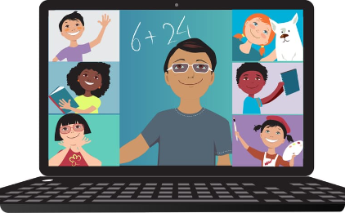

FUTURE OPPORTUNITIES
Digital transformation of businesses
Distance learning
Improved health services
Providing distance education services to students.
Improving healthcare delivery in Africa by providing remote services, medical data security and collaboration between healthcare professionals.
Transform digitally, efficiently and cost-effectively by providing advanced resources and technologies.
Autorité de Régulation des Télécommunications/TIC de Côte d’Ivoire

Slide 12
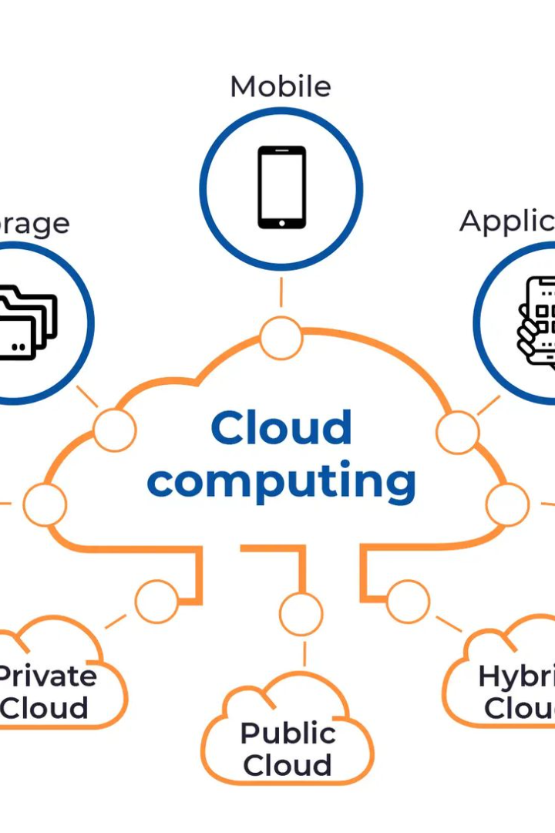
CONCLUSION
African businesses, governments and organisations must strategically adopt Cloud Computing and Data Handling.
These are powerful drivers for innovation and digital transformation.
Autorité de Régulation des Télécommunications/TIC de Côte d’Ivoire

Slide 13
JE VOUS REMERCIE
Autorité de Régulation des Télécommunications/TIC de Côte d’Ivoire

