Slide 1

The Gap Between Reality and Expectations of Metaverse
Yuntao WANG
ITU-T Q5/16 Rapporteur
Deputy Chief Engineer of Cloud Computing and Big data Research Institute
China Academy of Information and Communications Technology (CAICT)
Director of The Metaverse Innovation and Exploration Alliance (MINE)

Slide 2
5 GAPS
What the users want VS What is provided
What the companies tell VS What they actually do
What the government want VS What really happens
What technologies are expected VS What we have now
What kinds of standards are expected VS What we’re doing now

Slide 3
GAP 1: User Expectations: What things would you do in the metaverse?
Things you would do in the metaverse but not in real life worldwide 2021
Share of respondents
20
Description: Trying extreme sports is the most popular thing that people would do in the metaverse but not in real life. Other such activities include altering one's consciousness with VR instead of intoxicants, or creating an alter ego. Apps and video games that allow users to create alternative personalities and design their lifestyle in a virtual world are expected to be among the first successful applications to translate to the metaverse. Read more
Note(s): Worldwide; 2021; 1,050 respondents
Source(s): Tidio

Slide 4
GAP 1: Application Reality: Number of mobile apps referring to the metaverse together with selected popular keywords as of February 2022
Apps mentioning selected keywords along with "metaverse" 2022
39
Description: As of February 2022, of the 552 apps that included the keyword "metaverse" in their description, 144 did so in conjunction with the keyword "crypto." NFTs was the second most popular topic referred to by apps mentioning the metaverse, with 118 apps reporting both keywords. Only 73 and 55 apps referring to the metaverse also mentioned AR and VR, respectively. Read more
Note(s): Worldwide; February 2022; 552 apps including the keyword "metaverse"
Source(s): DIW; Sensor Tower

Slide 5
GAP 1 analysis: Metaverse is not just the transformation from real world to digital world, people want more!
Digital Native world
Digital transformation of the traditional world
Only for digital content
The whole process of digital assets can be self-looped in the virtual world, such as the identification, valuation and circulation of digital assets
Can be used with the real world, through "cross-world trade", to meet other needs that cannot be achieved in the virtual world itself, such as food, drink, and transportation, etc.
Dependence of the real-world market, business and financial systems
Simple Transformations of traditional economies with digital technologies

Slide 6
GAP 2: Number of mobile apps with the keyword "metaverse" in their name or description as of February 2022, by category
Number of apps with "metaverse" in their name 2022
Number of apps
38
Description: As of February 2022, 107 mobile apps that mentioned the keyword "metaverse" in their description were mobile gaming apps. Finance apps came in second, with 101 apps in this category using the keyword in their name or description. Social apps came in third, with 70 mobile apps in this category referring to the metaverse. At the end of 2021, Facebook announced its rebranding into Meta, in order to better encapsulate the company's new focus on developing the metaverse. Read more
Note(s): Worldwide; February 2022
Source(s): Sensor Tower

Slide 7
GAP 2: Market capitalization of the metaverse, Facebook and gaming worldwide as of October 2021 (in trillion U.S. dollars)
Global market capitalization of metaverse, Facebook and gaming 2021
4
Description: As of October 2021, the total market capitalization of Web 2.0 metaverse companies was 14.8 trillion U.S. dollars. For gaming and eSports and also Facebook (now known as Meta after an October 2021 restructuring and pivot to VR), this figure sits much lower at 1.98 trillion and 0.90 trillion, respectively. Read more
Note(s): Worldwide; October 29, 2021
Source(s): Bloomberg; CoinGecko; MVIS; Roundhill Investments

Slide 8
In what type of projects does your company invest in the metaverse?
Metaverse project investments according to companies worldwide 2022
Share of respondents
67
Description: According to a March 2022 survey of companies from selected countries that have already invested in the metaverse, more than half of responding businesses stated that they invested in cryptocurrencies. NFTs were ranked second. Work environment and remote work were ranked third, with 40 percent of respondents stating that they invested in projects pertaining to this sector. Read more
Note(s): Worldwide; February 24 to March 1, 2022; 200 respondents; companies that have already invested in the metaverse; wider industry metrics may vary
Source(s): Sortlist

Slide 9
How would you define the budget that your company invests in the metaverse?
Metaverse investment budget according to companies worldwide 2022
Share of respondents
68
Description: According to a March 2022 survey of companies from selected countries that have already invested in the metaverse, almost a third of responding businesses stated that their metaverse investments took up approximately ten to 20 percent of their marketing or innovation budget. For 17 percent of businesses, metaverse projects were a priority investment. Read more
Note(s): Worldwide; February 24 to March 1, 2022; 200 respondents; companies that have already invested in the metaverse; wider industry metrics may vary
Source(s): Sortlist

Slide 10
GAP 2: Total users of selected virtual platforms worldwide as of October 2021
Global users of selected virtual platforms 2021
 | Number of users
Web 3.0 virtual worlds | 50000
Non-fungible tokens | 412578
Blockchain gaming | 2364576
Decentralized finance | 3450000
Global crypto | 220000000
Gaming/eSports | 250000000
Facebook | 2970000000
6
Description: Virtual platforms gained a surge of attention in October 2021, when Facebook Inc. rebranded and restructured itself as Meta, a virtual reality company, in a pivot towards the metaverse. As of that month, Facebook was the leading virtual platform with a total of almost three billion users worldwide. In contrast, Web 3.0 virtual worlds had a grand total of 50,000 users around the globe. Read more
Note(s): Worldwide; October 2021
Source(s): Crypto.com; CryptoSlam; Dune Analytics; Facebook; Goldman Sachs; Grayscale; NonFungible

Slide 11
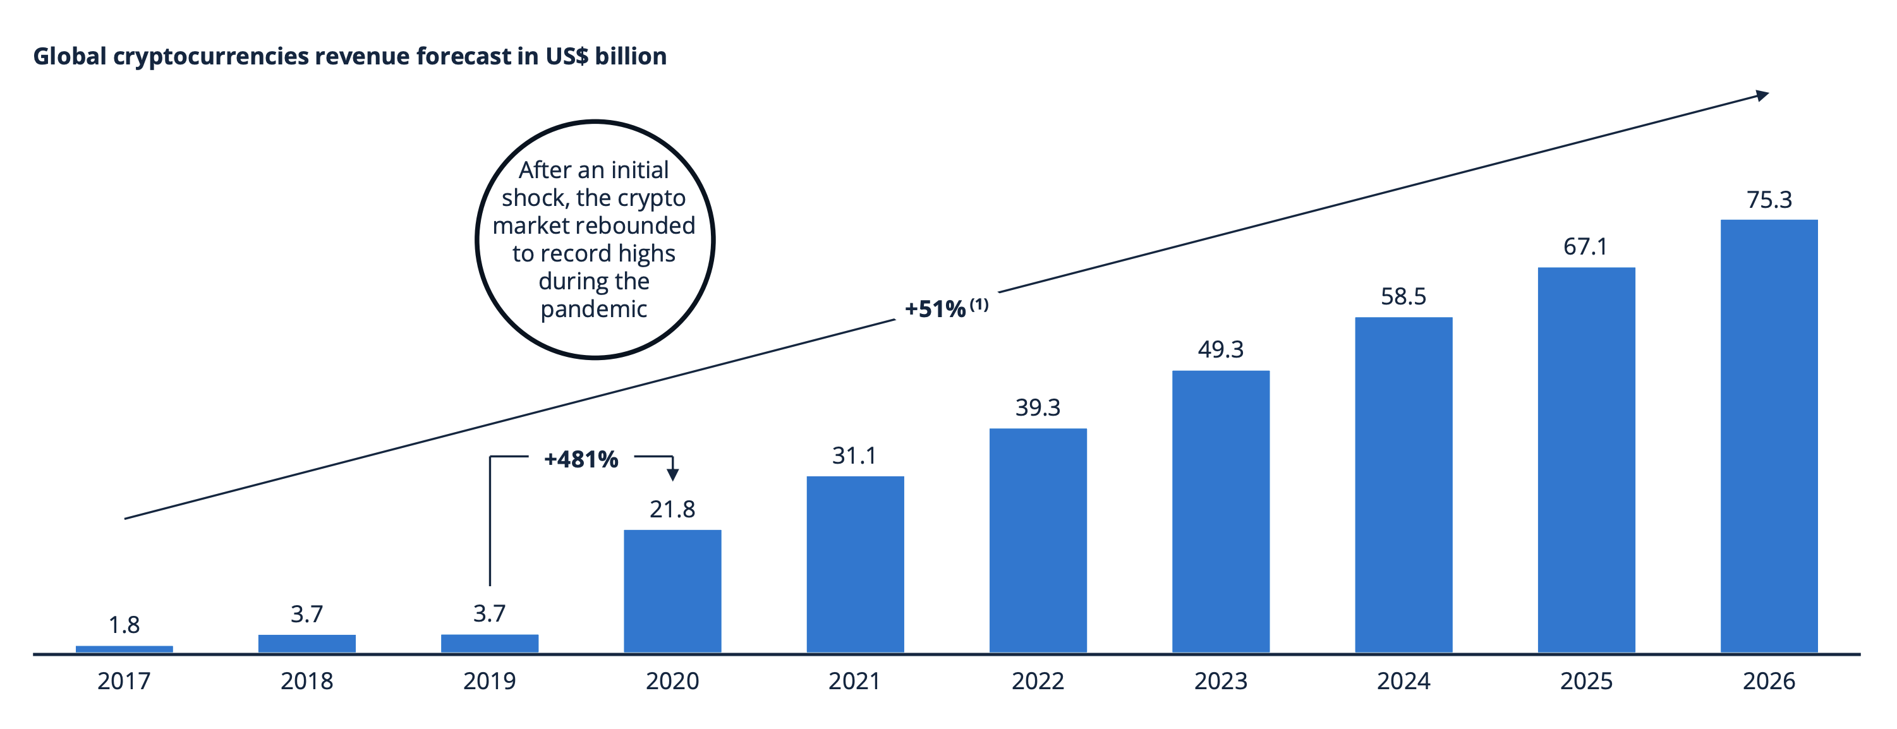
GAP 2 analysis: Crypto is the one making real money under the cover of Metaverse!
The size of U.S. digital assets has doubled 215 times in five years. Non-state issued digital assets soar from $14 billion in early 2016 to $3 trillion by November 2021.
The market value of Bitcoin, Ether and other token economies has reached $1.9 trillion, close to Italy's annual GDP, making it "richer than the country”
The pandemic triggered a significant increase in revenues made in the crypto sector with growth of 481% from 2019 to 2020

Slide 12
GAP 3: Leading benefits of the metaverse worldwide in 2021
Benefits of the metaverse worldwide 2021
Share of respondents
8
Description: A late 2021 survey of global internet users found that overcoming obstacles that prevented them from doing something in real life was perceived as the biggest benefit of the metaverse. Enhancing creativity and imagination was ranked second with 37 percent of respondents claiming this as a benefit. The metaverse also holds promise for upskilling, education, and exploring new career opportunities. Read more
Note(s): Worldwide; 2021; 1,050 respondents
Source(s): Tidio

Slide 13
GAP 3: Metaverse potential consumer expenditure total addressable market in the United States as of 2022, by segment (in billion U.S. dollars)
U.S. metaverse potential consumer expenditure TAM 2022, by segment
Consumer expenditure TAM in billion U.S. dollars
7
Description: The metaverse market in the United States has a potential total consumer expenditure total addressable market of 8.3 trillion U.S. dollars as of 2022. Real estate (30.4 percent), motor vehicles (8.5 percent), and home related (8.44 percent) segments will account for the largest share of this expenditure. Read more
Note(s): United States; 2022
Source(s): BEA; Morgan Stanley; NCES; PwC US; US Census Bureau

Slide 14
GAP 3 analysis: We ‘re far behind the ideal world due to unsolved technical ethical and regulation problems
Leading barrier to creating the metaverse according to U.S. game developers 2021
Share of respondents
54
Description: A November 2021 survey of game developers in the United States found that the opinion on the single biggest barrier to creating the metaverse was split fairly evenly amongst the respondents. Overall, 17 percent of respondents claimed that privacy and ethics were the single biggest hurdle in creating the metaverse, and the same amount of responding developers felt the same about cyber security being the biggest impediment. Read more
Note(s): United States; November 18 to 29, 2021; 400 respondents; game developers
Source(s): OnePoll; Various sources (Improbable)

Slide 15
GAP 4: Two Pillar Technologies are expected to form an ideal Metaverse
Pillar One: Immersive interaction
Pillar Two: Distributed System
emphasizing the application of front-end technologies to enhance user experience and the application of technologies such as extended reality (XR).
The communication network evolution route determines its development level, and as the network evolves from fixed broadband and mobile Internet to high-speed mobile communication technologies such as 5G and 6G, the
The front-end immersive interactive applications that can be realized on the user side are becoming richer and richer.
emphasizing the back-end technology system oriented to organizational structure, based on distributed architecture and the application of technologies such as blockchain.
The Internet evolution route determines its development level. As the Internet goes from Web 1.0 with platform, Web 2.0 with users producing and disseminating content, to the new Web 3.0 system where users have more autonomy over their identity, data and algorithms.
Blockchain technology can enable users to have more autonomous control over their own identity and wealth, etc.

Slide 16
GAP 4: Expected features of the metaverse according to video game developers
Metaverse feature expectations according to U.S. game developers 2021
Share of respondents
51
Description: A November 2021 survey of game developers in the United States found that 37 percent of respondents expected to find access to a variety of gaming activities in the metaverse. Another top expected feature were the opportunities to create and sell content. Read more
Note(s): United States; November 18 to 29, 2021; 400 respondents; game developers
Source(s): Improbable; OnePoll

Slide 17
GAP 4: Augmented reality (AR), virtual reality (VR), and mixed reality (MR) market size worldwide in 2021 and 2028 (in billion U.S. dollars)
XR/AR/VR/MR market size 2021-2028
27
Description: The global augmented reality (AR), virtual reality (VR), and mixed reality (MR) market reached 28 billion U.S. dollars in 2021, rising to over 250 billion U.S. dollars by 2028. Read more
Note(s): Worldwide; 2021
Source(s): The Insight Partners

Slide 18
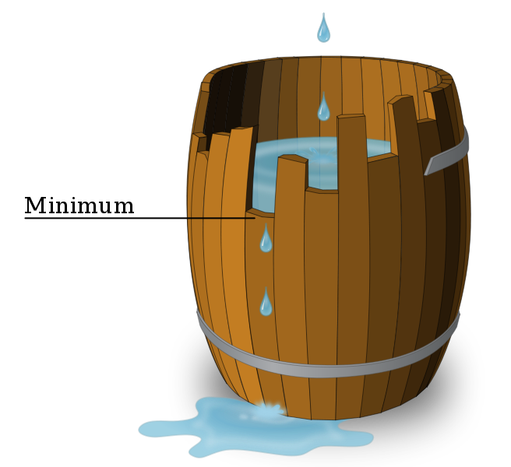
GAP 4 analysis: Fusion of different sets of technologies is the key to unlock the door to metaverse, which we don’t have
AI
Blockchain
AR/VR
1. KEY TECH MISSING
MISSING
2. COLLEBRATIVE TECHNOLOGY MISSING

Slide 19
GAP 5: Consensus on Metaverse are hard, even with definitions
Metaverse description according to U.S. game developers 2021
Share of respondents
27
Description: A November 2021 survey of game developers in the United States found that when trying to describe the metaverse, over half of respondents settled on a definition of that included a combination of multiple elements of technology, including virtual reality, augmented reality and video where users lived within a virtual world. Only a third of respondents felt that "the next version of a global internet" was an applicable description. Read more
Note(s): United States; November 18 to 29, 2021; 400 respondents; game developers
Source(s): Improbable; OnePoll

Slide 20
GAP 5: Definition of the metaverse according to companies worldwide that have already invested in the metaverse as of March 2022
Global business definition of the metaverse 2022
Share of respondents
63
Description: According to a March 2022 survey of companies from selected countries that have already invested in the metaverse, over a third of businesses defined the metaverse as a virtual world. Additionally, Facebook's rebrand as Meta Platforms at the end of 2021 has also had an effect as 20.63 percent of survey respondents claimed that the metaverse was "Facebook's new name". Read more
Note(s): Worldwide; February 24 to March 1, 2022; 200 respondents; companies that have already invested in the metaverse; wider industry metrics may vary
Source(s): Sortlist

Slide 21



Gap 5 : Metaverse has far more players than expected
Leading business sectors already investing in the metaverse 2022
Share of respondents
Description: According to a March 2022 survey of companies from selected countries that have already invested in the metaverse, businesses in the computer and IT sector were most like to have done so already. Overall, 17 percent of companies in this sector had already invested in the metaverse as a business opportunity, with the education sector coming in second as 12 percent of responding businesses had already decide to pursue this business avenue. Read more
Note(s): Worldwide; February 24 to March 1, 2022; 200 respondents; companies that have already invested in the metaverse; wider industry metrics may vary
Source(s): Sortlist

Slide 22
Gap 5 Analysis: Standardization should focus on the incremental part of Metaverse
Separate Tech
Tech Fusion
Metaverse
New Players
Solid Background
New Challenges
Interoperability
Interfaces
Content oriented Technologies
Regulation and ethical problems
……

Slide 23


Thank you

