Slide 1
Joint IEEE 802 and ITU-T Study Group 15 Workshop
Overview of G.8052.1
and its connection to the IEEE YANG
Kam LAM (CICT) Q14/15 Rapporteur

Slide 2
G.8052.1 Scope
Augment the IEEE 802.1Qcx CFM with Carrier Ethernet OAM
Take G.8052 IM (UML) as the base
Keep/refactor the OAM part and Prune the rest
Translate the IM into DM (YANG)
Augment the Qcx CFM YANG
G.8052 UML
Covers:
Forwarding
OAM (G.8013)
Protection (G.8031, G.8032)
G.8052.1 UML
Covers:
OAM (G.8013)
G.8052.1 YANG
Covers:
OAM (G.8013)
Pruning & Refactoring
Translation

Slide 3
Carrier Ethernet OAM Functions
 | SDO | OAM | Op-code
CFM | IEEE 802.1 | CCM, LBM/LBR, LTM/LTR | 1..7
Carrier | ITU-T SG15 G.8013 | GNM/BNM, AIS, LCK, TST, APS, MCC/EDM, 1DM, DMM/DMR, LMM/LMR, 1SL, SLM/SLR EXM/EXR, VSM/VSR, CSF | 32..54
Service | MEF | LLM/LLR, SAT | 56..59
Link | IETF | TRILL | 64..67

Slide 4
IEEE CFM YANG Reverse-engineered UML
Source CFM YANG: https://github.com/YangModels/yang/tree/master/standard/ieee/draft/802.1/Qcx
Re-engineered UML: https://www.itu.int/ifa/t/2017/sg15/exchange/wp3/q14/2019.09-2020.01_eMeeting_Modeling/cd/cd05r7_PapyrusIeeeCfmOxygenWorkspace_2019.10.15.zip
High level diagram:
Detail diagram:
Actions, Alarms, CFM Bridge, Bridge, CFM Data types, 1Q Data types, 1AB Data types, Data types

Slide 5
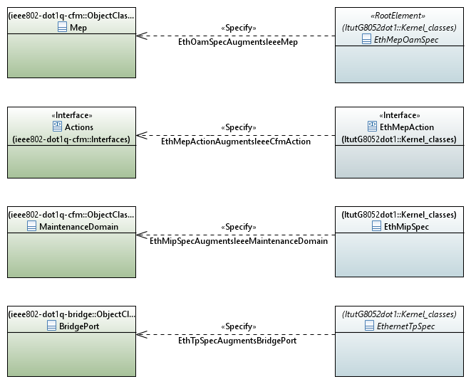
Augmentation
G.8052.1 UML augments the CFM re-engineered UML

Slide 6
G.8052.1 UML
G.8052.1 UML: https://www.itu.int/ifa/t/2017/sg15/exchange/wp3/q14/G.8052.1/G.8052.1_current/
Pruned/refactored from the base G.8052 UML
Termination point
MEP OAM
Current data and Threshold
History data
MIP
Operations
Measurement Jobs

Slide 7
G.8052.1 YANG
G.8052.1 YANG: https://www.itu.int/ifa/t/2017/sg15/exchange/wp3/q14/G.8052.1/G.8052.1_current/
Yang module
Yang tree

Slide 8
Interworking
Client and server implementation scenarios
 | IEEE client ieee yang | ITU client ieee yang + itu yang
IEEE server ieee yang | A ieee yang | C ieee yang
ITU server ieee yang + itu yang | B ieee yang Note: The client will only configure the ieee yang The itu yang will be ignored by the client | D ieee yang + itu yang

Slide 9
In progress: OAM parameter comparison/mapping
ieee802-dot1q-cfm.yang | G.8021 parameter
cfm/maintenance-group/mep/mep-db/rmep-failed-ok-time: ro mandatory | Not supported in ITU-T. Need to agree on what value the ITU-T server to put into this leaf when encoding the value (to indicate it is not supported).
cfm/maintenance-group/mep/mep-db/mac-address: ro mandatory | Not supported in ITU-T. Need to …
cfm/maintenance-group/mep/mep-db/port-status-tlv: ro optional | Not supported in ITU-T. It is optional. Not support is fine.
cfm/maintenance-group/mep/mep-db/interface-status-tlv: ro optional | Not supported in ITU-T. It is optional. Not support is fine
cfm/maintenance-group/mep/continuity-check/defect: 5 bits: def-rdi-ccm, def-mac-status, def-remote-ccm, def-error-ccm, def-xcon-ccm | No cDEG, no cUNPr xcon-ccm is composition of cUNL and cMMG error-ccm is composition of cUNP and cUNM Proposal solution: define an itu-defects leaf, with typedef .., and describe the relationship of some of the bits with the 802.1 mep-defect-type
cfm/maintenance-group/mep/action: transmit-loopback/input: loopback-input-grouping: case dest-mep-id | Case dest-mep-id is not supported.
cfm/maintenance-group/mep/action: transmit-loopback/output: leaf lbm-request-id | To check and verify whether this is Transaction ID/Sequence Number (see Figure 9.3-1/G.8013)
cfm/maintenance-group/mep/action: transmit-linktrace/input: linktrace-input-grouping: case target-mep-id | Case target-mep-id is not supported? To check and verify whether this is TargetMAC Address (see Figure 9.5-1/G.8013)
cfm/maintenance-group/mep/action: transmit-linktrace/input: linktrace-input-grouping: leaf ltm-flags | To check and verify whether this is Flags (see Figure 9.5-1/G.8013)
cfm/maintenance-group/mep/action: transmit-linktrace/output: ltm-transaction-id | To check and verify whether this is Transaction ID (see Figure 9.5-1/G.8013)
cfm/maintenance-group/mep/action: transmit-linktrace/output: ltm-egress-identifier | To check and verify whether this is Egress Identifier (see Figure 9.5-3/G.8013)
cfm/maintenance-group/mep/linktrace-reply/responses/ltr-receive-order | This SHOULD be a stamp assigned by the Linktrace initiator to the received LTR frame, not a field inside the LTR frame. This SHOULD belong to G.8021 (the process at the sink function of the initiator MEP), instead of G.8013. Currently G.8021 bundles all of the LTR results into a single "Results" parameter, it doesn't say how the different responses are distinguished within this. This will require update to G.8021.
cfm/maintenance-group/mep/linktrace-reply/responses/ltr-forwarded | To check and verify whether this is the FwdYes flag (see figure 9.6-2 of G.8013)
cfm/maintenance-group/mep/linktrace-reply/responses/ltr-terminal-mep | To check and verify whether this is the TerminalMEP flag (see figure 9.6-2 of G.8013)
cfm/maintenance-group/mep/linktrace-reply/responses/ltr-relay | To check and verify whether this is the RelayAction field (see figure 9.6-1 of G.8013)

Slide 10
Status
G.8052.1 (draft):
Text: v0.12 in TD521/3 (1/2020)
Models: https://www.itu.int/ifa/t/2017/sg15/exchange/wp3/q14/G.8052.1/G.8052.1_current/
Need the A.5 justification for the normative reference to IEEE 802.1Qcx CFM, including the YANG

Slide 11
THANK YOU

