Slide 1
Joint IEEE 802 and ITU-T Study Group 15 Workshop
ITU-T Information & Data Modeling and Status
Kam LAM (CICT) Q14/15 Rapporteur

Slide 2
ITU-T Q14/15 Modeling Work
Mandate & Scope
Modeling Methodology
Evolution
Pruning/Refactoring & Augmentation
UML to YANG Generation
Status

Slide 3
Q14/15 Mandate & Scope
Management and control of transport systems and equipment
Technology architecture & function → Management/Control
requirement, information model, data model
 | Generic | SDH | OTN (L1) | Carrier Ethernet | MPLS-TP | MTN | Media (L0) | Sync
Transport Architecture | G.800 G.805 G.807 | G.803 | G.872 | G.8010 | G.8110.1 | G.media-arch | G.807 | G.8265.1 G.8275.1 G.8275.2
Interface |  |  | G.709 | G.8013 | G.8113.x | G.mtn | G.698.1..4
Equipment Function | G.806 | G.783 | G.798 | G.8021 | G.8121.x | G.mtn-eqpt G.mtn-prot
Mgmt/Control Requirement | G.7710 | G.784 | G.874 | G.8051 | G.8151 | G.mtn-mgmt | G.876 | G.7721
Information Model | G.7711 | G.774.1-10 (CMISE) | G.875 | G.8052 | G.8152
Data Model |  |  |  | G.8052.1/2 | G.8152.1/2 |  |  | G.7721.1
Q10,
Q11,
Q12,
Q13
Q14

Slide 4
Model Development Methodology
Common Information Model
Interface Creation Process
Core Model G.7711 / ONF TR-512
Forwarding & Termination
Foundation
Topology
Resilience
Physical
….
View of the common IM for a particular purpose
Map
Data schema
for interface 1
Map
Interface
instance 1
Prune/refactor
Map
Interface instance 2
Technology specific models, e.g.,
G.875 OTN
G.8052 Transport ETH
Application specific models (e.g. storage)
xxx model
Guidelines
UML
Common Guidelines
Papyrus tool and GitHub
Common process
Interface specific
Interface specific
Interface specific
Model structure

Slide 5
UML Modelling Guidelines evolution
multi SDO
UML Modeling Guidelines IISOMI 514
UML Modeling Guidelines ONF TR-514
ITU-T SG15 Modelling Guidelines
NGCOR Modelling Requirements
Other candidates:
ONAP
OIF
…
JWG MA Model Repertoire

Slide 6
Information Model evolution

Slide 7
Influence Across Standards and Open Source
ONF OTCC
TAPI FRS
Use cases & Requirements
ONF OIMT
ONF OIMT
TAPI UML Information Model
Open Model Profile
ONF Core Information Model
UML-YANG
Generation Tool
ONF Technology Specification Models
TAPI YANG
Data Schema
SNOWMASS TAPI SDK
YANG-SWAGGER Generation Tool
SWAGGER/REST APIs
Python Stub Generation Tool
OTN
(ITU-T G.874.1)
ETH
(ITU-T G.8052)
MPLS-TP
(ITU-T G.8152)
Code
Python Reference Implementation
EAGLE Modeling Tools
Technology Generic Core Model
(ITU-T G.7711)
ITU-T SG15
MEF
Open CS Implementations
OIF
Interop Implementations
NRM
NRP
Optical Transport
Packet WAN
Multi-carrier
T-SDN Interop
Implementation Agreements & Certification
MEF Models

Slide 8
Pruning/Refactoring example
ONF OIMT
ONF OTCC TAPI
Core Information Model
(TR-512 / G.7711)
Pruning & Refactoring (P&R)
TAPI UML Information Model
ONF Technology Specification Models
How: Spec model approach (TR-512.7 / G.7711 Annex G)
What: Technology IMs
OTN
(G.875)
ETH
(G.8052)
MPLS-TP
(G.8152)
SYNC
(G.7721)
Media
(G.876)
ITU-T SG15
Technology IMs

Slide 9
UML Modelling
UML Modeling Guidelines
ONF TR-514 v1.3 (IISOMI-514 v1.3)
https://www.opennetworking.org/software-defined-standards/models-apis/

Slide 10
UML Modelling Tools
Papyrus & Github Guidelines
ONF TR-515 v1.3 (IISOMI-515 v1.3)
https://www.opennetworking.org/software-defined-standards/models-apis/

Slide 11
UML to YANG Mapping
Mapping Guidelines
ONF TR-531 v1.1 (IISOM-531 v1.1)
https://www.opennetworking.org/software-defined-standards/models-apis/
Mapping Tool
xmi2yang
https://github.com/OpenNetworkingFoundation/EagleUmlYang
To download the tool:
Go to https://github.com/OpenNetworkingFoundation/EagleUmlYang,
click , select “Download ZIP”
Extract the zip file
Put the “xmi2yang” folder anywhere you like in your explore.

Slide 12
UML to YANG Mapping Tool
Open Source Tool: https://github.com/OpenNetworkingFoundation/EagleUmlYang
Background:
Initially developed by the ONF open source project “EAGLE”
Now run by the Informal Inter SDO Open Model Initiative (IISOMI), including active participants from ONF, ITU-T SG15, MEF, TMF, …
Mapping Guidelines (rules): IISOMI-531 v1.3
Mapping Tool: xmi2yang
Programming language: JavaScript
Set up the running environment: node.js (download from https://nodejs.org/en/ the node-v8.9.4-x64.exe and run it once)
Also, from time to time, update the environment by running the command “npm install” in the folder xmi2yang
How to run:
Copy the UML file of the UML model into the “project” sub-folder of the xmi2yang directory
Run the command “node main.js” at the xmi2yang directory
The YANG file will be generated in the “project” sub-folder
Validate the YANG file at http://www.yangvalidator.com/ and get also the YANG Tree.

Slide 13
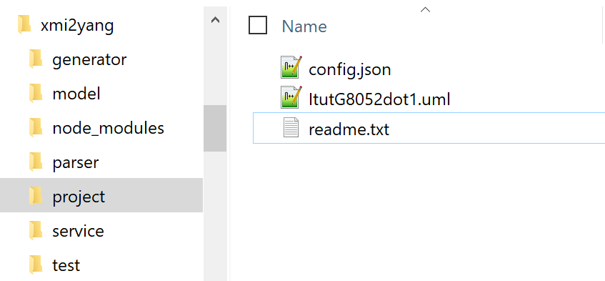
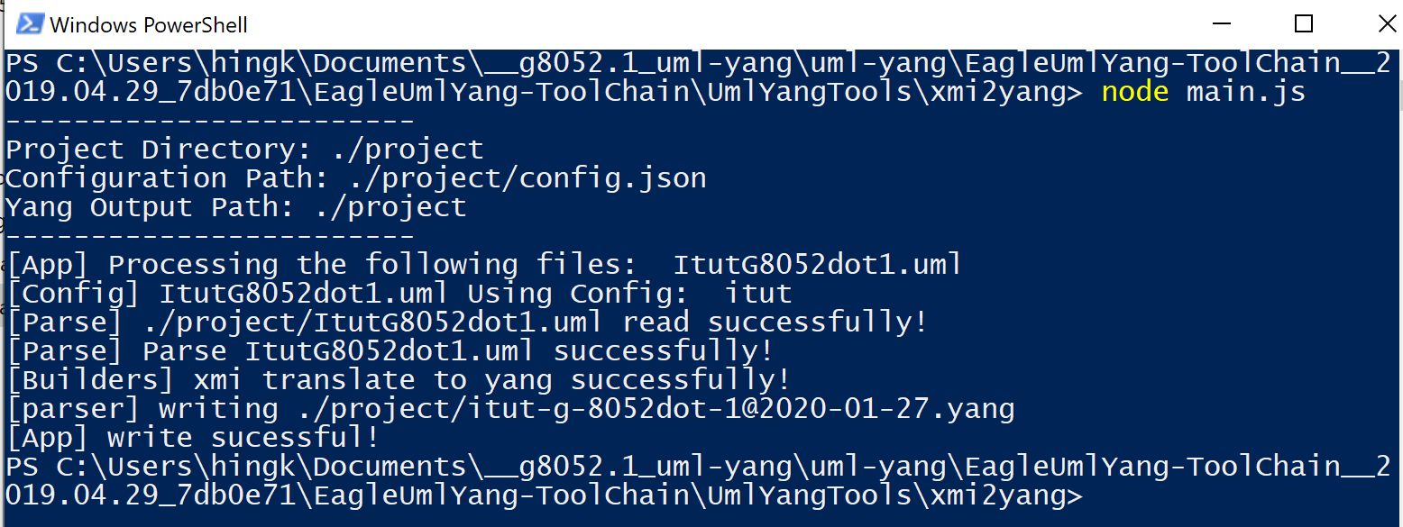
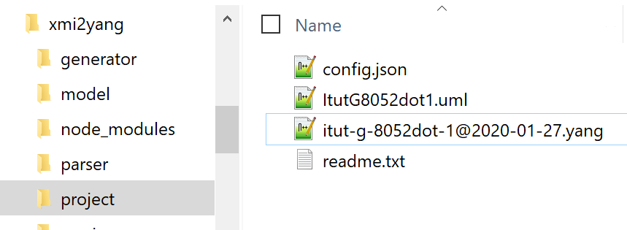
UML to YANG Mapping Tool - Demo
The model
The tool
Run!
The output

Slide 14
Status of ITU-T Technology-specific and Generic Information Models
G.7711 – Core information model, generic to transport technology; same model as ONF TR-512
v3.05 in TD370r1/3 (7/2019); to align with ONF TR-512 v1.4.1-info and consent in 9/2020
G.875 – OTN (L1)
v4.06 in TD439/P(1/2020); is planned for consent at this 2/2020 SG15 plenary meeting
G.876 – Photonic media (L0); requirements and information model
v0.09 in TD476/3 (1/2020); is progressing and planned for consent in 09/2020
G.7719 – Management/Control components IM; revision to ex. G.7718.1; v1.02 in TD373r1/3 (7/2019);
G.7721 – Synchronization IM; management requirements and information model; v1.0 approved in 11/2018;
G.7721.1 – Synchronization management data model; v0.01, Just started
G.8052 – Carrier Ethernet; v3.02 in TD484/3 (1/2020);
G.8052.1 – OAM information/data model for Carrier Ethernet; v0.12 in TD521/3 (1/2020);
G.8052.2 – Resilience information/data for Carrier Ethernet; v0.12 in TD521/3 (1/2020);
G.8152 – MPLS-TP; V1 (12/2016);
G.8152.1 – OAM information/data model for MPLS-TP; v0.04 in TD486/3 (1/20202)
G.8152.2 – Resilience information/data model for MPLS-TP; v0.04 in TD487/3 (1/20202)
G.mtn-mgmt – MTN management requirements and information model; just started

Slide 15
THANK YOU

