Slide 1
5G Ecosystem
JCA-IMT2020
Scott Mansfield

Slide 2
Thanks!
5G Ecosystem
Transport Building Blocks
Enhancing the Ecosystem
Takeaway

Slide 3
Ecosystem

Slide 4
Transport Network Building Blocks
ITU-T Study Groups 13 and 15 are an integral part of the Standard Ecosystem necessary to enable the Transport Network capable of supporting 5G
Service Scenarios
Network Softwarization, Slicing, Orchestration
Quality of Service Aspects for IMT-2020
Control Plane Technologies
Transport and Access Network Protocols
Equipment Requirements
SG 13
SG 15

Slide 5
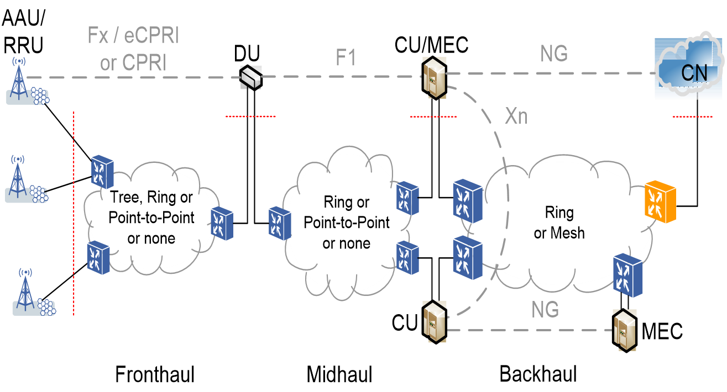
Transport Software Defined Networking
Customer Controlled Slicing
Intent-Driven Slicing
Customer Controlled Slicing
Once the network can be controlled programmatically (data and control planes)
Addition of Machine Learning/Adaptive Artificial Intelligence is logical next step
Metrics Collection (Big Data)

Slide 6
Enhancing the Ecosystem
ITU-T FG-ML5G
ITU-T Proposed work on Quantum and AI for Autonomous Driving
ETSI ISG ENI Experiential Networked Intelligence
https://www.etsi.org/technologies/experiential-networked-intelligence
ETSI ISG SAI - Securing AI
https://www.etsi.org/committee/1640-sai
ETSI ISG ZSM - Zero touch network and service management
https://www.etsi.org/technologies/zero-touch-network-service-management
O-RAN
https://www.o-ran.org/specifications
ONAP Acumos
https://wiki.onap.org/display/DW/Artificial+Intelligence+and+Deep+Learning

Slide 7
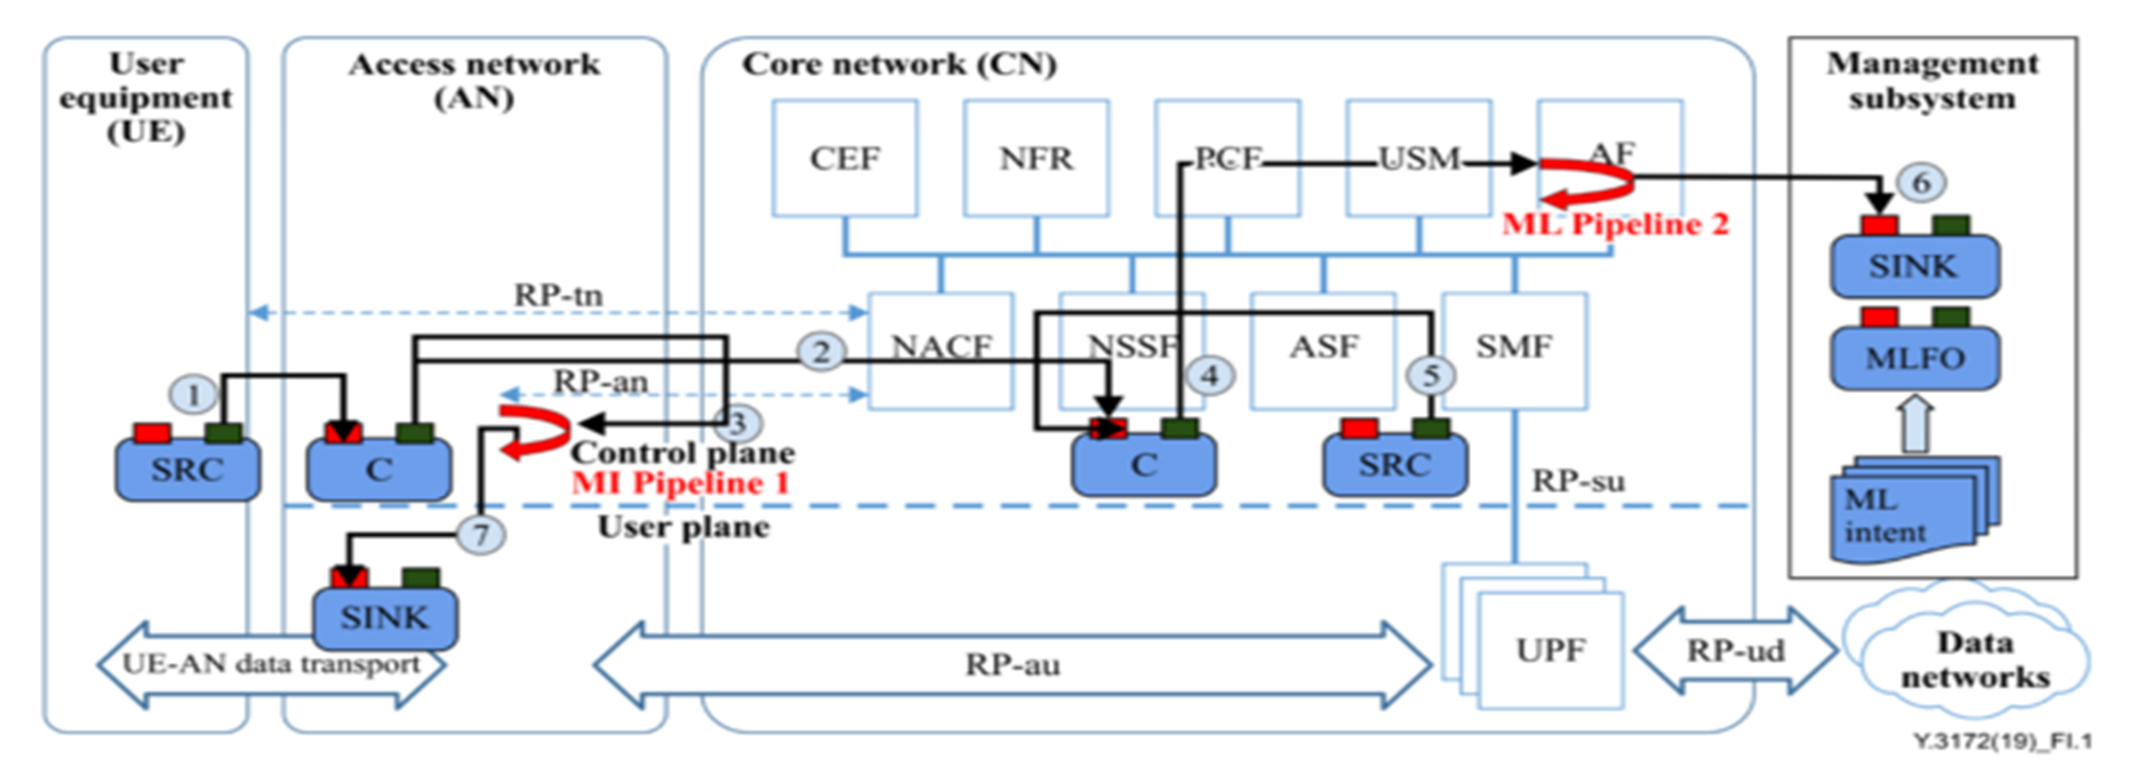
Related Work: ML5G

Slide 8
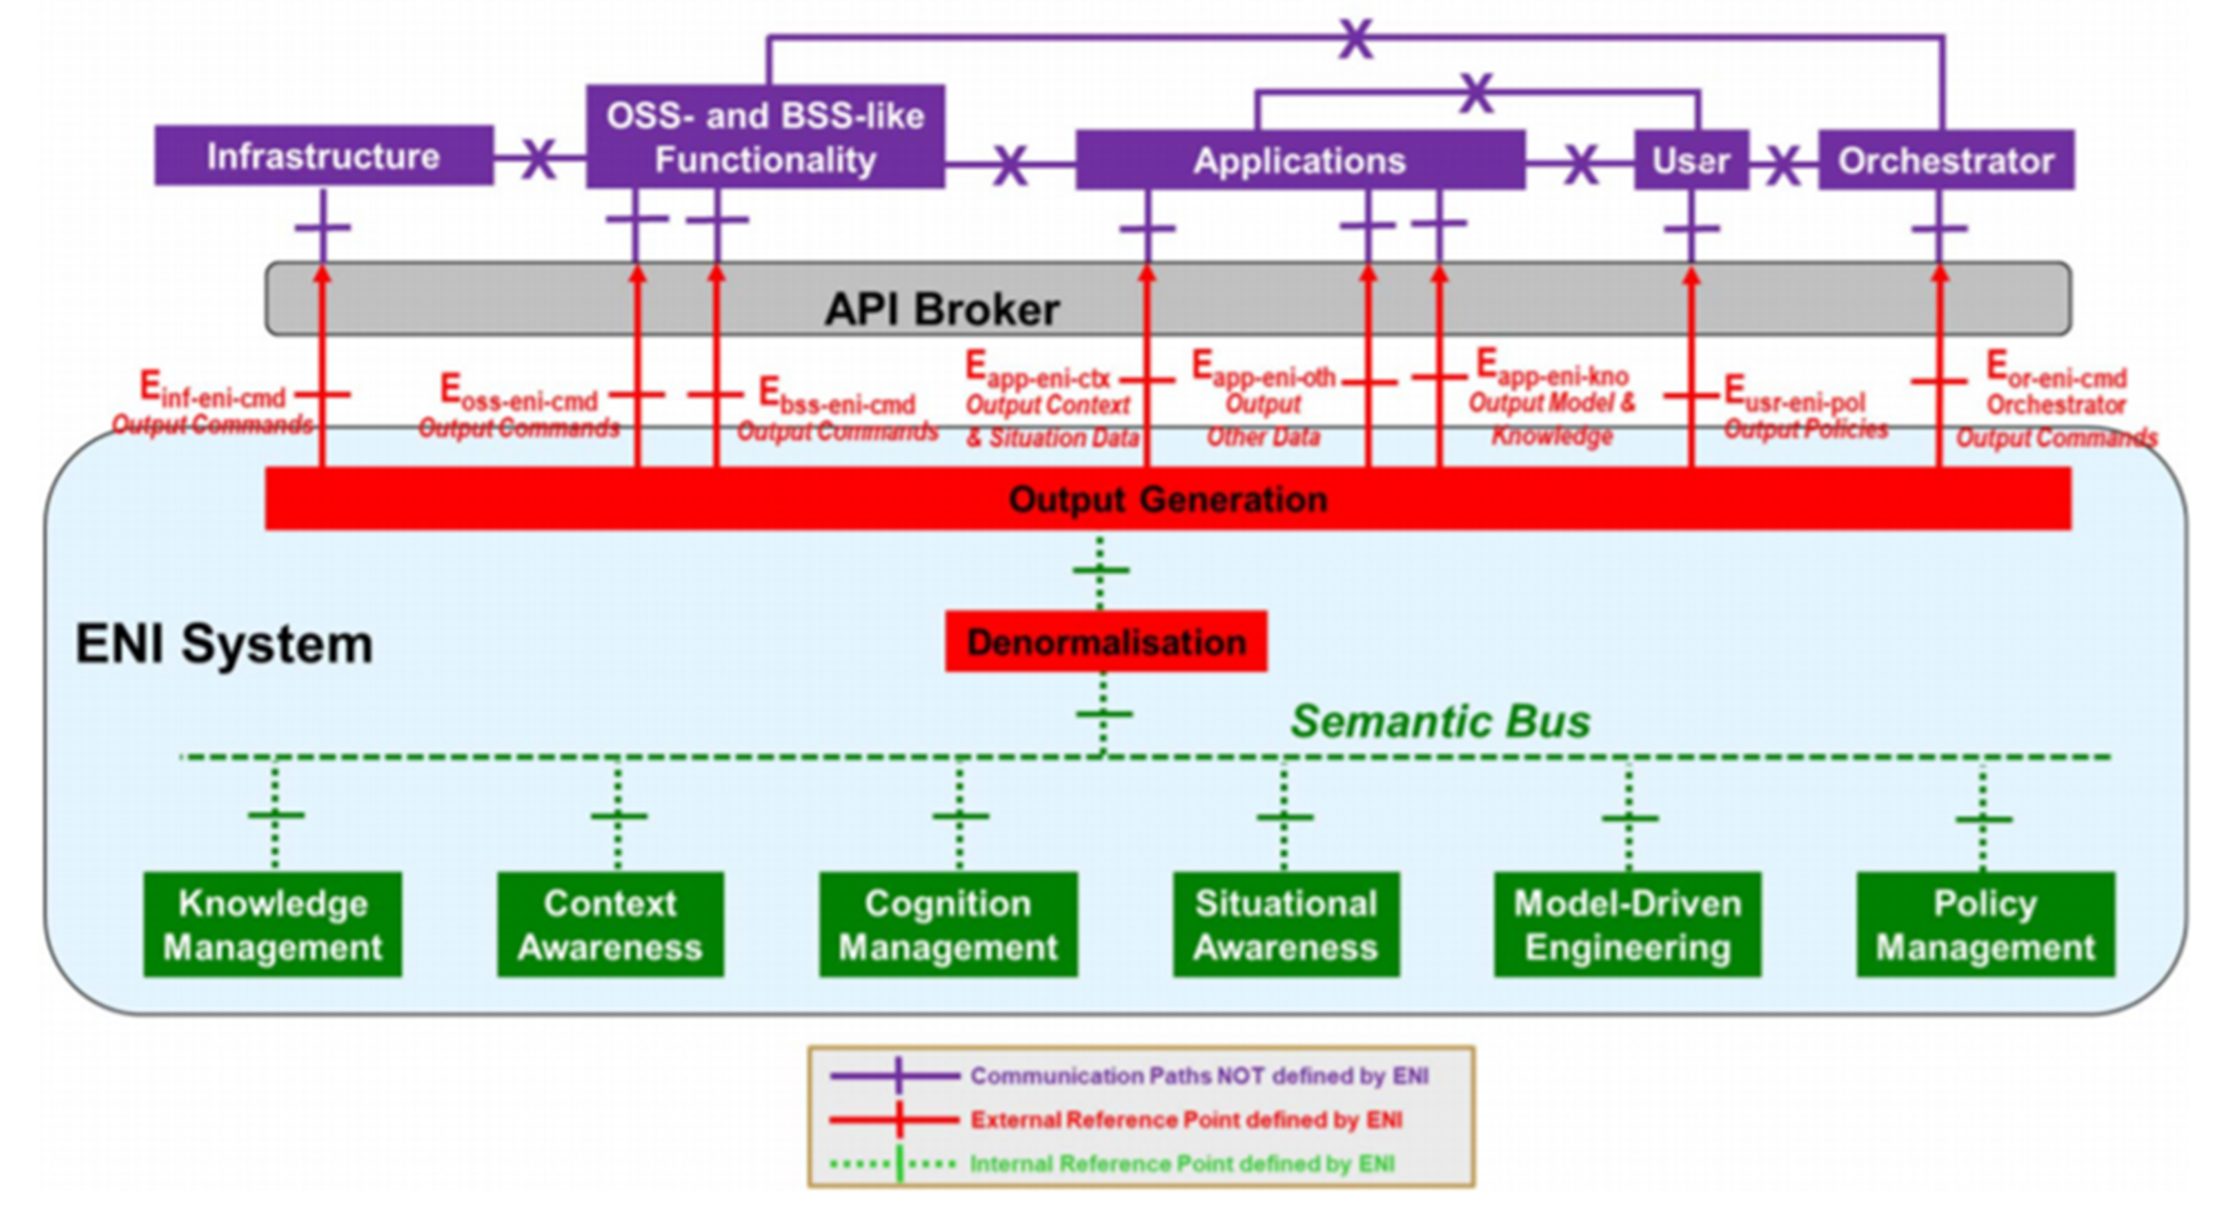
Related Work: ETSI ENI
Experiential Networked Intelligence

Slide 9
JCA-IMT2020
Joint Coordination Activity for IMT2020
https://www.itu.int/en/ITU-T/jca/imt2020/Pages/default.aspx
Roadmap: JCA-IMT2020 Roadmap
Come to the next meeting!
Thursday 17 October 2019 (1800-1930)

Slide 10
Takeaway
Collaboration is Key!
Networking is more than just moving bits!
Intelligence and Computation in the Network is Coming!

