Slide 1
Experience of Uzbekistan in implementation of e-services in the development of society

Slide 2
INTRODUCTION
the usage of information technologies to involve the public in the decision-making processes and developing public policy
E-services and measures taken to improve them
measures taken by the Government to solve actual issues and citizens' problems by ICT
the results achieved to improve business and in the field of non-cash payments
providing access to open data to ensure transparency of the activities of the state bodies and providing an opportunity to develop information systems, as well as services and applications for both government agencies and business entities.

Slide 3
Uzbekistan in the UN E-government ranking
Indicator | 2014 | 2016 | Changes
UN E-government development index | 100 | 80 | +20
TELECOMMUNICATION INFRASTRUCTURE INDEX | 119 | 119 | –
Online service index | 74 | 47 | +27
Human capital index | 86 | 91 | -5
E-PARTICIPATION INDEX OF UN | 71 | 47 | +24
UN experts noted launching portals :
Housing and communal services (e-kommunal.uz)
Open data (data.gov.uz)
System Regulatory impact assessment (regulation.gov.uz)
as positive examples of ensuring the state's mechanisms of openness, transparency and feedback to the public
3

Slide 4
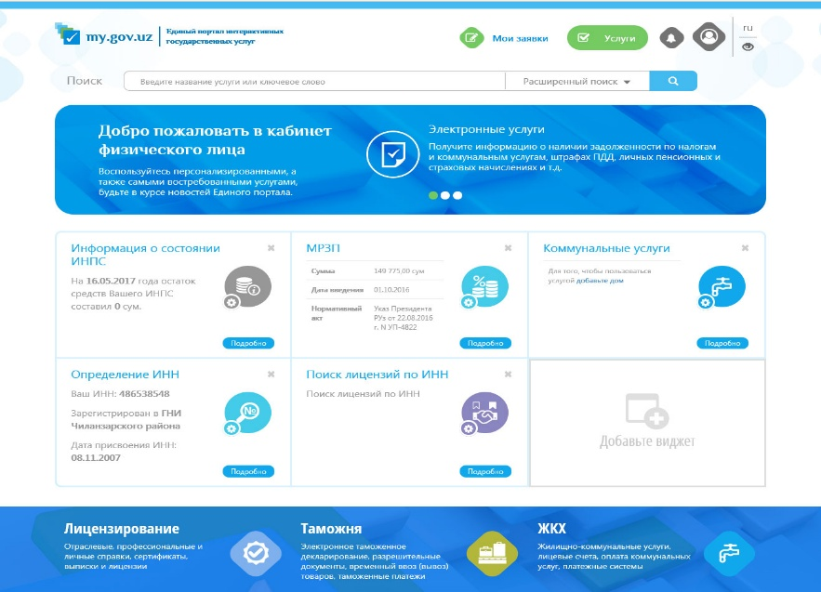
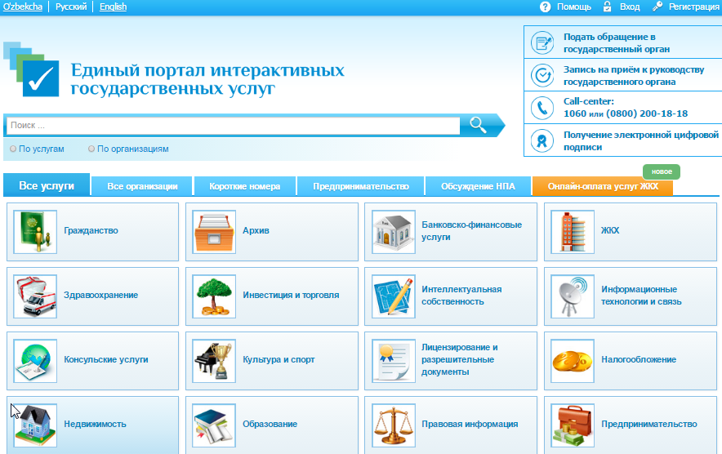
New edge of online services
New version
Current version
4

Slide 5
New Version of Single Portal of Interactive services state services
ONLINE SERVICES:
Only demanded and automated services
1. Informative 2. Automated 3. Semi-automated
Planned online services
Abroad travel sticker registration | Ministry of Internal Affairs
Temporary registration in Tashkent
Electronic queue at the passport offices
Electronic application for car purchase | Uzavtosanoat
Obtaining a license for pharmaceutical activities | Ministry of Healthcare
Registration of the real estate transactions | Ministry of Justice
5

Slide 6
The President acted as the guarantor of observance of the rights and freedoms of citizens, Constitution and laws of the Republic of Uzbekistan
Advantages:
Public confidence in government
The political will of the President in the development of E-government
Transparency
Each applicant has an opportunity to track the progress of
his appeal
The media and social networks can track actual problems
The prevention of corruption
Due to the direct access of public to the “government” activity, local officials are more attentive to solve local problems without excessive bureaucracy
Total
Completed
In process
6

Slide 7
Doing business index
From 2006 to 2016 in Uzbekistan was carried out totally 27 reforms. Due to these reforms, the Doing business index has risen from 154 to 87 rank.
Period of registration of business
Until launching the single Portal, business registration took an average from 2 days up to 7 days. From April, 2017, business registration is carried out in real time within 30 minutes from the moment of sending of statements through the one stop shops (single window centers).
7

Slide 8
Online business registration
SINGLE POINT FOR YOUR BUSINESS
RE-REGISTRATION OF BUSINESS Modify registration data in electronic form (the certificate on registration, constituent documents)
SUSPENSION AND LIQUIDATION
Want to close the business? To apply for the suspension of activities of individual entrepreneur or liquidation of organization will pass quickly and smoothly
SERVICES OF THE CENTERS ONE WINDOW
Provision of public services for your business in a single portal
REGISTRATION OF BUSINESS
Now you have the opportunity to apply to register a business and receive you have electronic documents online
8

Slide 9
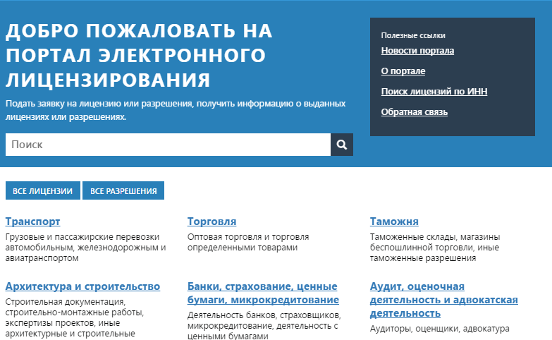
Electronic licensing - license.gov.uz
State body | Licenses
Ministry of ICT | 5088
Ministry of Justice | 3642
Ministry of Agriculture and water recourses | 2656
Ministry of Internal affairs | 870
Agency of Intellectual property | 389
41 of 62 licensed activities
128 363
information about register of licenses and permissions
9

Slide 10
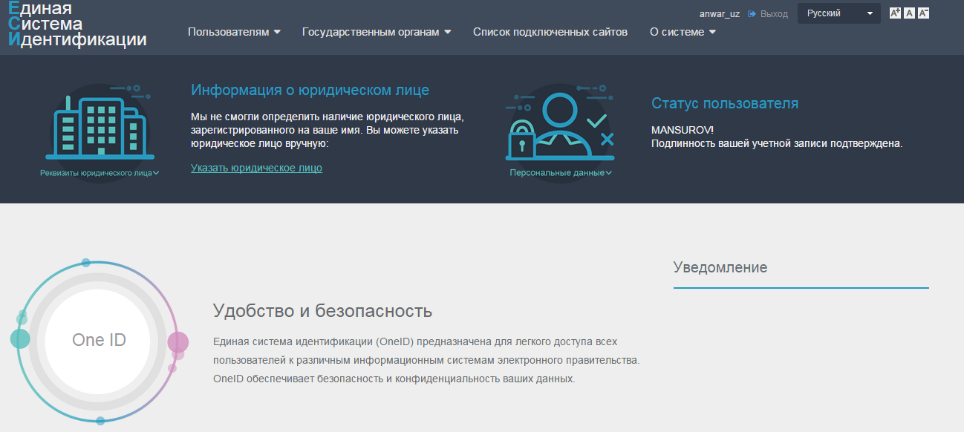
Single identification system - id.gov.uz
Launched in October, 2016
Advantages:
One account for all e-government systems
2. Definite identification of individuals and legal entities
3. Privacy of users’ data
10 500 users are registered already
The list of connected resources
fo.birdarchа.uz
10

Slide 11
ICT Implementation into the court system and e-procurement
171 584 requests have been received and 118 753 of them have been satisfied during the period 2013-2016
Volume of corporate purchases - "E-xarid" for 2016: - compiled - 444.8 billion UZS - increased by - 29.3% Savings of financial resources - 95.5 billion UZS (39.6% more than in 2015) The share of small businesses - 97%
On state purchases, the volume of electronic trading in the system - «E-xarid" for 2016: - compiled - 596.1 billion UZS - increased by - 19,9% Savings of budgetary funds - 133.0 billion UZS. The share of small businesses is 99%
11

Slide 12
Electronic payment - business accelerator
Currently in Uzbekistan more than 11 million cards of "UZCARD EMV" (online) system are put into operation.
The volume of non-cash payments via online cards in 2016 - 48,30 trillion UZS, 19% more than - 22,04 trillion UZS in 2015.
The amount of purchases paid by offline cards has decreased by 71% for 2016.
The number of transactions by debit cards in 2016 – 916,2 mln. UZS, 34% more than - 391,0 mln. UZS in 2015.
12

Slide 13
Opendata - open, transparent and effective tool
Top 5 datasets
State body | Datasets
Khokimiyat of Tashkent region | 303
State Committee on statistics | 230
Khokimiyat of Tashkent city | 211
Khokimiyat of Djizakh region | 165
Khokimiyat of Syrdarya region | 109
Currency rates of Central Bank | Central Bank
The numbers of the established telephone hotlines of the divisions and the branch services of the Ministry of Internal Affairs | Ministry of Internal Affairs
Register of medicines produced abroad | Ministry of healthcare
Demographic data of the Surkhandarya region | Khokimiyat of Surkhandarya region
List of legal documents formed in the field of information technologies and communications | UNICON.UZ
Dataset | Download | Organization
2 687 | 877 556 | 125
13

Slide 14
Big data in Uzbekistan
What have got
What is planning
Banks and Cellular companies
Analyzing information of cameras
Large retail chains
Analyzing information of GPS on public transportation
Transport and logistics companies
Traffic flows
Classification of citizens’ appeal on pm.gov.uz
Analyzing social networks
14

Slide 15
Thanks for your attention!
NOZIMJON DALIBAEV
Deputy director of UZINFOCOM Computerization and information technologies development center Email: info@uzinfocom.uz
Telephone: +998 (71) 238-4200

