Slide 1

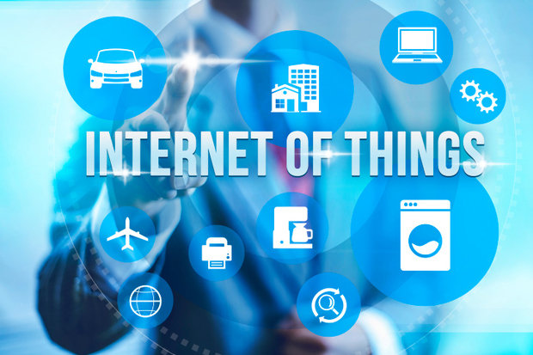
MINISTRY OF DEVELOPMENT OF INFORMATION TECHNOLOGIES AND COMMUNICATIONS OF THE REPUBLIC OF UZBEKISTAN
TASHKENT UNIVERSITY OF INFORMATION TECHNOLOGIES
NAMED AFTER MUHAMMAD AL-KHWARIZMI
ABOUT PREPARATION OF PERSONNEL POTENTIAL IN THE DIRECTIONS OF DEVELOPMENT THE INTERNET OF THINGS
Professor R. Isaev

Slide 2
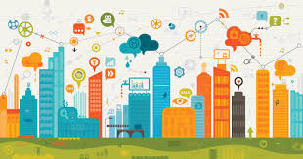
The “Internet of Things” offers great opportunities for the country's economy sectors: improving efficiency, reducing costs, reducing risks, increasing the reliability of assets, and increasing incomes. However, the introduction of IoT technologies is a complex process that requires a state strategy, an implementation plan, and a comprehensive assessment of possible risks and benefits.
It is known that the solution of these problems requires a highly qualified human resources potential in the IoT.
In this regard, this report examines the development of IoT, international experience in training human resources and suggests an approach to the systematization of training human resources in the field of IoT.

Slide 3
IoT strategies include
What tasks for are being implemented IoT?
Which IoT technologies necessary to use?
How IoT will affect to the economy?
Main objectives of implementation
Development of new income sources
Improving the quality of services
Increasing the efficiency
How can we implement and support the IoT ecosystem?
What results will be achieved and in what time frame?
Decrease the risks and increase the safety

Slide 4
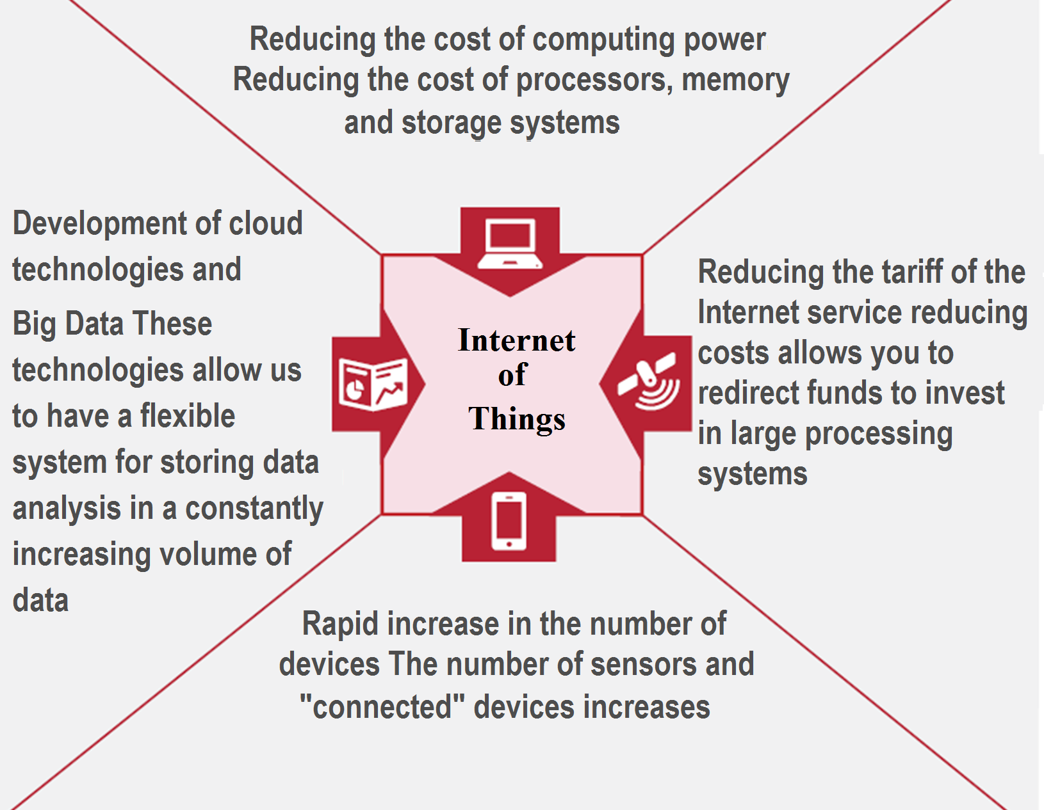
Development of IoT in the world became possible thanks to four technological trends:
to depreciation of computing capacities;
to reduction of tariffs for services of telecommunication;
to rapid growth of number of the “connected” devices;
to development of a cloud computing and Big Data (Figure 1).
Fig. 1. Technological trends in the basis of IoT.

Slide 5
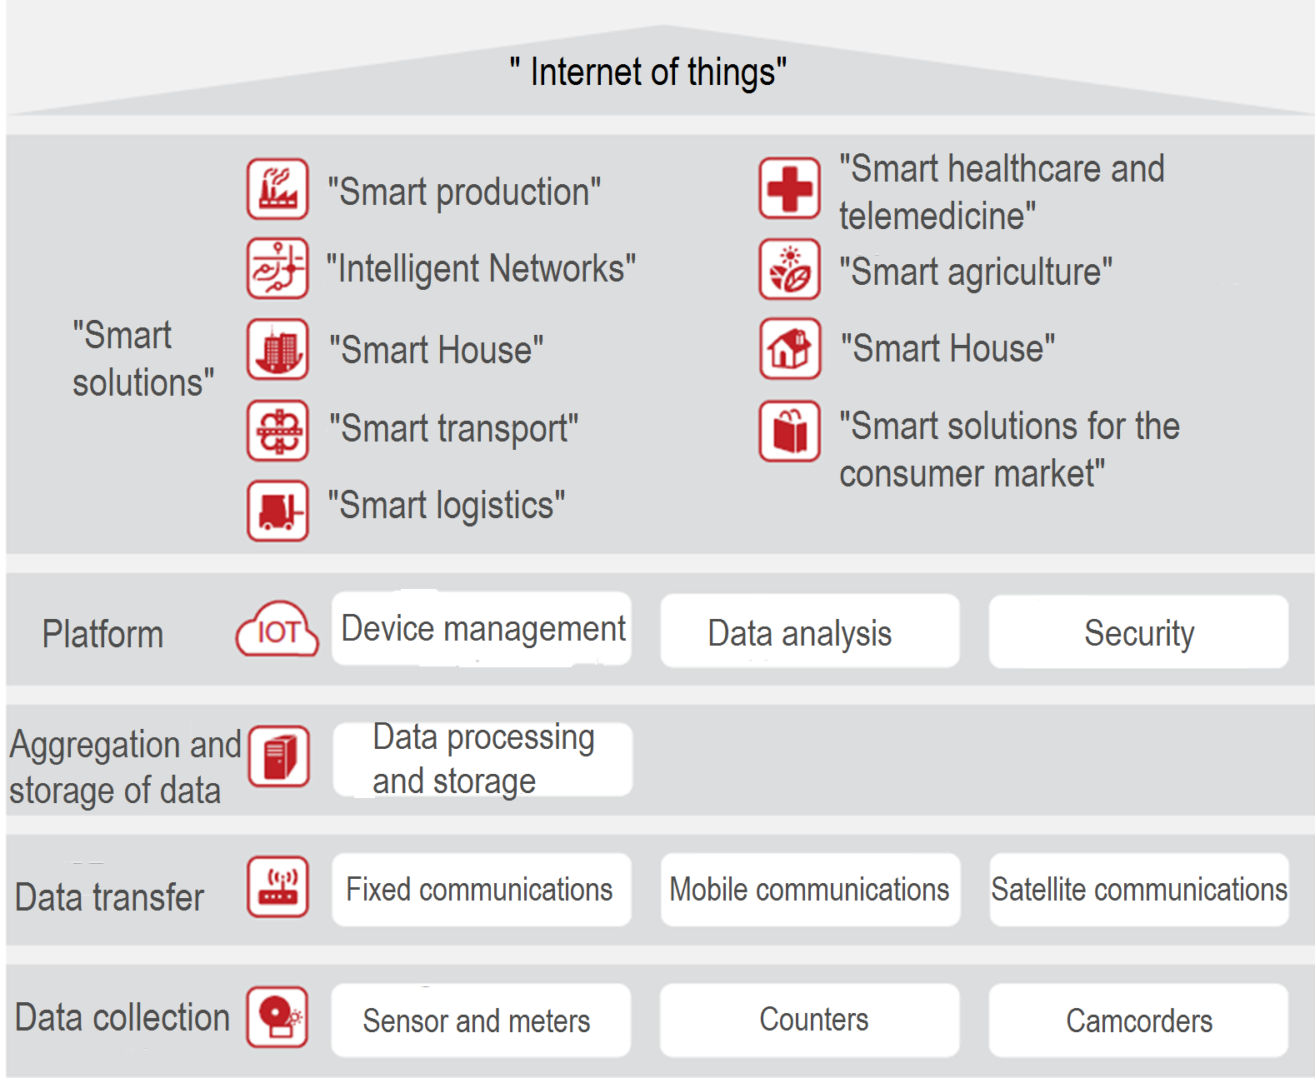
The development of IoT is not only an increase in the penetration of “connected” devices, but also the creation of a technological ecosystem - a set of technological solutions for data collection, transmission, aggregation and a platform that allows processing data and using it to implement “Smart" solutions (Figure 2).
Fig. 2. The technological ecosystem of IoT.

Slide 6
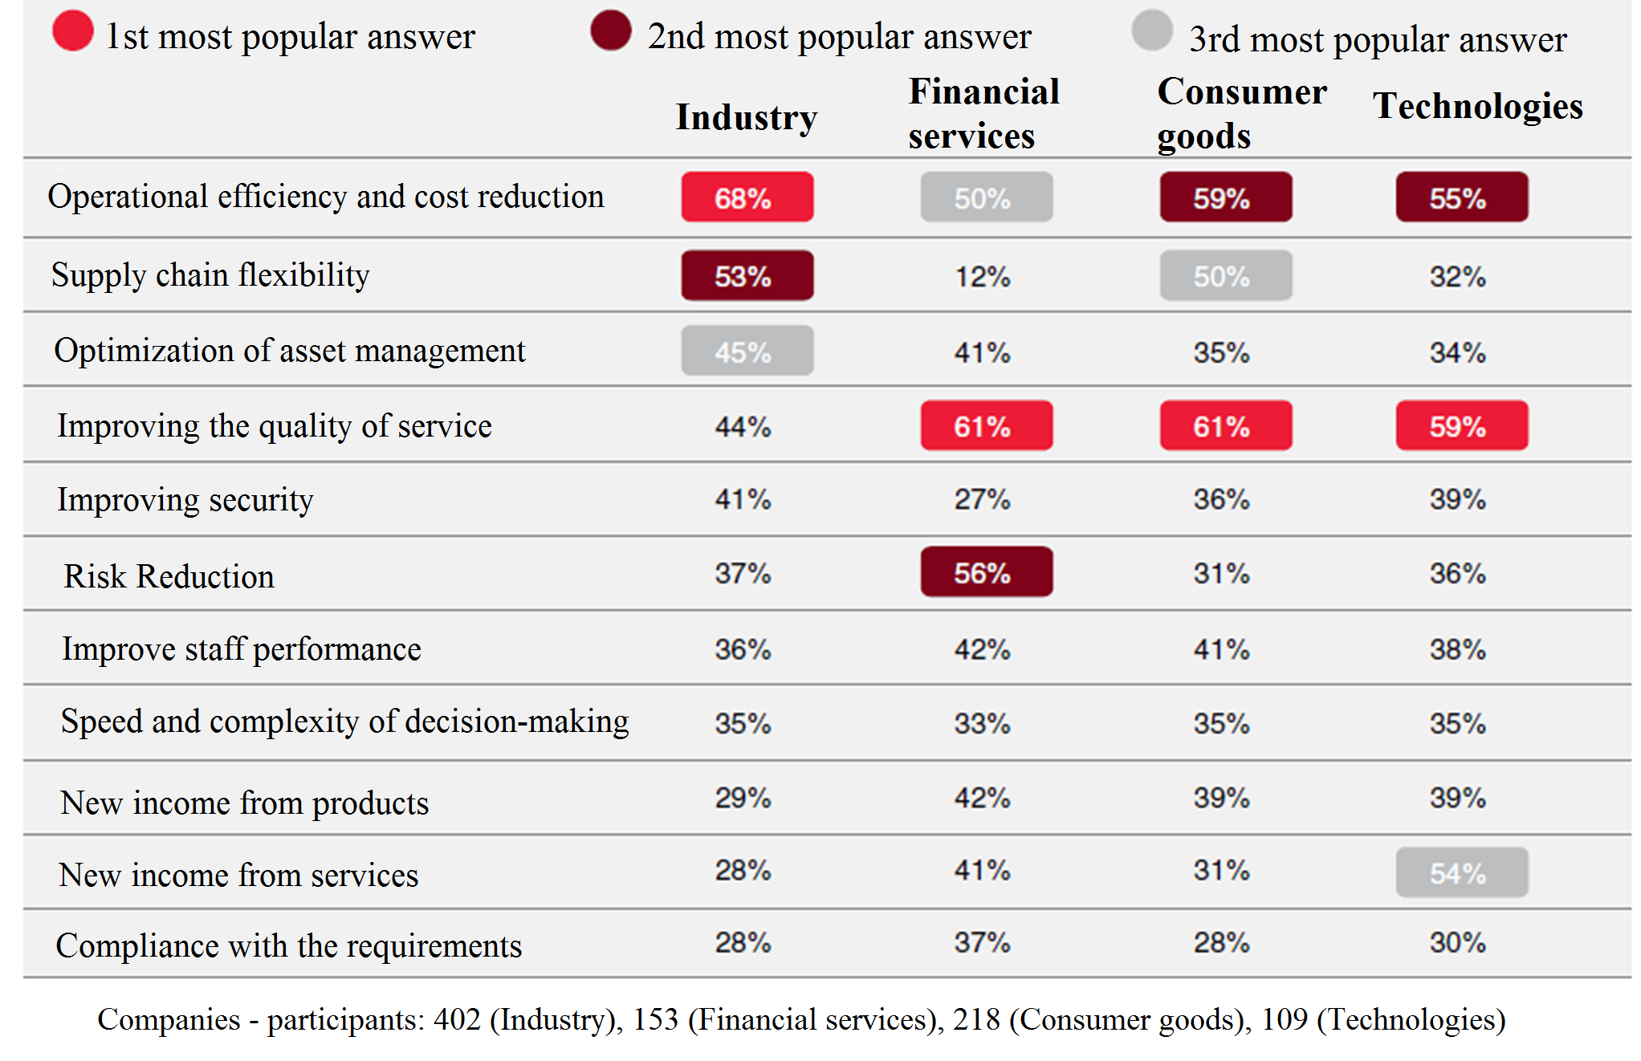
Fig. 3. Results of the survey on expected benefits from investments in IoT technology
Notes:
As part of the survey of leaders of the largest companies of APEC countries (Asia-Pacific Economic Cooperation), were asked a question about in which areas they expect the greatest benefits from the introduction of IoT technologies in the next three years (Figure 3). Most executives expect that investments in IoT will reduce costs among industrial companies. This answer was the first in popularity. Heads of companies in the field of financial services, technology and consumer goods in the first place expect improvement in the quality of customer service. At the same time, the heads of financial companies have great expectations in the field of risk mitigation through investments in IoT. For example, it allows to develop “Smart" insurance, when the data on driving a vehicle is transferred to the insurance company in real time, which affects the assessment of risks and insurance rates. Technology companies expect that the introduction of IoT will increase revenue from services.

Slide 7
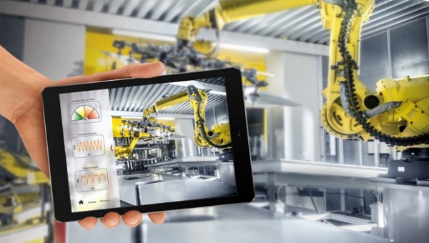
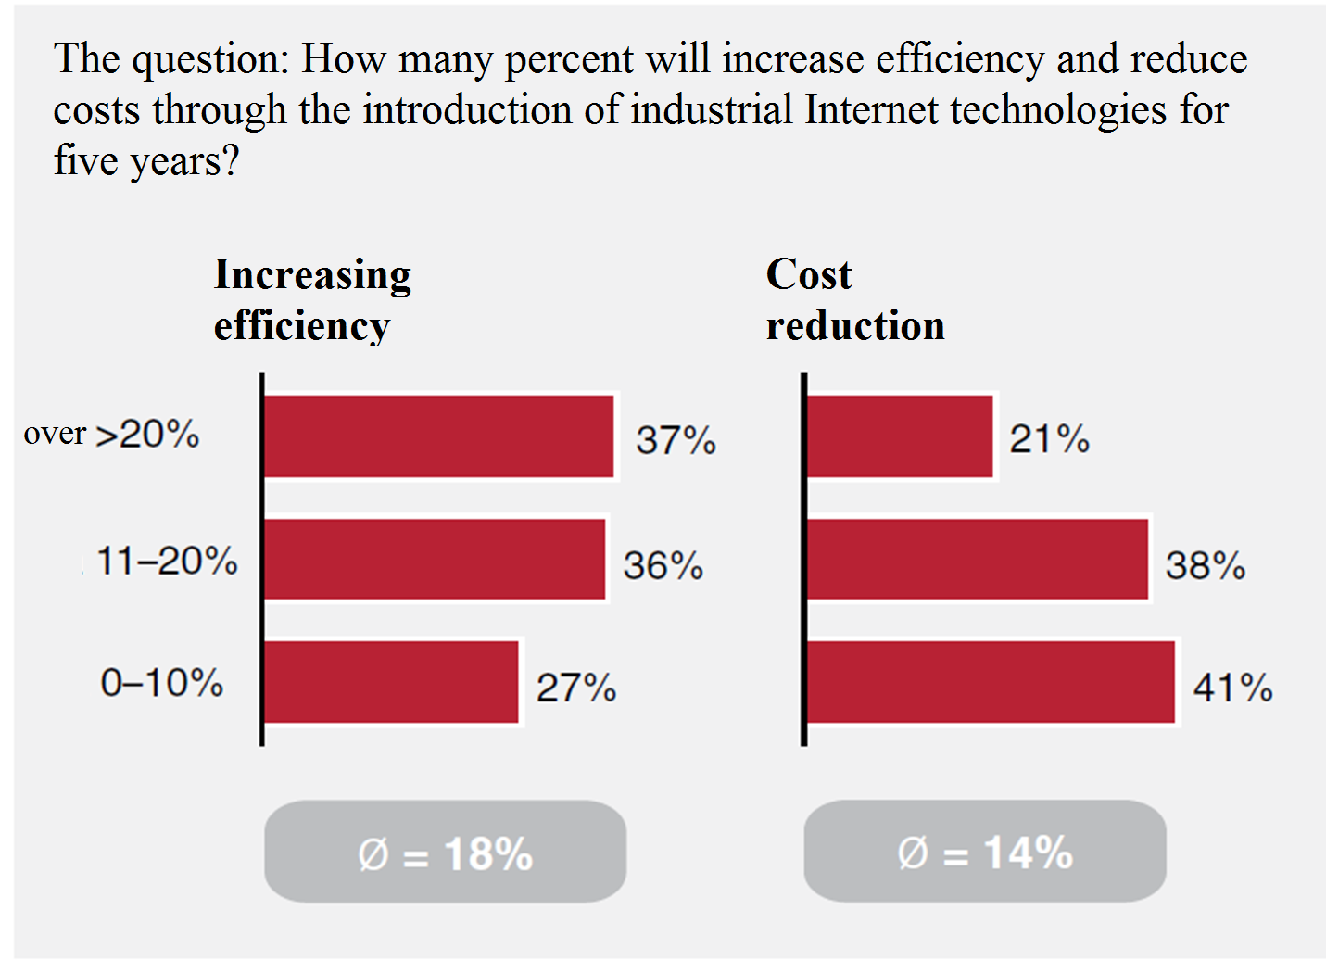
Fig. 4. Results of the survey on the expected benefits of investments in industrial Internet technologies
Notes:
IoT technologies used in the industry (Industrial Internet of Things), can significantly reduce costs and increase productivity. According to the survey of the largest German companies, it was revealed that, in the expectation of companies for five years, investments in industrial Internet technologies can allow to increase efficiency by an average of 18% and reduce costs by 14% (Figure 4).
At the same time, IoT allows industrial companies to transform business models and increase revenue from services (for example, from after-sale services): companies forecast that on average these technologies will ensure revenue growth of 2.9% per year.

Slide 8
At the level of management of the system, balances and regimes in the electric power industry, the step towards digital bundling of assets can provide an opportunity to optimally plan the loading of generating capacities and, most importantly, their volume. The creation of an intellectual distribution model would allow some inefficient generation to be taken out of service and partially solve the issue of overproduction of generating capacities. At the same time, this would allow more modern introduction of incentives to reduce electricity consumption: for example, demand response.
In the power grid, the wider introduction of intelligent technologies, especially taking into account the length of linear objects, could lead to increased reliability and lower operating costs. This would finally allow us to switch to managing the network "by state", and not carry out repairs in accordance with strict regulatory deadlines.

Slide 9
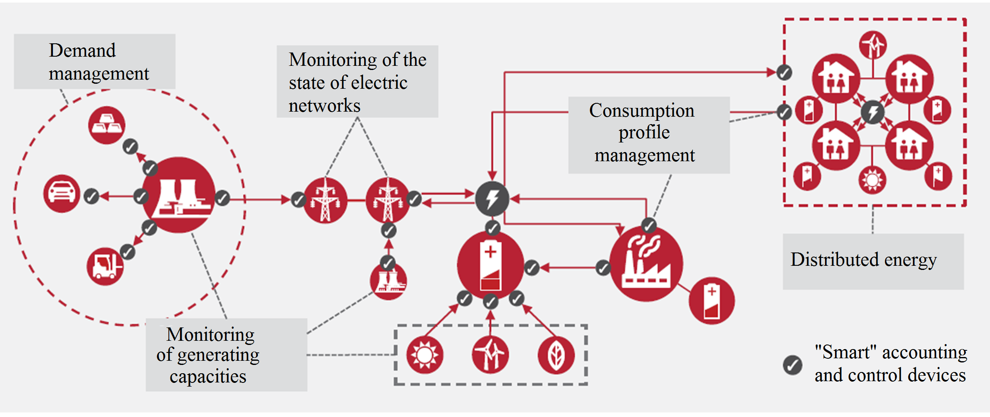
Fig. 5. “Intellectual networks”.
Notes:
In the electric power industry, the Internet of Things can lead to significant changes, transforming the traditional electromechanical energy system into a digital one. In the electric power industry, the definition of "Internet of things" usually includes "smart" or "intellectual" networks (smart grids) and smart meters (Figure 5).

Slide 10
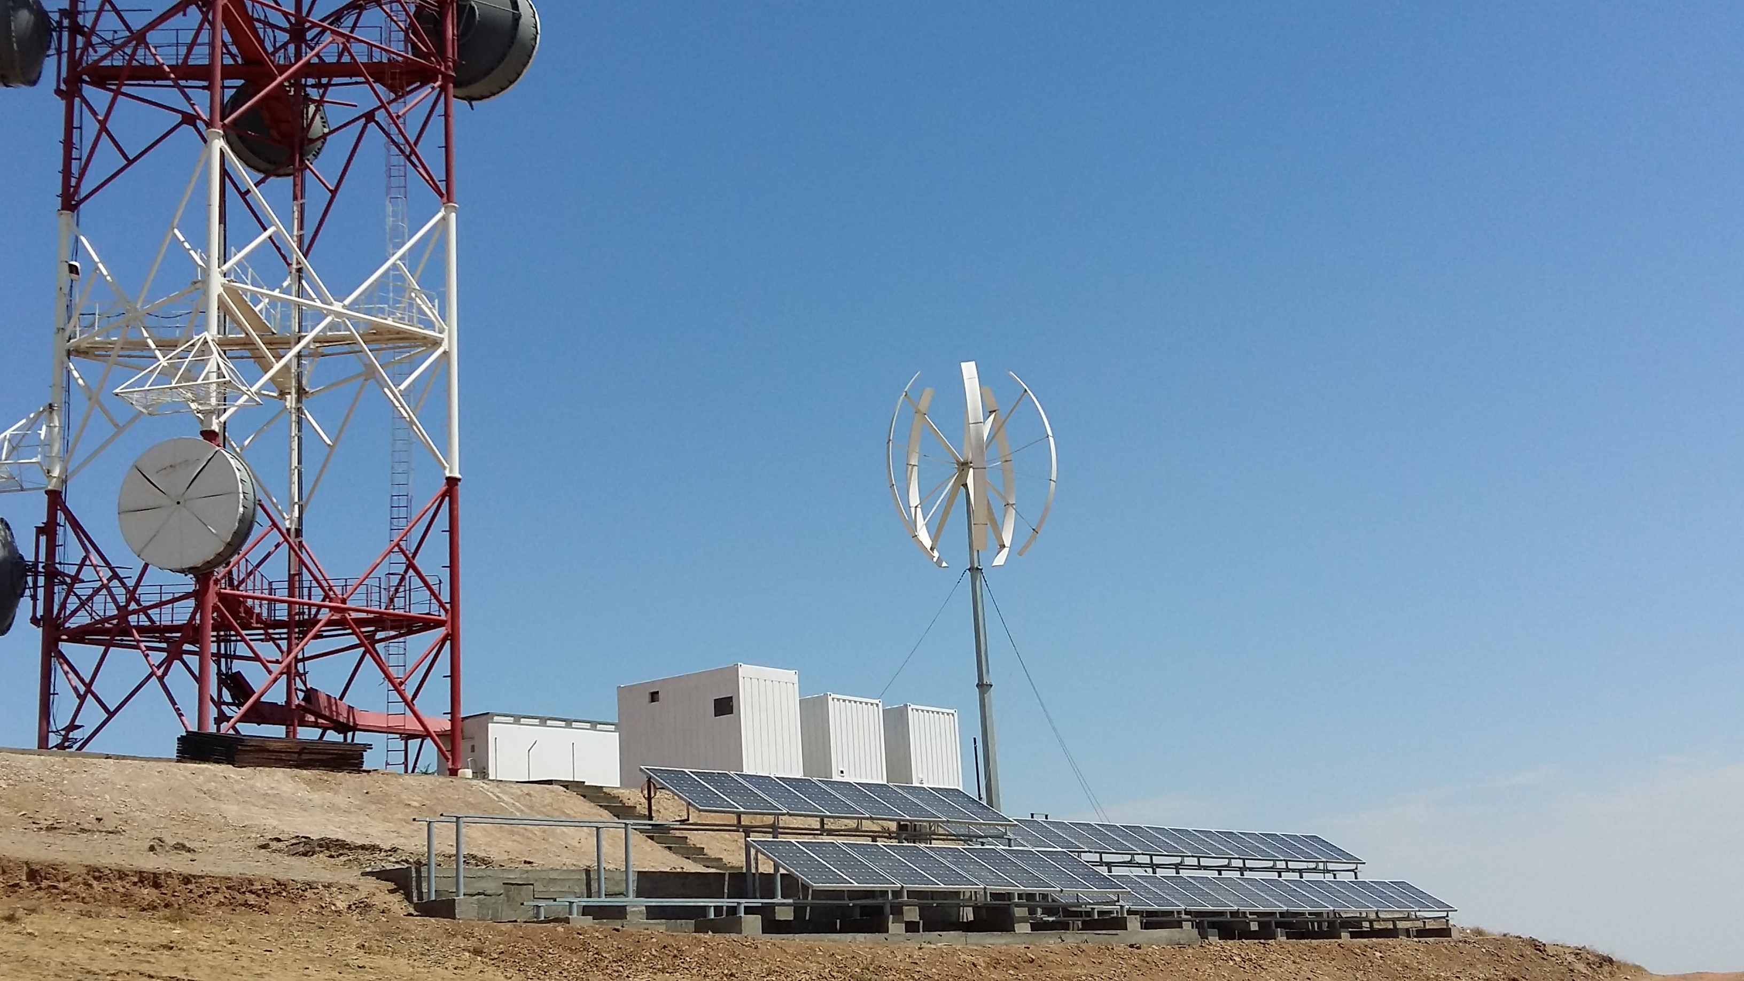
Fig. 6. Autonomous solar-wind-diesel power station on the object "Zambar".
Notes:
Also, IoT is important in the context of using autonomous renewable energy sources for sustainable energy supply of telecommunications/ICT facilities located in remote regions. For example, an autonomous solar-wind-diesel power station (Figure 6), built in a remote region in 22 parameters (via sensors, sensors) sends data to the Control Center, where the data is collected, compared with the norms, and a decision is taken on the status of the autonomous power supply system. If there is a need, then a specialist is sent to the facility for a specific purpose. This system also allows to predict by 22 parameters. This minimizes the cost of maintenance and operation.

Slide 11
The greatest development of IoT was in road transport due to the proliferation of the same smartphones that drivers take with them on the road. Thanks to them, systems were built for monitoring traffic congestion on Yandex, Google, and other maps.
Around the smartphone in the car - the whole ecosystem of software solutions (for example, Uber, Yandex Taxi, Get Taxi, MyTaxi, TashBus, etc.). These solutions completely changed the taxi market in large cities. Such services are no longer confined to the sphere of taxis and penetrate into the sphere of logistics: like UberCargo and Trucker path, there appeared startups GoCargo and iCanDrive, which are based on the use of IoT.
More serious intelligent transport monitoring systems are implemented by installing in vehicles remote monitoring systems based on GLONASS/GPS sensors and fuel consumption monitoring systems. Such devices allow to significantly reduce costs and monitor the targeted use of transport, analyze and optimize traffic routes, which is extremely important for logistics.

Slide 12
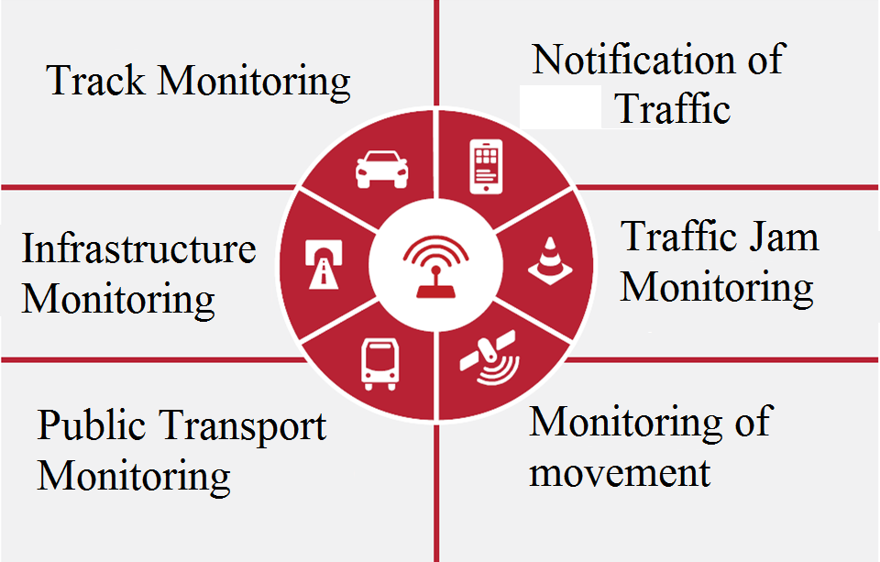
Cloud technologies will also lead to the emergence of platform solutions, and they, in turn, - to new business models, such as “Virtual Forwarding." This will also contribute to the scalability and standardization of processes. In many respects, therefore, in the world, logistics companies plan to spend about 5% of their revenues on digitalization of logistics. At the same time, the potential for introducing the Internet of Things in the transport sector is very significant - both in the railway, in the pipeline and other modes of transport (Figure 7).
Fig. 7. "Smart" solutions for transport

Slide 13
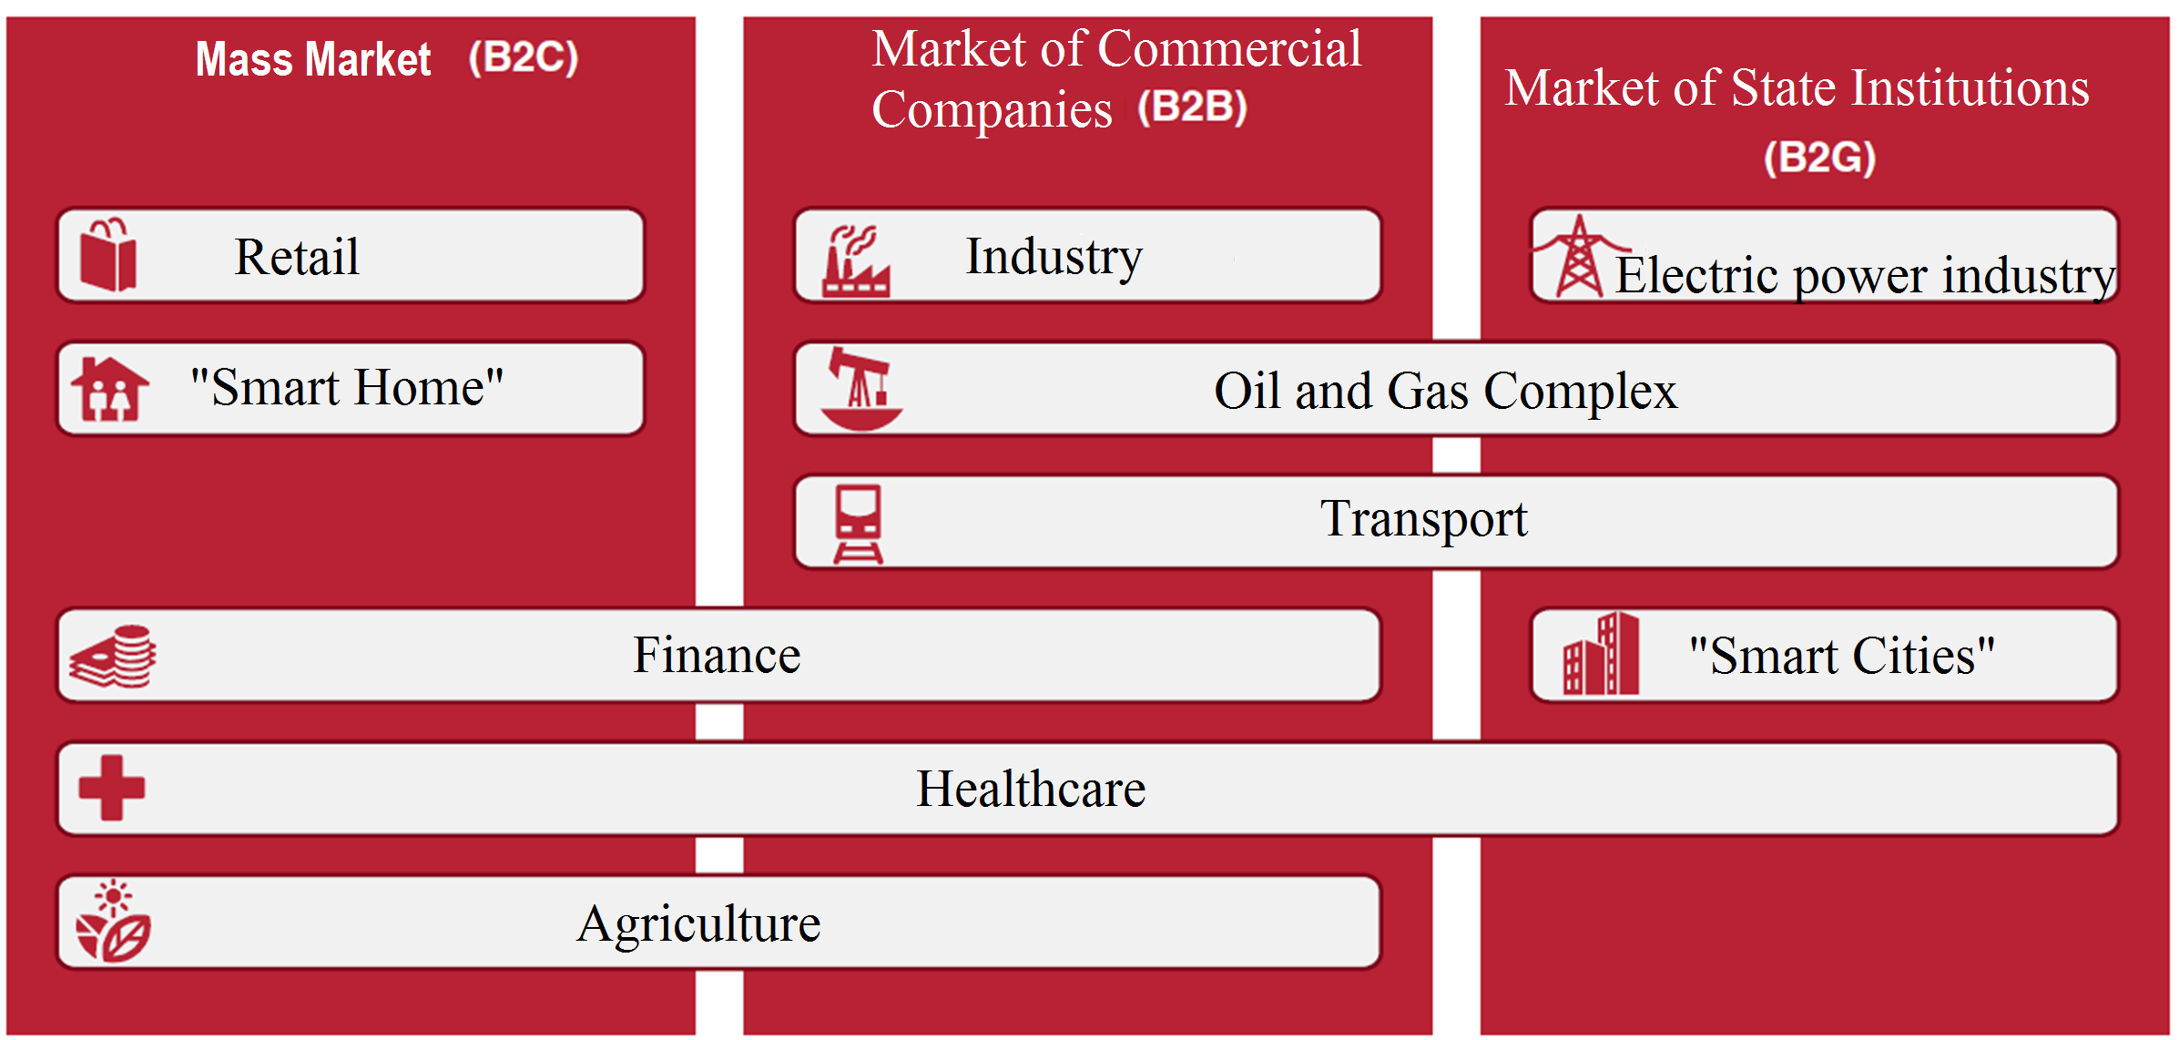
Markets for the application of IoT technologies
Notes:
There are three markets for applying IoT technologies: the mass market (B2C), the market of commercial companies (B2B), the market of state institutions and state-owned companies (B2G). The mass market (B2C) is traditionally susceptible to new innovative technologies and products based on these technologies. Private consumers often make purchases on the basis of a momentary impulse or under the influence of trends, they are willing to save a few months to buy the latest version of a smartphone, tablet or other digital gadget. The market of commercial companies (B2B) is more inert than the market of private consumers, as companies need time for the analysis of the external environment, awareness of the need for new technologies, the coordination of investments and the implementation of projects. Often such a process can take several years. The market of state institutions and state-owned companies (B2G) has the maximum economic potential for introducing IoT technologies in terms of increasing energy efficiency and reducing the costs of servicing production assets.
All of the above features of using IoT are important.

Slide 14
International experience in the Educational activities of the Internet of Things
University of Oxford | Open Data Science for the Internet of Things course
The Coursera | Training on the Internet of Things which includes courses on Introduction to the Internet of Things and Embedded Systems, The Arduino Platform and C Programming, Interfacing with the Arduino, The Raspberry Pi Platform and Python Programming, Interfacing with the Raspberry Pi
Massachusetts Institute of Technology | Training program on Internet of Things with the following sections: IoT architecture, sensor data processing, SLAM, stand-alone devices (cars, robots), IoT standards, wearable devices, security, Web of Things, wireless protocols, storage And data analysis, human-machine interfaces.
Kings College London | Practical courses on IoT
University of Washington | Practical courses on IoT
HP and Intel | Courses on IoT, which deal with Smart Cities, Smart Home, Smart Health, and others
Notes:
From the foregoing it can be seen that IoT covers all sectors of the country's economy. In this regard, the issue of training in IoT is a priority in the world and in Uzbekistan.
Let's consider the international experience.
University of Oxford conducts the Open Data Science for the Internet of Things course, which addresses the use of machine learning for the Internet of things.
The Coursera provides training on the Internet of Things, which includes courses on Introduction to the Internet of Things and Embedded Systems, The Arduino Platform and C Programming, Interfacing with the Arduino, The Raspberry Pi Platform and Python Programming, Interfacing with the Raspberry Pi .
A professional training program at the Massachusetts Institute of Technology offers a training program on Internet stuff with the following sections: IoT architecture, sensor data processing, SLAM, stand-alone devices (cars, robots), IoT standards, wearable devices, security, Web of Things, wireless protocols, storage And data analysis, human-machine interfaces.
Kings College London and University of Washington offer practical courses on IoT.
Technology companies HP and Intel offer courses on IoT, which deal with Smart Cities, Smart Home, Smart Health, and others.

Slide 15
In the enlarged form it is possible to offer the following sections of the curriculum on the subject "Fundamentals of the Internet of Things" for the preparation of Bachelors:
Architecture of IoT, M2M and M2H applications
Sensors and meters in the IoT
Data models used in IoT
IoT network communication models
Network and other standards used in IoT
Methods of data processing
Basic models used in the design and operation of IoT, M2M and М2Н systems
IoT security
Simultaneous Localization And Mapping (SLAM)
Notes:
A brief analysis of international experience shows that the training of highly skilled IoT personnel is at the initial stage of development, i.e. There is still no systematic approach in this matter. Of course this issue is very complicated, but it must be solved and solved today.
In the enlarged form it is possible to offer the following sections of the curriculum on the subject "Fundamentals of the Internet of Things" for the preparation of Bachelors:
- Architecture of IoT, M2M and M2H applications;
- Sensors and meters in the IoT;
- Data models used in IoT;
- IoT network communication models;
- Simultaneous Localization And Mapping (SLAM)
- Network standards used in IoT;
- Methods of data processing;
- Basic models used in the design and operation of IoT, M2M and M2H systems;
- IoT security.

Slide 16
It is advisable to prepare masters for the following special branches:
Smart production
Intelligent networks
Smart city
Smart transport
Smart logistics
Smart healthcare and telemedicine
Smart agriculture
Smart House
Smart solutions to the consumer market
Finance
Electric power industry and housing and communal services
Oil and gas complex
For example: the following subjects are offered for masters training in field Smart Cities: networks and communications, traffic flow planning, real-time systems, geo-information systems, modeling systems, security. The focus is on urban planning and management.
Notes:
It should be noted that the issue of preparing masters for IoT is of great importance.
An analysis of international experience shows that the training of the Masters is carried out in specific areas of the IoT.
In this connection, it is advisable to prepare masters for the following special branches:
- Smart production;
- Intelligent networks;
- Smart city;
- Smart transport;
- Smart logistics;
- Smart healthcare and telemedicine;
- Smart agriculture;
- Smart House;
- Smart solutions to the consumer market;
- Finance;
- Electric power industry and housing and communal services;
- Oil and gas complex.

Slide 17
It should be noted that the development of IoT requires the solution of the following problems announced by ITU in 2010 at the World Telecommunication Development Conference in Hyderabad, India:
Development of broadband access to telecommunications/ICT networks and services
Providing information security of telecommunications/ICT
Ensuring sustainable energy supply for telecommunication/ICT facilities
Notes:
In all directions, it is advisable to include in the list a compulsory subject - telecommunications networks, IoT planning taking into account the features of the directions, the real-time system, the modeling system, and security.

Slide 18

Things are defined by the ITU Telecommunication Standardization Sector (ITU-T) in the concept of the Internet of things as "objects of the physical world (physical things) or the information world (virtual things) that can be identified and integrated in the communication network." This definition, taking into account virtual things and allows you to talk about trillions of networks. Note also that the identification and integration of such a huge number of terminals into the network is possible only when developing a new concept of smart all-pervasive networks based on system-network developments on all-pervasive wireless sensor networks and IoT. The development of wireless broadband access opens up more distant horizons.
The International Research Wireless Forum estimates the number of things on the network at 7 trillion units by 2017-2020. At the same time, the limit value of the number of things in communication networks is estimated at 3000-5000 units per person, which allows talking about 50 trillion items online. Taking into account the adopted approximation of the development of telecommunications in the logistic curve and evaluation of the period of sustainable development of new technologies based on examples of broadband access and 4G networks, it is possible to forecast a 10-year cycle of sustainable development of the Internet of Things for the period from 2020 to 2030.

Slide 19
Therefore, it is necessary to take into account the continuous growth of traffic in the telecommunications network. Telecommunication networks both at the national level and at the international level should be prepared to handle a large volume of traffic and these issues should be taken into account when teaching bachelors and masters in IoT.
Particular attention should be paid to the educational and methodological and logistical support of the educational process and modern conditions should be created for training human resources for IoT.

Slide 20
Thank you for your attention!

