Slide 1
ITU-T Study Group 20: IoT and its applications including smart cities and communities
ITU Workshop Smart Sustainable Cities, Samarkand, Uzbekistan
Ramy Ahmed Fathy ITU-T SG20 Vice Chairman

Slide 2
ITU-T Study Group 20: IoT and its applications including smart cities and communities (SC&C)
WP2/20
Responsible for international standards to enable the coordinated development of IoT technologies, including M2M communications and ubiquitous sensor networks
Visible contact point on IoT and SC&C activities
WP1/20
JCA – IoT and SC&C
Coordination across ITU-T SGs, ITU-R and ITU-D
Cooperation with external bodies working in the field of IoT & SCC
Notes:
The formation of the new ITU-T Study Group 20 has contributed to the consolidation of over 10 years of ITU activity in IoT standardization and the group's work targeted towards smart cities will provide valuable stimulus to this key IoT application area.

Slide 3
ITU-T SG20 Current Key topics
Research and emerging technologies including terminology and definitions
Common terminology for IoT and SC&C
Consideration on end user adoption of IoT
IPv6
Research and emerging technologies related to IoT and SC&C
Internet of Things (IoT) Aspects
General requirements and capabilities of IoT applications and services
Frameworks and functional architectures of IoT to support networks and gateway
Specific IoT services covering transportation safety services, e-health services and so on
IoT based smart greenhouse, smart farming, smart manufacturing and Big Data issues
Security, trust and privacy protection in IoT
Smart cities and Communities (SC&C) Aspects
SC&C related ecosystem, applications, services and use cases
Standards that are directly related to SC&C with focus on:
Urban planning
Water
Mobility
Logistic
Healthcare
E-government
Education
Transport
Energy
Open Data
Spatio-temporal modeling for SC&C
Integrated sensing & management for Smart Sustainable Cities
Notes:
28 on-going Work Items under WP1/20

Slide 4
ITU-T SG20 main results
6 New Recommendations approved
9 New Supplements agreed
ITU-T Y.4113 “Requirements of the network for the Internet of Things”
ITU-T Y.4451 “Framework of constrained device networking in the IoT environments”
ITU-T Y.4452 “Functional framework of Web of Objects”
ITU-T Y.4453 “Adaptive software framework for IoT devices”
ITU-T Y.4553 “Requirements of smartphone as sink node for IoT applications and services”
ITU-T Y.4702 “Common requirements and capabilities”
ITU-T Y.Supp.42 to ITU-T Y.4100 series “Use cases of User-Centric work Space (UCS) Service
ITU-T Y.Supp.34 to ITU-T Y.4000 series "Smart Sustainable Cities - Setting the stage for stakeholders' engagement"
ITU-T Y.Supp.33 to ITU-T Y.4000 series "Smart Sustainable Cities - Master plan"
ITU-T Y.Supp.32 to ITU-T Y.4000 series "Smart sustainable cities - a guide for city leaders“
ITU-T Y.Supp.31 to ITU-T Y.4550 series "Smart Sustainable Cities - Intelligent sustainable buildings“
ITU-T Y.Supp.28 to ITU-T Y.4550 series ”Integrated management for smart sustainable cities”;
ITU-T Y.Supp.29 to ITU-T Y.4250 series “Multi-service infrastructure for smart sustainable cities in new-development areas”;
ITU-T Y.Supp.30 to ITU-T Y.4250 series “Overview of smart sustainable cities infrastructure”;
ITU-T Y.Supp.27 to ITU-T Y.4400 series “Setting the framework for an ICT architecture of a smart sustainable city”.
1 Draft new Recommendation determined
ITU-T Y.4454 “Platform Interoperability for Smart Cities”
Notes:
28 on-going Work Items under WP1/20

Slide 5
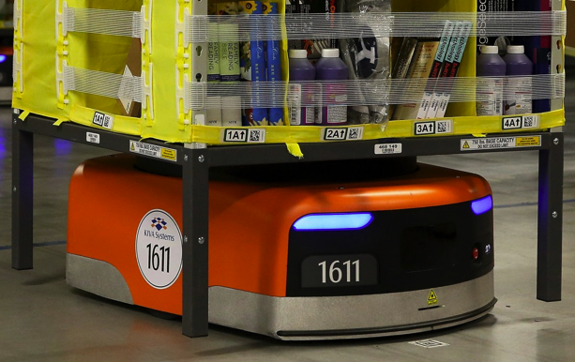
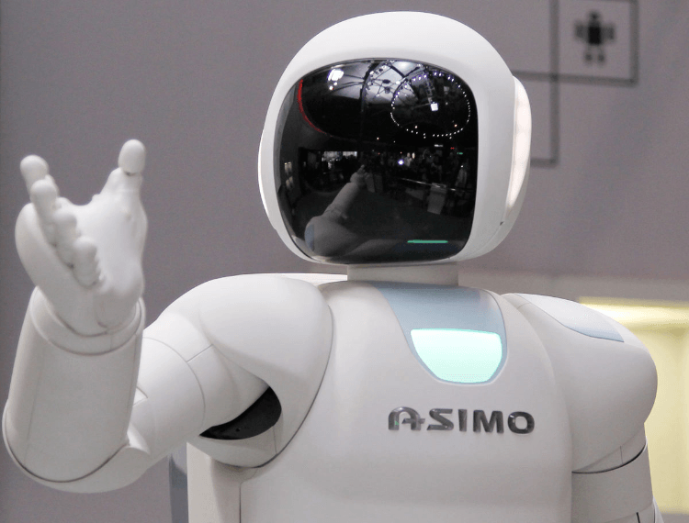
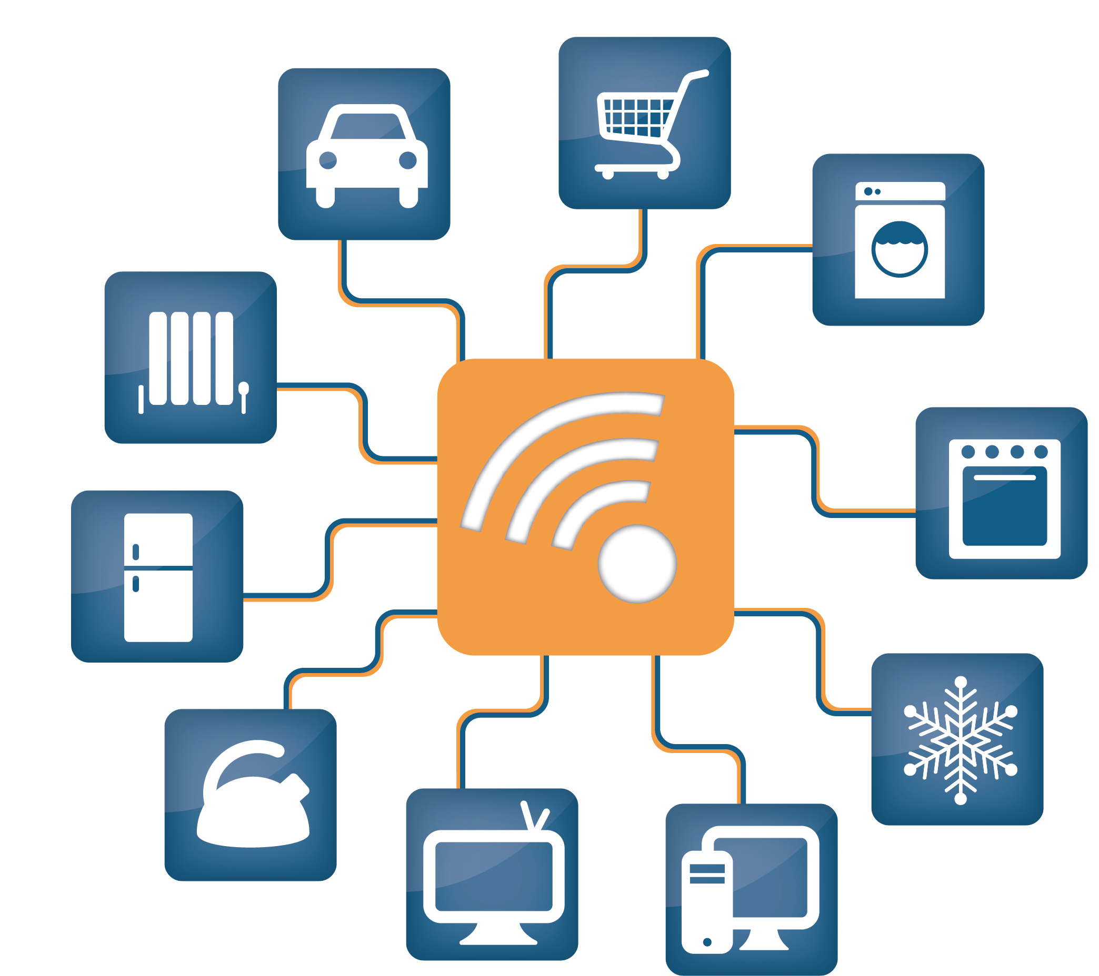
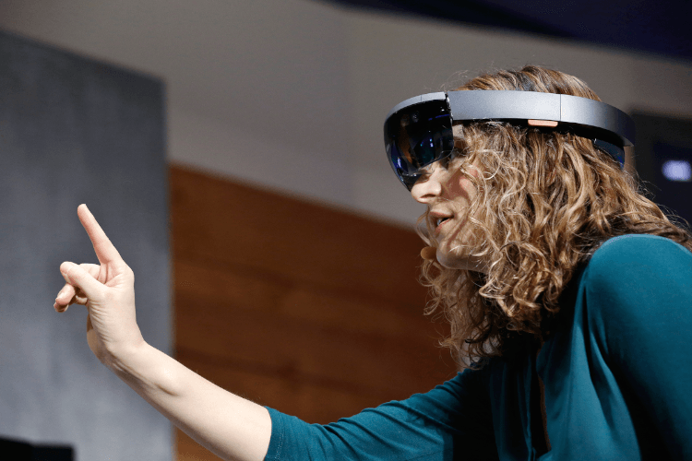
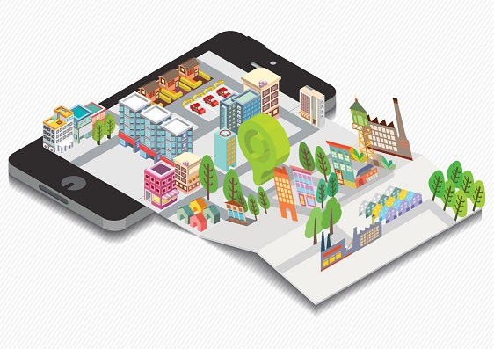
ITU-T SG20 future topics
Robotic and Artificial Intelligence
Industrial Internet of Things
Connected vehicles
Augmented reality
Smart services
Integrated Management for SSC
Notes:
Its future work may include new or further studies in the following areas (but not limited to):
– Identification and addressing aspects in IoT
– Security, privacy and trust of IoT/SC&C systems, services and applications
– Accessibility of IoT
– Data centric capabilities for IoT, including Big Data:
- Semantic and syntax aspects of IoT
– IoT management and provisioning
– Quality of service and end-to-end performance for IoT and its applications
– IoT and cloud computing
– IoT and end user networks
– IoT applications and services
– Connected vehicles and intelligent transportation
- Industrial Internet and smart manufacturing
– Retail stores
– Use cases and requirements in other application domains
– IoT functional architectures (in different application domains)
– APIs and protocols for IoT
– Network evolution for smart city services (5G & IoT)
– Platforms interoperability for smart cities and communities
– Integrated management for smart cities, including smart residential communities, smart port, tourist destinations, smart building etc.
– Metadata and modelling for smart cities
– IPv6 potential for the Internet of Things and Smart Cities
– ICT use for city infrastructure
– Key performance indicators for smart sustainable cities
– Global smart sustainable cities index
– Open data and/or open source data
– Artificial intelligence
– E-smart services
– Applications for SSC

Slide 6
Publications, Events & Projects on IoT and Smart Cities
8 events from Oct 2015 to Oct 2016
Flipbook on Unleashing the potential of the Internet of Things
Montevideo Declaration towards Habitat III
Flipbook on Shaping smarter and more sustainable cities: Striving for Sustainable Development Goals
Dubai
Buenos Aires
Singapore
Montevideo
Valencia
Manizales
and many others…

Slide 7
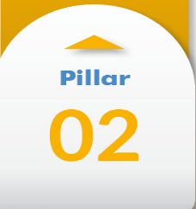
United for Smart Sustainable Cities (U4SSC) – new UN Initiative!
Setting the Framework
U4SSC is a global platform for smart city stakeholders which advocates for public policy to encourage the use of ICTs to facilitate the transition to smart sustainable cities.
WG
Urban planning
Policy, standards & regulation
Key performance indicators
Connecting Cities and Communities
WG
Smart living
Smart mobility
Smart environment
JOIN us now!
Co-Chairmen:
H.E. Ms Daiva Matoniene, Vice Minister of Environment (Lithuania)
Nasser Saleh Al Marzouqi, Chairman, ITU-T SG20
Secretariat:
Contact: u4ssc@itu.int
Enhancing Innovation & Participation
WG
Smart governance
Smart people
Smart economy
A Virtual Meeting every month!

Slide 8
Thank you
ITU-T, IoT and applications, smart cities
http://itu.int/go/tsg20
tsbsg20@itu.int

