Slide 1
ITU Activities in the CIS Region Farid Nakhli, Programme Officer, ITU Area Office for CIS
1

Slide 2
Contents
General information
Main types of activities
Regional initiatives
2016 events
2017 events
2

Slide 3
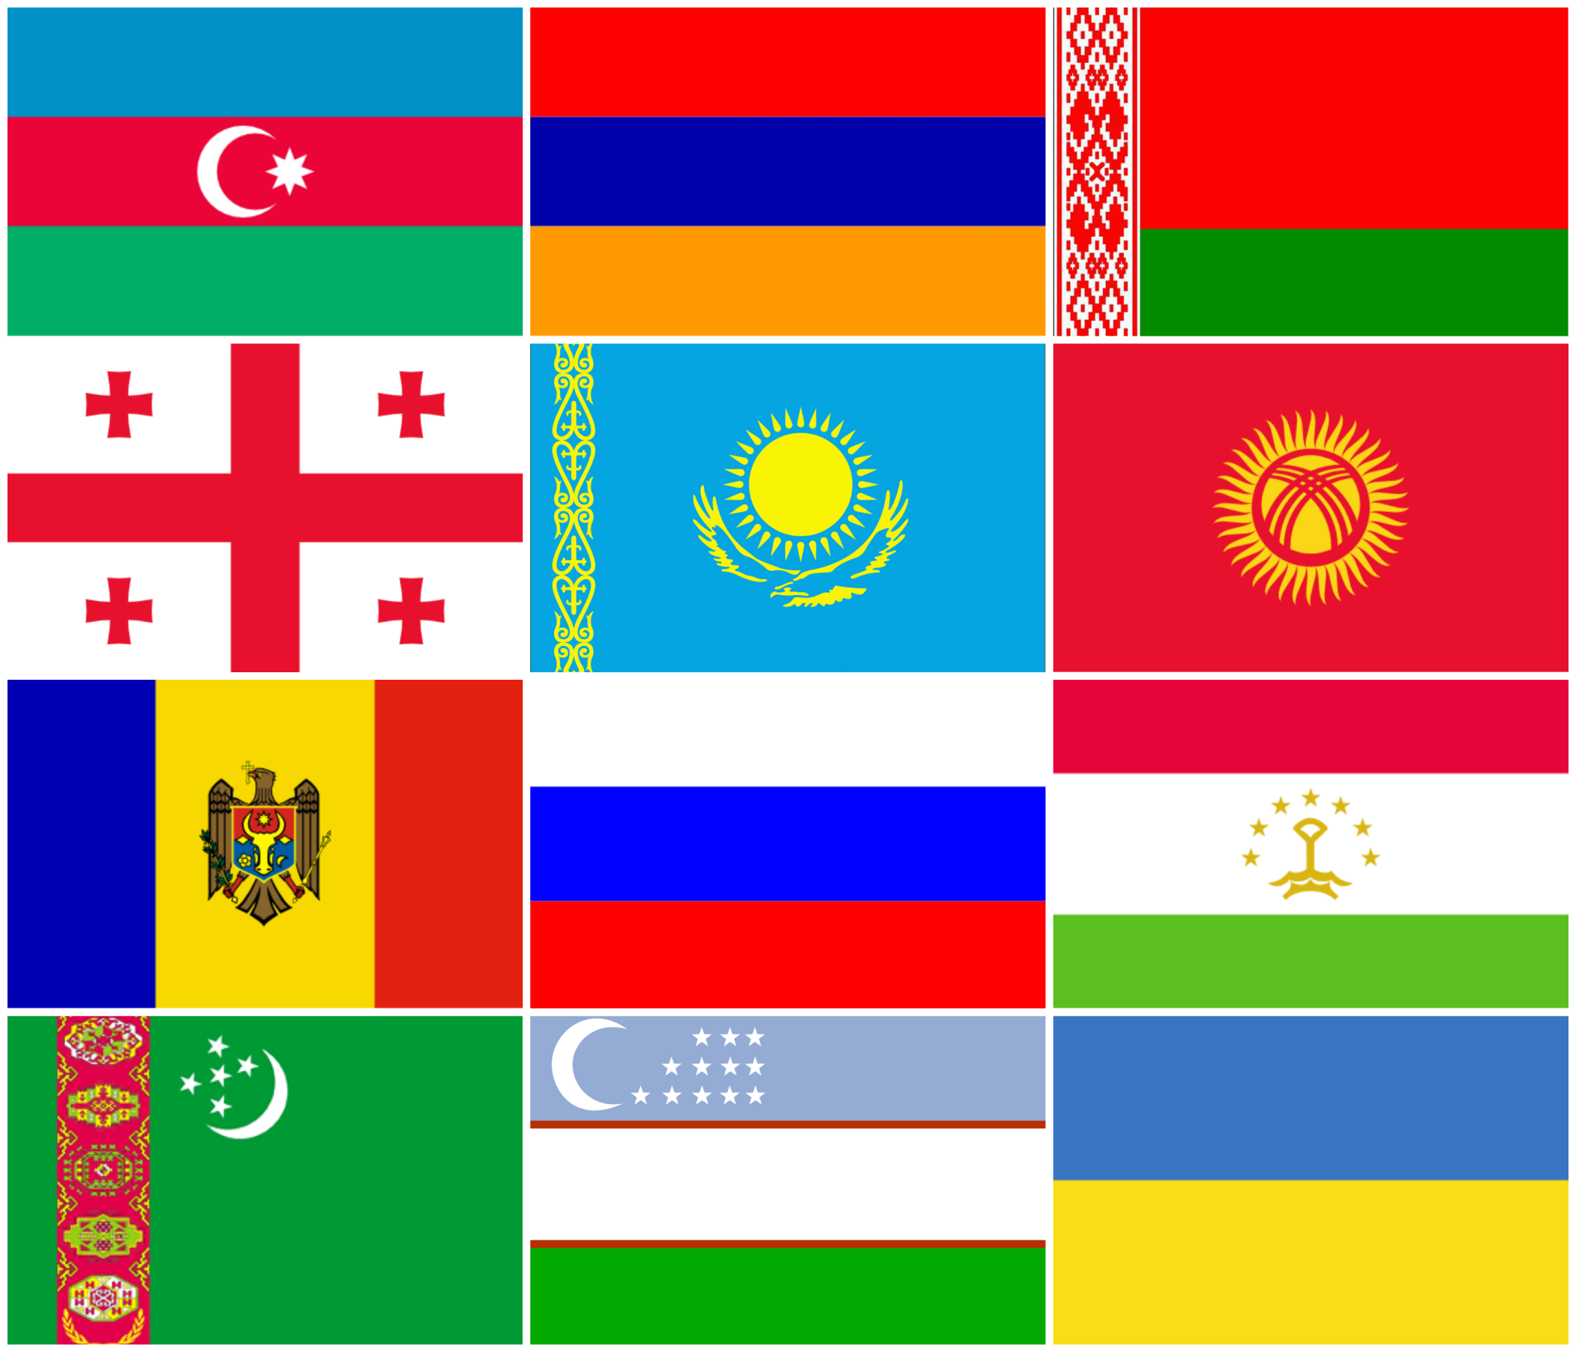
General information
ITU Area Office in Moscow was established in 2006 and represents the International Telecommunication Union in the 12 ITU Member States inthe Region: Armenia, Azerbaijan, Belarus, Georgia, Kazakhstan, Kyrgyzstan, Moldova, Russia, Tajikistan, Turkmenistan, Ukraine and Uzbekistan​​
Web: http://www.itu.int/ru/ITU-D/Regional-Presence/CIS/Pages/default.aspx
Twitter: @ITUMoscow
Flickr: https://www.flickr.com/photos/147330406@N05/sets
3

Slide 4
Main types of activities
Regional initiatives
Events
Technical assistance, country projects
Publications
Membership coordination
4

Slide 5
WTDC-14 Regional Initiatives
RI1: Creating a child online protection center for the CIS region
RI2: Ensuring access to telecommunications/ICT services for persons with disabilities
RI3: Introduction of training technologies and methods using telecommunications/ICT for human capacity building
RI4: Development of broadband access and adoption of broadband
RI5: Building confidence and security in the use of ICTs
5

Slide 6
RI1 major outputs
Multimedia online training course on safe use of the Internet: https://onlinesafety.info/ During first 6 months since launch the course was used by 13,500 unique users from 60 countries
6

Slide 7
RI1 major outputs
Database of technical solutions for child online protection (content filtering) and software (automated system) for choosing optimal technical solution https://contentfiltering.info/
7

Slide 8
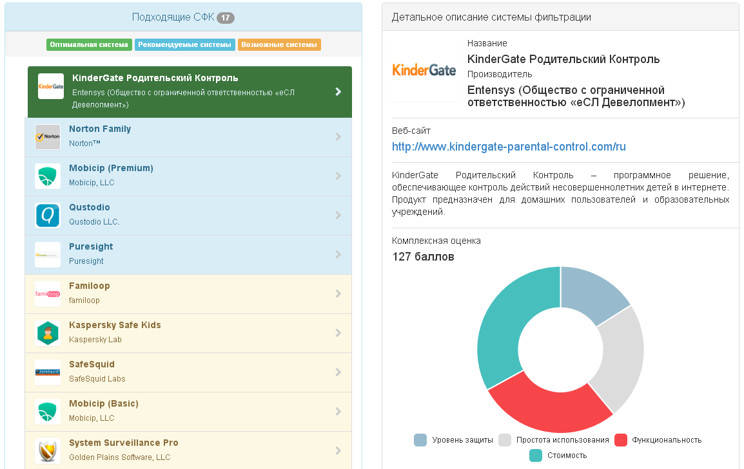
RI1 major outputs
8

Slide 9
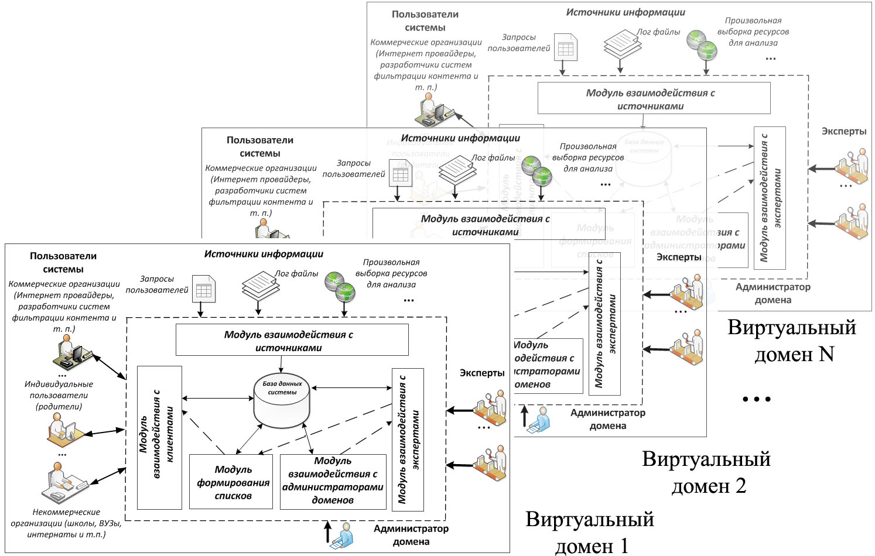
RI1 major outputs
Automated distribution system of "black" (unsafe) and "white" (safe) lists of Internet resources https://beta.bwld.online/
9

Slide 10
RI2 major outputs
October 2015: ICT Training Center for motor impaired users and visually impaired users in Bishkek, Kyrgyz Republic
November 2015: ICT Training Center for visually impaired people in the suburb of Chisinau, Republic of Moldova
August 2016: ICT Training Center for blind users, for users with visual impairments, muscle and skeleton disorders, and hearing and speech disorders (Yakutsk, Republic of Sakha, Russian Federation). Photos from the opening ceremony
September 2016: ICT Training Center for persons with hearing and speech disorder in Minsk, Republic of Belarus (+ photos from the opening ceremony)
April 2017: ICT Training Center for persons with hearing and speech disorder in Vitebsk, Republic of Belarus
10

Slide 11
RI3 major outputs
Software (Automated System) for diagnosis of human susceptibility to one or more channels of information perception
Recommendations on implementing ICT in education (in Russian)
Recommendations on creating and structuring e-learning resources (in Russian)
Workshop "Using telecommunications/ICTs for quality and safe educations" for management and informatics teachers of general education schools, Odessa, Ukraine (report in Russian)
11

Slide 12
RI5 major outputs
Professional standards for several qualifications dealing with building confidence and security in the use of ICTs
ICT Research and Training Center dedicated to capacity building in the area of confidence and security in the use of ICTs created in Moscow, Russian Federation
Research paper covering legislative, policy and technical aspects of building confidence and security in the use of ICTs in CIS countries (in Russian)
12

Slide 13
Events in 2016
Events
Regional Workshop on Experience in the Implementation and Operation of Digital TV Broadcasting, Moscow, Russia, 16-18 Feb 2016. 63 participants from 6 countries. Link
Regional Workshop on Mobile Number Portability, Conformance and Interoperability Moscow, Russia, 22-24 Mar 2016. 40 participants from 8 countries. Link
Regional Videoconference Seminar Dedicated to the International Girls in ICT Day, Moscow, Russia, 28-29 Apr 2016. 68 participants from 8 countries. Link
Regional Workshop on Complex Aspects of Cybersecurity in Infocommunications, Odessa, Ukraine, 15-17 Jun 2016. 70 participants from 12 countries. Link
Regional Workshop on Radiocommunication Development Trends in the light of WRC-15 and RA-15, Yerevan, Armenia, 27-29 Jun 2016. 55 participants from 8 countries. Link
Regional Workshop on the Most Popular Mobile Applications: Implementation and Development, Issyk Kul, Kyrgyz Republic, 6-8 Sep 2016. Link
Regional workshop "Trends in Converged Networks: Post-NGN, 4G and 5G Solutions", Kyiv, Ukraine, 17-18 Nov 2016. 100 participants from 8 countries. Link
13

Slide 14
Events in 2017
Title | Venue | Date
ITU Regional Forum "Strengthening Innovation Capabilities in the ICT-centric Ecosystem and Fostering the Growth of ICT Startups" | Chisinau, Moldova | 28-29 Mar
ITU Regional Workshop for "Strengthening Capacity Building in the field of Telecommunications/ICT" | Odessa, Ukraine | 12-14 Apr
ITU Regional Videoconference Seminar Dedicated to the International Girls in ICT Day | Moscow, Russia | 27 Apr
ITU Digital Innovation Framework Workshop | Chisinau, Moldova | 12 May
ITU Regional Seminar on Spectrum Management and Broadcasting for Europe and CIS | Rome, Italy | 29-31 May
ITU Regional Workshop on Smart Sustainable Cities | Samarkand, Uzbekistan | 1-2 Jun
ITU Regional Conference on Perspective Services in Post-NGN, 4G and 5G. Organizational and Technical Solutions for their Implementation and Protection | Kyiv, Ukraine | 7-9 Jun
14

Slide 15
Events in 2017
Title | Venue | Date
ITU Regional Workshop on the Internet of Things (IoT) and Future Networks | Saint Petersburg, Russia | 19-20 Jun
Meeting of ITU-T Study Group 20 Regional Group for Eastern Europe, Central Asia and Transcaucasia (SG20RG-EECAT) | Saint Petersburg, Russia | 20-21 Jun
Meeting of ITU-T Study Group 11 Regional Group for Regional Commonwealth in the field of Communications (SG11RG-RCC) | Saint Petersburg, Russia | 22 Jun
ITU Regional Forum on Digital Financial Services Development | Astana, Kazakhstan | 4-5 Jul
ITU Regional Workshop "Calibrating the policy, legal and regulatory environment in response to Digitization" | Moscow, Russia | 7-8 Sep
ITU Regional Workshop "Key Aspects of Cybersecurity in the Context of Internet of Everything (IoE)" | Tashkent, Uzbekistan | 19-21 Sep
15

Slide 16
Events in 2017
Title | Venue | Date
ITU Regional Workshop "Organizational and Technical Aspects of Broadband Development" | Odessa, Ukraine​ | 27-29 Sep
ITU Regional Forum on Data Flows Management and Data Privacy | Tbilisi, Georgia | 1-2 Nov
ITU Regional Cyber Drill | Chisinau, Moldova | 7-9 Nov
ITU Regional Workshop "Cooperation with ITU: Opportunities for Member-States, Sector Members and Academia. ITU Structure and Working Methods Explained" | Tashkent, Uzbekistan | Nov
ITU Regional Spectrum Management Conference | Yerevan, Armenia | Dec
16

Slide 17
Thank you for your attention
Farid Nakhli Programme Officer ITU Area Office for CIS farid.nakhli@itu.int
17

