Slide 1

ITU-T overview
ITU Workshop on Smart Sustainable Cities, 1-2 June 2017
~ Chaesub Lee, TSB Director

Slide 2

ITU-T overview
ITU membership
700+
* Academia admitted to 3 Sectors of ITU for a single fee
193
150*
MEMBER STATES
PRIVATE-SECTOR ENTITIES
ACADEMIA

Slide 3


ITU-T overview
What we do
Allocation of radiofrequency spectrum and satellite orbits
Bridging the digital divide
‘Committed to Connecting the World’
Establishing international standards

Slide 4
ITU-T overview
Focus on ITU-T
ITU’s Standardization Sector (ITU-T) has three main objectives:
To develop interoperable, non-discriminatory international standards
To extend and facilitate cooperation among international and regional standards bodies
To assist in bridging the standardization gap between developed and developing countries

Slide 5



ITU-T overview
ITU-T platform
Membership-driven Study Groups develop international standards (ITU-T Recommendations)
Open-to-all Focus Groups define new directions in ITU standardization
Open-to-all Workshops and Symposia analyze emerging trends and encourage peer-learning

Slide 6
ITU-T overview
ITU-T Study Groups
Participation ITU standardization to influence the development of the standards that will give shape to 5G, IoT and Smart Sustainable Cities
SG2: Operational aspects
SG3: Economic and policy issues
SG5: Environment and circular economy
SG9: Broadband cable and TV
SG11: Protocols and test specs
SG12: Performance, QoS and QoE
SG13: Future networks
SG15: Transport, access and home
SG16: Multimedia
SG17: Security
SG20: IoT, smart cities and communities

Slide 7
ITU-T overview
ITU-T Focus Groups
Three new Focus Groups established in 2017
Data Processing and Management
First meeting:17-19 July 2017
Digital Currency including Digital Fiat Currency
First meeting: Planned for November 2017
Focus Group on Application of Distributed Ledger Technologies
First meeting:17-19 November 2017

Slide 8
ITU-T overview
ITU-T leadership
Key results continue to be achieved in standardization areas characterized by ITU-T leadership

Slide 9

ITU-T overview
Broadband access
G.fast: G.fast achieves up to 2 Gb/s over existing telephone lines
40G Fibre to the Home (NG-PON2): First series of standards to provide broadband access beyond 10 Gbit/s
Rural broadband: ITU-T L.1700 brings broadband to rural communities – lightweight optical fibre with a focus on ease of deployment, cost-efficiency and reliability
Broaband cable and TV: New standard for 4K UHD TV
set-top boxes with a functional specification of such cable set-top boxes

Slide 10
ITU-T overview
Ultra-high-speed networks
In 2016 ITU-T concluded a three-year process to enable optical transport at rates higher than 100 Gbit/s
Foundational element to the next generation of optical transport
Synchronized mobile backhaul networks for 4G, 5G and beyond enables highly accurate time synchronization and high reliability
New standards for Software-Defined Networking will support more dynamic network orchestration

Slide 11

ITU-T overview
Video coding
ITU-T H.265 ‘High Efficiency Video Coding’
4th edition of H.265 adds extensions profiles for screen content coding, scalable range extensions profiles, and additional high-throughput profiles
ITU-T and ISO/IEC MPEG ‘Call for Evidence’ supporting the case for next-generation video codec
Aiming to double the video compression capability of HEVC
Standardization project horizon: 2020

Slide 12

ITU-T overview
Performance, QoS and QoE
ITU-T is a leading venue for the development of international standards on performance, quality of service (QoS) and quality of experience (QoE)
These standards are highly relevant to operators in providing the level of service necessary to attract and retain customers
Regulatory authorities look to ITU-T for technical guidance in steering their national markets towards high QoS/QoE

Slide 13
ITU-T overview
ICT-enabled convergence
The ICT sector has gained a diverse range of new stakeholders
Other industry sectors continue to scale-up their use of ICTs as ‘enabling technologies’

Slide 14

ITU-T overview
e-Health
Medical-grade personal e-health devices supported by the personal connected health specifications in the ITU-T H.810-H.850 series
ITU collaboration with WHO continues on the safe listening of music players

Slide 15

ITU-T overview
Connected, automated vehicles
Tests to assess the performance of mobile phones when connected as gateways to vehicles’ hands-free systems
Secure over-the-air software updates for connected cars
New ITU standard under development to provide security guidelines for ‘V2X’ communications
Collaboration with the UNECE Transport Division
The new global regulation on vehicle emergency calls, ‘Automatic Emergency Call Systems’, will reference an ITU voice-quality performance standard.
Future Networked Car symposium at Geneva Motor Show, 9 March 2017, in partnership with UNECE

Slide 16
ITU-T overview
Digital financial inclusion
ITU has partnered with the World Bank and the Bill & Melinda Gates Foundation in establishing the new multi-partisan Financial Inclusion Global Initiative (FIGI)
FIGI is a 3-year programme of collective action aimed at accelerating progress towards universal access to financial services
The initiative will provide targeted assistance to selected countries in their pursuit of financial-inclusion targets.
This implementation work stream will be supported by annual symposia as well as thematic working groups.
An estimated 2 billion adults are still without access to a bank account, but some 1.6 billion of them have access to a mobile phone

Slide 17
ITU-T overview
2020 vision
5G, IoT and Trust will be the three guiding lights to ITU-T standardization on the road to 2020

Slide 18
ITU-T overview
Network aspects of IMT-2020 (5G)
ITU’s Radiocommunication Sector (ITU-R) is coordinating the international standardization and identification of spectrum for 5G mobile development
ITU’s Standardization Sector (ITU-T) will play a similar convening role for the technologies and architectures of the wireline elements of 5G systems
e.g. network softwarization and slicing; information-centric networking; fixed-mobile convergence

Slide 19

ITU-T overview
Internet of Things and Smart Cities
ITU-T develops international standards for the coordinated development of IoT technologies and applications, leveraging IoT to address urban-development challenges
Pilot project implementing ITU Key Performance Indicators for Smart Sustainable Cities
United for Smart Sustainable Cities (U4SSC) advocates for ICTs to play a definitive role in smart cities

Slide 20

ITU-T overview
Security and Trust
ITU-T develops international standards to build confidence and security in the use of ICTs
Our success in achieving the potential of the 5G era will be conditional on our success in building trust into the Information Society
The first two ITU standards on trust:
Basic principles of a trusted environment in ICT infrastructure
An overview of trust provisioning in ICT

Slide 21
ITU-T overview
Bridging the standardization gap
ITU-T works to empower developing countries to draw maximum possible value from their participation in ITU-T standardization

Slide 22
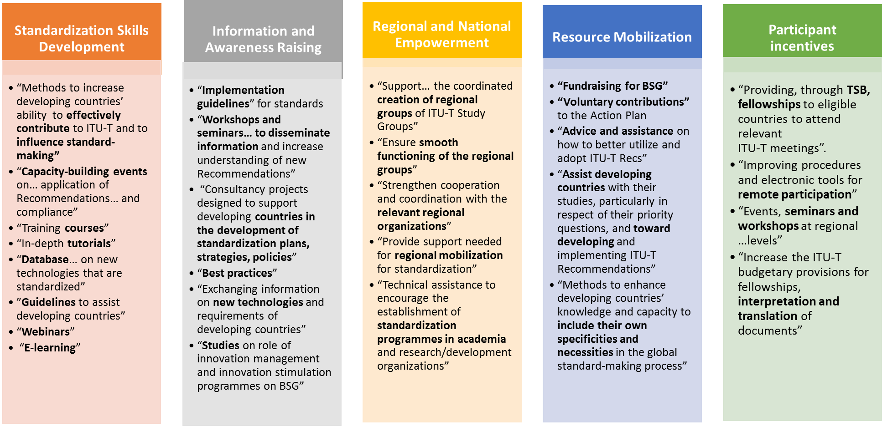
ITU-T overview
5 strategic pillars

Slide 23
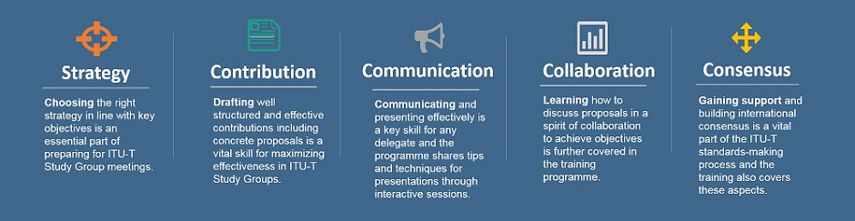
ITU-T overview
BSG ‘hands-on’ training
New ITU-T training programme for delegates from developing countries

Slide 24
ITU-T overview
Regional Groups
Regional Groups within ITU-T Study Groups have proven effective mechanisms to assist in bridging the standardization gap.
ITU-T now has 23 Regional Groups:
  x8 for Africa (Study Groups 2, 3, 5, 12, 11, 13, 17 and 20)
  x4 for Americas (Study Groups 2, 3, 5 and 20)
  x5 for Arab States (Study Groups 2, 3, 5, 17 and 20)
  x2 for Asia and the Pacific (Study Groups 3 and 5)
  x1 for Europe and the Mediterranean Basin (Study Group 3, not yet active)
  x1 for Eastern Europe, Central Asia and Transcaucasia (Study Group 20)
  x2 for the Regional Commonwealth in the field of Communications / Commonwealth of Independent States (RCC/CIS in Study Group 3 and RCC in Study Group 11)

Slide 25


Slide 26
CONTENT STURUCTURE OF THE PROGRAMME
Smart ABC
Zone
Smart Cities Showcases
- Showcases of the cities using
ITU KPIs
- Demos of smart city projects
- Exhibits from industries involved
in smart city ecosystem
Smart Banking Showcases
- Demos of Fintech start-ups
- Showcases of financial industry
- Financial Inclusion case demos
- Exhibits from industries involved in
financial service ecosystem
Smart Intelligence Showcases
- Demos of AI start-ups
- Showcases of AI-powered projects
- IBM Watson AI Xprize winners
Forums
High Level Forum
- Smart Cities Roundtable
: Roundtable 1 - “Mayors meet mayors”
: Roundtable 2 - “Mayors meet business”
- Asian Digital Financial Services Roundtable
: Roundtable 1 - “Finance talks about its future”
: Roundtable 2 - “Finance meets tech”
- Artificial Intelligence Special Session
: Detailed content to be confirmed
Cross-sectoral Debates
- AI-powered Financial Services
: RegTech, Crowdfunding, Intelligent fund
distribution, etc
- Fintech & Smart Cities
: Smart transportation with smart payment,
M2M transactions (Internet of value), etc
- From Smart to Smarter
: AI-powered “Smarter” Cities
Networking
Events
Leaders Dinner – by invitation only
Cross-sector networking cocktails

Slide 27

www.itu.int

