Slide 1
™
Cost efficient and low latency delivery of IP-based services

Slide 2






Meeting 5G KPIs
Your Service Just One Hop Away – Enabled by Our ICN Intelligence
HBO
NETFLIX
AMAZON
YOUTUBE
Latency
Service Placement
Serving content & services under 5G constraints
Mobilize CDNs
The ultimate goal:
One hop away
Pure E2E not sustainable
COTS
platform
Introduce CDNs
CPE
Distance

Slide 3
Project Elevator Pitch
Reinventing the approach to IP based services through a backward compatible introduction of new methodologies supported by an SDN/NFV enabled network fabric & designed to meet challenging 5G KPIs
It looks like IP, it smells like IP, BUT with this technology inside networks will simply work better…
The target for this tech: Telcos & Switch Vendors

Slide 4
The Problem & Current Approaches
Bandwidth costs
# of user viewings determine BW costs
HBO
NETFLIX
AMAZON
YOUTUBE
HTTP Unicast Proliferation
IP Unicast Legacy
SDN controller
IP Gateway
SDN controller
SDN Switch
Emerging Network
# of User Connections
NFV COTS
Two current approaches – Two shortcomings
  CDNs are currently used for popular content but this is overly complex and results in inefficiencies associated with indirections
  Overprovisioning of resources drives unsustainable spiraling costs
  Both shortcomings are unsustainable for 5G
CPE

Slide 5
Our Solution: Re-Introducing Multicast
Bandwidth costs
Our Solution will Drive Down Bandwidth Costs
HBO
NETFLIX
AMAZON
YOUTUBE
Benefit #1: True Multicast
Implicit Multicast
ICN Gateway Layer
ICN Intelligence
SDN controller
IP Gateway
SDN Switch
# of User Connections
NFV COTS
POINT/RIFE: The Innovative ICN approach for competitive 5G (or before) operator networks
Re-introduce multicast into world of predominantly personalized web experience
-> higher network utilization
Flexible routing at runtime through cloudifiable software elements
-> increased resilience, latency reduction
App (e.g. HTTP)
ICN Gateway Layer
IP
IP
ICN
L1/L2
CPE

Slide 6
Our Solution: Localize Communication
Bandwidth costs
Our Solution will Drive Down Bandwidth Costs
HBO
NETFLIX
AMAZON
YOUTUBE
Benefit #2: Dynamic Web Servers
Implicit Multicast
Surrogate Mgmt.
ICN Gateway Layer
ICN Intelligence
SDN controller
# of User Connections
The next logical step: Dynamic Web Servers, spun up possibly just one hop away
Creates new service possibilities for operators, utilizing in-network NFV-based computing capabilities
Helps meeting challenging 5G KPIs, such as 5ms service-level latency & 1000x capacity increase
Dynamic
Web Servers
App (e.g. HTTP)
ICN Gateway Layer
IP
IP
ICN
L1/L2
CPE

Slide 7
Other Opportunities
Easy SDN integration
  Uses existing OF1.3 features
  In-the-night shipping possible
Mobility support
  Direct path routing with no anchor point and only slightly higher ctrl signalling as proxy MIPv6 (see http://arxiv.org/abs/1610.09011)
Network management through ICN itself
  Pub/sub-based context awareness framework (KI9 in 3GPP SA2)
Compliance with 5G control plane architecture
  Reference here 5GPPP CONFIG effort

Slide 8
UK NextGen Network
Our Demo

Slide 9

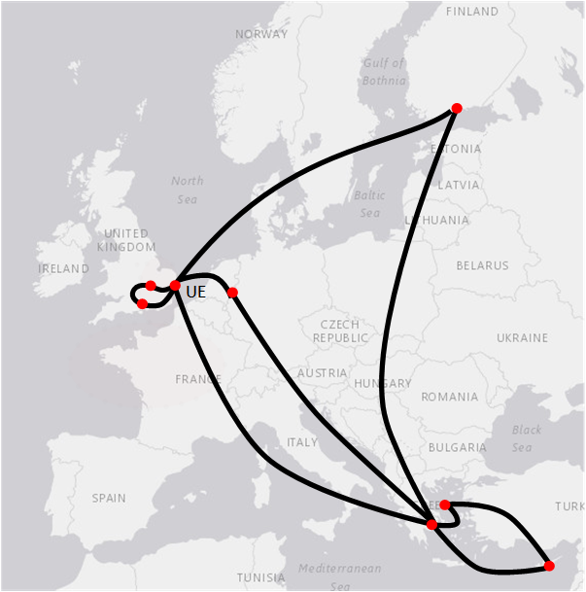


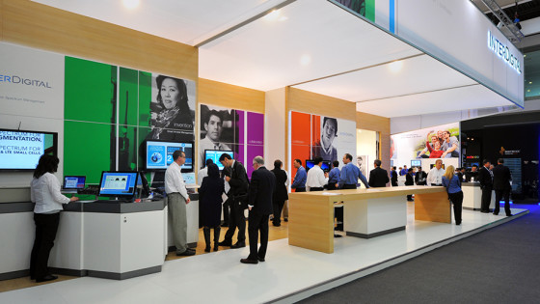
Demo Setup
Improvement:
Multicast Gain = ratio of incoming vs. outgoing bytes
(1.0 for IP solutions, expected >>10 in demo due to POINT solution)
Improvement:
Improved local playout quality (scale to HD quality)
(while emulated users will continue to receive SD quality from Bristol)
Local visitors using IDC-provided
demo tablets or their own devices
Remote Video
Feed
30+ emulated users
in data center
From our POINT/RIFE European Network
Local Video
Feed
…To Our Booth in Geneva

Slide 10


Schematic Setup
Control traffic
L2 link
IP-only
Receiver
UE
NAP
SDN
Switch
RV
SDN
Switch
NAP
IP-only
Sender
UE
HLS
Video
Server
NAP
TM
SDN Controller
Mininet setup with
~30 emulated users
in server cluster
ITU booth
Backhaul network

Slide 11
Demo Aspect 1: Multicast Gain
Aspect 1 demonstrates
the multicast gain as well
as the reduced server load
through multicast delivery
of HTTP responses in HLS
video streaming scenario
IP-only
Receiver
UE
Sending around 5 HLS
streams via multicast
NAP
SDN
Switch
IP-only
Sender
UE
SDN
Switch
RV
NAP
HLS
Video
Server
NAP
TM
SDN Controller
Video traffic
Control traffic
L2 link
Sending around 1 HLS
stream via multicast
Mininet setup with
~30 emulated users
in server cluster

Slide 12
Demo Aspect 2: Surrogate Server for Latency Reduction
Surrogate
Video
Server
Aspect 2 demonstrates
the latency reduction and
video quality improvement
through surrogate server
at MWC
IP-only
Receiver
UE
Sending around 5 HLS
streams via multicast
NAP
SDN
Switch
IP-only
Sender
UE
SDN
Switch
RV
NAP
HLS
Video
Server
NAP
TM
SDN Controller
Video traffic
Control traffic
L2 link
Sending 1 HLS
stream via multicast
Mininet setup with
~30 emulated users
in server cluster

