Slide 1


5G
End-to-End Slicing
Demo
December 7th 2016
FG-IMT-2020 Geneva

Slide 2
Outline
Background
Architecture
Prototype

Slide 3
One Size Does Not Fit All
time
Mobile
Broad
Band
((
Machine
Machine
frequency
Reliable
Low
Latency
((
Access DC
Metro DC
Core DC
others
4G - UE
4G - air
4G – packet core
Multiple
Applications ☺
Different QOS
requirements ☺
Same air interface
for every application +
Air interface controls
most of QOS +
COMPROMISES ☹
Same authentication +
Same mobility +
Same reliability +
Same delay +
Same QOS +
COMPROMISES ☹
=
=

Slide 4
Solution is custom tailoring (slice)
time
((
EMBB
MMTC
frequency
((
URLLC
other
Access DC
Metro DC
Core DC
5G - UE
5G – air(s)
5G – packet core(s)
No compromises air interface(s)
Ultra high bandwidth for MBB
Ultra low delay/reliability for URLLC
No reservations for MMTC
Room to grow for many others eg:
improved mobility velocity
No compromises packet core(s)
Ultra high bandwidth for MBB/content near UE
Ultra low delay/reliability for URLLC (dedicated BW)
No reservations for MMTC
Virtualized core / programmable air interface allows
Unlimited growth for ‘other’ slice types.

Slide 5
Major Components of 5G Infrastructure
time
((
EMBB
MEC
MMTC
1
2
3
SDN
frequency
((
MEC
URLLC
5
other
3
4
3
4
SDN NFV
SDN
NFV SDN
(T)SDN
NFV SDN
5
Orchestration Hierarchy
5G - UE
5G – air(s)
1
1 F-OFDM – Filtered OFDM – flexibly isolates the bands allowing different behaviors
2 SCMA – Sparse Code Multiple Access – allows reservation free access
3 SDN – software defined networking – to program user plane or orchestrate F connectivity.
4 NFV – Network Function Virtualization – to run packet core functions on general CPUs
ORCHESTRATION – co-ordinate SDN / NFV / radios to create/change/manage slices.
6 POLAR CODES – flexible efficient error correcting codes for arbitrary block sizes.
2
3
4
5
6

Slide 6
Slices however must “breathe”
time
((
EMBB
MMTC
frequency
((
URLLC
Access DC
Metro DC
Core DC
5G - UE
5G – air(s)
5G – packet core(s)
Since slices are allocated dedicated resources this can lead to inefficiencies. So:
Must be possible for slices to change size (breath) and to exchange physical resources
Example the MMTC slice shrinks and gives up capacity to the EMMB slice.
Example the ‘other’ slice is not present for some period of time. Its resources given to URLLC.
Must happen with minimum interference or the capability is not usable sufficiently often.

Slide 7
Slicing in terms of resource sets/subsets.
UE
Antennas
Fronthaul
CRAN fabric
CRAN CPU/S/W
RAT Numerology
Back Haul
Core CPU/S/W
+
+
+
+
+
+
+
From the Universe of resource sets..
A slice can be thought of as a set of subsets …
UE
Antennas
Fronthaul
CRAN fabric
CRAN CPU/S/W
RAT Numerology
Back Haul
Core CPU/S/W
+
+
+
+
+
+
+

Slide 8
Slices may share and trade resources – starting at UE
Many levels of Slice Selection Implicit/Explicit
UE
Antennas
Fronthaul
CRAN fabric
CRAN CPU/S/W
RAT Numerology
Back Haul
Core CPU/S/W
+
+
+
+
+
+
+
= S_{i}
))))
))))
Eg 4.xG
A
OS
= S_{j}
APP
Thing
Thing
))))
))))
= S_{k}
B
OS
OS
Slices can be isolated all the way to
antenna.
Slices can share antennas, fronthaul
CRAN etc. but be separated by frequency
time or code space.
Different RATs
Different NG-EPC
(demux at Slice Selection Function in NB)
Different downstream of the NG-EPC
(eg different FW/LB etc.)
SSF
APP
APP
APP
APP
= S_{l}
UEs/”Things” can be it
a single slice, or multiple slices
A UE in multiple slices can be
sliced A) horizontally (slice = QOS/QOE) or
B) vertically (slice = virtual UE).
= S_{m}

Slide 9
Slices can“breath”i.e. grow/shrink & trade resources hit-lessley, automatically or on high level stimulus
Antennas
Fronthaul
CRAN fabric
CRAN CPU/S/W
RAT Numerology
Back Haul
Core CPU/S/W
Slice_{i} =
+
+
+
+
+
+
f
Δ In response to
various stimulus
f
Antennas
Fronthaul
CRAN fabric
CRAN CPU/S/W
RAT Numerology
Back Haul
Core CPU/S/W
Slice_{k} =
+
+
+
+
+
+
f

Slide 10

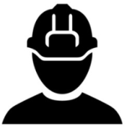
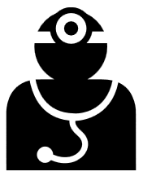
Various Stimuli to trigger resource Δ
Operator
request for
new slice or
delete old
Schedules
time of Day
Profile or
S/W version
changes
6
Physical
resource
add/remove
Temporary
H/W
maintenance
UE’s density
changes
dramatically
!!
Spectrum
or spectral
efficiency
change
%
Detected
congestion
CPU thresholds
Emergency
Response
!!
t
After trigger (any type) everything is automatic
closed loop and hitless.

Slide 11
Rapid Automation of every component is imperative!
IOT
CAPEX savings of 5G cloud come from statistical gains.
  Want to allocate resources less than peak requirements.
  Statistical gains need fast adaption to take advantage of ebb/flow of the tidal changes inter/intra slice.
  Slow reconfiguration means more equipment is required.
  Smaller Δτ (i.e. better automation) ➔ reduced peak HW.
  Trade-offs of resources is complex optimization problem.
X
Larger Δτ =
More Peak HW
More Loss
X
eMBB
Δτ
time
IOT
Smaller Δτ =
Less Peak HW
Less Loss
eMBB
Δτ
time
OPEX of 5G nf()/ng() without automation greater than physical f()/g().
  Many more components to manage/configure than physical.
  Exploiting parallelism requires many more logical conns/nfs.
  Dynamic management of infrastructure not just RAT/RAN.
  Hand debugging of virtualized entities requires specialized skills.
f()
g()
nf_{c[i]}()
ng_{c[i]}()
..
..
nf_{c[i]}()
ng_{c[i]}()
f()
g()
nf_{u[i]}()
ng_{u[i]}()
..
..
physical
nf_{u[i]}()
ng_{u[i]}()
nf_{u[i]}()
ng_{u[i]}()

Slide 12
A small sub-sample of some of the required commands to setup one slice in one C-RAN (non Radio parts) i.e. its very complex.
5g-1
auto p1
iface p1 inet manual
bond-master bond0
auto p2
iface p2 inet manual
bond-master bond0
auto bond0
iface p1 inet static
bond-mode 4
bond-miimon 100
bond-lacp-rate 1
bond-slaves p1 p2
Encoded
lxc start endoeB
ovs-vsctl add-port 5g-br0 enodeB_veth_0
ovs-vsctl set port enodeB_veth_0 tag=10
HSS
lxc start hss
ovs-vsctl add-port 5g-br0 hss_veth_0
ovs-vsctl set port hss_veth_0 tag=10
5g-4
auto p1
iface p1 inet manual
bond-master bond0
auto p2
iface p2 inet manual
bond-master bond0
auto bond0
iface p1 inet static
bond-mode 4
bond-miimon 100
bond-lacp-rate 1
bond-slaves p1 p2
5g-6
auto p1
iface p1 inet manual
bond-master bond0
auto p2
iface p2 inet manual
bond-master bond0
auto bond0
iface p1 inet static
bond-mode 4
bond-miimon 100
bond-lacp-rate 1
bond-slaves p1 p2
5g-7
auto p1
iface p1 inet manual
bond-master bond0
auto p2
iface p2 inet manual
bond-master bond0
auto bond0
iface p1 inet static
bond-mode 4
bond-miimon 100
bond-lacp-rate 1
bond-slaves p1 p2
EPC
virsh net-define 5g-network.xml
virsh net-start 5g-network
virsh define epc
virsh start epc
ovs-vsctl add-port 5g-br0 epc_veth_0
ovs-vsctl set port epc_veth_0 tag=10
Switch-1
vlan 10
interface eth-trunk1
Description: To 5g-2
port link-type trunk
port trunk allow-pass vlan 10
mode lacp-dynamic
interface eth-trunk2
Description: To 5g-4
port link-type trunk
port trunk allow-pass vlan 10
mode lacp-dynamic
interface eth-trunk9
Description: To 5g-1 RRH
port link-type trunk
port trunk allow-pass vlan 10
mode lacp-dynamic
interface eth-trunk21
Description: To Optical Node
port link-type trunk
port trunk allow-pass vlan 10
mode lacp-dynamic
Switch-2
vlan 10
interface eth-trunk1
Description: To 5g-6
port link-type trunk
port trunk allow-pass vlan 10
mode lacp-dynamic
interface eth-trunk2
Description: To 5g-7q
port link-type trunk
port trunk allow-pass vlan 10
mode lacp-dynamic
interface eth-trunk21
Description: To Optical Node
port link-type trunk
port trunk allow-pass vlan 10
mode lacp-dynamic
5g-2
auto p1
iface p1 inet manual
bond-master bond0
auto p2
iface p2 inet manual
bond-master bond0
auto bond0
iface p1 inet static
bond-mode 4
bond-miimon 100
bond-lacp-rate 1
bond-slaves p1 p2
RRH
docker attach rrh
ovs-docker add-port 5g-br0 eth1 rrh –ipaddress==192.168.10.2/24
ovs-vsctl set port rrh_veth_0 tag=10
Transport network,
radio and EPC attributes
not shown

Slide 13
Outline
Background
Architecture
Prototype

Slide 14
Slicing create/control hierarchical orchestration infrastructure
UDM
SliceTemplate(eMBB-A)
C
I()
A
B
NG7
NG5
INPUT
NG1
NG-CP
AF
NG2
NG4
SOFTWARIZATION(APIs)
UE
NG(R)AN
NG3
NG-UP
NG6
FW
Data
Network
ORCHESTRATION
F()
G()
H()
CONTROL
SOFTWARIZATION(APIs)
TAPI
SOFTWARIZATION(APIs)
TAPI
ORCHESTRATION
ORCHESTRATION
CONTROL
CONTROL
MACHINE
SOFT
SOFT
SOFT
SOFT
SOFT
SOFT
Docker
SOFT
SOFT
SOFT
SOFT
Op-NFV
SOFT
PCE
MGMT
MGMT
MGMT
MGMT
ODL
MGMT
MGMT
MGMT
PCE
MGMT
ODL
MGMT
MGMT
MGMT
CTRL
CTRL
CTRL
CTRL
CTRL
CTRL
CTRL
CTRL
CTRL
CTRL
Container
LXD
CTRL
F()
G()
H()
Container
LXD
(G)MPLS
F()
G()
H()
(G)MPLS
Σ
Λ
Π
ANT/freq
FH
DSP
Fabric
CUS
NFs
NW
Fabric
CPUS
NFs
NW
((
eMBB Slice-A
Σ
F()
L2VPN
G()
H()
I()
OUTUT
URLLC
eMBB
((
URLLC Slice-B
f
F()
G()
H()
L3VPN
I()

Slide 15
High Level Events – Capability Exposure & Abstraction
UDM
SliceTemplate(eMBB-A)
C
I()
A
B
NG7
NG5
INPUT
NG1
NG-CP
AF
NG2
NG4
SOFTWARIZATION(APIs)
UE
NG(R)AN
NG3
NG-UP
NG6
FW
Data
Network
ORCHESTRATION
F()
G()
H()
CONTROL
SOFTWARIZATION(APIs)
TAPI
SOFTWARIZATION(APIs)
TAPI
ORCHESTRATION
ORCHESTRATION
CONTROL
CONTROL
MACHINE
SOFT
SOFT
SOFT
SOFT
SOFT
SOFT
Docker
SOFT
SOFT
SOFT
SOFT
Op-NFV
SOFT
PCE
MGMT
MGMT
MGMT
MGMT
ODL
MGMT
MGMT
MGMT
PCE
MGMT
ODL
MGMT
MGMT
MGMT
CTRL
CTRL
CTRL
CTRL
CTRL
CTRL
CTRL
CTRL
CTRL
CTRL
Container
LXD
CTRL
F()
G()
H()
Container
LXD
(G)MPLS
F()
G()
H()
(G)MPLS
Σ
Λ
Π
ANT/freq
FH
DSP
Fabric
CUS
NFs
NW
Fabric
CPUS
NFs
NW
((
OUTUT
Σ
URLLC
((
URLLC Slice-B
f
F()
G()
H()
L3VPN
I()

Slide 16

High Level Events – Import Slice Delta & compute resource allocation
UDM
SliceTemplate(eMBB-A)
I()
A
B
NG7
NG5
INPUT
NG1
NG-CP
AF
NG2
NG4
SOFTWARIZATION(APIs)
UE
NG(R)AN
NG3
NG-UP
NG6
FW
Data
Network
ORCHESTRATION
F()
G()
H()
CONTROL
SOFTWARIZATION(APIs)
TAPI
SOFTWARIZATION(APIs)
TAPI
ORCHESTRATION
ORCHESTRATION
CONTROL
CONTROL
MACHINE
SOFT
SOFT
SOFT
SOFT
SOFT
SOFT
Docker
SOFT
SOFT
SOFT
SOFT
Op-NFV
SOFT
PCE
MGMT
MGMT
MGMT
MGMT
ODL
MGMT
MGMT
MGMT
PCE
MGMT
ODL
MGMT
MGMT
MGMT
CTRL
CTRL
CTRL
CTRL
CTRL
CTRL
CTRL
CTRL
CTRL
CTRL
Container
LXD
CTRL
F()
G()
H()
Container
LXD
(G)MPLS
F()
G()
H()
(G)MPLS
Σ
Λ
Π
ANT/freq
FH
DSP
Fabric
CUS
NFs
NW
Fabric
CPUS
NFs
NW
((
OUTUT
Σ
URLLC
((
URLLC Slice-B
f
F()
G()
H()
L3VPN
I()

Slide 17
High Level Events – Sub divide problem by region/domain
UDM
SliceTemplate(eMBB-A)
((
I()
A
NG7
NG5
INPUT
NG1
NG-CP
AF
NG2
NG4
SOFTWARIZATION(APIs)
UE
NG(R)AN
NG3
NG-UP
NG6
FW
Data
Network
ORCHESTRATION
F()
G()
H()
CONTROL
((
SOFTWARIZATION(APIs)
TAPI
SOFTWARIZATION(APIs)
TAPI
ORCHESTRATION
ORCHESTRATION
CONTROL
CONTROL
MACHINE
SOFT
SOFT
SOFT
SOFT
SOFT
SOFT
Docker
SOFT
SOFT
SOFT
SOFT
Op-NFV
SOFT
PCE
MGMT
MGMT
MGMT
MGMT
ODL
MGMT
MGMT
MGMT
PCE
MGMT
ODL
MGMT
MGMT
MGMT
CTRL
CTRL
CTRL
CTRL
CTRL
CTRL
CTRL
CTRL
CTRL
CTRL
Container
LXD
CTRL
F()
G()
H()
Container
LXD
(G)MPLS
F()
G()
H()
(G)MPLS
Σ
Λ
Π
ANT/freq
FH
DSP
Fabric
CUS
NFs
NW
Fabric
CPUS
NFs
NW
((
OUTUT
Σ
URLLC
((
URLLC Slice-B
f
F()
G()
H()
L3VPN
I()

Slide 18
High Level Events – Recursive.. divide problem by region/domain
UDM
SliceTemplate(eMBB-A)
((
I()
A
NG7
NG5
INPUT
NG1
NG-CP
AF
NG2
NG4
SOFTWARIZATION(APIs)
UE
NG(R)AN
NG3
NG-UP
NG6
FW
Data
Network
ORCHESTRATION
F()
G()
H()
CONTROL
((
SOFTWARIZATION(APIs)
TAPI
SOFTWARIZATION(APIs)
TAPI
ORCHESTRATION
ORCHESTRATION
CONTROL
CONTROL
MACHINE
SOFT
SOFT
SOFT
SOFT
SOFT
SOFT
Docker
SOFT
SOFT
SOFT
SOFT
Op-NFV
SOFT
PCE
MGMT
MGMT
MGMT
MGMT
ODL
MGMT
MGMT
MGMT
PCE
MGMT
ODL
MGMT
MGMT
MGMT
CTRL
CTRL
CTRL
CTRL
CTRL
CTRL
CTRL
CTRL
CTRL
CTRL
Container
LXD
CTRL
F()
G()
H()
Container
LXD
(G)MPLS
F()
G()
H()
(G)MPLS
Σ
Λ
Π
ANT/freq
FH
DSP
Fabric
CUS
NFs
NW
Fabric
CPUS
NFs
NW
((
OUTUT
Σ
URLLC
((
URLLC Slice-B
f
F()
G()
H()
L3VPN
I()

Slide 19
High Level Events – Leaf (Physical) instantiation
UDM
SliceTemplate(eMBB-A)
((
I()
A
NG7
NG5
INPUT
NG1
NG-CP
AF
NG2
NG4
SOFTWARIZATION(APIs)
UE
NG(R)AN
NG3
NG-UP
NG6
FW
Data
Network
ORCHESTRATION
F()
G()
H()
CONTROL
((
SOFTWARIZATION(APIs)
TAPI
SOFTWARIZATION(APIs)
TAPI
ORCHESTRATION
ORCHESTRATION
CONTROL
CONTROL
MACHINE
SOFT
SOFT
SOFT
SOFT
SOFT
SOFT
Docker
SOFT
SOFT
SOFT
SOFT
Op-NFV
SOFT
PCE
MGMT
MGMT
MGMT
MGMT
ODL
MGMT
MGMT
MGMT
PCE
MGMT
ODL
MGMT
MGMT
MGMT
CTRL
CTRL
CTRL
CTRL
CTRL
CTRL
CTRL
CTRL
CTRL
CTRL
Container
LXD
CTRL
F()
G()
H()
Container
LXD
(G)MPLS
F()
G()
H()
(G)MPLS
Σ
Λ
Π
ANT/freq
FH
DSP
Fabric
CUS
NFs
NW
Fabric
CPUS
NFs
NW
((
eMBB Slice-A
Σ
F()
L2VPN
G()
H()
I()
OUTUT
URLLC
eMBB
((
URLLC Slice-B
f
F()
G()
H()
L3VPN
I()

Slide 20
Outline
Background
Architecture
Prototype

Slide 21
Basic Setup & Reaction Capability
{create, delete, adjust of multiple slice types}
2
Hitless 10G DWDM bandwidth adjustment
hard or soft per slice
1 x 2xGE LAG per slice
DWDM
C
DWDM
Emulator
2
Interrelated
Dimensions
5G
RADIO
PHY
1
10GE
SWITCH-A
DWDM
A
DWDM
B
10GE
SWITCH-B
3
Server
DC A/1
Server
DC A/2
T-SDN CTRL
5G ORCH
Server
DC B/1
Server
DC B/2
NF
NF
NF
NF
NF
NF
State 1
Hitless spectrum changes. Take from slice 1, Give to slice 2 etc.
Thousands of possible
NF placements. Chosen by global optimizer. Hitless changes.
NF
NF
NF
State 2
NF
NF
NF
1
3
State n
NF
NF
NF
NF
NF
NF

Slide 22
Logical Demo and Physical Hardware
eMBB
DWDM
C
DWDM
Emulator
15Khz
SUB FRAME
Load
Generator
F-OFDM
0.5ms
7 symbol
5G
RADIO
PHY
1000Mhz (5 x 20Mhz) @ 4.6Ghz
SUB FRAME
10GE
SWITCH-A
DWDM
A
DWDM
B
10GE
SWITCH-B
MMTC
30Khz
0.25ms
7 symbol
SCMA
F-OFDM
30Khz
SUB FRAME
Server
DC A/1
Server
DC A/2
Server
DC B/1
Server
DC B/2
FRAME
URRLC
0.25ms
7 symbol
F-OFDM
TSDN
SONAC
5G ORCH
Spectrum
Analyzer
cv
RFU
6850(switch)
6850(switch)
UE-Server
RFU
6800
Servers
2288
Servers
2288
Servers
2288
Servers
UE-Radio (FPGA)
:
:
B-CUBE (FPGA)
OPTIX 9800(DWDM)
MUX
MUX
OPTIX 9800(DWDM)
OPTIX 9800(DWDM)
UE-Server
RFU
UE-Radio (FPGA)

Slide 23
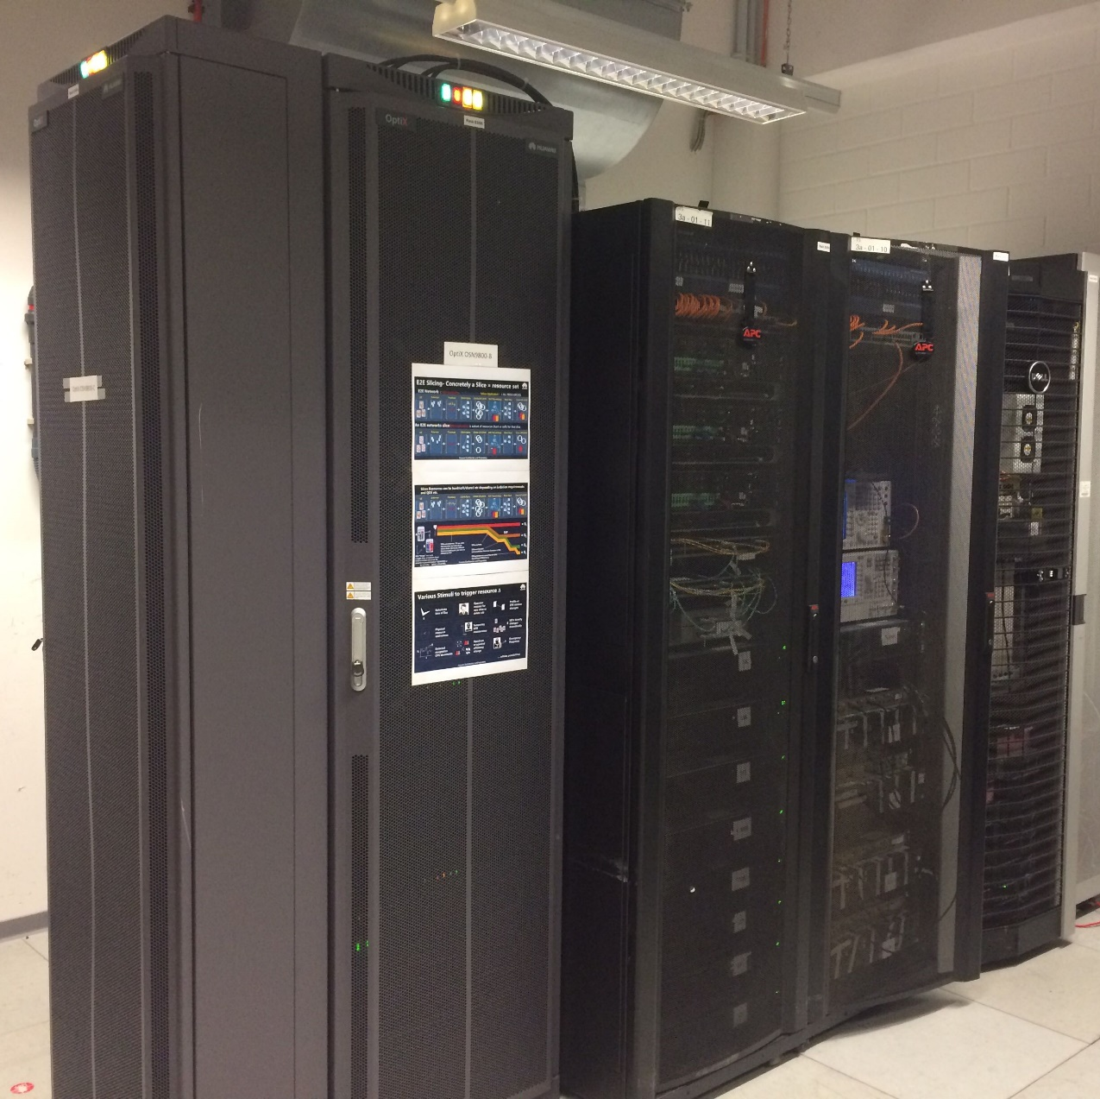
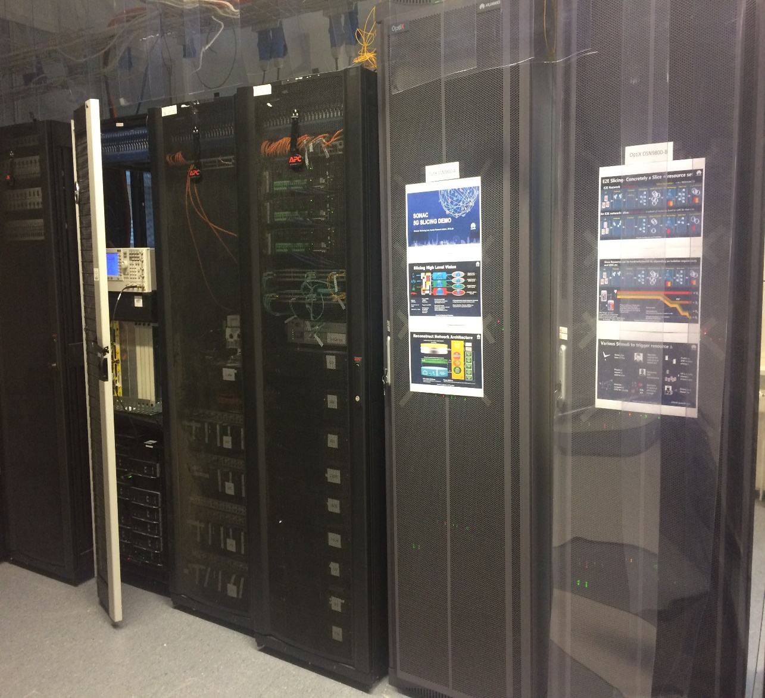
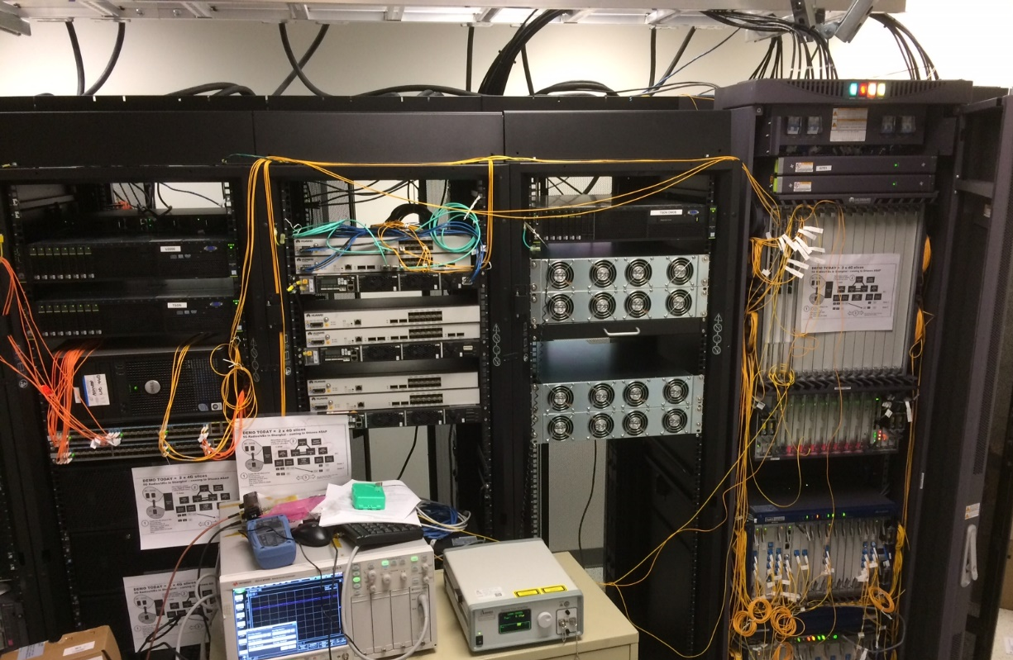
SHANGHAI/CHINA
BONN/GERMANY
OTTAWA/CANADA

Slide 24
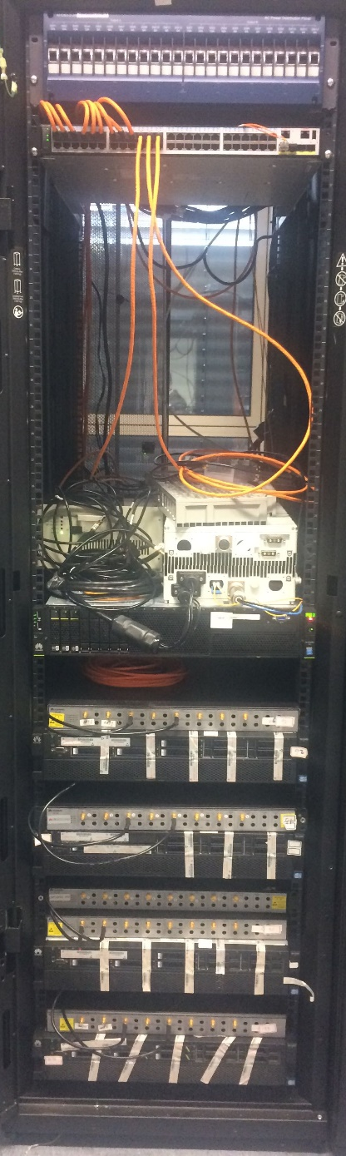
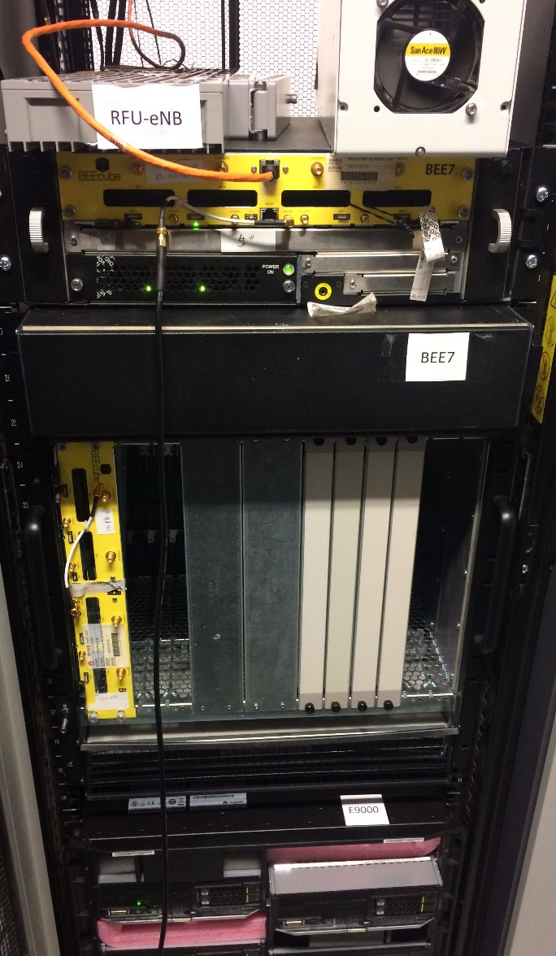
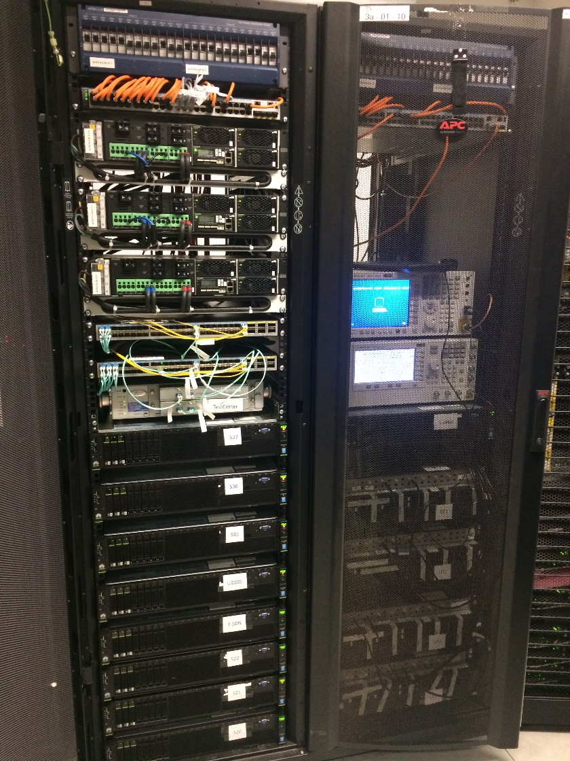
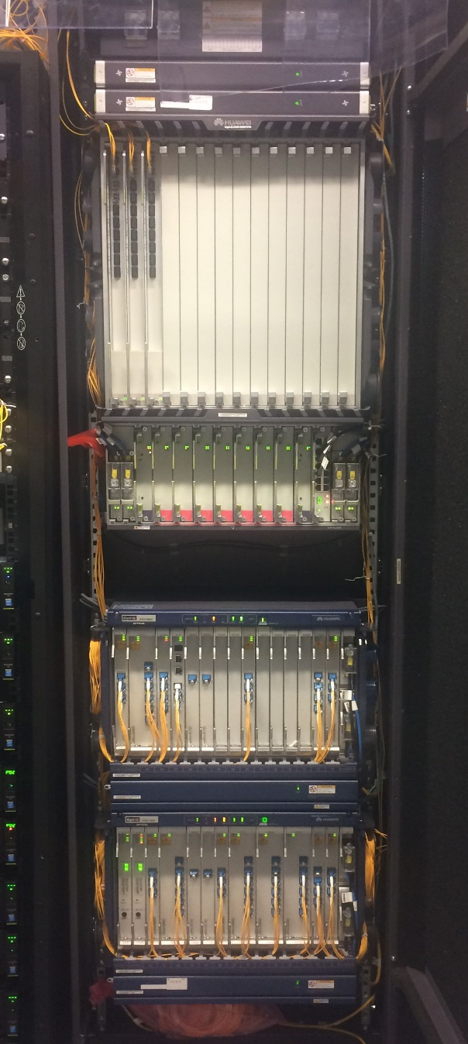
General purpose
compute in DC and
C-RAN including
40GE High Density
Switches LAG’ed over
DWDM network.
5G Radio real time
logic in BEE-7 FPGAs.
5G UE Radios real time
FPGAs and test servers.
DWDM NETWORK
+ ROADMS

Slide 25
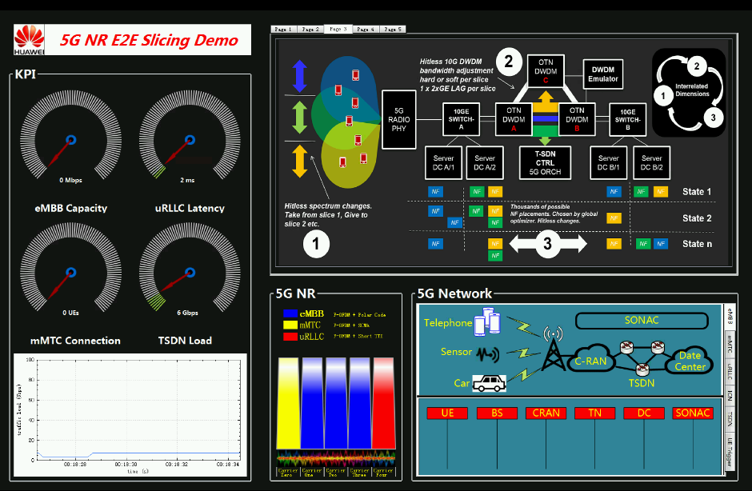
SONAC DEMO GUI
High level
view of what’s
happening
IMPORTANT
KPIS FOR EACH
SLICE
TRANSPORT
BANDWIDTH
CRAN-DC
View of
Messaging
data flow
100 Mhz as 5x20Mhz F-OFDM
blocks colored to show slice assignment

Slide 26
Resource allocation by mixed integer/linear program
BW(demand)
Ordering Constraint
Slice 1
Slice 2
Slice 3
Delay
Mmtc-PHY
Embb-nb
Embb-gw
Embb-content
CPU cores
CPU I/O
≤
Resources(demand)
Embb-MME
constraints
Embb-HSS
DWDM link
variables
Slice ~= Graph of network functions (creates ordering constraints)
Resource utilization = f_{network-function}(slice demand)
Routing
Delay
Optimization program:
Minimize selected costs/delays while:
Placing network functions(slices) and
Respecting system resource limitations.
MILP is a well known method, but:
Poor scalability
Problem changes before you compute solution
NP-hard combinatorial problem
System Resources =
Server resources
CPU
Memory
IO
OTN Resources
Bandwidth
System Costs =
Resource costs
Server-server cost
Server delays
Server-server delays
Randomized algorithms - approximate solutions but:
Good scalability
Parallelizable
Continuous optimization tracks requirement changes
Start at LP solution and
branch-and-bound
Notes:
If we look at some of the goals of 5G vs where we are today we an see the gap that has to be bridged over the next few years. The goal of 1ms latency is nearly 50x better than current LTE systems, to get from 100Mbps per user to 10G we need 100x the throughput per connection. The current 10,000 connections per square kilometer needs to increase to 1Million connetions so a 100x increase in density. Reliabile communications today with LTE top out about 350km/h and we expect to bring that up by 1.5x to 500km/h . Finally the current core networks and backhaul/front haul are inflexible with wasted pools of bandwidth. The introduction of SDN/NFV will allow much better ability to chop up and virtualize the network resources for lower operational costs and capital costs and much greater flexibility.

Slide 27
STATE-0 – idle, no slices, NFs, min BW
2
Minimum B/W up between DC’s.
DWDM
C
9800
Emulator
5G
RADIO
PHY
Test UE’s are all idle
10GE
SWITCH-A
DWDM
A
DWDM
B
10GE
SWITCH-B
1
4G
RADIO
PHY
Server
DC A/1
Server
DC A/2
T-SDN CTRL
5G ORCH
Server
DC B/1
Server
DC B/2
Real LTE UE’s are disconnected
3
No network functions present in either CRAN
/EDGE or DC.
NF
NF
NF
NF
NF

Slide 28
LTE in slice – create two LTE slices
LTE Phy H/W instantiated.
E-2-E network configured and sized.
5a-OVS bridges, 5b-phys switches. 5c-TSDN allocates and
brings up lambdas into switch LAG for this slice.
4
DWDM
C
DWDM
Emulator
5
LTE-PHY
10GE
SWITCH-A
DWDM
A
DWDM
B
Skype
4G
PHY
10GE
SWITCH-B
LTE-PHY
Server
DC A/1
Server
DC A/2
T-SDN CTRL
5G ORCH
Server
DC B/1
Server
DC B/2
Two smartphones
connect, one per slice.
Skype initiated.
LTE-gw containers
moved.
6
Lte-eNB
LTE-gw
LTE-mme
LTE- hss
1
Operator !! requests LTE slices
Lte-eNB
LTE-gw
LTE-mme
LTE- hss
3
2
Global Optimizer assigns resources
LTE MME&HSS NFs
placed in DC, cores
assigned, started,
configured.
NF
EPC NF’containers placed in C-RAN
3
NF
NF
NF

Slide 29
STATE-1 – eMBB slice created
eMBB PHY instantiated.
Spectrum/OFDM etc.
attributes configured.
E-2-E network configured and sized.
5a-OVS bridges, 5b-phys switches. 5c-TSDN allocates and
brings up lambdas into switch LAG for this slice.
4
DWDM
C
DWDM
Emulator
5
5G
RADIO
PHY
Mmtc-PHY
10GE
SWITCH-A
DWDM
A
DWDM
B
10GE
SWITCH-B
>display stats
30,30303
30303.
5
>display stats
30,30303
30303.
Test-UE’s start generating traffic into this slice for the content.
Server
DC A/1
Server
DC A/2
T-SDN CTRL
5G ORCH
Server
DC B/1
Server
DC B/2
Embb-gw
6
KPI displays Spectrum
Analyzer etc.
Embb-nb
Embb mme
Embb hss
Embb-content
1
Operator !! requests eMBB slice
3
2
Global Optimizer assigns resources
eMBB MME&HSS NFs
placed in DC, cores
assigned, started,
configured.
eMBB NF’containers placed in C-RAN
  1-eMBB NB protocol
  2-eMBB gateways, 3-some content
  Cores assigned, started, configured.
NF
3
NF
NF
NF

Slide 30
STATE-2 – mMTC slice created
MMTc PHY instantiated.
Spectrum/OFDM etc.
attributes configured.
4
E-2-E network configured and sized.
5a-OVS bridges, 5b-phys switches. 5c-TSDN allocates and
brings up lambdas into switch LAG for this slice.
DWDM
C
DWDM
Emulator
5
5G
RADIO
PHY
Mmtc-PHY
10GE
SWITCH-A
DWDM
A
DWDM
B
10GE
SWITCH-B
>display stats
30,30303
30303.
5
>display stats
30,30303
30303.
Test-UE’s generate 10,000 different UE IDs.
Server
DC A/1
Server
DC A/2
T-SDN CTRL
5G ORCH
Server
DC B/1
Server
DC B/2
Mmtc-prot
Mmtf-agg
6
KPI displays packet
loss etc. Spectrum
Analyzer etc.
Mmtc-split
1
Operator !! requests MMTC slice
3
2
Global Optimizer assigns resources
MMTc small packet
disaggregator NF
placed in DC, cores
assigned, started,
configured.
MMTc NF’ containers placed in C-RAN
  1-MMTc NB protocol
  2-MTc small packet aggregator
  Cores assigned, started, configured.
NF
3
NF
NF
NF

Slide 31
STATE-3 – URRLC slice created
URRLC PHY instantiated.
Spectrum/OFDM etc.
attributes configured.
4
DWDM
C
DWDM
Emulator
6
Three slices running.
5G
RADIO
PHY
urrrlc-PHY
10GE
SWITCH-A
DWDM
A
DWDM
B
10GE
SWITCH-B
>display stats
30,30303
30303.
5
>display stats
30,30303
30303.
Test-UE’s A generates
urgent vehicle to vehicle message to Test-UE-B
Round trip delay displayed on related laptop.
Server
DC A/1
Server
DC A/2
T-SDN CTRL
5G ORCH
Server
DC B/1
Server
DC B/2
Urrrlc-nb
6
KPI displays packet
loss etc. Spectrum
Analyzer etc.
1
Operator !! requests URRLC slice
2
Global Optimizer assigns resources
3
URRLC-NB NF container placed in C-RAN
  1-URRLC NB protocol
NF
NF
NF
NF

Slide 32
STATE-4 – Breath- increase URLLC
URRLC PHY hitless spectrum increase. MMTC
hitless spectrum decrease.
Fronthaul B/W increased for MMTC
since its moved out of C-RAN.
New 10G lambda created added to LAG.
5
4
DWDM
C
Three slices running after
spectrum change
DWDM
Emulator
6
Mmtc-PHY
5G
RADIO
PHY
urrrlc-PHY
10GE
SWITCH-A
DWDM
A
DWDM
B
10GE
SWITCH-B
>display stats
30,30303
30303.
6
>display stats
30,30303
30303.
Server
DC A/1
Server
DC A/2
T-SDN CTRL
5G ORCH
Server
DC B/1
Server
DC B/2
Test-UE’s for all
three slices continue
Uninterrupted.
eMBB not shown for
clarity.
Mmtc-prot
Mmtf-agg
Urrrlc-nb
Mmtc-split
6
KPI displays all
slices still working.
1
Operator !! requests URRLC slice spectrum growth by reducing MMTC spectrum
3
2
Global Optimizer has to move MMTC to DC for URRLC performance increase. Also more DC/CRAN B/W required for MMTC-protocol to PHY
MMTc NF container moved out of C-to DC because URRLC needs the compute resources.
NF
NF
NF
NF

Slide 33
STATE-5 – eMBB/ICN slice created
6
Due to increase in MBB
traffic on the ICN slice
TSDN configures extra
10GE lambda to the MBB slice LAG.
DWDM
C
DWDM
Emulator
5
5G
RADIO
PHY
Mmtc-PHY
10GE
SWITCH-A
DWDM
A
DWDM
B
10GE
SWITCH-B
>display stats
30,30303
30303.
>display stats
30,30303
30303.
Server
DC A/1
Server
DC A/2
T-SDN CTRL
5G ORCH
Server
DC B/1
Server
DC B/2
6
KPI displays Spectrum
Analyzer etc.
SSF
Embb-nb
ICN-MGR
ICN-ROUTER
1
Operator !! requests eMBB ICN slice
ICN-ROUTER
ICN-Video
2
Global Optimizer assigns resources
ICN-ROUTER container placed in C-RAN
  eMBB NB Slice Selection Function
  SSF configured to forward ICN packets direct ICN-router NF.
ICN-ROUTER ,
MANAGER, VIDEO CONF
APP containers placed in DC
NF
3
4
NF
NF
NF

Slide 34
STATE-6 – eMBB/ICN slice operation
1
ICN UEs register interest
In SOURCE’s content.
>display stats
30,30303
30303.
DWDM
C
DWDM
Emulator
>display stats
30,30303
30303.
(((((((
5G
RADIO
PHY
(((((((
Mmtc-PHY
10GE
SWITCH-A
DWDM
A
DWDM
B
2
10GE
SWITCH-B
6
ICN Manager
Displays KPIs.
5
ICN UE-s receive
content of interest.
Server
DC A/1
Server
DC A/2
T-SDN CTRL
5G ORCH
Server
DC B/1
Server
DC B/2
ICN-SOURCE
SSF
Embb-nb
eMMB-NB SSF sends
To ICN ROUTER(s)
Bypassing eMBB G/Ws.
ICN-MGR
ICN-ROUTER
ICN-ROUTER
2
ICN-Video
ICN replicates at
a fork in interest
directly to eMBB-NB
In same C-RAN DC.
3
4
3
ICN Source content
follows interest ‘tree’

Slide 35
State-7 Breathing response to B/W
SPIRENT
TESTER
1
Generate 9.5 G worth of background eMBB traffic into eMBB slice LAG.
DWDM
C
5G
RADIO
PHY
10GE
SWITCH-A
DWDM
A
DWDM
B
10GE
SWITCH-B
+λ
Server
DC A/1
Server
DC A/2
T-SDN CTRL
5G ORCH
5G Orchestrator notes increased B/W in slice at critical link and asks TSDN for additional 10G lambda which it then add to the LAG in a
make-before-break manner (no hit).
2

Slide 36

Thank-You

