Slide 1
Progress of Network Architecture Work in FG IMT-2020
Namseok Ko (nsko@etri.re.kr)
Network Architecture Group Champion

Slide 2
5W1H of Architecture Work
  W
  Gap Analysis (phase 1) : 19 gaps in architecture
  Draft Recommendations (phase 2) : Framework and Requirements
  W
  High-level architecture group with all FG members
  W
  San Diego, Torino, Geneva, Beijing, Seoul, Palo Alto
  W
  June 2015 ~ December 2016
  W
  To define IMT-2020 architecture from network perspective
  H
  8 face-to-face meetings and multiple conference calls

Slide 3
Phase 1 : Gap Analysis (1/2)
19 architectural gaps
  Various bandwidth/data-rates demands
  Complex connectivity model
  Application-aware and distributed network architecture
  Signalling complexity in massive MTC
  Increasing service availability
  Signalling to reduce end-to-end complexity
  End-to-end network latency model
  Mobile network optimized softwarization architecture
  Data plane programmability

Slide 4
Phase 1 : Gap Analysis (2/2)
19 architectural gaps (cont’d)
  End-to-end QoS framework
  Energy efficiency
  Enhancement of privacy and security
  Enhancement identity management
  Multi-RAT connectivity
  Fixed mobile convergence
  Flexible mobility
  Mobility management for distributed flat network
  End-to-end network management in a multi-domain environment
  OAM protocols

Slide 5
Phase 2 : IMT-2020 Requirements (1/2)
Requirements from service points of view
  Enhanced mobile broadband services
  Enhanced massive machine type communications
  Ultra-reliable and low latency communication services
Requirements from network operation point of view
  Network flexibility and programmability
  Fixed-mobile convergence
  Enhance mobility management
  Scalability
  Network capability exposure
  Authentication

Slide 6
Phase 2 : IMT-2020 Requirements (2/2)
Requirements from network operation point of view (cont’d)
  Flexible signaling
  Numbering, naming and addressing
  QoS Control
  Context awareness
  Profile management (User, Device, etc.)
  Network management
  Accounting and charging
  Interworking
  Security
  …

Slide 7
Phase 2 : IMT-2020 Framework (1/3)
IMT-2020 slice life-cycle management
Applications
Management and Orchestration Plane
(including slice templates)
Service Plane
Softwarization is embedded across overall layers by leveraging SDN, NFV, data plane programmability, cloud computing, etc.
Control Plane
Data Plane
Resources
Applications
Applications
MGM
T
Service Plane
MGM
T
Service Plane
MGM
T
Service Plane
Control Plane
Control Plane
…
Control Plane
Data Plane
Data Plane
Data Plane
Resources
Resources
Resources
Instance #1
Instance #2
Instance #n
Slice instances (eMBB, CritC, etc.)
Conceptual IMT-2020 non-radio network architecture

Slide 8
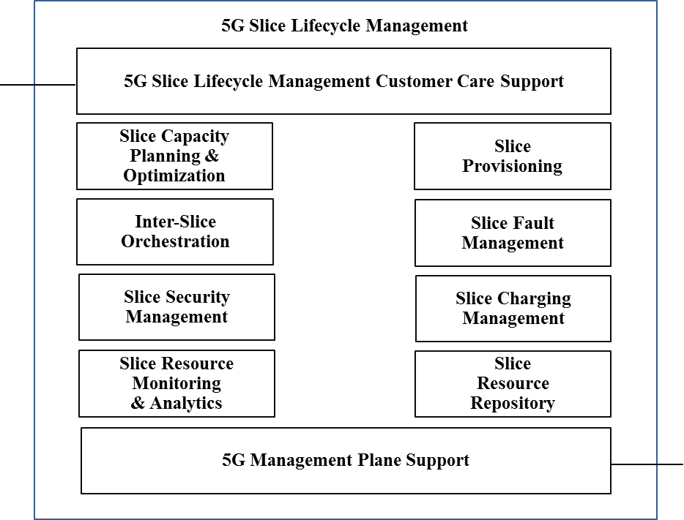
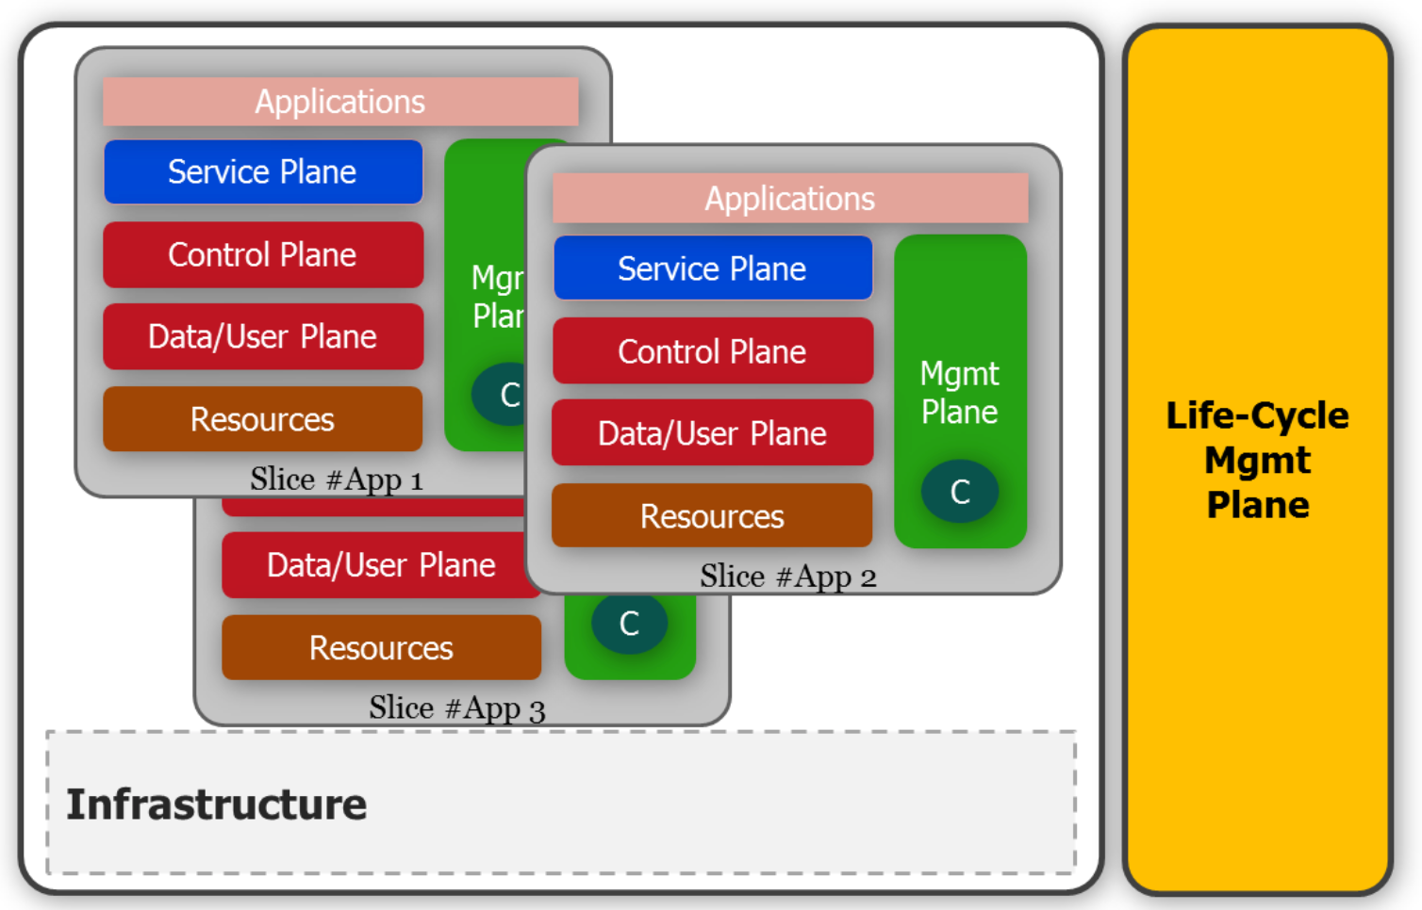
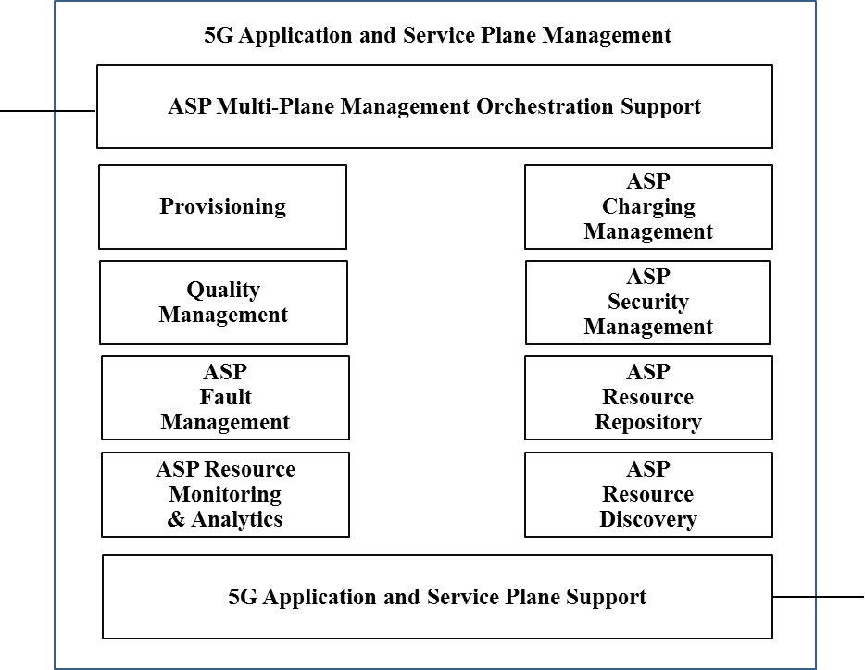
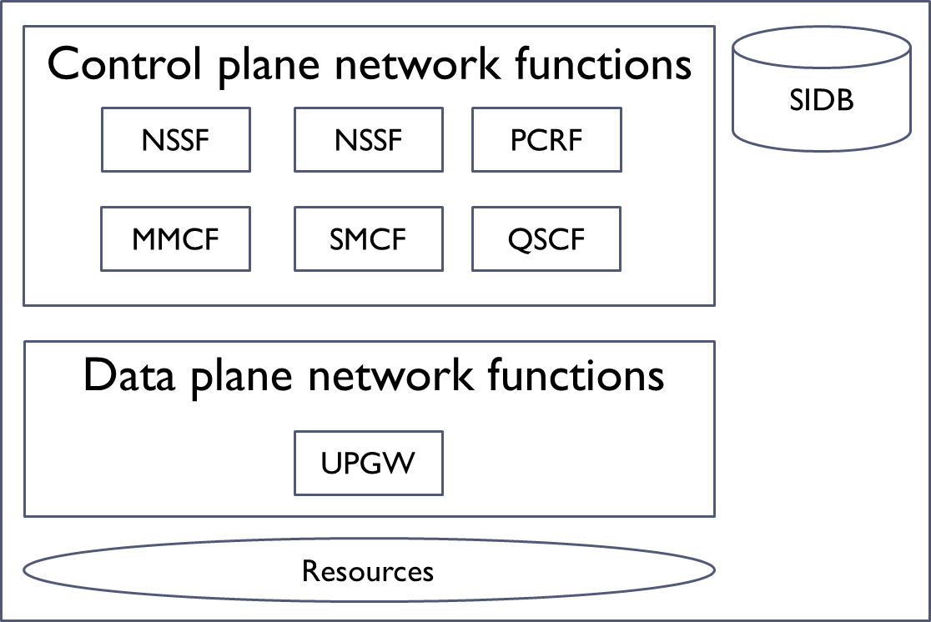
Phase 2 : IMT-2020 Framework (2/3)
IMT-2020 Architecture Diagrams

Slide 9
Phase 2 : IMT-2020 Framework (3/3)
Multiple access technologies (IMT-2020, IMT, WiFi, and fixed networks) with access agnostic common core network
Separation of control plane (CP) and user plane (UP) functions, allowing independent scalability and evolution
Distributed flat network allowing flexible deployment of CP/UP functions
  Converged data plane functions (IP flow management, Multi-RAT coordination, etc.)
  Unified control functions (e.g. authentication) at the core with some functions at the edge
  Modular function design to enable flexible network (e.g. separation of MM and SM)
Architecture to support diverse service requirements
  Different mobility and diverse end-to-end QoS (data rate, reliability, latency etc.) requirements
  Softwarization everywhere leveraging existing tools such as SDN and NFV
  End-to-end network slicing to provide dedicated logical networks with customer (or service) specific functionality; network capability exposure
  Edge cloud support (MEC), distributed content and services

Slide 10
Next Step!
Question # | Question title
A/13 | IMT-2020: Network requirements & functional architecture
B/13 | NGN evolution with innovative technologies including SDN and NFV
C/13 | Software-defined networking, network slicing and orchestration
D/13 | QoS aspects including IMT-2020 networks
E/13 | Upcoming network technologies for IMT-2020 & Future Networks
F/13 | Fixed-Mobile Convergence including IMT-2020
G/13 | Knowledge-centric trustworthy networking and services
H/13 | Innovative services scenarios, deployment models and migration issues based on Future Networks
I/13 | Applying networks of future and innovation in developing countries
J/13 | Big data driven networking (bDDN) and Deep packet inspection (DPI)
K/13 | Requirements, ecosystem, and general capabilities for cloud computing and big data
L/13 | Functional architecture for cloud computing and big data
M/13 | End-to-end Cloud computing management and security
WP: IMT-2020 Networks & Systems

Slide 11
Q & A

