Slide 1
ITU Workshop on "Combating Counterfeit Using Conformance and Interoperability Solutions"
Geneva, Switzerland
28 June 2016
Mutual benefits for Mobile Operators and Governments
in deploying Device Management Systems
Joseph Eid
Sales Director, Invigo
joseph.eid@invigo.com
Jeid_20160628
Notes:
Thank you for the opportunity to contribute to this workshop. As a brief introduction, my name is joseph Eid, I have been working with mobile operators for over 12 years in the device management and billing space. In my presentation I will first start by looking at the benefits for MNOs of eliminating grey market, both as a revenue generating opportunity, as well as a cost reduction initiative.
Then I propose a multi-stakeholder system that when deployed solves the issues of Grey Market of devices, but also helps addresses other pressing issues like SIM-Boxes, SIM Registration and more. At the end, I will conclude with some observations on current ongoing initiatives, and some recommendations that, if implemented, can actually encourage the operators to actively support government initiatives to eliminate Grey Market.

Slide 2
Abstract
Across the globe today, going from Asia, Africa, Middle East and Central America, mobile operators also face the challenges of invalid and counterfeit phones.
Operators are not able to identify and segment their customer base, their Device Supply strategy is inefficient due to Grey Market. Moreover, they are blamed for delivering low QoS and need to invest into additional stations to cover the same territory because of the invalid devices. Furthermore, the life of an invalid and low quality phone is short, hence necessitates frequent changes and investments that impact the end consumer instead of spending his money on expanding his mobile services.
Mobile Operators initially resist initiatives of deploying systems to fight counterfeit devices because they are afraid it will affect their revenues and growth, either directly or indirectly. However, if done correctly and in a smooth manner, all stakeholders including Operators, Government, Consumers and Mobile Device Manufacturers and Distributors will benefit.

Slide 3





















In the Mobile Operator shoes
Over
the Top
Revenue Flat,
ARPU Decline
Complexity
and Costs Rising
Telecomm
Business
Model
Device
Proliferation
Demand
Explosion
Rising
Competition,
Internal and Adjacent
4G
Notes:
More and more into the future, operator are losing control over the user. Hence, Operators are taking initiative on all fronts.: Partnerships with OTTs, or in some other countries fight them. For Demand Explosion Operators are consolidating and Virtulisating their networks to manage to grow cost effectively, and also they care a lot about Device based strategies, both to capture market share, but also to prevent churn and generate more revenue. Let’s take a closer look.

Slide 4

Why is the Device central to the operator to generate more revenue
The device is now more valuable to the consumer than the actual operator
The mobile phone is symbol of social status and spending power
The consumer is ready to spend regularly, and significantly, to upgrade his phone – itch cycle
A smartphone will consume much more data than a basic phone ( 20 + times). Same goes to a 4G phone vs a 3G phone.
Invalid Devices cannot be configured OTA (Over The Air). So when users purchase the device, the operator cannot give them data service unless the device is Manually configured (APN etc.).
Customers expect plug-n-play and high speed data, and are very frustrated if they lose connection
Due to Illegal Importation, Operators are not able to compete on Device Distribution, and do not benefit from Device Champion campaigns. (Ex. The latest iphone is exclusively offered by MNO x).
The cost of the device to the operator is higher than the market, hence operator is not able to offer proper Handset Financing solutions, and Handset Locking.
In a fair competitive and legal device market, operators can evaluate strategies such as device portfolios, smartphone distribution, subsidies, buy-backs, trade-ins, reverse subsidies, own-branded devices, handset financing.
Notes:
Due to Illegal Importation, Operators are not able to compete on Device Distribution, and do not benefit from Device Champion campaigns. (Ex. The latest iphone is exclusively offered by MNO x).
The cost of the device to the operator is higher than the market, hence operator is not able to offer proper Handset Financing solutions, and Handset Bundling.
The operator is paying for customer care in solving Handset issues of configuration. (ex. Invalid and none-identified handsets cannot be configured OTA (Over The Air) to access data services. Ex. Airtel Madagascar more than 30% of devices are not identified, for when users purchase the device, the operator cannot give them data service unless the device is Manually configured (APN etc.).

Slide 5
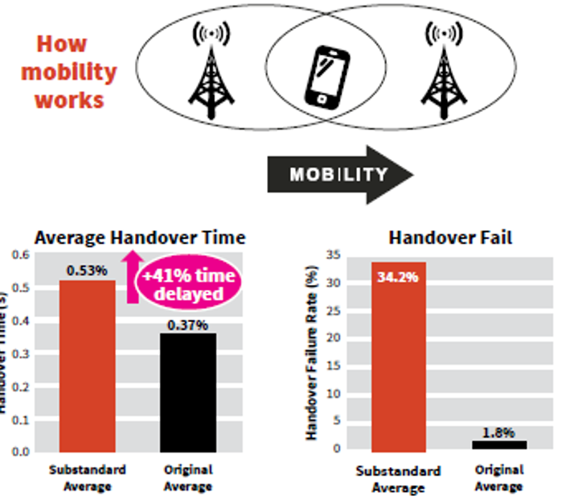
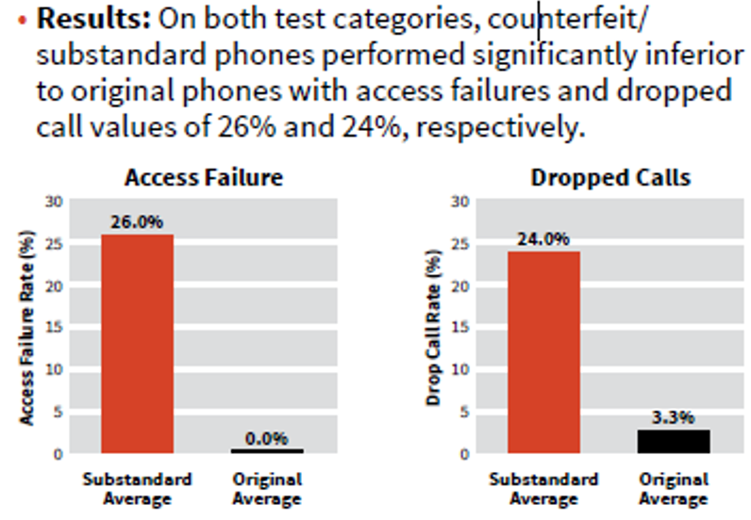
Invalid devices introduce high cost to the operator
*Source is MMF, The Mobile Manufacturer Forum
www.spotafakephone.com
Notes:
Madagascar example.

Slide 6
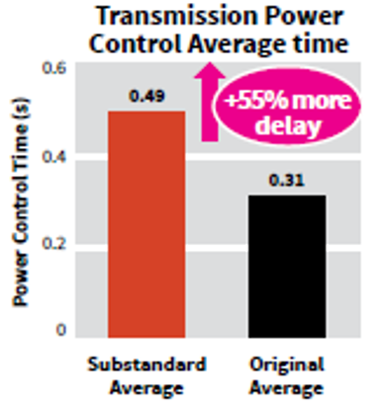
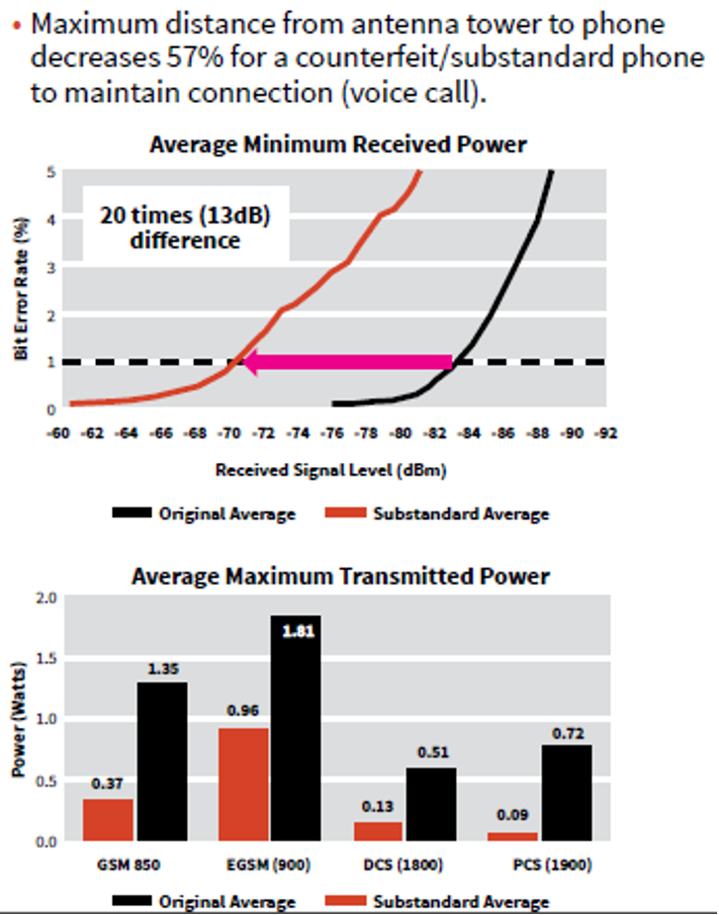
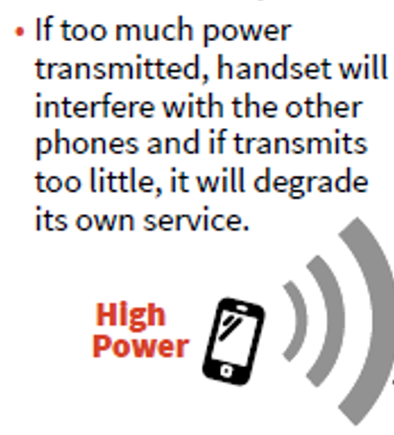

*Source is MMF, The Mobile Manufacturer Forum
www.spotafakephone.com
Notes:
If operator are importing devices, they do Quality test. Battery level good. Queries to the network. Better Antenna reception… Poor Antenna. Draining of Battery. Low signal, bad-lock on the signaling.
Distributors does not care about QoS.
The big, they used to send samples to the operators.
Small ones they do not do the exercise

Slide 7
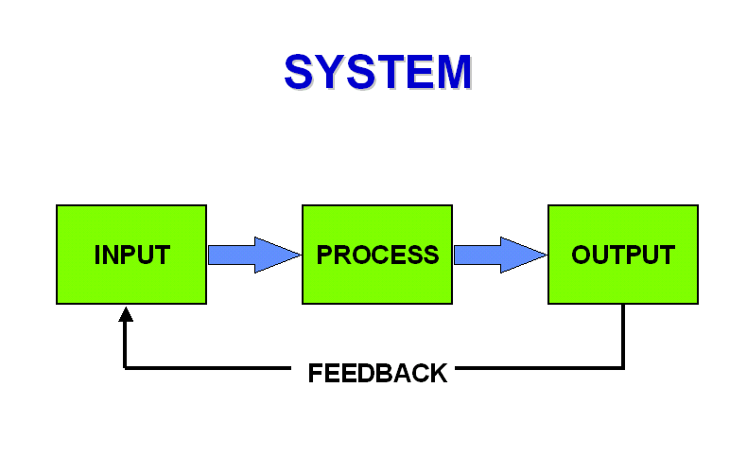
When you use a tool, you can solve with it many problems. Its efficiency depends on how you use it.
IMEI and SIM Registration Database
Central
EIR
Build a comprehensive National IMEI database and detection system of all devices in the territory, including roamers. A continually updated information system.
Effective and real-time nationwide secure interception system for policy enforcement
SIM-Box Detection Module
Type Approval
Module
Location Awareness
Module
Real-time detection of all devices in the country
Illegal Importation
Tax Enforcement Module
Cloned Device Module
Configurable Lists
(Black, Grey, White list)
Block, Monitor or Authorize
Device – SIM Locking rules
Tracking and Security Module
Statistics and Business Intelligence
Graphical User Interfaces
Security and Access Privileges
Notes:
All operators when they become aware of the benefits they can gain, they want to take action and solve the issue. But what they do not want is to lose customers to Blacklisting.
Regulator at the front. More control more security.
It depends about the nature of the operator, if I am in the handset business… I am willing to listen.
Device price will increase on ALL. Market reaction.
If operator is in the Handsets business. It’s very important to have this system.
Azerbeijan, they locked it. Pairing of MSISDN and IMEI. This is important
SIM lock at manufacturer they request minimum quantity.
Allows small countries to offer something that only big countries can do.
Now, this can be done from the CID platform. At operator level.
No HW branded, SW branding and SIM lock. For some reason they cannot sell it, they dump them in Grey market.
You no longer need to SIM lock from the manufacturer. They can do small order. This reduces the overhead of the operator..
Security.
Operator has to put Cost. Regulator charges operator 1 USD per IMEI for pairing. For locking the phone. Feature.

Slide 8
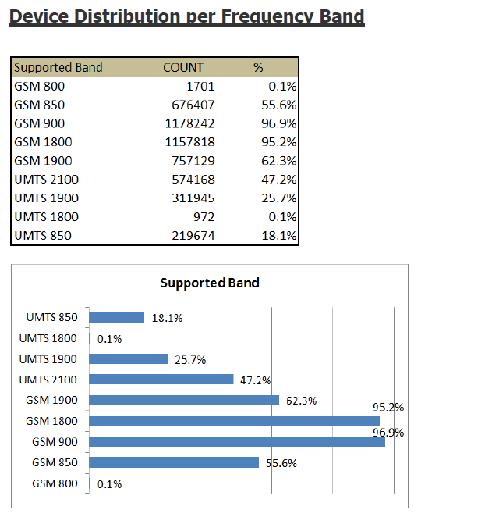
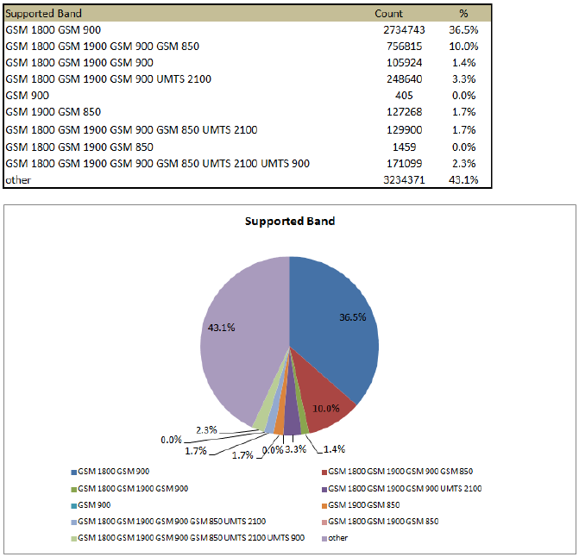
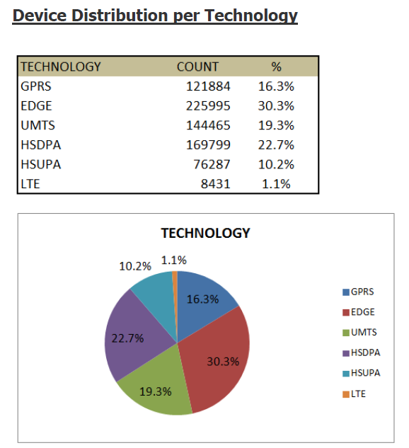
Data and precise knowledge is key to policy making
Advanced near-real-time Nationwide Statistics
and reports – Dedicated User Interface

Slide 9
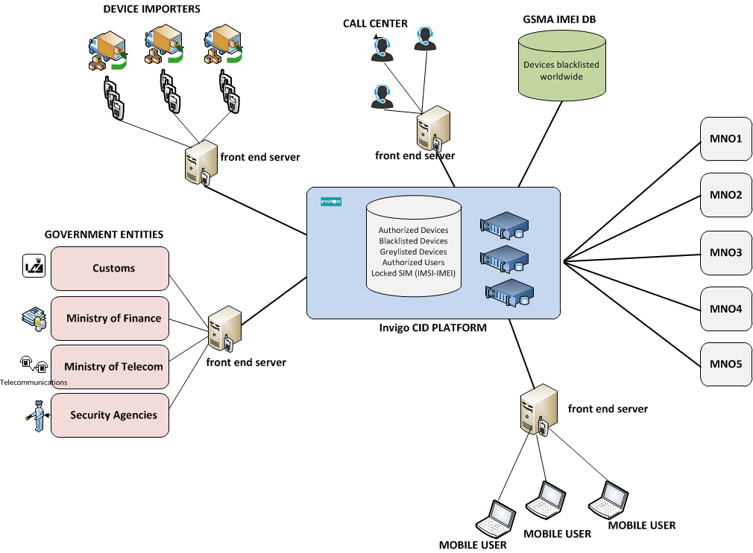


Multi-stakeholder system for the benefit of all parties
Multi-
Stakeholder
system
National ID and SIM Registration DB

Slide 10
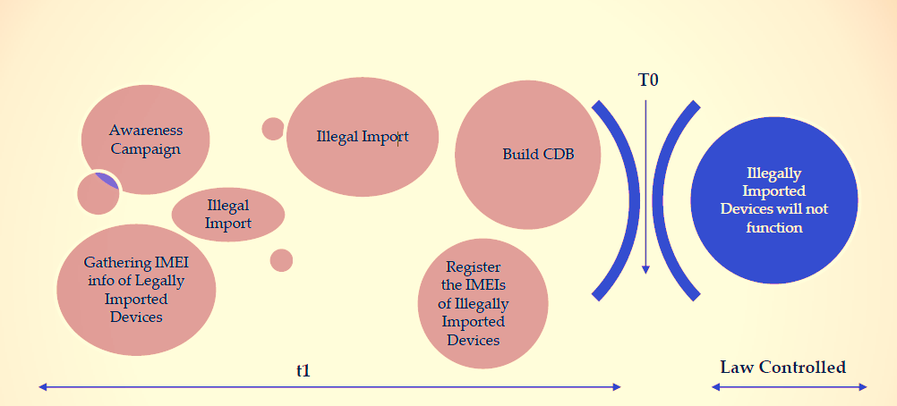

The way the system is introduced is equally important
The Solution
All existing devices in the country are detected and kept operational, even illegal with invalid or cloned IMEIs, for a grace period.
New illegal, invalid or cloned devices are not allowed to enter the country.
Consumers are informed if they hold an invalid or cloned IMEI device, and of their grace period
Once consumers naturally switch to a genuine IMEI device, they can no longer use an invalid one.
Notes:
In some countries, initiative of immediate Blacklisting of existing invalid/Duplicate handsets has impacted negatively the operator business. Other deployment methods which are gradual can actually be an opportunity to the operator to revise and align his device based strategy, without negative impact.
In some other countries, there is no system at all, and users are only given an option to check IMEI. Very few users do it because most actually know that the system is counterfeit.

Slide 11
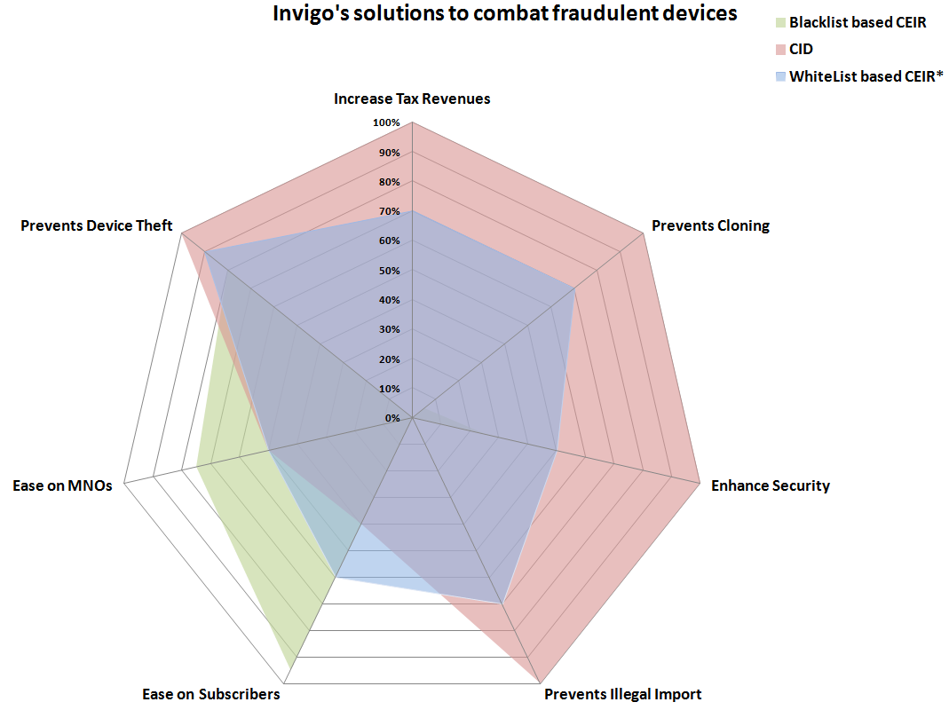

Slide 12
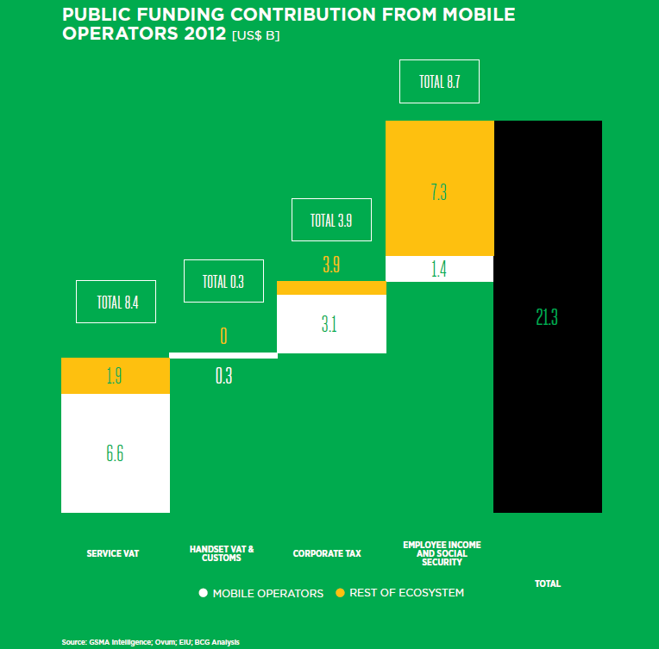
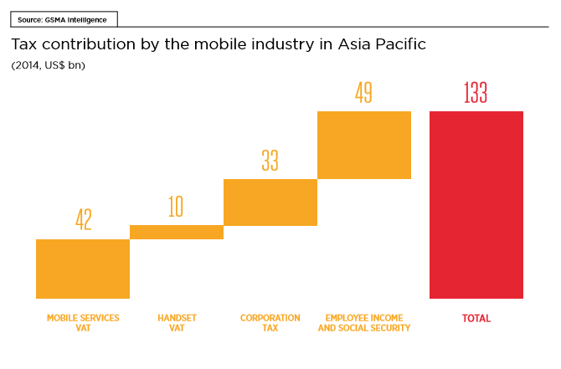
Notes:
Operators have to form partnerships to succeed. Both with OTT players and with Handset vendors.
Example, in Europe and US there is very tight partnership (Orange branded devices, Verison, etc..)
Small operators are not able to leverage partnerships with handset manufacturer. (Minimum quantity).

Slide 13
Conclusions
Operators are interested in stopping counterfeit and substandard equipment, but if done in collaboration with them from the start.
Nationwide Device Management Systems can solve many issues that the operators face, like SIM–boxes, QoS, Handset Subsidies and Lock service.
Nationwide Device Management Systems can also put the security issues in the hands of government, hence not operator dependent. (ex. Terminate non-registered SIM cards)
Having MNOs invest in EIRs will delay such projects. Fastest way is no investment for operators.
Operators would appreciate a smooth launching with Grace Periods and Awareness, and not intrusive.

Slide 14












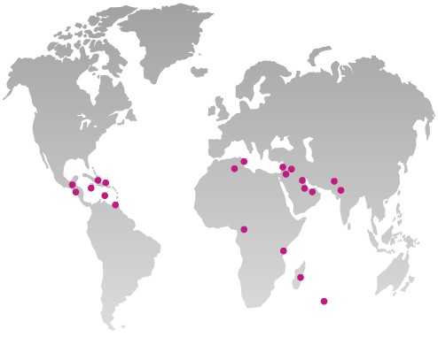



























Invigo was founded in 2004 and has more than 100 references in 60 countries
Invigo provides cost-effective Device and SIM Management solutions for mobile operators and governments
About
Invigo
Device Management
Automatic Device Detection
VoLTE DM
Invalid, Cloned, Fake Devices management
Automatic Device Configuration
M2M and Fixed TR-069 DM
Customer Care DM for Smartphones
Wifi Offloading
Equipment Identity Register
Weekly updated Device Repository
Marketing Tool and Analytics
Enterprise MDM
SIM Control OTA
Our offices are in Beirut, Dubai, and Amsterdam and Paris
Notes:
14

Slide 15


Slide 16


