Slide 1
ITU and IEC workshop on Rights Information Interoperability (RII)
Jack Sheldon
IEC Standardization Strategy Manager
ITU and IEC RII
2015-02-13
ITU

Slide 2
IEC Mission
The IEC's mission is to be globally recognized as the leading provider of standards, conformity assessment systems and related services needed to facilitate international trade and enhance user value in the fields of electricity, electronics and associated technologies.

Slide 3
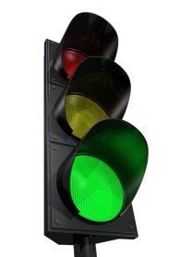
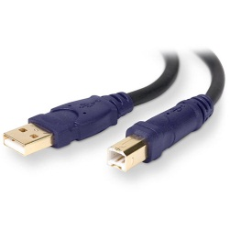
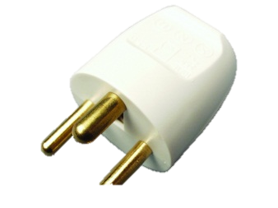
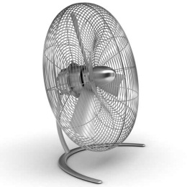
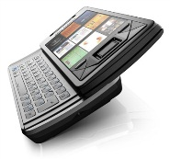
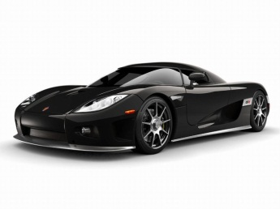
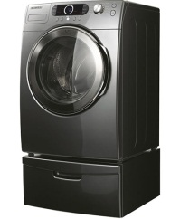
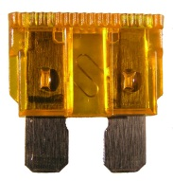
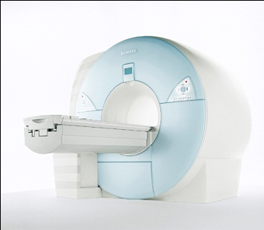
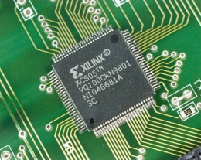
IEC Activities
International Standards
~7000 publications (IS, TS, TR, PAS)
174 Committees
~15000 Experts
Conformity Assessment
4 CA Systems

Slide 4
IEC
Obligation to represent all stakeholders in their country
Implementation of IS as national standards
IEC standards are an enabler to world trade

Slide 5
Cooperation
187 partners
Formal agreements with ITU, ISO and IEEE (amongst others)

Slide 6
IEC 62698
Multimedia home server systems - Rights information interoperability for IPTV
Defines the common semantics and core elements on rights information inter-operability for IPTV systems/equipment that is subject to multimedia content to be used across different platforms legally. The rights information includes rights and security related metadata that is described in ITU-T Recommendation H.750

Slide 7
Workshop on Rights Informaiton
Presentation of activities
Exchange of views
Collaboration

Slide 8
Thank you

