Slide 1
“Joint ITU and IEC workshop on Rights Information Interoperability (RII) ” (Geneva, Switzerland, 13 February 2015)
ArtistComm ID operational experiment
KIKUCHI Naoto,
Project Associate Professor, Keio University
kikuchi@nao.to

Slide 2
Specific Activities Artist ID
The center of ArtistComm’s activities has become the establishment, issuing of numbers, and management of an Artist ID system that expands the RII*

Slide 3
Specific Activities Basic Artist information
Establishing and maintaining official artist photographs and profiles to the minimum required level

Slide 4
Outline of Artist ID System
Features of the ID system are that it can describe not only individuals, but also groups, and that it can describe all of the content and services related to an artist

Slide 5
Artist ID
AC (country code)-(individual/group)-(12-digits)-(check digit)
Artist Code (AC) number issued in ArtistComm
Issuance Example:
JP-G-0000-0000-0001-(1) L’Arc~en~Ciel (group)
JP-I -0000-0000-0002-(8) hyde (individual)

Slide 6
Contents ID
(content type)-(country code)-(issued code of center)- (10 digits)-(check digit)-artist ID
Content Description Example:
SM-JP-11-1234567890(3)-JP-G-0000-0000-0001-(1) SM: Music (Sound Music) content
VO-JP-11-0987654321(8)-JP-G-0000-0000-0001-(1) VD: Video (VisualObject) content

Slide 7
Interoperability
Securing interoperability with an international artist ID system like ISN (International Standard Name Identifier) will be examined for the future.

Slide 8
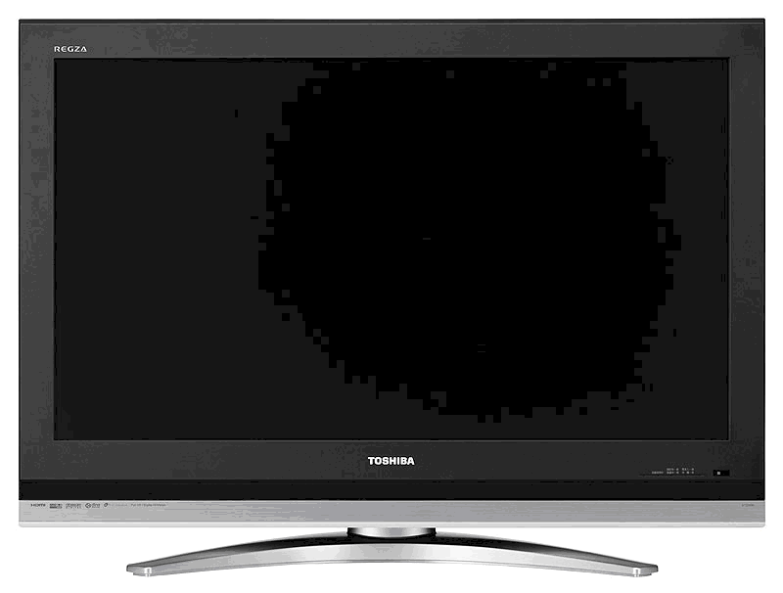
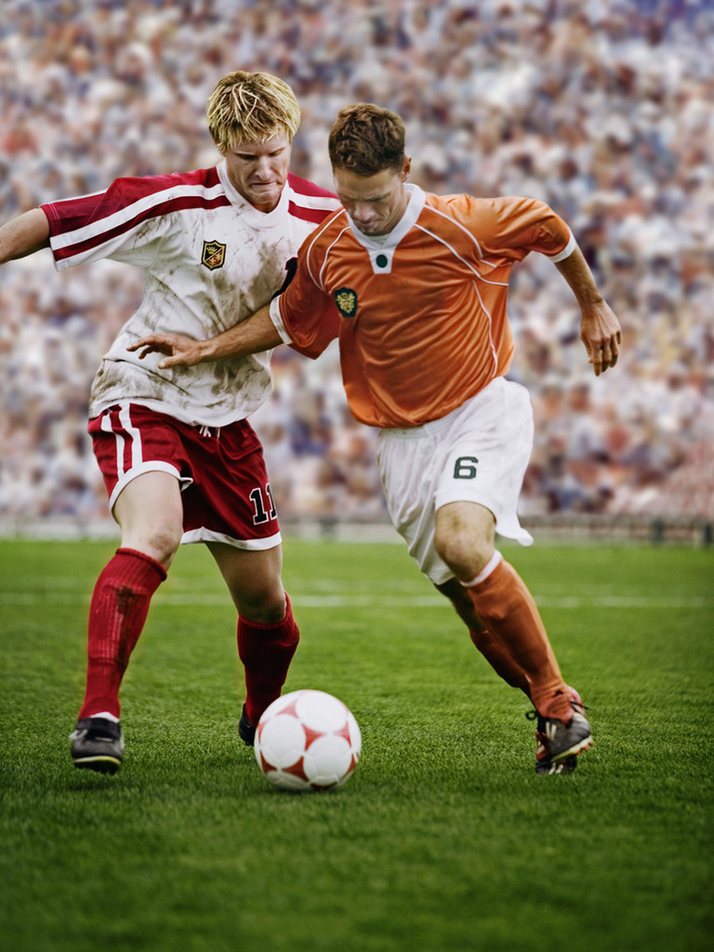
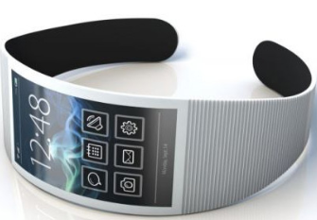
ArtistComm IDs
Issuing of Unique Artist IDs and Maintenance of Basic Information
Use artists as the basis for linking big data, including live performances, goods and music, to create a hub that links stakeholders such as broadcasters, and Japanese and overseas users.
Production
Companies
Goods
Artists
Broadcasters
Live
Perf.
Characters
Record Companies
Overseas
Artist IDs
Sports
Internet Companies / Content Providers
Copyright Management Companies
Content
Rights
Japanese / Overseas Users
Linking related information using the ArtistComm ID as the key
Connecting different industries
Connecting different industries
Concrete Scenarios
Broadcasts/
Smartphone Links
Global
2020 Olympics
●Improve search accuracy.
Reduce effect of language and abbreviations.
●Prevention of illegal distribution.
Photo management by linking with IDs.
●Smooth rights processing.
Increase accuracy of overseas rights processing based on performers’ specifications.
●Overseas promotions.
Worldwide transmission of latest information
etc.
Promote Japanese
Culture
Related Information
New broadcast
linkage service
Related Info
(English）
Sync
entertainment pleasant.
Related Info（Japanese）
entertainment pleasant.
Sync
・プロフィール
・グッズ情報
・ライブ情報、etc.
■
Cast
I love
TV
!! It makes
■
entertainment pleasant.
Story
Related Info（Chinese）
Second screen changes
・プロフィール
・グッズ情報
・ライブ情報、etc.
■
the flow of contents.
・Profile
・Goods information
・Live performances, etc..
APP
F
動
APP
Linking related information about artists and characters
entertainment pleasant.
■
Global distribution of related multilingual information based on local environment
Cast
I love
TV
!! It makes
Can send related multilingual content based on sports athletes
■
entertainment pleasant.
Story
Second screen changes
entertainment pleasant.
■
the flow of contents.
APP
F
動
APP
Improve accuracy of program searches.
Sale of related products such as tickets.
Gain international Fans
and Users
Send related multilingual content by synchronizing with TVs/event screens.

Slide 9
Thank you

