Slide 1
Workshop on Rights Information Interoperability (RII) (Geneva, Switzerland, 2015-02-13)
IEC TC 100 Introduction
David C. Felland
IEC TC 100 Chairman
®

Slide 2
Contents
TC 100 Title and Scope
TC 100 Overview
TC 100 Structure
Technical Areas and Groups
TC 100 officers
Objectives and Strategy of TC 100
TC 100 typical publications
TC 100 coming standardization items
Future meetings
Summary
®

Slide 3
TC 100 Title and Scope
®
Title
Audio, video and multimedia systems and equipment
Scope
To prepare international publications in the field of audio, video and multimedia systems and equipment. These publications mainly include specification of the performance, methods of measurement for consumer and professional equipment and their application in systems and its interoperability with other systems or equipment.
Note: Multimedia is the integration of any form of audio, video, graphics, data and telecommunication and integration includes the production, storage, processing, transmission, display and reproduction of such information.

Slide 4
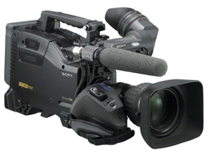
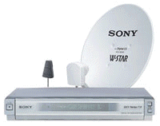
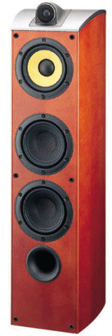
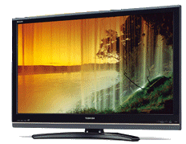
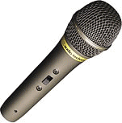
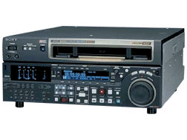
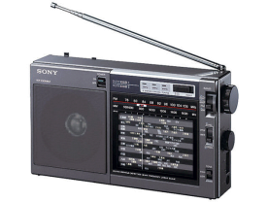
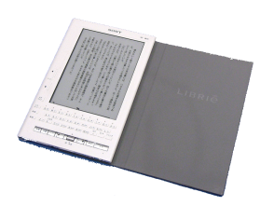
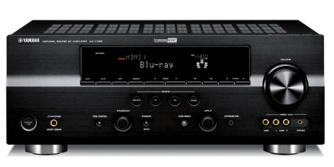
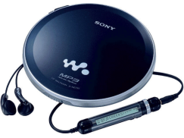
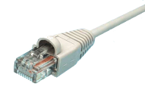
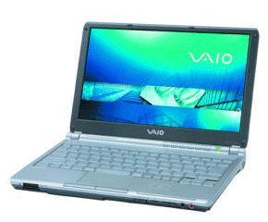
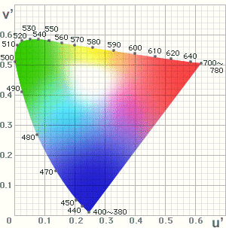
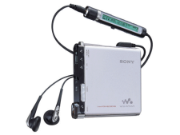
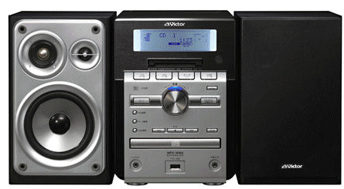
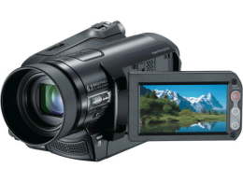
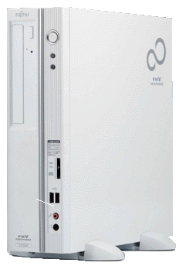
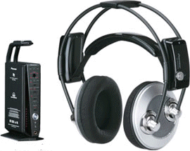
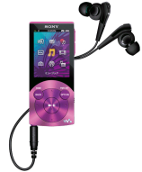
AV & Multimedia Systems and Equipment
Professional
Consumer

Slide 5
AV & Multimedia Systems and Equipment
IEC 60461 (Time code)
IEC 61016 (D1)
IEC 61189 (D2)
IEC 62071 (D7)
IEC 62141 (D16)
IEC 62289 (D10)
IEC 62336 (D11)
IEC 62330 (HD-D5)
IEC 62447 (D12)
IEC 62261 (TV Metadata)
IEC 62360 (ISDB)
IEC 62216 (DVB)
IEC 62002 (DVB-H)
IEC 60728 series
(Cable system)
Professional
IEC 60107 series
(TV)
IEC 62087
(Energy Efficiency)
IEC 60268-5
(Loudspeaker)
IEC 60315 series (Radio)
IEC 61883
(Digital AV I/F)
IEC 62229
IEC 62448
(e-Book)
Consumer
IEC 62481 series
(DLNA)
IEC 61606 series
(Audio measurement)
IEC 60908 (CD)
IEC 61606-4
(PC audio)
IEC 62389
(DVD player
measurement)
IEC 61909 (MD)
IEC 61966 series
(Color management)
IEC 60958, 61937
(Digital Audio I/F)
IEC 62318, 62328
(Multimedia
Home server)
IEC 62227
(Permission code)
IEC 60268 series
(Audio System)
IEC 61834 series
(DV format)
IEC 61603 (IR)

Slide 6
TC 100 Overview
®
Chairman
Mr. David C. Felland (US)
Secretariat
Japan (took over the secretariat from the Netherlands at 2004-01)
Secretary: Tadashi Ezaki (Sony)
Assistant Secretary: Toshihiro Inokuchi (Panasonic)
Assistant Secretary: Koichi Hasebe (Toshiba)
22 P-member countries, 22 O-member countries
Total number of publications: 412 (2015-01)
Total number of work programme: 70 (2015-01)

Slide 7
TC 100 National Committees (as of 2015-01)
®
22- Participating Countries
Australia, Austria, Belgium, China, Finland, France, Germany, India, Ireland, Israel, Italy, Japan, Republic of Korea, Mexico, Netherlands, Pakistan, Romania, Russian Federation, Turkey, Ukraine, United Kingdom and United States
22 - Observer Countries
Belarus, Bulgaria, Croatia, Czech Republic, Denmark, Egypt, Greece, Hungary, New Zealand, Norway, Republic of the Philippines, Poland, Portugal, Serbia, Singapore, Slovakia, Slovenia, South Africa, Spain, Sweden, Switzerland and Thailand

Slide 8
Liaisons
Numerous existing liaisons
ISO, IEC, ISO/IEC JTC 1, ITU, CIE CENELEC, AES, SMPTE, ATSC, ARIB, DVB, DLNA, 1394TA, DVD forum, Digital Europe, RDS forum, MMA, USB IF, etc.
Category D liaisons with consortia and fora
®

Slide 9
TC 100 Structure
®
Project team and Technical Area system
Audio, video and multimedia = Fast moving technology
Need of flexible structure and efficient working style for faster standardization
All the standards are developed by Project Teams
Project Teams are grouped by Technical Areas (TAs)
TA works the same as Sub Committee
TA is established and disbanded flexibly
All the voting is done at TC 100 level
Some projects are allocated directly under TC 100
General Maintenance Team (GMT)
Advisory Group on Strategy (AGS)
Advisory Group on Management (AGM)

Slide 10
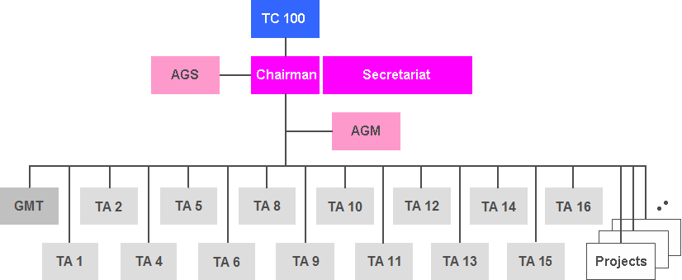
TC 100 Structure
®
TA has
Technical Area Manager (equivalent to SC chairman) and
Technical Secretary (equivalent to SC secretary)

Slide 11
Technical Areas and Groups
TA 1: Terminals for audio, video and additional data services
TA 2: Colour measurement and management
TA 4: Digital system interfaces and protocols
TA 5: Cable networks for television signals, sound signals and interactive services
TA 6: Storage media, data structures, equipment and systems
TA 8: Multimedia home server systems
TA 9: Audio, video and multimedia applications for end-user network
TA 10: Multimedia e-publishing and e-book technology
TA 11: Quality for audio, video and multimedia systems
TA 12: AV energy efficiency and smart grid application
TA 13: Environmental aspects in the field of audio, video and ICT equipment
TA 14: Interfaces and methods of measurement for personal computing equipment
TA 15: Wireless power transfer
TA 16: AAL, accessibility and user interfaces
GMT: General Maintenance Team
Projects directly under TC 100
AGS: Advisory Group on Strategy
AGM: Advisory Group on Management
®
RII standard was developed in TA 8

Slide 12
TC 100 TA and GMT officers
* Assistant Technical Secretary
TA | Technical Area Manager | Technical Secretary
TA 1 | Mr. P. Talmola (FI) | Mr. K. Hasebe (JP)
TA 2 | Dr. H. Sugiura (JP) | Mr. J. Holm (US)
TA 4 | Dr. J-Y Lee (KR) | Mr. K-S Choi (KR)
TA 5 | Dr. L. Halme (FI) | Mr. J. Alve, Mr. E. Sorri* (FI)
TA 6 | Mr. H. Ohtaka (JP) | Mr. K. Tsukada (JP)
TA 8 | Mr. S. Matsumura (JP) | Mr. H. Sakakihara (JP)
TA 9 | Ms. G. Wei (US) | Mr. K. Naka (JP)
TA 10 | Dr. Y. Uemura (JP) | Mr. Y. Narui (JP)
TA 11 | Mr. J. Yoshio (JP) | Mr. M. Yonge (UK)
TA 12 | Mr. J. Fairhurst (US) | Mr. T. Inokuchi, Mr. Y. Ishii* (JP)
TA 13 | Ms. D. Sadowy (US) | Mr. T. Naruoka (JP)
TA 14 | Mr. S. Matsumura (JP) | Mr. H. Sakakihara (JP)
TA 15 | Dr. K. Grajski (US) | Dr. S-O Lim, Mr. O-W Nam* (KR)
TA 16 | Dr. K. Grant (UK) | Ms. U. Haltrich (DE)
GMT | Mr. J. Woodgate (UK) | Mr. T. Ezaki (JP)

Slide 13
TC 100 Guidelines and Procedures
®
TC 100 TA structure and some special rules are described in 100/1180/INF and the basic part is described in Annex SN of IEC supplement to ISO/IEC Directives
TA system
AGS and AGM
GMT
TC 100 special rules

Slide 14
TC 100 AGS (Advisory Group on Strategy)
®
AGS discusses and recommends future technology areas and efficient work style for TC 100
AGS membership consists of regional participation (America, Europe, Asian and Oceania)
Representation from industry associations
Chairman and Secretaries of TC100
Meets semi-annually
Presentations on new and existing technologies
Presentations on liaison activities
Recommendations to AGM on new projects or new technical areas
Mr. Y. Komachi – AGS Chairman

Slide 15
TC 100 AGM (Advisory Group on Management)
®
AGM discusses and recommends management and operational issues in TC 100
AGM membership consists of all Technical Area Managers, Technical Secretaries, General Maintenance Manager, IEC CO officer, TC 100 chairman and secretaries
Meets semi-annually
Reviews information from Central Office including SMB activities, patent declaration, electronic communication tools
Reviews liaison activities
Reviews AGS activities
Setup future meeting locations and dates
Mr. D. Felland – Chairman

Slide 16
TC 100/GMT (General Maintenance Team)
®
To maintain all international publications within the scope of TC100
International publications within the scope of an existing Technical Area are maintained by a maintenance team allocated within that technical area.
GMT secretary maintains TC 100 publications’ database
GMT secretary distributes a list of publications to be maintained within two years to TA officers for their maintenance work
Mr. J . Woodgate – GMM(General Maintenance Manager)
For TAs, please visit TC 100 Web site

Slide 17
Objectives and Strategy of TC 100 (3 to 5 years)
®
Two major objectives of TC 100 standardization are:
to enrich human life with entertainment provided by audio, video and multimedia in home and networked environment; and
to contribute to society by pursuing energy efficiency and by addressing the options for accessibility in the use of audio, video and multimedia equipment.

Slide 18
TC 100 typical publications
®
To enrich human life
- Functional specifications: TV, Audio equipment, Headphones, Microphones, Loudspeakers, etc.
- Audio recording format: Record players, Tape recorders, CD audio, MD, DAT, Professional audio tape recorder format
- Video recording format: Betamax, VHS, 8 mm video, DV, Professional video tape recorder formats, etc.
- Audio, video interface: Audio optical I/F, 1394 I/F, CGMS, etc.
- AV home network applications: DLNA, Multimedia home gateway ECHONET, etc.
- Colour management: sRGB, scRGB, xvYCC, etc.
To contribute to society
- Measuring methods of power consumption for AV equipment
- Battery charger interface for mobile devices

Slide 19
TC 100 coming standardization items
®
To enrich human life
Smart television
IPTV and Internet TV receiver specifications
- Optical cable distribution systems
- Audio archive system
- DLNA guidelines maintenance and new parts
- e-Book and e-Publishing related format
- 3DTV related specifications
- USB Interface
To contribute to society
- Measuring methods of power consumption for AV and ICT equipment
Energy efficiency and smart grid application
AAL, Accessibility and usability for AV and multimedia equipment

Slide 20
Future standardization themes (TC 100/AGS)
®
TC 100/AGS (Advisory Group on Strategy) is investigating the following standardization themes
3DTV and UHD TV related standardization
AAL (Active Assisted Living)
Standardization of ambient assisting technologies for easy living
EV(Electric Vehicle) and multimedia
Robotics technology within the scope of TC 100
Wearable systems and equipment
etc.

Slide 21
Next meetings
®
TC 100 AGS and AGM meetings 2015
2015-04-22, 23 in Milan, Italy
TC 100 Plenary and TA meetings 2015
2015-10 in Minsk, Belarus

Slide 22
Summary
®
TC 100 has two objectives
Enrich human life:
Consortia and Fora standards
Market oriented standardization
Efforts for faster standardization
Contribution to society:
Energy efficiency
Environment
Accessibility, AAL and user interface
Looking at future technologies

Slide 23
Useful links
®
TC 100 dashboard (IEC web site)
TC 100 SBP (IEC web site)
TC 100 Website (http://tc100.iec.ch)
ISO/IEC Directives, IEC supplement, Annex SN
Contact: TC 100 secretary, Tadashi Ezaki tadashi.ezaki@jp.sony.com

Slide 24
Thanks
®

