Slide 1
An overview of solutions to ensure that devices meet the standards at importation and in the country
Combating Counterfeit and Substandard ICT Devices
(Geneva, Switzerland, 17-18 November 2014)
Yves Jobin,
Business Development Manager, SGS Société Générale de Surveillance SA
Yves.jobin@sgs.com

Slide 2
Agenda
Introduction to SGS
Solutions for Telecommunication Devices
SGS Product Conformity Assessment (PCA)
Central Equipment Identity Register (CEIR)
Conclusions

Slide 3
SGS
World’s leading inspection, verification, testing and certification company
Nº1
WORLD LEADER
80,000
EMPLOYEES
1,650
OFFICES AND LABORATORIES
13 +
GLOBAL INDUSTRIES
GLOBAL
SERVICE
LOCAL
EXPERTISE

Slide 4
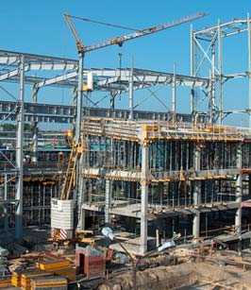
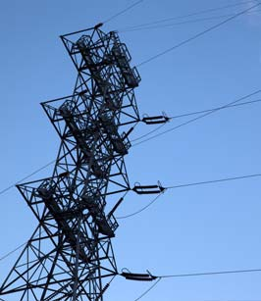
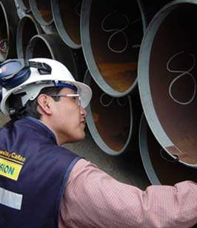
AGRICULTURE AND FOOD
AUTOMOTIVE
CHEMICAL
CONSTRUCTION
CONSUMER GOODS AND RETAIL
ENERGY
FINANCE
INDUSTRIAL MANUFACTURING
LIFE SCIENCES
LOGISTICS
MINING
OIL AND GAS
PUBLIC SECTOR

Slide 5
Public Sector
Facilitating international trade and sustainable development
Govern
Our government solutions enable revenues to be increased, as well as improve accessibility and effectiveness
DEVELOP
Our border control services reduce risk worldwide by operating scanners, monitoring transit and risk profiling
Regulate
We assist governments in managing concessions for forestry, telecoms and procurement
Safeguard
We improve public infrastructure and the efficiency of transportation systems through services for road safety
Protect
We help authorities ensure suppliers comply with quality, health, safety and environment regulations
Reassure
Tori enjoys chatting with friends knowing that her laptop safely entered the country

Slide 6
Solutions for Telecommunication Devices
Standard conformity for Telecommunication devices is important to:
Ensure the health & safety of mobile device end-users;
Improve quality of service for end users
Protect legitimate import and distribution business from unfair competition;
Protect intellectual property of industry players
Improve government taxes revenues collection related to the import of legal phones;
Compliance Management to be managed by the authorities at different stages:
At importation
During Utilization

Slide 7
Conformity Assessment 1 - at Importation
Do We Have The Necessary…
FINANCIAL
RESOURCES
TECHNICAL
RESOURCES
TECHNICAL
CAPABILITIES
TIME TO
ESTABLISH
THE INFRA
GLOBAL
REACH

Slide 8
SGS Product Conformity Assessment (PCA)
PCA is a solution designed to ensure that specific products meet the requirements of the technical regulations and standards set by a regulatory authority in the importing country.*
Compliance verification is done following a review of the reports from one or a combination of interventions e.g. laboratory testing, physical Inspection and/or factory audits.
The conformity of the products is evidenced by the issuance of a Certificate of Conformity usually requested for customs clearance.
*In accordance with the WTO Agreement on Technical Barriers to Trade (TBT)

Slide 9
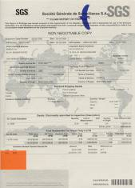
Conformity Assessment & Product Certification Activities As Per ISO 17065
Applicant
Product Information / Request for Certification
Certification Body (SGS)
Designated
Officers
Perform
REVIEW and take
CERTIFICATION DECISION
Accredited Laboratory
Test Report
Systems Certification body
Audit Report
CERTIFICATE OF
CONFORMITY
Application Review
Inspection Body
Inspection Report
Evaluation
Review and
Certification Decision

Slide 10
SGS PCA already deployed in
Algeria
Botswana
Burundi
Colombia
Egypt
Ethiopia
Ghana
Indonesia
Iran
Iraq
Kenya
Kurdistan
Kuwait
Nigeria
North Korea
Russia
Rwanda
Saudi Arabia
Syria
Tanzania
Uganda
In bold: countries having included mobile phones in the PCA scheme

Slide 11
Conformity Assessment 2 - During Utilization
Issues faced with limited controls at the border:
Mobile devices are items with high value and limited volume
Can enter a country out of the trade process
Theft

Slide 12
CEIR deployment
By deploying a Central Equipment Identity Register (CEIR) Regulatory authorities get the capability to:
collect the IMSI/IMSISDN/IMEI triplets from all GSM operators in real time
analyze the subscriber and device populations.
CEIR deployment in Tanzania for the Regulatory Authority (TCRA) in collaboration with HP

Slide 13
CEIR benefits
Capabilities to identify all devices and to create Business rules (color lists)
PCA data facilitates the creation of the authorized list
Rules based on IMSI/IMEI to cope with
advanced fraud patterns i.e. cloned devices and
“legacy” non compliant devices under specific conditions (i.e. leave time for public to replace “non-compliant” phones with “compliant” phones”
Leverage on GSMA IMEI Database – operators’ EIR to connect to it for stolen handset scenario
Business Intelligence services to help the regulator monitor the progress and maturity of its mobile market.

Slide 14
Conclusions
Solutions are available for authorities
Combined solutions for bigger impact
SGS Solutions Objectives:
Protect consumer’s health and safety and the environment
Safeguard local producers & Industry from unfair competition
Reduce the risk that the domestic market becomes the dumping ground for nonconforming products
Facilitate customs clearance process

