Slide 1
Combat of Counterfeit, Substandard and Unauthorized ICT devices in Brazil
Combating Counterfeit and Substandard ICT Devices
(Geneva, Switzerland, 17-18 November 2014)
João Alexandre Zanon (zanon@anatel.gov.br)
Regulatory Specialist, Regulatory and Planning Superintendence
National Telecommunications Agency (ANATEL) – Brazil
ITU-T Q8/11 Associate Rapporteur

Slide 2
Outline
Introduction
SIGA Project
SIGA Challenges
Blocking the entrance of Counterfeit Devices.
Importance of CA Policy
Multi Layer Initiative
What we should look for

Slide 3
General Statistics

Slide 4
SIGA - Sistema Integrado de Gestão de Aparelhos.
O “Sistema Integrado de Gestão de Aparelhos – SIGA” aims to control counterfeit, cloned and unauthorized mobile devices.
The project is based on Anatel Regulatory framework that dictates that operators can only allow on the network authorized devices.
The Project is lead by Anatel with the participation of all relevant actors (Anatel, Operators, ABR-Telecom, Manufactures, GSMA, among others).
The system is operated by ABR-Telecom and is active since march 2014 collecting the relevant information from all mobile networks on Brazil.
The system is generating the reports and alarms necessary to map the Brazilian scenario so that Anatel can define the next actions.

Slide 5
SIGA Premises
• Centralized solution: built jointly and integrated to all Brazilian mobile operators;
• Automated solution: allowing the input of information with low human intervention;
• Scalable, Dynamic and Flexible: expandable system, rules adjusted over time;
• Multiple sources of info: CDRs, operators systems, international databases;
• Reliable and secure: Minimize impacts on regular end users;

Slide 6
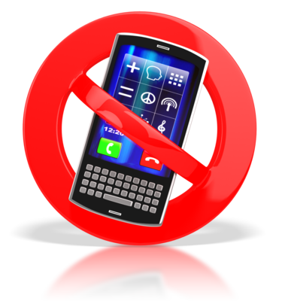
SIGA Workflow
query
Authorized Devices Database
System receive network key informations
Consumer use the device on the network
System generate alarms to operator
Operator take the necessary actions

Slide 7
Challenges Faced on SIGA
Identification and definition of actions for for each scenario.
Reduce end-user impact.
Construct a reliable reference database.
Define Legacy Terminal actions.
Actions effective only on terminal already on the network.
How to control the entrance of Counterfeit?

Slide 8
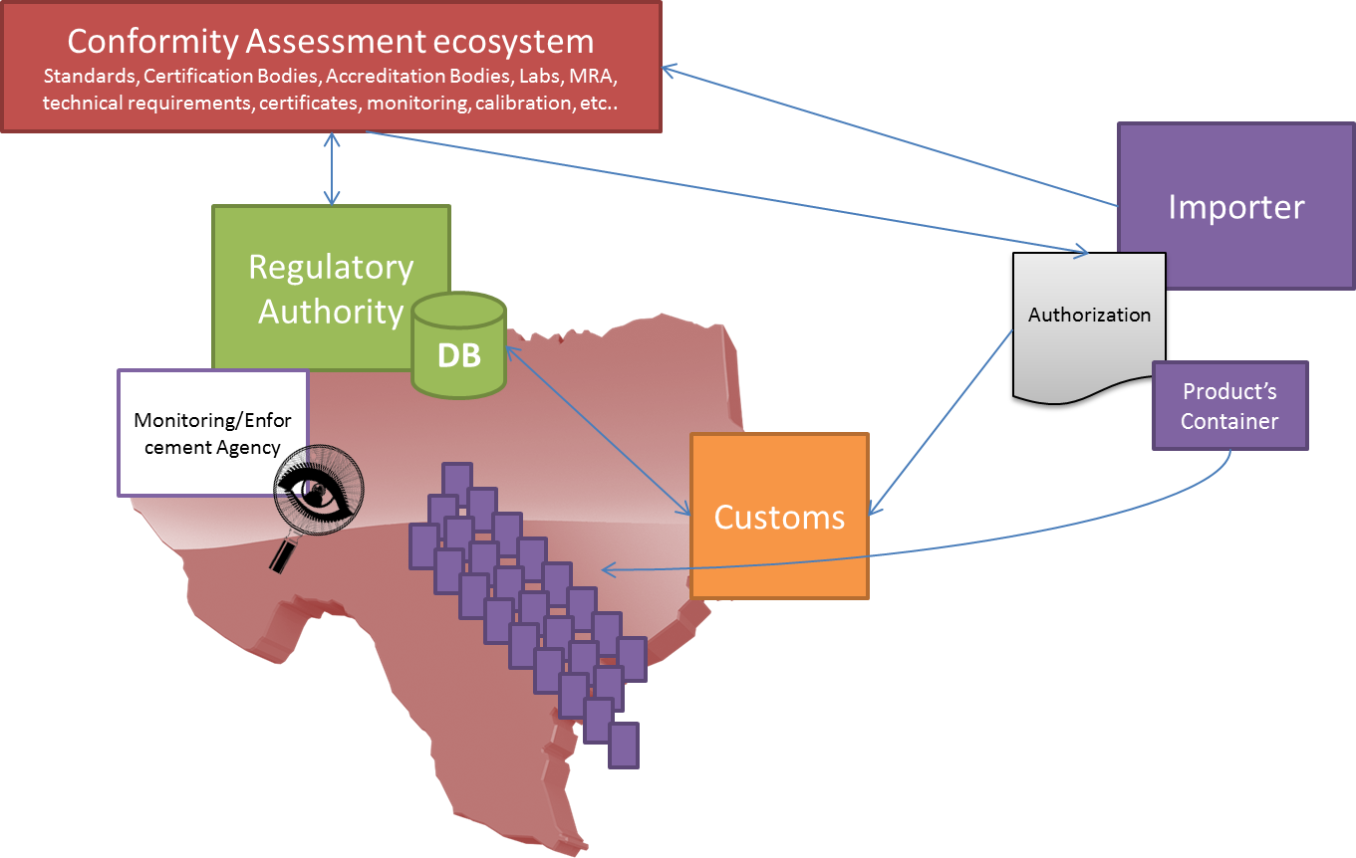
Blocking the entrance of Counterfeit Devices.

Slide 9
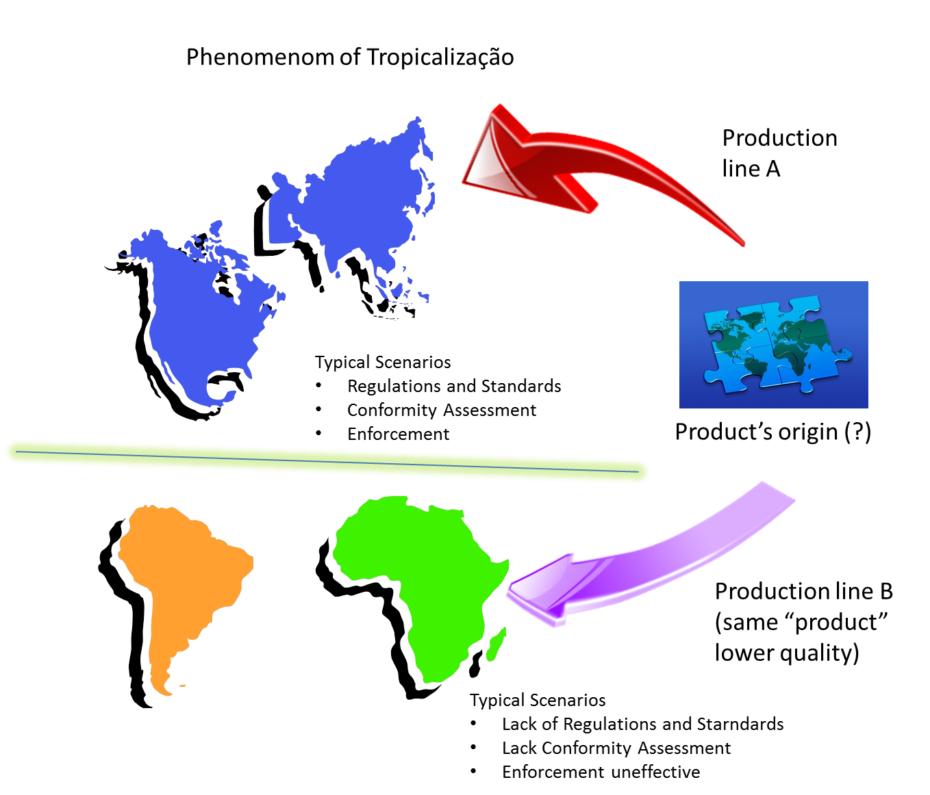
CA Policy Importance

Slide 10
Multi Layer Initiatives
National: Brazil SIGA and Custom Integration.
Regional: CITEL CCPI Correspondence Group on Counterfeit terminals discussions.
International– ITU Actions:
PP14 Resolution on Counterfeit.
ITU-T SG11 (Q8/11) Technical Report.
ITU-D interaction with ITU-T to implement the necessary actions on developing countries.
Cooperation with other organizations.

Slide 11
What we should look for
Multi Level Actions and Cooperation.
Bilateral and Regional cooperation.
International best-practices and recommendations.
Reduce End-user impact (Good Faith user)
Good user communication is crucial.
Weave for legacy terminal (turnover).
National multiple actions to combat Counterfeit
Structured CA Policy and Custom Integration.
Solution to Remove Counterfeit from the network.
Reliable reference databases to our solutions
Secure unique identifier (IMEI) – PP14 Res. Counterfeit

Slide 12
Thank You!
Any Questions?
João Alexandre Zanon
zanon@anatel.gov.br

