Slide 1
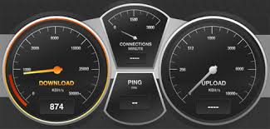
Q.Int_speed_test
Draft Recommendation
Eva Ibarrola eva.ibarrola@ehu.es
SG11 Q15 Acting Rapporteur
JCA-CIT meeting (electronic meeting)
26 November 2014

Slide 2
Motivation
The customer’s estimation of the quality of Internet access has become a very important issue.
Based on different parameters:
  Latency (Round Trip Time - RTT)
  Download data transmission speed
  Upload data transmission speed
Many actors may participate and take part (telecom operators, service providers, content service providers, regulators, users ...).
Many approach to asses the rate of Internet speed but…Are they neutral or valid for results comparison?
A unified approach to measure the access speed to the Internet as well as the access speed to the Internet resources is needed: Q.Int_speed_test Draft Rec.

Slide 3
Scope
A unified methodology and the measurement framework to estimate the Internet speed quality:
  Architecture of the framework
  Measurement parameters
  Requirements for the measurement
  Measurement procedure/methodology

Slide 4
Measurement Framework
Two different types of measurement tests are proposed:
  The Internet access speed test: considers the operator network itself and it may be used for SLA compliance monitoring by the fixed and mobile operators, regulators and clients.
  The Internet resources access speed test: considers the whole access speed to the Internet resource, since this measurement may be closer to the Internet speed quality as perceived by user.

Slide 5
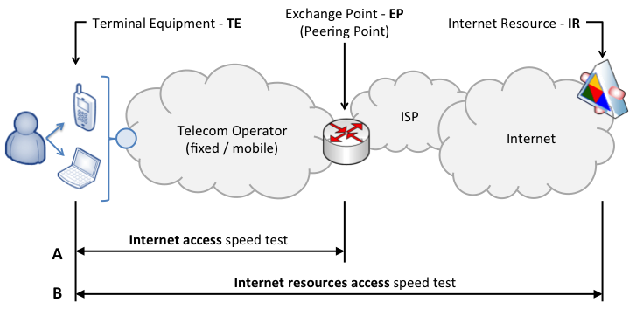
Global scenario and test definition

Slide 6
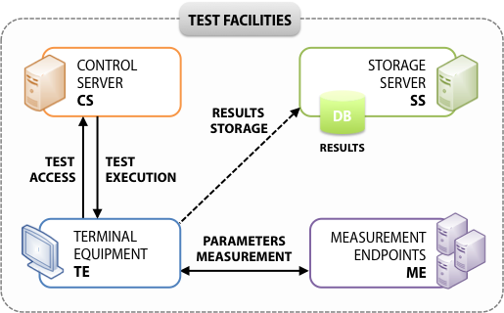
Measurement System Architecture
  End users should have access to the measurement test from their terminal equipment throughout a web page or an application (i.e.: smartphone app) connected to a Control Server.
  Once the test is accessed in the terminal equipment, it should be executed towards different measurement endpoints, and the results should be collected in a Storage Server.

Slide 7
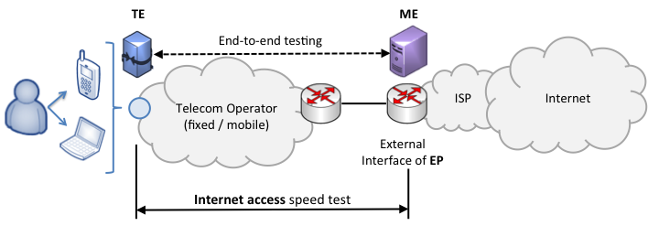
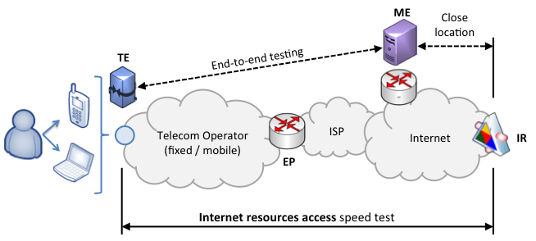
Measurement End Points
  In the Internet access speed test definition, the measurement endpoint should be placed on the output of the exchange point interface that connects the operator to the rest of the Internet .
  The location of the measurement endpoint for the Internet resources access speed test should be also carefully designed and different alternatives can be considered.

Slide 8
Test Parameters
  Download data transmission speed:
  The data transmission speed achieved in the downlink between the terminal equipment and the correspondent measurement endpoint.
  Upload data transmission speed:
  The data transmission speed achieved in the uplink between the terminal equipment and the correspondent measurement endpoint.
  Two-way delay:
  Also defined as the Round-Trip Time (RTT) delay, the two-way delay is the elapsed time needed to complete an ICMP Echo Request/Reply (Ping) to a valid destination (IP address).

Slide 9
Requirements
  General purpose requirements
    Transparency and validity.
    Accuracy.
    Repeatability, consistency with the protocols and used interfaces on TE.
    Natural conjugation with the assessment of the quality of telecommunications services in general.
    Accessibility to stakeholders (users, Internet providers, regulators).
  Specific measurement requirements
    SW available in user´s equipment.
    Measurement should at least consist of the Internet access speed test.
    Data to be transmitted must guarantee its incompressibility
    …. TBD

Slide 10
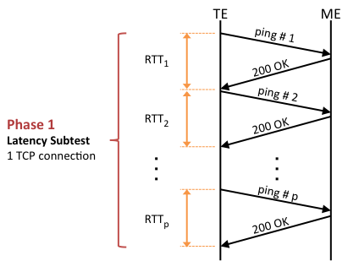
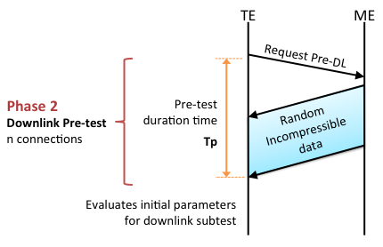
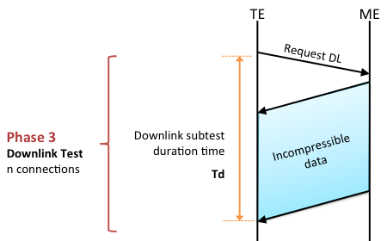
Test Methodology
Different phases proposal

Slide 11
Test Methodology(II)
Many open issues TBD
  Number of concurrent transfers
  Duration of the test
  Impact of configuration
    Repeatability and reliability
  Maximum achieved vs. maximum achievable

Slide 12

Comments of Q.Int_speed_test
University of the Basque Country
(UPV/EHU)
Fidel Liberal fidel.liberal@ehu.es
Eva Ibarrola eva.ibarrola@ehu.es
SG11 Q15
Interim Rapporteur Meeting
Geneva, 13 Nov 2014

Slide 13
Analysis of issues under study
Location of external resources
Required additional information from users’ HW/SW
Methodology
  Number of concurrent transfers
  Duration of the test
  Impact of configuration
    Repeatability and reliability
  Maximum achieved vs. maximum achievable
Delay (and other measurements)

Slide 14
Location of external resources
Options for selecting meaningful resources
  1.- Top 10 or 20 websites (i.e. in Alexa Rank)
  2.- Most important CDNs
  3.- Most important network interconnection points (with higher traffic volume/peaks, most used...)
  4.- A specifically selected network of geographically dispersed destinations around the world, to cover, at least, tests in different ranges (same continent, long distance...)

Slide 15
Required additional information from users’ HW/SW
User characterization purpose
  More accurate evaluation [NEUTRALITY?]
    Access technology
    SNR/Others
  Informative
    Statistics for users per access technology, OS, browser
  User Warning/Notification
    Un-suitable configuration detected
    Un-reliable measurement
Issues
  Privacy (i.e. geolocation)
  Availability of information
    OK for Mobile Apps
    NA for web apps

Slide 16
Methodology: Impact of configuration
Rationale: Easy to measure maximum TCP goodput on steady stage ~ e2e capacity
  Valid for “constant channels” ~ fixed access
TCP flavours
  OS buffer size limitation
  Congestion Control
  Flow Control

Slide 17
File size/Test duration
Extremely dependant of TCP congestion mechanisms
Low enough not to discourage users
Proposal: For Further Study (To be periodically reviewed)

Slide 18
Delay and other measurement
Aligned with the purpose of the Recommendation
  End users
Need to access lower level API
Synchronization issues

Slide 19
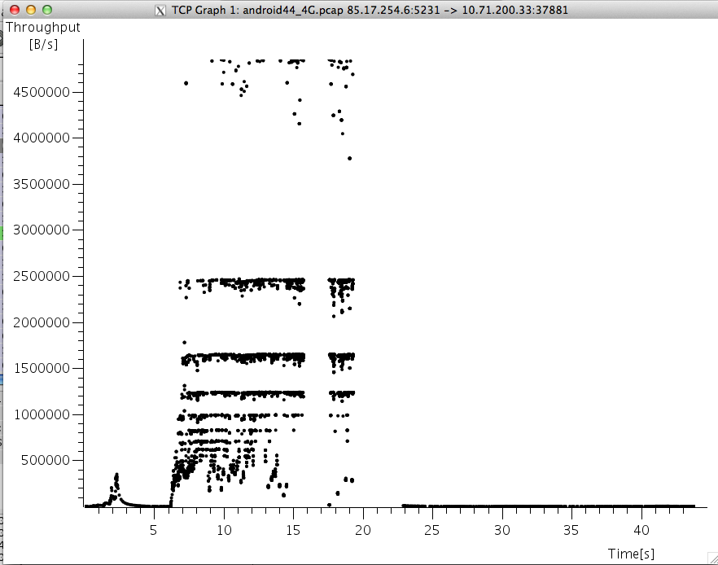
Maximum goodput ~ e2e capacity
Mobile?> Average?=> Closer to user perception

