Slide 1
ITU-ML5G-PS-011 Combinatorial Optimization Challenge - Delivery route optimization
Victor Bear

Slide 2
Table of contents
Our team
Goal
Data Analysis
Realization
Result
Application
Improvement

Slide 3
Our Team
Victor Bear
Jiansheng Xiong
Jane Jiang
Xinyi Ren

Slide 4
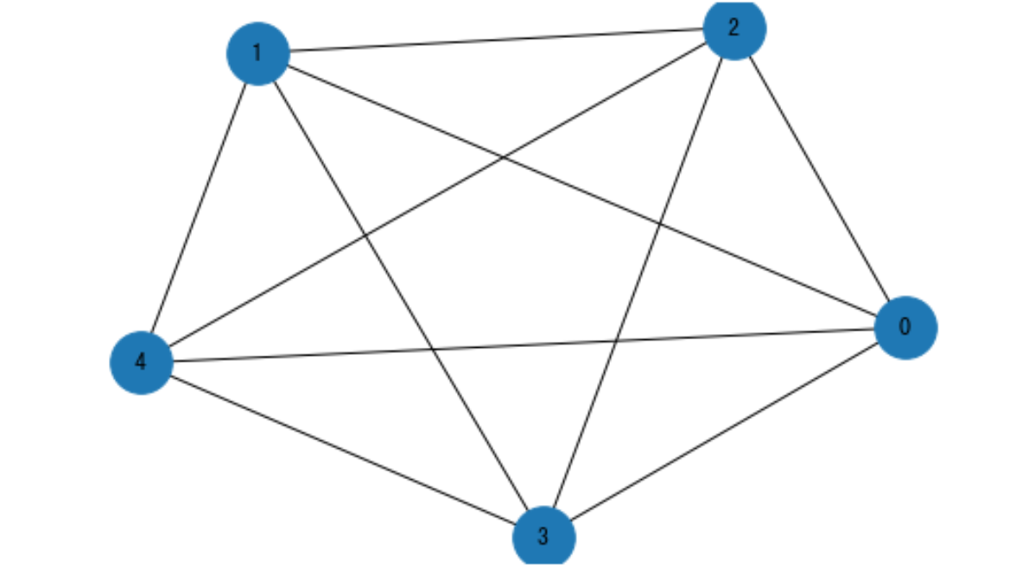
Goal
Find the route with lowest cost
Plan the lanes for the deliveries

Slide 5
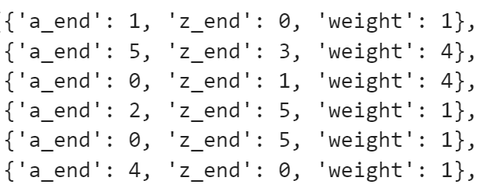
Data Analysis
node_num | edge_num | service_num
0 | 5 | 150
1 | 6 | 165
2 | 9 | 180
3 | 16 | 195
4 | 18 | 210
5 | 19 | 225
6 | 20 | 240
7 | 22 | 255
8 | 37 | 270
9 | 53 | 285
10 | 56 | 300
11 | 57 | 315
12 | 65 | 330
13 | 66 | 345
14 | 73 | 360
15 | 112 | 405
16 | 115 | 420
17 | 122 | 465
18 | 124 | 495
19 | 129 | 510
20 | 135 | 525
21 | 156 | 585
22 | 175 | 630
23 | 199 | 660
24 | 206 | 705
25 | 211 | 720
26 | 226 | 765
27 | 235 | 810
28 | 250 | 855
29 | 254 | 870
Graph data Eaxample
Service data Example

Slide 6
Realization
Find the route with lowest cost
Dijastra’s Algorithm
Plan the lanes for the deliveries
Loop

Slide 7
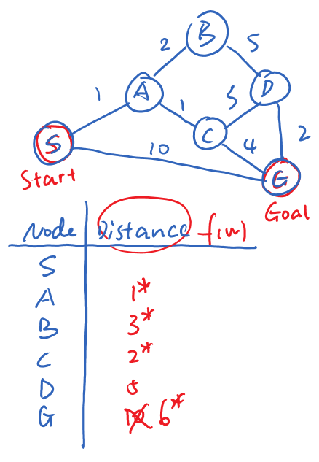
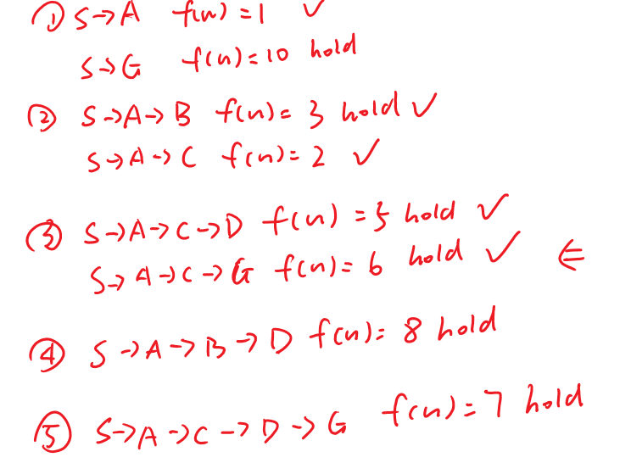
Dijastra’s Algorithm
It starts at the source node and it analyzes the graph to find the shortest path between that node and all the other nodes in the graph.
The algorithm keeps track of the currently known shortest distance from each node to the source node and it updates these values if it finds a shorter path.

Slide 8
Result
node_num | edge_num | service_num | used_time(s) | total_cost | cost_per_service
0 | 5 | 150 | 0.01192 | 246 | 1.64
1 | 6 | 165 | 0.010068 | 298 | 1.806060606
2 | 9 | 180 | 0.019755 | 266 | 1.477777778
3 | 16 | 195 | 0.043464 | 352 | 1.805128205
4 | 18 | 210 | 0.04936 | 428 | 2.038095238
5 | 19 | 225 | 0.061117 | 470 | 2.088888889
6 | 20 | 240 | 0.082251 | 470 | 1.958333333
7 | 22 | 255 | 0.088772 | 562 | 2.203921569
8 | 37 | 270 | 0.238882 | 669 | 2.477777778
9 | 53 | 285 | 0.490323 | 807 | 2.831578947
10 | 56 | 300 | 0.612258 | 846 | 2.82
11 | 57 | 315 | 0.641868 | 803 | 2.549206349
12 | 65 | 330 | 0.946883 | 937 | 2.839393939
13 | 66 | 345 | 0.828338 | 949 | 2.750724638
14 | 73 | 360 | 1.062732 | 1012 | 2.811111111
15 | 112 | 405 | 2.909848 | 1287 | 3.177777778
16 | 115 | 420 | 3.039717 | 1343 | 3.197619048
17 | 122 | 465 | 3.882274 | 1485 | 3.193548387
18 | 124 | 495 | 4.355329 | 1650 | 3.333333333
19 | 129 | 510 | 4.604171 | 1647 | 3.229411765
20 | 135 | 525 | 5.16469 | 1712 | 3.260952381
21 | 156 | 585 | 8.539958 | 2010 | 3.435897436
22 | 175 | 630 | 11.399389 | 2207 | 3.503174603
23 | 199 | 660 | 14.468948 | 2338 | 3.542424242
24 | 206 | 705 | 17.39767 | 2519 | 3.573049645
25 | 211 | 720 | 18.182642 | 2519 | 3.498611111
26 | 226 | 765 | 21.490169 | 2748 | 3.592156863
27 | 235 | 810 | 25.529427 | 2952 | 3.644444444
28 | 250 | 855 | 31.190989 | 3212 | 3.756725146
29 | 254 | 870 | 33.127553 | 3212 | 3.691954023

Slide 9
Application
Optical Transport Network (OTN)
Graph – optical layer
Service – electrical layer
Lane – channel
Weight – bit rates

Slide 10
Improvement
Service route balance

