Slide 1
Challenge Summary Slides
Sponsored by:
Organized by:

Slide 2
ITU Global Challenge on AI/ML in 5G
AI will have profound impact on the world’s communication networks –
But: how to do it right and scale?
ITU is at the forefront of exploring how best to use AI in 5G
The ITU Global Challenge on AI/ML in 5G will:
Bring together network operators, network manufactures and academia
Innovate and solve network problems with AI/ML
Apply ITU’s AI/ML architecture frameworks in IMT-2020
Uncover problems and point to practical solutions

Slide 3
ITU specifications for collaboration (1/2)
Output Document | Status | Description
Use case document | Approved October 2019, published as ITU-T Y-series Recommendations – Supplement 55 https://www.itu.int/rec/T-REC-Y.Sup55-201910-I/en | More than 30 use cases submitted to the FG ML5G Requirements were analyzed for each, reviewed classified as “critical”, “expected” and “added value”.
Architecture document | Approved June 2019, published August 2019 as ITU-T Y.3172 https://www.itu.int/rec/T-REC-Y.3172/en | 20 architectural requirements, derived from use cases Declarative approach to designing and using ML in the network Orchestration and management of ML
Data handling framework | ITU Y.3174 – approved 5 February 2020 | Includes data broker for mapping data models and APIs between ML overlay and underlay.
Intelligence level document | ITU Y.3173 – approved 5 February 2020 | Includes 5 levels of intelligence of 5G networks and an architecture perspective.
Marketplace document | Ongoing work item | Standard mechanisms for efficient transfer and handling of ML models

Slide 4
ITU specifications for collaboration (2/2)
Output Document | Status | Description
MLFO document | ML5G-I-216 Ongoing work in FG ML5G | Requirements and architecture for ML function orchestrator.
Model optimization document | ML5G-I-171-R1 Ongoing work in FG ML5G | Requirements and architecture for ML model optimization.
Benefit: Joint contributions to ITU, training of students and professionals in AI/ML for 5G

Slide 5
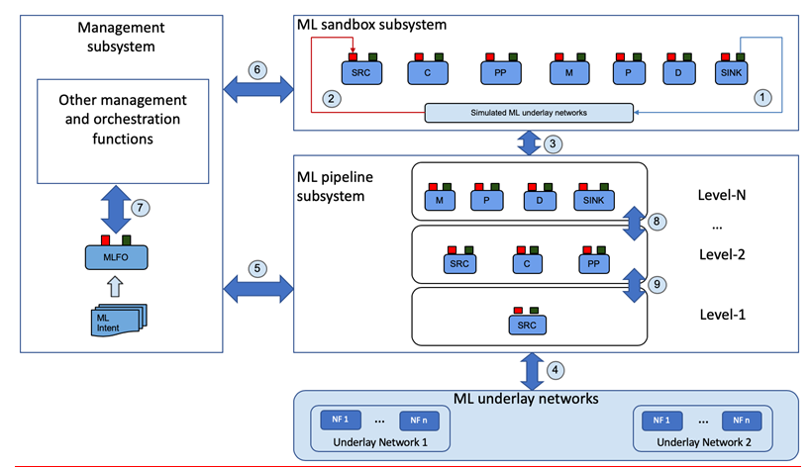
ITU Y.3172
training and benchmarking projects
Marketplace
orchestration and management
Serving, monitoring
5G networks
Refer: https://www.itu.int/rec/T-REC-Y.3172-201906-P
Benefit: Mapping and application of ITU standards to solve problems in the network using AI/ML.

Slide 6
ITU Global Challenge: Technical Tracks and Data
Technical Track | Real Data (“secure track”) | Open Data | Synthetic Data | No Data
Network | ✓ | ✓ | ✓
Verticals | ✓ | ✓ | ✓
Enablers |  |  |  | ✓
Social Good | ✓ | ✓ | ✓ | ✓
* Secure data handling practices (for real anonymized network data)
Benefit: Unlock AI/ML research using secure data for solving problems in 5G networks.

Slide 7
Participation
Students
Students need to be registered as students at a university
Professionals
Anyone else is considered a “professional”: a person who has the necessary skills to complete the problem sets they choose to tackle in the Challenge
AI/ML
Note: We encourage participants to submit solutions that are open source implementations, based on (ITU) standards.
Open source implementations will enable industry stakeholders to access outcomes and enhance collaboration.
Benefit: Create a network of innovation to solve 5G and future networks using AI/ML.

Slide 8
ITU Global Challenge: Timeline
Global call for challenge entries
Best teams advance
Final Conference
Global Round Begins
online
Problem Statement Selection
Hackathon
Dataset release
Global Round Ends
Demos
Warm-Up Phase
Announce winners
May / June 2020
Oct 2020
Feb 2020 to April 2020
Nov /Dec 2020
Energize the AI/ML, 5G ecosystem, culminate with focal point of conference.

Slide 9
ITU AI/ML in 5G Challenge: Milestones for Participants
Data Available
(start working on the problem)
Test Dataset
AIIA (China)
restricted problem statements
BNN.UPC (Spain)
Registration
Pick Problem Statement
Mentoring and support
Final Conference
UFPA (Brazil)
Declare winners
ITU-ML5G-PS-013
more problem statements to come
Submit & Evaluation
Global Round

Slide 10
Any Questions?
Email: ai5gchallenge@itu.int

