Slide 1

ITU AI/ML in 5G Challenge
Summary Slides

Slide 2
ITU Global Challenge on AI/ML in 5G
AI will have profound impact on the world’s communication networks –
  But: how to do it right and scale?
ITU is at the forefront of exploring how best to use AI in 5G
The ITU Global Challenge on AI/ML in 5G will:
Bring together network operators, network manufactures and academia
Innovate and solve 5G problems with AI/ML
Apply ITU’s AI architecture in 5G
Benefit for sponsor: Technology leadership along with ITU for the region

Slide 3
ITU specifications for collaboration (1/2)
Output Document | Status | Description
Use case document | Approved October 2019, published as ITU-T Y-series Recommendations – Supplement 55 https://www.itu.int/rec/T-REC-Y.Sup55-201910-I/en | More than 30 use cases submitted to the FG ML5G Requirements were analyzed for each, reviewed classified as “critical”, “expected” and “added value”.
Architecture document | Approved June 2019, published August 2019 as ITU-T Y.3172 https://www.itu.int/rec/T-REC-Y.3172/en | 20 architectural requirements, derived from use cases Declarative approach to designing and using ML in the network Orchestration and management of ML
Data handling framework | ITU Y.3174 – approved 5 February 2020 | Includes data broker for mapping data models and APIs between ML overlay and underlay.
Intelligence level document | ITU Y.3173 – approved 5 February 2020 | Includes 5 levels of intelligence of 5G networks and an architecture perspective.
Marketplace document | Ongoing work item | Standard mechanisms for efficient transfer and handling of ML models

Slide 4
ITU specifications for collaboration (2/2)
Output Document | Status | Description
MLFO document | ML5G-I-216 Ongoing work in FG ML5G | Requirements and architecture for ML function orchestrator.
Model optimization document | ML5G-I-171-R1 Ongoing work in FG ML5G | Requirements and architecture for ML model optimization.
Benefit: Joint contributions to ITU, training of students and professionals in AI/ML for 5G

Slide 5
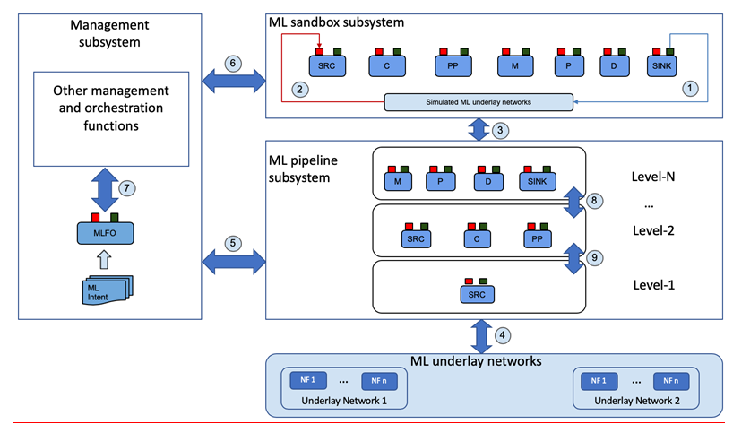
ITU Y.3172
training and benchmarking projects
Marketplace
orchestration and management
Joint activity with UAE: to problem statements, architecture mappings, specifications and APIs.
Serving, monitoring
5G networks
Refer: https://www.itu.int/rec/T-REC-Y.3172-201906-P
Benefit: Mapping and application of ITU standards to solve problems in the network using AI/ML.

Slide 6

ITU Global Challenge: Technical Tracks and Data
Technical Track | Real Data (“secure track”) | Open Data | Synthetic Data | No Data
Network | ✓ | ✓ | ✓
Verticals | ✓ | ✓ | ✓
Enablers |  |  |  | ✓
Social Good | ✓ | ✓ | ✓ | ✓
* Secure data handling practices (for real anonymized network data)
Benefit: Unlock AI/ML research using secure data for solving problems in 5G networks.

Slide 7




Participation
Students
Students need to be registered as students at a university
Professionals
Anyone else is considered a “professional”: a person who has the necessary skills to complete the problem sets they choose to tackle in the Challenge
AI/ML
Note: We encourage participants to submit solutions that are open source implementations, based on (ITU) standards.
Open source implementations will enable industry stakeholders to access outcomes and enhance collaboration.
Benefit: Create a network of innovation to solve 5G and future networks using AI/ML.

Slide 8
ITU Global Challenge: Timeline
Warm-Up Phase
Global Conference
Global Round = 2nd Round
Best teams advance
Global call for challenge entries
Best teams invited & compete at global round
Hackathon
Regional round = 1st Round
Demos
Announce winners
Feb 2020 to April 2020
May 2020 to July 2020
Aug 2020 to Oct 2020
Nov /Dec 2020
Energize the AI/ML, 5G ecosystem, culminate with focal point of conference.

