Slide 1




Challenge Summary Slides
Gold Sponsor
Bronze sponsors
Organized by

Slide 2

ITU AI/ML in 5G Challenge
AI will have profound impact on the world’s communication networks –
  But: how to do it right and scale?
ITU is at the forefront of exploring how best to use AI in 5G
The ITU Global Challenge on AI/ML in 5G will:
Bring together network operators, network manufactures and academia
Innovate and solve network problems with AI/ML
Apply ITU’s AI/ML architecture frameworks in IMT-2020
Uncover problems and point to practical solutions

Slide 3


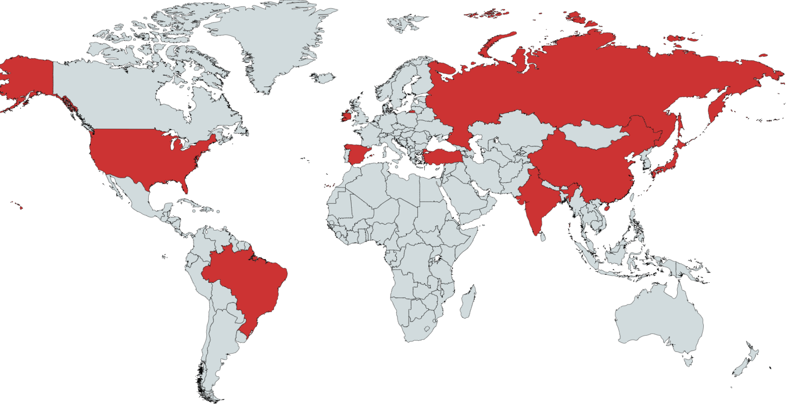









Regional Hosts for Global Round
China
Spain 1
Spain 2
Brazil
India
Ireland
United States of America
Japan
Turkey
10. Adlik/ZTE
11. Russia

Slide 4




ITU AI/ML in 5G Challenge: Participation
Students
Students need to be registered as students at a university
Professionals
Anyone else is considered a “professional”: a person who has the necessary skills to complete the problem sets they choose to tackle in the Challenge
AI/ML
Note: We encourage participants to submit solutions that are open source implementations, based on (ITU) standards.
Open source implementations will enable industry stakeholders to access outcomes and enhance collaboration.
Benefit: Create a network of innovation to solve 5G and future networks using AI/ML.

Slide 5
Timeline
Best teams advance
Grand Challenge Finale - online
Global call for challenge entries
Global Round Begins
Presentations of
Problem Statement Selection
1. Winning teams; judges to determine
final winners
2. Sponsors
3. Industry players
4. Academia;
5. Start-ups.
6. Virtual networking.
Dataset release
Registration
Global Round Ends
Warm-Up Phase
Nov 2020
July 2020
Feb 2020 to June 2020
15-17, Dec 2020
Submission Deadline: Oct 15th
Winners (top 3) official announcement: Nov. 20th
Awards and presentation: 15-17, Dec. 2020

Slide 6



Prizes
Judges filter
Sponsored prizes? E.g. Area of opensource?
Team-1
Final event
Team-2
Judges filter
Host-1
Team-3
Internship/collaboration/job offer…..
$$⋮$$
Team-N
$$⋮$$
300 CHF per problem statement
Top 3 Challenge winning Teams
1st prize: 5kCHF
2nd prize: 3kCHF
3rd prize: 2kCHF
Team-1
Team-2
3 Challenge runners up
Host-N
Team-3
- 1kCHF each
$$⋮$$
Team-N
Honorable mention
certificates

Slide 7
ITU AI/ML in 5G Challenge: Milestones for Participants
Data Available
(start working on the problem)
Test Dataset
Choose from Problem statement document on the Challenge website
Mentoring and support
Registration
Pick Problem Statement
Final Conference
Declare winners
more problem statements
Submit & Evaluation
Global Round

Slide 8






Sponsors and Promotional Partners
Sponsorship
Challenge Promotion
Gold Sponsor: TRA, UAE
LF AI Foundation:
SG Innovate (Singapore):
Bronze Sponsors: Cisco Systems and ZTE
Next Generation Mobile Networks Alliance:

Slide 9
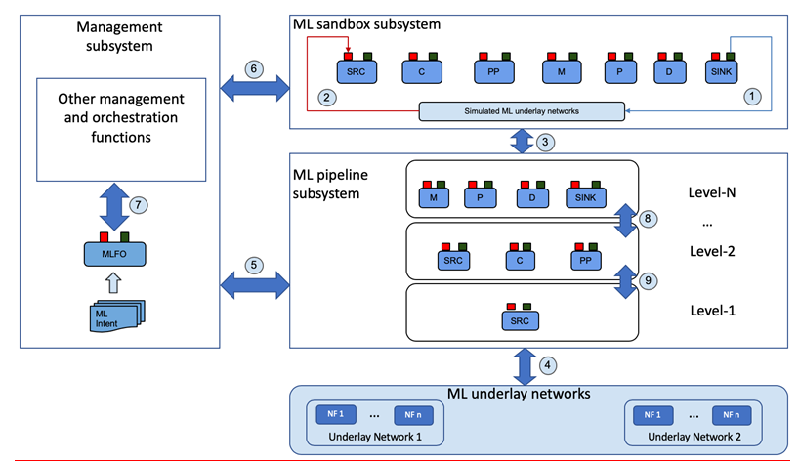
ITU Specifications: Y.3172
training and benchmarking projects
orchestration and management
Serving, monitoring
5G networks
Refer: https://www.itu.int/rec/T-REC-Y.3172-201906-P
Benefit: Mapping and application of ITU standards to solve problems in the network using AI/ML.

Slide 10
ITU Additional Specifications (1/2)
Output Document | Status | Description
Use case document | Approved October 2019, published as ITU-T Y-series Recommendations – Supplement 55 https://www.itu.int/rec/T-REC-Y.Sup55-201910-I/en | More than 30 use cases submitted to the FG ML5G Requirements were analyzed for each, reviewed classified as “critical”, “expected” and “added value”.
Architecture document | Approved June 2019, published August 2019 as ITU-T Y.3172 https://www.itu.int/rec/T-REC-Y.3172/en | 20 architectural requirements, derived from use cases Declarative approach to designing and using ML in the network Orchestration and management of ML
Data handling framework | ITU Y.3174 – approved 5 February 2020 | Includes data broker for mapping data models and APIs between ML overlay and underlay.
Intelligence level document | ITU Y.3173 – approved 5 February 2020 | Includes 5 levels of intelligence of 5G networks and an architecture perspective.
Marketplace document | Ongoing work item | Standard mechanisms for efficient transfer and handling of ML models

Slide 11
ITU Additional Specifications (2/2)
Output Document | Status | Description
MLFO document | ML5G-O-038 work in FG ML5G submitted to ITU-T SG13 | Requirements and architecture for ML function orchestrator.
Serving framework for ML models | ML5G-O-036 work in FG ML5G submitted to ITU-T SG13 | Mechanism for serving ML models in telecommunication networks
Machine Learning Sandbox | ML5G-O-035 work in FG ML5G submitted to ITU-T SG13 | Requirements, architecture, and implementation examples for ML Sandbox
Benefit: Joint contributions to ITU, training of students and professionals in AI/ML for 5G

Slide 12
Any Questions?
Email: ai5gchallenge@itu.int
Organized by
Gold Sponsor
Bronze sponsors

